Slide 1


Slide 2
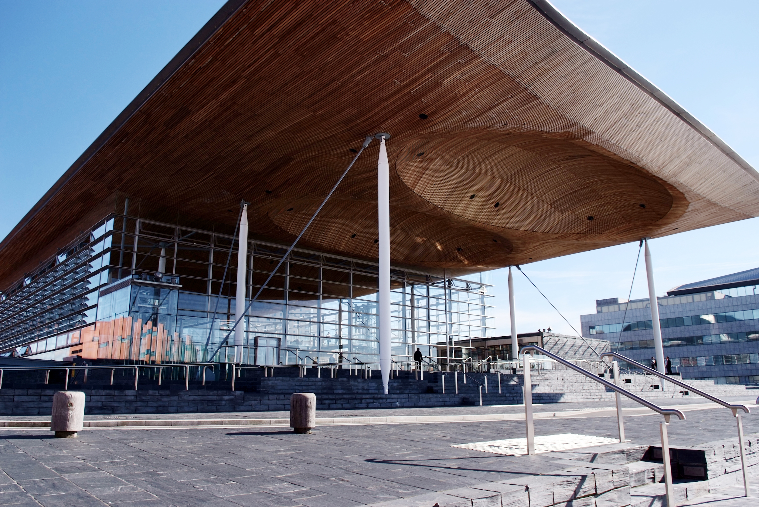
Senedd Election 2021
Notes:
Elections do decide who runs the country for the next 5 years
Every area in Wales will choose their local Member of the Senedd, or MS
16/17 year-olds can vote for the first time

Slide 3
Project Vote
Notes:
A parallel election designed for young people aged 11-15
Votes across Wales counted so we can see who would run the country if only young people decided
This vote won’t count towards the real Senedd election in May, but will help you learn more about how elections work and why they matter to all of us

Slide 4
Do elections affect you?
Notes:
Ask students whether they think elections affect them
Do one of the activities from the lesson plan

Slide 5
Daily timetable (examples)
Example 1
Example 2
8am: Get the bus to school
9am: Start my lessons
1pm: Have lunch
3pm: Get the bus home
5pm: Go to the park
8am: Brush my teeth
9am: Walk in the forest
1pm: Have lunch
2pm: Go to the museum
4pm: Go to my club
Notes:
This is an example for Option 1, which you could show students.

Slide 6



Widgit symbols © Widgit software www.widgit.com
Notes:
All of these things are affected by Senedd elections: Exams; What you learn at school; If you can get a school bus for free; how good walking paths are in your community

Slide 7



Widgit symbols © Widgit software www.widgit.com
Notes:
All of these things are affected by Senedd elections: How much money your council gets to run youth clubs; how hospitals are run; support for mental health

Slide 8



Widgit symbols © Widgit software www.widgit.com
Notes:
All of these things are affected by Senedd elections: how well waste is recycled, and the environment; some extra support for young people and families (not Universal Credit), including: help to buy school uniforms and equipment, extra help for children who’ve been in care, grants for University students; how homelessness is tackled

Slide 9
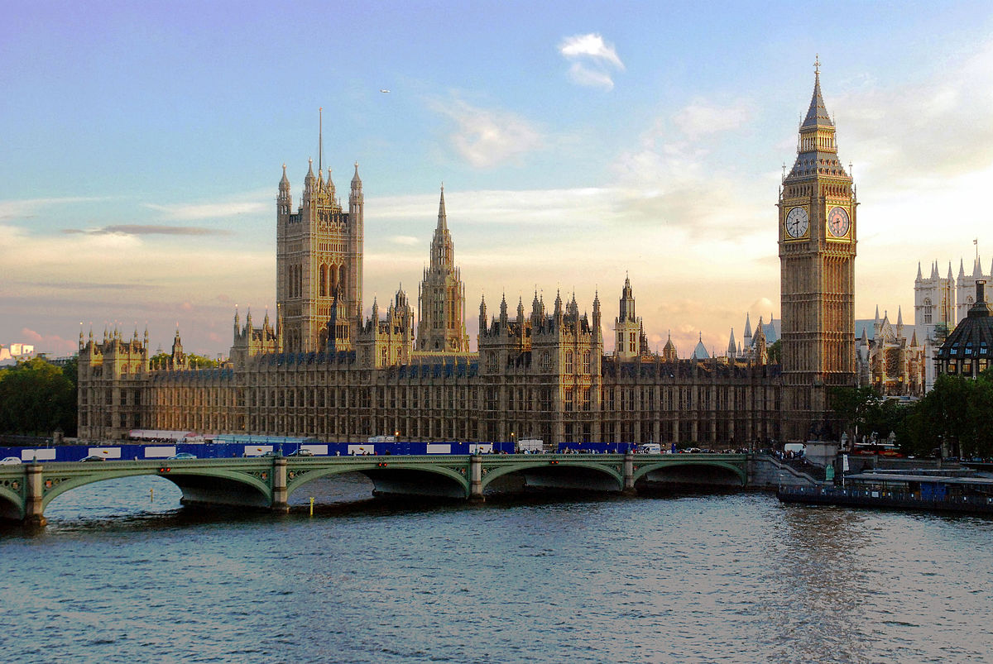
Senedd or Westminster?
Notes:
Tell the students you will play a game called ‘Senedd or Westminster’. You’ll have 12 facts on the next slides that relate to each - they will have to say whether they think the facts are about the Senedd (left) or Westminster (right).

Slide 10


Senedd or Westminster?
Q1.
Q2.
Widgit symbols © Widgit software www.widgit.com
Notes:
Question 1: Which parliament’s building collects rainwater to flush toilets and burns recycled material for heating?
Answer: Senedd
Question 2: Which parliament’s members decide who can get free school meals in Wales?
Answer: Senedd
Related question: Ask pupils if they know which English celebrity recently put pressure on the UK Government to give more children in England free school meals? Answer: Manchester United footballer Marcus Rashford

Slide 11

Senedd or Westminster?
Q3.
Q4.
Widgit symbols © Widgit software www.widgit.com
Notes:
Question 3: Which parliament’s members decide on coronavirus restrictions in Wales?
Answer: Senedd
Question 4: Which parliament’s members affect how hospitals are run in Wales, and how you get help with your mental health?
Answer: Senedd

Slide 12

Senedd or Westminster?
Q5.
Q6.
Widgit symbols © Widgit software www.widgit.com
Notes:
Question 5: Which parliament did Guy Fawkes try to blow up on November 5th 1605?
Answer: Westminster
Question 6: Which parliament’s members decide if children in Wales should sit GCSE and A-Level exams?
Answer: Senedd

Slide 13


Senedd or Westminster?
Q7.
Q8.
Widgit symbols © Widgit software www.widgit.com
Notes:
Question 7: Which parliament’s members were the first to introduce the 5p plastic bag charge?
Answer: Senedd
Question 8: Which parliament’s members decide where members of the armed forces in Wales go and what they do?
Answer: Westminster

Slide 14

Senedd or Westminster?
Q9.
Q10.
Widgit symbols © Widgit software www.widgit.com
Notes:
Question 10: Which parliament affects how much money your council has to spend on youth clubs? Senedd or Westminster?
Answer: Senedd
Question 11: Which parliament’s members decide the cost Welsh students pay when they go to University?
Answer: Senedd

Slide 15


Senedd or Westminster?
Q11.
Q12.
Widgit symbols © Widgit software www.widgit.com
Notes:
Question 11. Which parliament can make rules for social media companies to keep young people safe online?
Answer: Westminster
Question 12. There are 100 staircases, more than 1,000 rooms and three miles of corridors in this parliament. Which one?
Answer: Westminster

Slide 16

What does voting do?
Widgit symbols © Widgit software www.widgit.com
Notes:
Ask for three volunteers to act as Members of the Senedd.
Invite them to take the role of candidates - explain that they want to be Members of the Senedd, and the other class members are going to vote to decide which one of them will win.
Explain that one of the big issues the Senedd wants to decide is what time school starts and finishes.
Ask the three students what time they want school to start and finish. This is the change they will fight for if they get elected to the Senedd.
(You could easily substitute this for a different issue that suits your class).
Write their answers on the board. Answers must be different to each other.
Now ask the class which one of the three would they want to represent them in the Senedd? Hold a class vote to decide the winner.
Explain that the winner will now stand up for that option in the Senedd, making it more likely that the law will be changed in that way.
Ask students to consider how their vote in an election could affect how laws are made.

