Slide 1
Notes:
Wales has its own parliament that makes laws only for Wales. It’s called the Senedd, or the Welsh Parliament - both terms mean the same thing. There are certain areas where the Senedd can’t make laws - the UK Parliament in Westminster is responsible for making laws in these areas.
Explain that you are going to show an animation about the Senedd and how elections in Wales work.

Slide 2
Video from Senedd Cymru (Click on picture to open link)
Notes:
Make notes to help with a quiz at the end of the lesson.
Play the video. https://www.youtube.com/watch?v=WoSG115QpCY
Did you know you have 5 Members of the Senedd that represent you in the Senedd? You only have one MP (Member of Parliament) to represent you in Westminster.

Slide 3
What do Members of the Senedd do?
Walk dogs from the local dog shelter every week. | Vote for new laws in Westminster. | Answer questions on BBC News every week.
Attend a monthly ceremony in the Senedd where a three-course meal is served, followed by a dance. | Challenge the Welsh Government to make things better for people in Wales. | Vote for new laws in the Senedd and take part in debates.
Listen to their local community members and raise their issues in the Senedd. | Some are asked to be part of the Welsh Government. They help decide how to run the country and how money is spent. | Raise money for charities by taking part in the weekly Senedd cross-country run.
Notes:
This has 9 statements about what Senedd members do - 5 are wrong and 4 are right.
Find the four correct answers.
The next slide reveals the four right answers.

Slide 4
What do Members of the Senedd do?
Walk dogs from the local dog shelter every week. | Vote for new laws in Westminster. | Answer questions on BBC News every week.
Attend a monthly ceremony in the Senedd where a three-course meal is served, followed by a dance. | Challenge the Welsh Government to make things better for people in Wales. | Vote for new laws in the Senedd and take part in debates.
Listen to their local community members and raise their issues in the Senedd. | Some are asked to be part of the Welsh Government. They help decide how to run the country and how money is spent. | Raise money for charities by taking part in the weekly Senedd cross-country run.

Slide 5
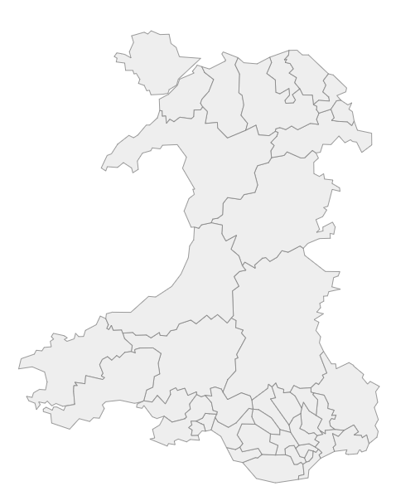
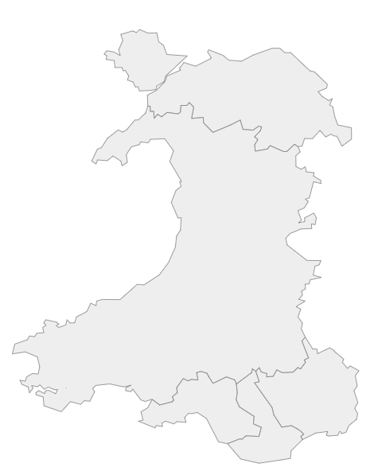
Constituencies e.g. Arfon, Cynon Valley
Regions e.g. North Wales, South Wales Central
Widgit symbols © Widgit software www.widgit.com
Notes:
In Wales we have:
40 smaller areas known as ‘constituencies’
5 larger areas known as ‘regions’
Wherever you live in Wales, you are a part of a constituency, and a part of a region.
In the election, one person is elected from every constituency. Four people are elected from every region.

Slide 6
Who can make a government? y
Circle Party
Triangle Party
Pentagon Party
Notes:
At the end of the election, the amount of Senedd members from every party is counted, and the party with the most members can make a Government. This means they can choose some of the Senedd Members in their party to decide how the country is run, how money is spent, and to suggest new laws to be voted on in the Senedd by all the other members. You could look further into this by telling your teacher about the ‘Mini Senedd’ activity. This can be found on our resources page in the face-to-face lesson plans. - https://www.projectvote.wales/resources/

Slide 7
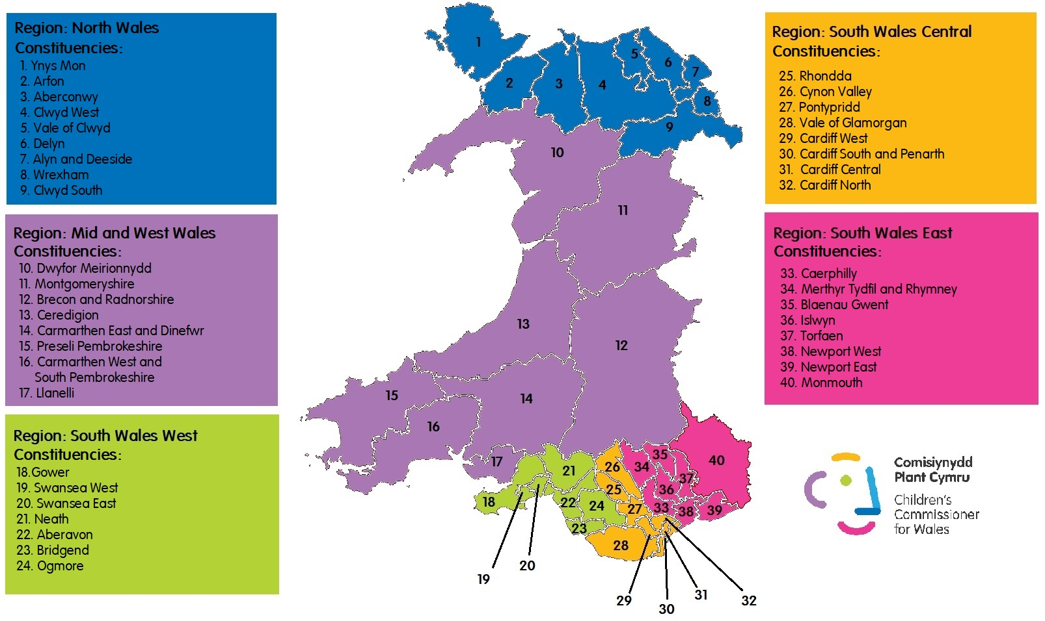

Slide 8
Quiz - Kahoot
Notes:
Kahoot link - https://create.kahoot.it/share/quiz-2021-senedd-elections/2c90f476-0971-4b89-bc17-153ef2dfd353

