Slide 1
Notes:
Remind students that Wales has its own parliament that makes laws only for Wales. It’s called the Senedd, or the Welsh Parliament - both terms mean the same thing. There are certain areas where the Senedd can’t make laws - the UK Parliament in Westminster is responsible for making laws in these areas.
Explain that you are going to show an animation about the Senedd and how elections in Wales work.

Slide 2
Video from Senedd Cymru (Click on picture to open link)
Notes:
Students will need to make notes to help them with a quiz at the end of the lesson.
Play the video. https://www.youtube.com/watch?v=WoSG115QpCY
Ask them to reflect on what they’ve learned.
Did they know they have 5 Members of the Senedd that represent them in the Senedd? They only have one MP (Member of Parliament) to represent them in Westminster.

Slide 3
What do Members of the Senedd do?
Walk dogs from the local dog shelter every week. | Vote for new laws in Westminster. | Answer questions on BBC News every week.
Attend a monthly ceremony in the Senedd where a three-course meal is served, followed by a dance. | Challenge the Welsh Government to make things better for people in Wales. | Vote for new laws in the Senedd and take part in debates.
Listen to their local community members and raise their issues in the Senedd. | Some are asked to be part of the Welsh Government. They help decide how to run the country and how money is spent. | Raise money for charities by taking part in the weekly Senedd cross-country run.
Notes:
Use the ‘What do Members of the Senedd do?’ slide. It has 9 statements about what Senedd members do - 5 are wrong and 4 are right.
Ask students to work in pairs to find the four correct answers.
The next slide reveals the four right answers.

Slide 4
What do Members of the Senedd do?
Walk dogs from the local dog shelter every week. | Vote for new laws in Westminster. | Answer questions on BBC News every week.
Attend a monthly ceremony in the Senedd where a three-course meal is served, followed by a dance. | Challenge the Welsh Government to make things better for people in Wales. | Vote for new laws in the Senedd and take part in debates.
Listen to their local community members and raise their issues in the Senedd. | Some are asked to be part of the Welsh Government. They help decide how to run the country and how money is spent. | Raise money for charities by taking part in the weekly Senedd cross-country run.
Notes:
Use the ‘What do Members of the Senedd do?’ slide. It has 9 statements about what Senedd members do - 5 are wrong and 4 are right.
Ask students to work in pairs to find the four correct answers.
The next slide reveals the four right answers.

Slide 5
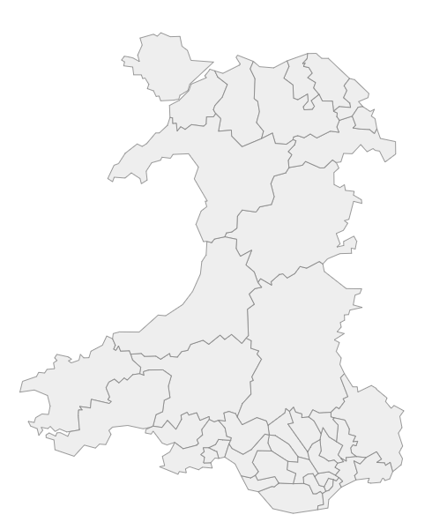
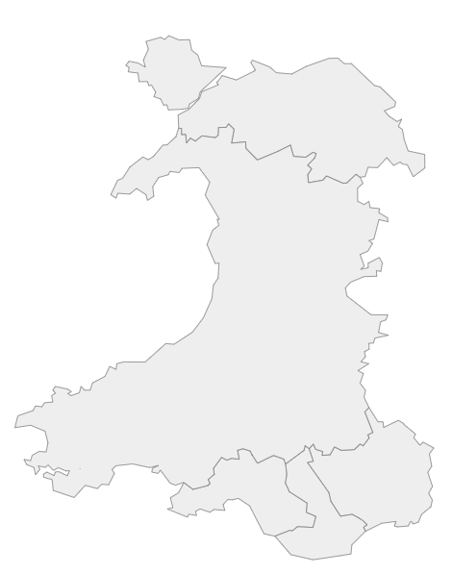
Constituencies e.g. Arfon, Cynon Valley
Regions e.g. North Wales, South Wales Central
Widgit symbols © Widgit software www.widgit.com
Notes:
In Wales we have:
40 smaller areas known as ‘constituencies’
5 larger areas known as ‘regions’
Remind students that wherever you live in Wales, you are a part of a constituency, and a part of a region.
In the election, one person is elected from every constituency. Four people are elected from every region.
Ask students if they can work out how many Members of the Senedd represent them in the Senedd?
Answer: Every person in Wales has five Members of the Senedd that represent them. They stand up for their local people in the Senedd.

Slide 6
Who can make a government? y
Circle Party
Triangle Party
Pentagon Party
Notes:
At the end of the election, the amount of Senedd members from every party is counted, and the party with the most members can make a Government. This means they can choose some of the Senedd Members in their party to decide how the country is run, how money is spent, and to suggest new laws to be voted on in the Senedd by all the other members. You can look further into this in the ‘Mini Senedd’ activity

Slide 7
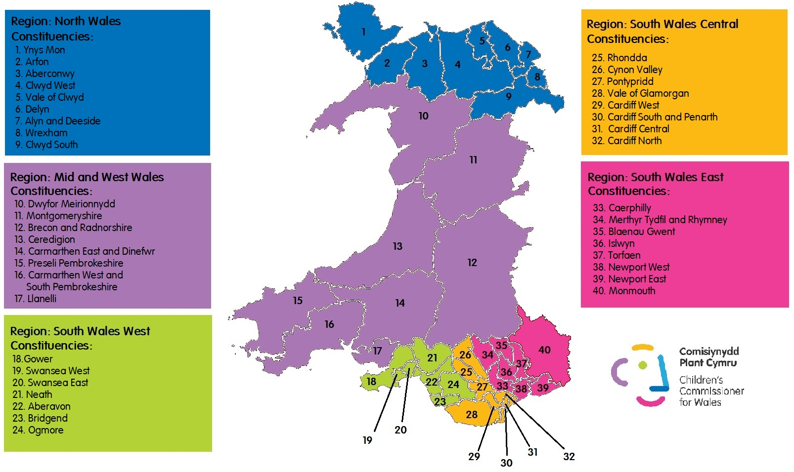

Slide 8
Quiz - Kahoot
Notes:
Link to Kahoot - https://create.kahoot.it/share/quiz-2021-senedd-elections/2c90f476-0971-4b89-bc17-153ef2dfd353

