Slide 2
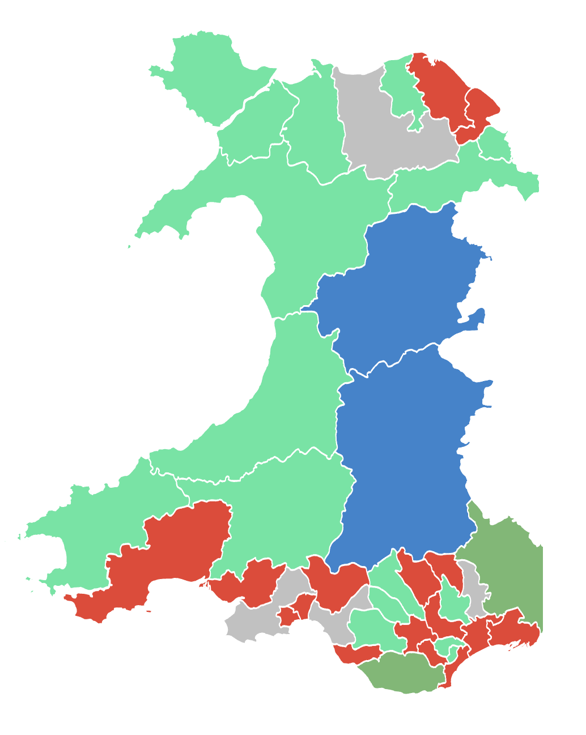
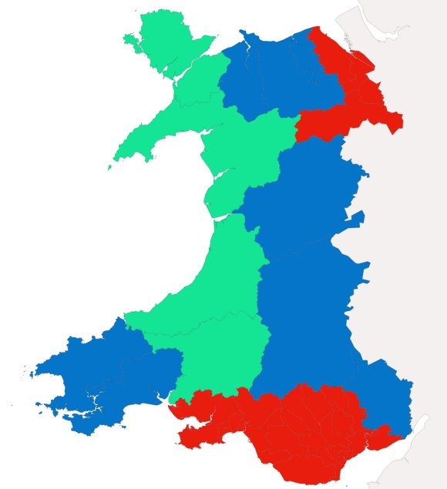
Prosiect Pleidlais | Project Vote
Etholiad go iawn | Real election
Notes:
Lliwiau’r pleidiau / Party colours
Ceidwadwyr / Conservatives – Glas / Blue
Llafur / Labour – Coch / Red
Plaid Cymru – Gwyrdd Golau / Light Green
Plaid Werdd / Green Party – Gwyrdd Tywyll / Dark Green
No results – Llwyd / Grey

Slide 3
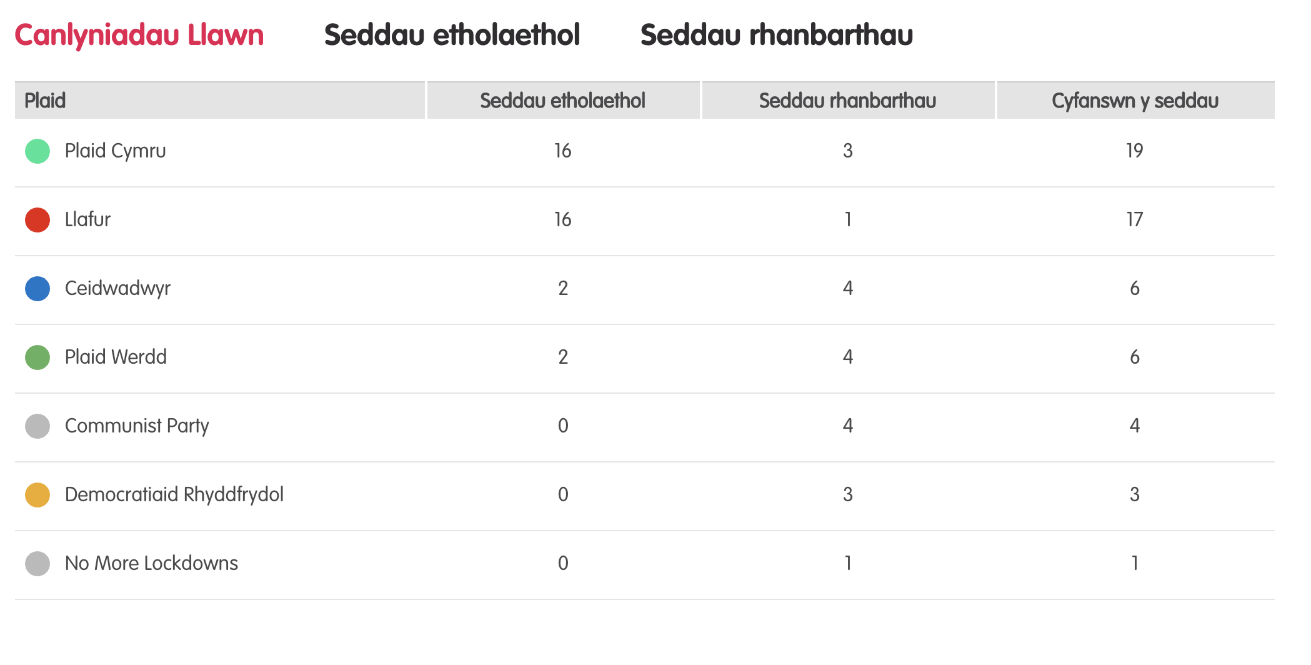
Canlyniadau llawn – Etholiad Paralel
Notes:
Tudalen wê canlyniadau’r Prosiect Pleidlais - https://prosiectpleidlais.cymru/canlyniadau/
Web page for Project Vote results – https://www.projectvote.wales/results/
Tudalen wê canlyniadau go iawn- https://www.bbc.co.uk/cymrufyw/pynciau/cvd627zw9rjt/etholiad-senedd-cymru-2021
Real results web page: https://www.bbc.co.uk/news/topics/cqwn14k92zwt/welsh-parliament-election-2021

Slide 4
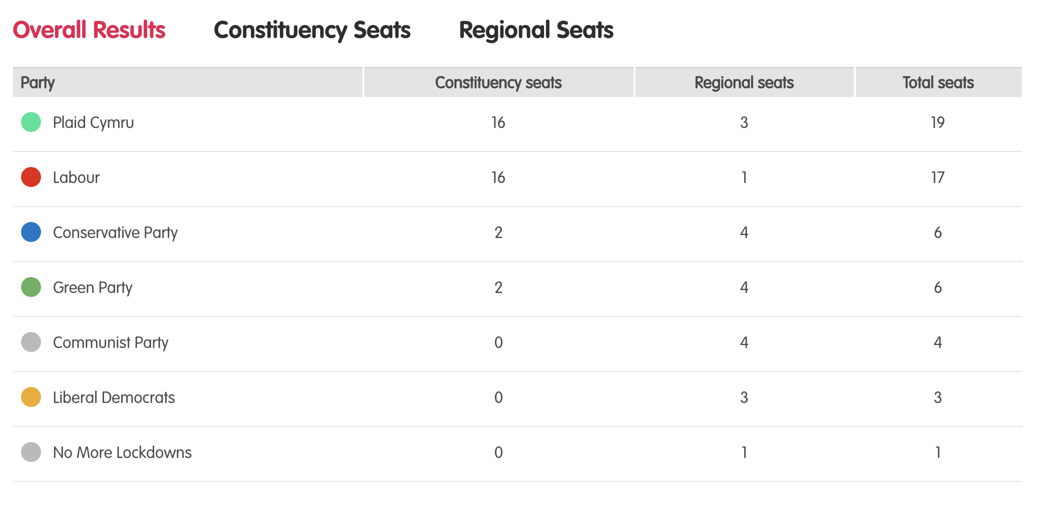
Full Results – Parallel election
Notes:
Tudalen wê canlyniadau’r Prosiect Pleidlais - https://prosiectpleidlais.cymru/canlyniadau/
Web page for Project Vote results – https://www.projectvote.wales/results/
Tudalen wê canlyniadau go iawn- https://www.bbc.co.uk/cymrufyw/pynciau/cvd627zw9rjt/etholiad-senedd-cymru-2021
Real results web page: https://www.bbc.co.uk/news/topics/cqwn14k92zwt/welsh-parliament-election-2021

Slide 5
Official election Results / Canlyniadau etholiad swyddogol
Plaid | Party | Seddau etholaethol | Constituency seats | Seddau rhanbarthau | Regional seats | Cyfanswn y seddau | Total Seats
Llafur / Labour | 27 | 3 | 30
Ceidwadwyr / Conservatives | 8 | 8 | 16
Plaid Cymru | 5 | 8 | 13
Democratiaid Rhyddfrydol / Liberal Democrats | 0 | 1 | 1

Slide 6
Etholaethau Constituencies

Slide 7
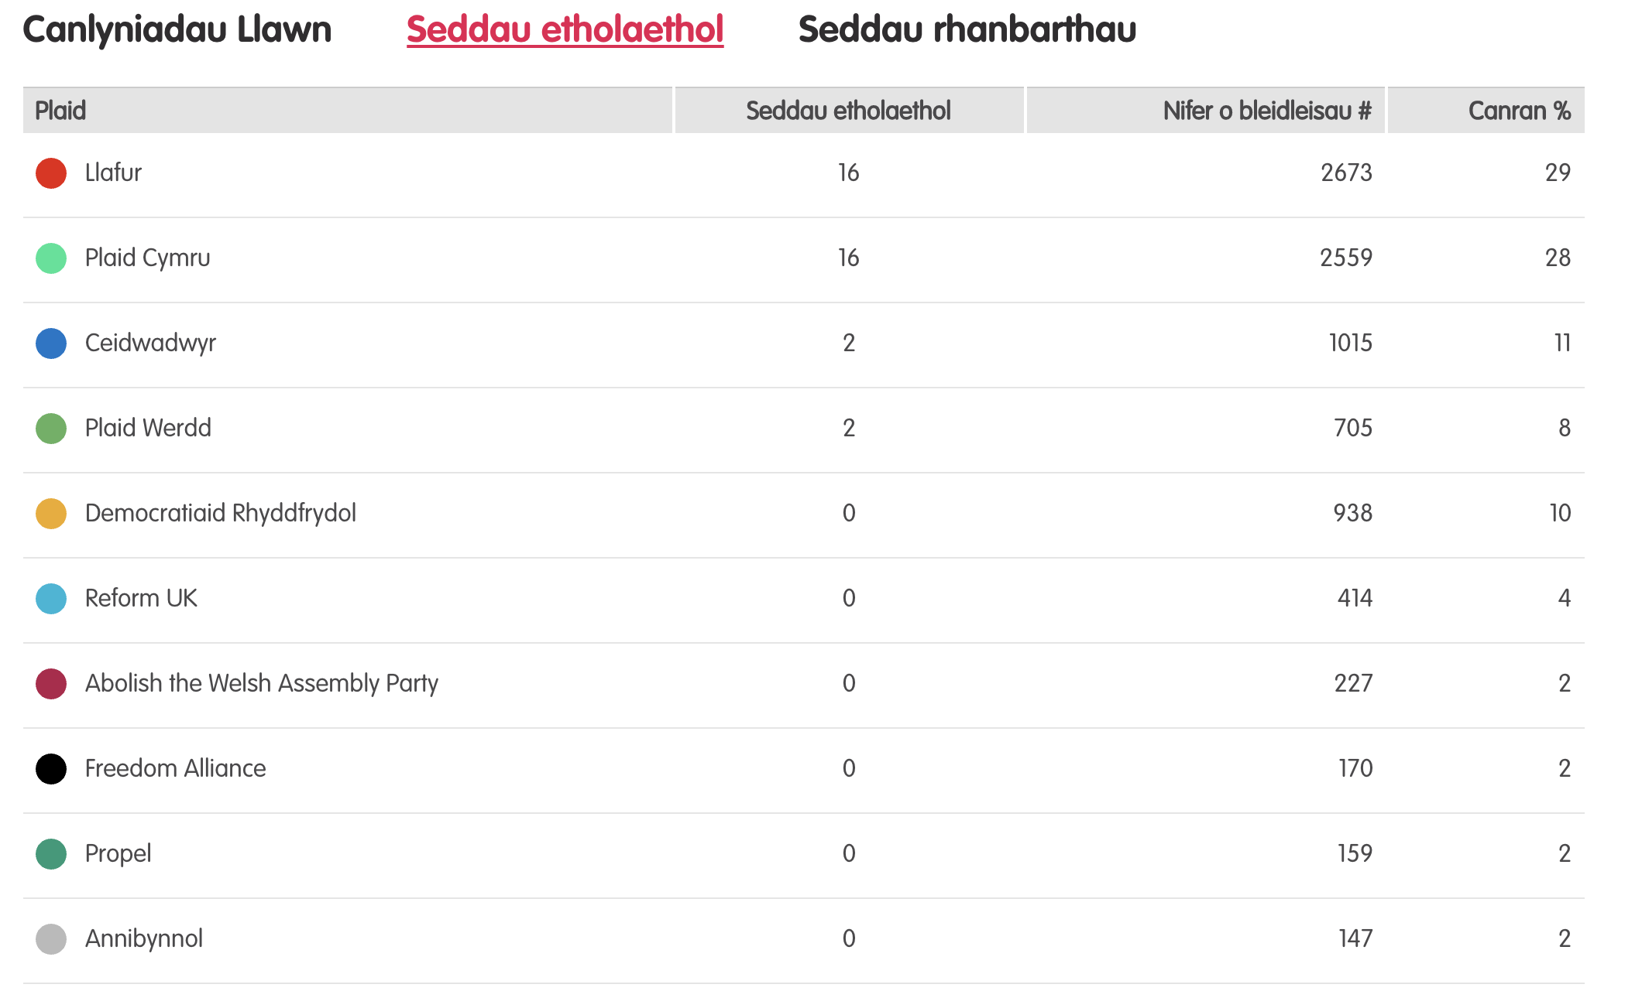
Canlyniadau – Etholiad Paralel
Notes:
Tudalen wê canlyniadau’r Prosiect Pleidlais - https://prosiectpleidlais.cymru/canlyniadau/
Web page for Project Vote results – https://www.projectvote.wales/results/
Tudalen wê canlyniadau go iawn- https://www.bbc.co.uk/cymrufyw/pynciau/cvd627zw9rjt/etholiad-senedd-cymru-2021
Real results web page: https://www.bbc.co.uk/news/topics/cqwn14k92zwt/welsh-parliament-election-2021

Slide 8
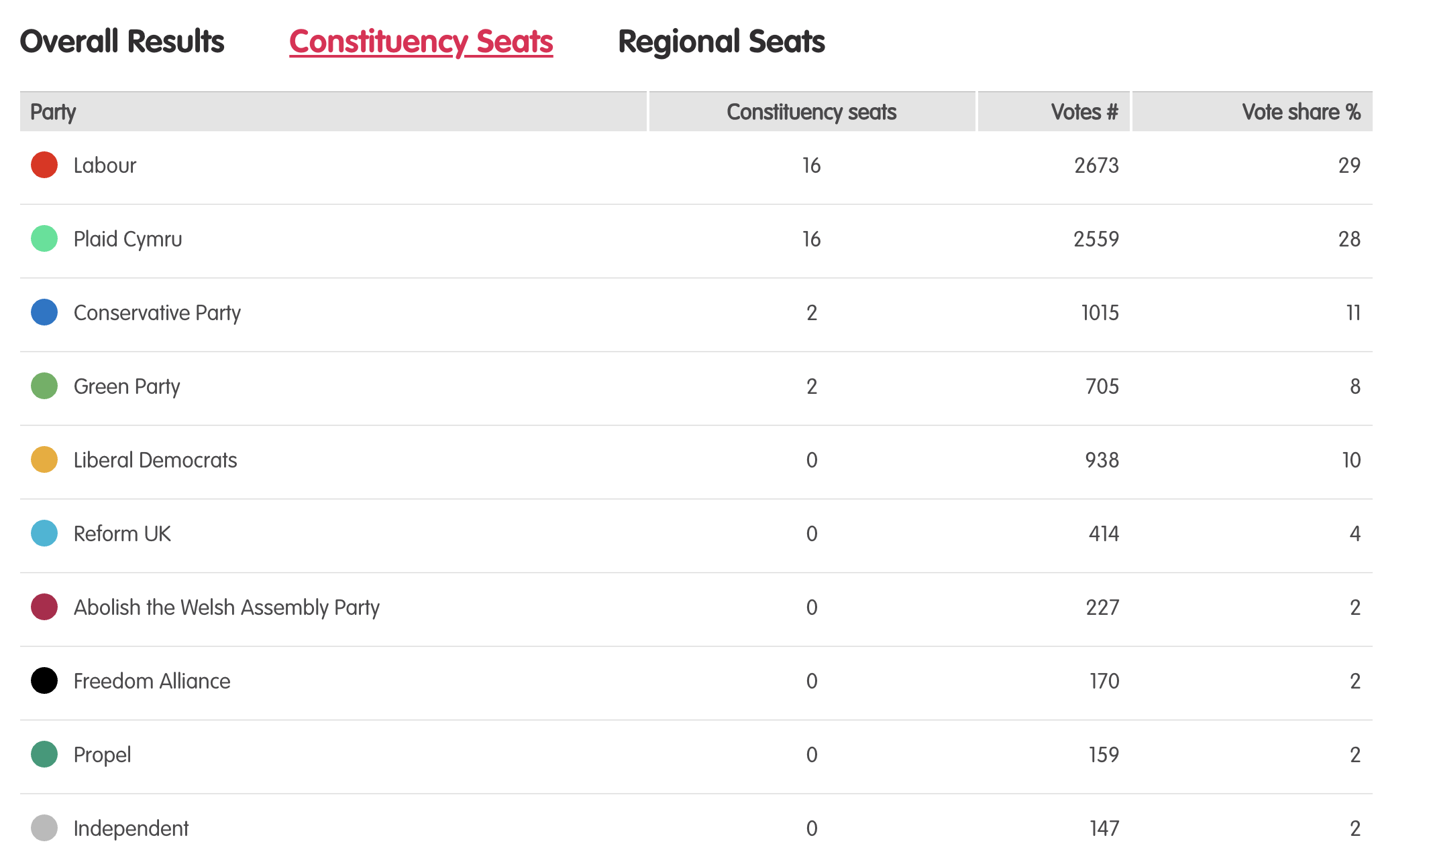
Results – Project vote parallel election
Notes:
Tudalen wê canlyniadau’r Prosiect Pleidlais - https://prosiectpleidlais.cymru/canlyniadau/
Web page for Project Vote results – https://www.projectvote.wales/results/
Tudalen wê canlyniadau go iawn- https://www.bbc.co.uk/cymrufyw/pynciau/cvd627zw9rjt/etholiad-senedd-cymru-2021
Real results web page: https://www.bbc.co.uk/news/topics/cqwn14k92zwt/welsh-parliament-election-2021

Slide 9
Canlyniadau swyddogol – Official results
Plaid | Party | Seddau etholaethol | Constituency seats | Nifer o bleidleisiau | Number of votes | Canran % | Vote share %
Llafur / Labour | 27 | 443,047 | 39.9%
Ceidwadwyr / Conservatives | 8 | 289,802 | 26.1%
Plaid Cymru | 5 | 225,376 | 20.3%
Democratiaid Rhyddfrydol / Liberal Democrats | 0 | 54,202 | 4.9%
Abolish the Welsh Assembly | 0 | 18,149 | 1.6%
Plaid Werdd / Green Party | 0 | 17,817 | 1.6%
Notes:
NB: the number and share of votes are for constituency votes only.
We have included the top 6 parties only here

Slide 10
Brycheiniog a Sir Faesyfed Brecon and Radnorshire

Slide 11
Canlyniadau Prosiect Pleidlais | Project Vote Results
Plaid | Party | Ymgeiswyr | Candidates | Pleidleisiau | Votes | %
Plaid Werdd / Green Party | Emily Durrant | 37 | 21%
Ceidwadwyr / Conservatives | James Evans | 56 | 31%
Plaid Cymru | Grenville Ham | 23 | 13%
Gwlad | Sam Holwill | 1 | 1%
Llafur / Labour | Gethin Jones | 24 | 13%
Annibynnol / Independent | Karen Laurie-Parry | 1 | 1%
Abolish the Welsh Assembly | Claire Mills | 5 | 3%
Reform UK | John Muir | 6 | 3%
Democratiaid Rhyddfrydol / Liberal Democrats | William Powell | 26 | 15%

Slide 12
Canlyniad Senedd go iawn | Real Senedd result
Plaid | Party | Ymgeiswyr | Candidates | Pleidleisiau | Votes | %
Plaid Werdd / Green Party | Emily Durrant | 1,556 | 4.8%
Ceidwadwyr / Conservatives | James Evans | 12,741 | 39.7%
Plaid Cymru | Grenville Ham | 2,075 | 6.5%
Gwlad | Sam Holwill | 75 | 0.2%
Llafur / Labour | Gethin Jones | 4,980 | 15.5%
Annibynnol / Independent | Karen Laurie-Parry | 345 | 1.1%
Abolish the Welsh Assembly | Claire Mills | 1,209 | 3.8%
Reform UK | John Muir | 213 | 0.7%
Democratiaid Rhyddfrydol / Liberal Democrats | William Powell | 28,921 | 27.8%

Slide 13
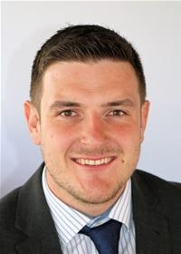
Prosiect Pleidlais Project Vote
Etholiad go iawn
Real election
Notes:
Prosiect Pleidlais / Project Vote – James Evans
Etholiad go iawn / Real election – James Evans

Slide 14
Trafodaeth | Discussion
- Meddyliwch am 3 pheth rydych ch wedi dysgu trwy wneud yr etholiad paralel
- Pa weithgareddau wnaethoch chi fwynhau mwyaf?
- Meddyliwch am un ffordd mae’r profiad wedi effeithio arnoch chi neu ddatblygu eich barn
- Oedd yna wahaniaeth yn eich ardal chi rhwng y canlyniadau paralel, a’r canlyniadau swyddogol/go iawn? Pam ydych chi’n meddwl?
- Ydych chi’n meddwl bod y pandemig wedi cael effaith ar faint mae pobl yn ei wybod am wleidyddiaeth Cymru?
- Name three things you’ve learned through this Parallel Election
- Which activities did you enjoy the most and why?
- Name one way this experience has changed you or developed opinions
- Was there a difference between the Project Vote results and the real election results? Why do you think that is?
- Do you think that the coronavirus pandemic had an impact on how much people know about Welsh politics?

Slide 15
Camau nesaf | Next steps
Eich aelod o’r Senedd – Mae eich aelod o’r Senedd yna i’ch cynrychioli chi yn y Senedd. Cofiwch mae gennych chi 5 aelod sy’n eich cynrychioli chi – yr un a gafodd ei ethol gan eich etholaeth, a’r 4 cafodd eu hethol gan eich rhanbarth (gweler diwedd y cyflwyniad)
Cofiwch gysylltu gyda nhw os:
- Rydych chi eisiau cyngor neu wybodaeth am rywbeth sydd gan y Senedd pwerau drosto
- Rydych chi eisiau gofyn iddyn nhw beth fydden nhw’n ei wneud i wella eich ardal i bobl ifanc
- Mae gennych chi ddiddordeb mewn mater lleol ac eisiau gwybod mwy
Paid ag ofni cysylltu gyda nhw. Maen nhw’n derbyn cannoedd o ebyst a galwadau ffôn pob blwyddyn ar bob math o fater – eu swydd nhw yw gwrando ar eich pryderon.
Your MS - your MS is there to represent you in the Senedd. Remember you have 5 members of the Senedd representing you – the 1 who was voted in by your constituency, and the 4 who were voted in by your region (see the end of the powerpoint).
Remember to get in touch with them if:
- you want advice or information on something that the Welsh Parliament has control over
- you want to ask them what they will be doing to make your local area better for young people
- there is an issue in your local area that you're interested in
Don't be shy about getting in touch with them. They receive hundreds of emails and phone calls every year on all sorts of issues - it's their job to listen to your concerns.

Slide 16
Camau nesaf | Next steps
Gwneud Gwahaniaeth
Os oes gennych chi ddiddordeb mewn creu newid i faterion sy’n bwysig i chi, yn yr ysgol neu yn eich cymuned leol, ewch i’n hadnodd Gwneud Gwahaniaeth. A plis cysylltwch os oes unrhyw gwestiwn gyda chi amdano fe.
Cofrestru i bleidleisio
Cofiwch gallwch gofrestru i bleidleisio os ydych chi’n 14+ oed.
Ewch at y gwefan yma i wneud hyn.
Byddwch chi wedyn yn gallu pleidleisio mewn etholiadau Senedd, ac etholiadau eich cyngor lleol, pan rydych chi’n troi’n 16.
Making a difference
If you're interested in making a difference to the issues that matter to you, whether it's in school or your local community, take a look at our Make a Difference resource. And please get in touch with us if you have any questions about it.
Registering to vote
Remember you can register to vote if you are aged 14+
Go to this website to do this.
You will then be able to vote in Senedd elections, and your local council elections, when you turn 16.

Slide 17
Dwyrain Caerfyrddin a Dinefwr Carmarthen East and Dinefwr

Slide 18
Canlyniadau Prosiect Pleidlais | Project Vote Results
Plaid | Party | Ymgeiswyr | Candidates | Pleidleisiau | Votes | %
Democratiaid Rhyddfrydol / Liberal Democrats | Monica French | 56 | 8%
Ceidwadwyr / Conservatives | Harvard Hughes | 66 | 10%
Llafur / Labour | Robert James | 132 | 19%
Reform UK | Karl Pollard | 17 | 2%
Plaid Cymru | Adam Price | 411 | 60%

Slide 19
Canlyniad Senedd go iawn | Real Senedd result
Plaid | Party | Ymgeiswyr | Candidates | Pleidleisiau | Votes | %
Democratiaid Rhyddfrydol / Liberal Democrats | Monica French | 975 | 2.9%
Ceidwadwyr / Conservatives | Harvard Hughes | 7,751 | 23.3%
Llafur / Labour | Robert James | 8,448 | 25.4%
Reform UK | Karl Pollard | 818 | 2.5%
Plaid Cymru | Adam Price | 15,261 | 45.9%

Slide 20
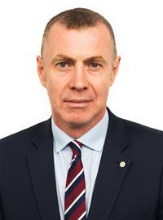
Prosiect Pleidlais Project Vote
Etholiad go iawn
Real election
Notes:
Prosiect Pleidlais / Project Vote – Adam Price
Etholiad go iawn / Real election – Adam Price

Slide 21
Trafodaeth | Discussion
- Meddyliwch am 3 pheth rydych ch wedi dysgu trwy wneud yr etholiad paralel
- Pa weithgareddau wnaethoch chi fwynhau mwyaf?
- Meddyliwch am un ffordd mae’r profiad wedi effeithio arnoch chi neu ddatblygu eich barn
- Oedd yna wahaniaeth yn eich ardal chi rhwng y canlyniadau paralel, a’r canlyniadau swyddogol/go iawn? Pam ydych chi’n meddwl?
- Ydych chi’n meddwl bod y pandemig wedi cael effaith ar faint mae pobl yn ei wybod am wleidyddiaeth Cymru?
- Name three things you’ve learned through this Parallel Election
- Which activities did you enjoy the most and why?
- Name one way this experience has changed you or developed opinions
- Was there a difference between the Project Vote results and the real election results? Why do you think that is?
- Do you think that the coronavirus pandemic had an impact on how much people know about Welsh politics?

Slide 22
Camau nesaf | Next steps
Eich aelod o’r Senedd – Mae eich aelod o’r Senedd yna i’ch cynrychioli chi yn y Senedd. Cofiwch mae gennych chi 5 aelod sy’n eich cynrychioli chi – yr un a gafodd ei ethol gan eich etholaeth, a’r 4 cafodd eu hethol gan eich rhanbarth (gweler diwedd y cyflwyniad)
Cofiwch gysylltu gyda nhw os:
- Rydych chi eisiau cyngor neu wybodaeth am rywbeth sydd gan y Senedd pwerau drosto
- Rydych chi eisiau gofyn iddyn nhw beth fydden nhw’n ei wneud i wella eich ardal i bobl ifanc
- Mae gennych chi ddiddordeb mewn mater lleol ac eisiau gwybod mwy
Paid ag ofni cysylltu gyda nhw. Maen nhw’n derbyn cannoedd o ebyst a galwadau ffôn pob blwyddyn ar bob math o fater – eu swydd nhw yw gwrando ar eich pryderon.
Your MS - your MS is there to represent you in the Senedd. Remember you have 5 members of the Senedd representing you – the 1 who was voted in by your constituency, and the 4 who were voted in by your region (see the end of the powerpoint).
Remember to get in touch with them if:
- you want advice or information on something that the Welsh Parliament has control over
- you want to ask them what they will be doing to make your local area better for young people
- there is an issue in your local area that you're interested in
Don't be shy about getting in touch with them. They receive hundreds of emails and phone calls every year on all sorts of issues - it's their job to listen to your concerns.

Slide 23
Camau nesaf | Next steps
Gwneud Gwahaniaeth
Os oes gennych chi ddiddordeb mewn creu newid i faterion sy’n bwysig i chi, yn yr ysgol neu yn eich cymuned leol, ewch i’n hadnodd Gwneud Gwahaniaeth. A plis cysylltwch os oes unrhyw gwestiwn gyda chi amdano fe.
Cofrestru i bleidleisio
Cofiwch gallwch gofrestru i bleidleisio os ydych chi’n 14+ oed.
Ewch at y gwefan yma i wneud hyn.
Byddwch chi wedyn yn gallu pleidleisio mewn etholiadau Senedd, ac etholiadau eich cyngor lleol, pan rydych chi’n troi’n 16.
Making a difference
If you're interested in making a difference to the issues that matter to you, whether it's in school or your local community, take a look at our Make a Difference resource. And please get in touch with us if you have any questions about it.
Registering to vote
Remember you can register to vote if you are aged 14+
Go to this website to do this.
You will then be able to vote in Senedd elections, and your local council elections, when you turn 16.

Slide 24
Gorllewin Caerfyrddin a De Sir Carmarthen West and South Pembrokeshire

Slide 25
Canlyniadau etholiad paralel | Parallel election Results
Plaid | Party | Ymgeiswyr | Candidates | Pleidleisiau | Votes | %
Democratiaid Rhyddfrydol / Liberal Democrats | Alistair Cameron | 2 | 5%
Plaid Cymru | Cefin Campbell | 6 | 16%
UKIP | Paul Dowson | - | -
Annibynnol / Independent | Jon Harvey | 1 | 3%
Llafur / Labour | Riaz Hassan | 17 | 45%
Ceidwadwyr / Conservatives | Sam Kurtz | 11 | 29%
Reform UK | Peter Prosser | 1 | 3%

Slide 26
Canlyniad Senedd go iawn | Real Senedd result
Plaid | Party | Ymgeiswyr | Candidates | Pleidleisiau | Votes | %
Democratiaid Rhyddfrydol / Liberal Democrats | Alistair Cameron | 1,224 | 4%
Plaid Cymru | Cefin Campbell | 6,615 | 20.9%
UKIP | Paul Dowson | 982 | 3.1%
Annibynnol / Independent | Jon Harvey | 866 | 2.7%
Llafur / Labour | Riaz Hassan | 10,304 | 32.6%
Ceidwadwyr / Conservatives | Sam Kurtz | 11,240 | 35.5%
Reform UK | Peter Prosser | 424 | 1.3%

Slide 27
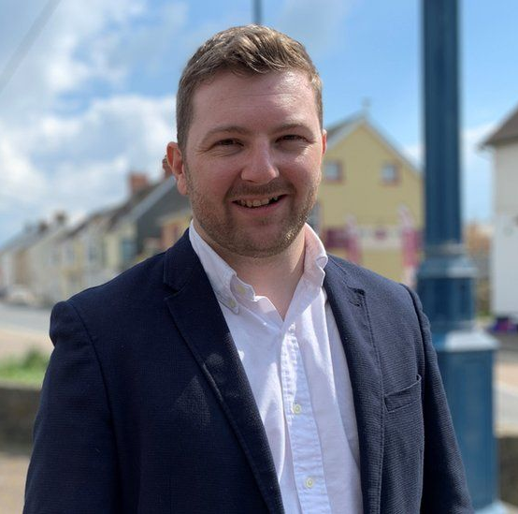
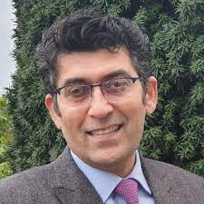
Prosiect Pleidlais Project Vote
Etholiad go iawn
Real election
Notes:
Prosiect Pleidlais / Project Vote – Riaz Hassan
Etholiad go iawn / Real election – Sam Kurtz

Slide 28
Trafodaeth | Discussion
- Meddyliwch am 3 pheth rydych ch wedi dysgu trwy wneud yr etholiad paralel
- Pa weithgareddau wnaethoch chi fwynhau mwyaf?
- Meddyliwch am un ffordd mae’r profiad wedi effeithio arnoch chi neu ddatblygu eich barn
- Oedd yna wahaniaeth yn eich ardal chi rhwng y canlyniadau paralel, a’r canlyniadau swyddogol/go iawn? Pam ydych chi’n meddwl?
- Ydych chi’n meddwl bod y pandemig wedi cael effaith ar faint mae pobl yn ei wybod am wleidyddiaeth Cymru?
- Name three things you’ve learned through this Parallel Election
- Which activities did you enjoy the most and why?
- Name one way this experience has changed you or developed opinions
- Was there a difference between the Project Vote results and the real election results? Why do you think that is?
- Do you think that the coronavirus pandemic had an impact on how much people know about Welsh politics?

Slide 29
Camau nesaf | Next steps
Eich aelod o’r Senedd – Mae eich aelod o’r Senedd yna i’ch cynrychioli chi yn y Senedd. Cofiwch mae gennych chi 5 aelod sy’n eich cynrychioli chi – yr un a gafodd ei ethol gan eich etholaeth, a’r 4 cafodd eu hethol gan eich rhanbarth (gweler diwedd y cyflwyniad)
Cofiwch gysylltu gyda nhw os:
- Rydych chi eisiau cyngor neu wybodaeth am rywbeth sydd gan y Senedd pwerau drosto
- Rydych chi eisiau gofyn iddyn nhw beth fydden nhw’n ei wneud i wella eich ardal i bobl ifanc
- Mae gennych chi ddiddordeb mewn mater lleol ac eisiau gwybod mwy
Paid ag ofni cysylltu gyda nhw. Maen nhw’n derbyn cannoedd o ebyst a galwadau ffôn pob blwyddyn ar bob math o fater – eu swydd nhw yw gwrando ar eich pryderon.
Your MS - your MS is there to represent you in the Senedd. Remember you have 5 members of the Senedd representing you – the 1 who was voted in by your constituency, and the 4 who were voted in by your region (see the end of the powerpoint).
Remember to get in touch with them if:
- you want advice or information on something that the Welsh Parliament has control over
- you want to ask them what they will be doing to make your local area better for young people
- there is an issue in your local area that you're interested in
Don't be shy about getting in touch with them. They receive hundreds of emails and phone calls every year on all sorts of issues - it's their job to listen to your concerns.

Slide 30
Camau nesaf | Next steps
Gwneud Gwahaniaeth
Os oes gennych chi ddiddordeb mewn creu newid i faterion sy’n bwysig i chi, yn yr ysgol neu yn eich cymuned leol, ewch i’n hadnodd Gwneud Gwahaniaeth. A plis cysylltwch os oes unrhyw gwestiwn gyda chi amdano fe.
Cofrestru i bleidleisio
Cofiwch gallwch gofrestru i bleidleisio os ydych chi’n 14+ oed.
Ewch at y gwefan yma i wneud hyn.
Byddwch chi wedyn yn gallu pleidleisio mewn etholiadau Senedd, ac etholiadau eich cyngor lleol, pan rydych chi’n troi’n 16.
Making a difference
If you're interested in making a difference to the issues that matter to you, whether it's in school or your local community, take a look at our Make a Difference resource. And please get in touch with us if you have any questions about it.
Registering to vote
Remember you can register to vote if you are aged 14+
Go to this website to do this.
You will then be able to vote in Senedd elections, and your local council elections, when you turn 16.

Slide 31
Ceredigion

Slide 32
Canlyniadau etholiad paralel | Parallel election results
Plaid | Party | Ymgeiswyr | Candidates | Pleidleisiau | Votes | %
Democratiaid Rhyddfrydol / Liberal Democrats | Cadan ap Tomos | 5 | 3%
Freedom Alliance | Stephanie Evans | - | -
Plaid Werdd/ Green Party | Harry Hayfield | 12 | 8%
Reform UK | Gethin James | 1 | 1%
Ceidwadwyr / Conservatives | Amanda Jenner | 2 | 1%
Plaid Cymru | Elin Jones | 116 | 74%
Llafur / Labour | Dylan Lewis-Rowlands | 20 | 13%

Slide 33
Canlyniad Senedd go iawn | Real Senedd result
Plaid | Party | Ymgeiswyr | Candidates | Pleidleisiau | Votes | %
Democratiaid Rhyddfrydol / Liberal Democrats | Cadan ap Tomos | 3,227 | 10.5%
Freedom Alliance | Stephanie Evans | 305 | 1%
Plaid Werdd/ Green Party | Harry Hayfield | 1,356 | 4.4%
Reform UK | Gethin James | 775 | 2.5%
Ceidwadwyr / Conservatives | Amanda Jenner | 4,801 | 15.6%
Plaid Cymru | Elin Jones | 16,946 | 55.1%
Llafur / Labour | Dylan Lewis-Rowlands | 3,345 | 10.9%

Slide 34
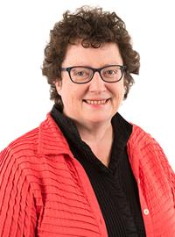
Prosiect Pleidlais Project Vote
Etholiad go iawn
Real election
Notes:
Prosiect Pleidlais / Project Vote – Elin Jones
Etholiad go iawn / Real election – Elin Jones

Slide 35
Trafodaeth | Discussion
- Meddyliwch am 3 pheth rydych ch wedi dysgu trwy wneud yr etholiad paralel
- Pa weithgareddau wnaethoch chi fwynhau mwyaf?
- Meddyliwch am un ffordd mae’r profiad wedi effeithio arnoch chi neu ddatblygu eich barn
- Oedd yna wahaniaeth yn eich ardal chi rhwng y canlyniadau paralel, a’r canlyniadau swyddogol/go iawn? Pam ydych chi’n meddwl?
- Ydych chi’n meddwl bod y pandemig wedi cael effaith ar faint mae pobl yn ei wybod am wleidyddiaeth Cymru?
- Name three things you’ve learned through this Parallel Election
- Which activities did you enjoy the most and why?
- Name one way this experience has changed you or developed opinions
- Was there a difference between the Project Vote results and the real election results? Why do you think that is?
- Do you think that the coronavirus pandemic had an impact on how much people know about Welsh politics?

Slide 36
Camau nesaf | Next steps
Eich aelod o’r Senedd – Mae eich aelod o’r Senedd yna i’ch cynrychioli chi yn y Senedd. Cofiwch mae gennych chi 5 aelod sy’n eich cynrychioli chi – yr un a gafodd ei ethol gan eich etholaeth, a’r 4 cafodd eu hethol gan eich rhanbarth (gweler diwedd y cyflwyniad)
Cofiwch gysylltu gyda nhw os:
- Rydych chi eisiau cyngor neu wybodaeth am rywbeth sydd gan y Senedd pwerau drosto
- Rydych chi eisiau gofyn iddyn nhw beth fydden nhw’n ei wneud i wella eich ardal i bobl ifanc
- Mae gennych chi ddiddordeb mewn mater lleol ac eisiau gwybod mwy
Paid ag ofni cysylltu gyda nhw. Maen nhw’n derbyn cannoedd o ebyst a galwadau ffôn pob blwyddyn ar bob math o fater – eu swydd nhw yw gwrando ar eich pryderon.
Your MS - your MS is there to represent you in the Senedd. Remember you have 5 members of the Senedd representing you – the 1 who was voted in by your constituency, and the 4 who were voted in by your region (see the end of the powerpoint).
Remember to get in touch with them if:
- you want advice or information on something that the Welsh Parliament has control over
- you want to ask them what they will be doing to make your local area better for young people
- there is an issue in your local area that you're interested in
Don't be shy about getting in touch with them. They receive hundreds of emails and phone calls every year on all sorts of issues - it's their job to listen to your concerns.

Slide 37
Camau nesaf | Next steps
Gwneud Gwahaniaeth
Os oes gennych chi ddiddordeb mewn creu newid i faterion sy’n bwysig i chi, yn yr ysgol neu yn eich cymuned leol, ewch i’n hadnodd Gwneud Gwahaniaeth. A plis cysylltwch os oes unrhyw gwestiwn gyda chi amdano fe.
Cofrestru i bleidleisio
Cofiwch gallwch gofrestru i bleidleisio os ydych chi’n 14+ oed.
Ewch at y gwefan yma i wneud hyn.
Byddwch chi wedyn yn gallu pleidleisio mewn etholiadau Senedd, ac etholiadau eich cyngor lleol, pan rydych chi’n troi’n 16.
Making a difference
If you're interested in making a difference to the issues that matter to you, whether it's in school or your local community, take a look at our Make a Difference resource. And please get in touch with us if you have any questions about it.
Registering to vote
Remember you can register to vote if you are aged 14+
Go to this website to do this.
You will then be able to vote in Senedd elections, and your local council elections, when you turn 16.

Slide 38
Dwyfor Meirionnydd

Slide 39
Canlyniadau etholiad paralel | Parallel election Results
Plaid | Party | Ymgeiswyr | Candidates | Pleidleisiau | Votes | %
Plaid Cymru | Mabon ap Gwynfor | 71 | 55%
Democratiaid Rhyddfrydol / Liberal Democrats | Steve Churchman | 18 | 14%
Llais Gwynedd | Robert Daniels | 8 | 6%
Ceidwadwyr / Conservatives | Charlie Evans | 7 | 5%
Reform UK | Louise Hughes | 5 | 4%
Llafur / Labour | Cian Ireland | 16 | 13%
Freedom Alliance | Michelle Murray | 1 | 1%
Propel | Peter Read | 2 | 2%

Slide 40
Canlyniad Senedd go iawn | Real Senedd result
Plaid | Party | Ymgeiswyr | Candidates | Pleidleisiau | Votes | %
Plaid Cymru | Mabon ap Gwynfor | 11,490 | 48.2%
Democratiaid Rhyddfrydol / Liberal Democrats | Steve Churchman | 916 | 4%
Llais Gwynedd | Robert Daniels | 1,136 | 4.8%
Ceidwadwyr / Conservatives | Charlie Evans | 4,294 | 18.5%
Reform UK | Louise Hughes | 710 | 3%
Llafur / Labour | Cian Ireland | 3,702 | 15.5%
Freedom Alliance | Michelle Murray | 152 | 0.6%
Propel | Peter Read | 1,314 | 5.5%

Slide 41
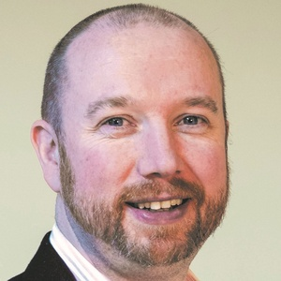
Prosiect Pleidlais Project Vote
Etholiad go iawn
Real election
Notes:
Prosiect Pleidlais / Project Vote – Mabon ap Gwynfor
Etholiad go iawn / Real election – Mabon ap Gwynfor

Slide 42
Trafodaeth | Discussion
- Meddyliwch am 3 pheth rydych ch wedi dysgu trwy wneud yr etholiad paralel
- Pa weithgareddau wnaethoch chi fwynhau mwyaf?
- Meddyliwch am un ffordd mae’r profiad wedi effeithio arnoch chi neu ddatblygu eich barn
- Oedd yna wahaniaeth yn eich ardal chi rhwng y canlyniadau paralel, a’r canlyniadau swyddogol/go iawn? Pam ydych chi’n meddwl?
- Ydych chi’n meddwl bod y pandemig wedi cael effaith ar faint mae pobl yn ei wybod am wleidyddiaeth Cymru?
- Name three things you’ve learned through this Parallel Election
- Which activities did you enjoy the most and why?
- Name one way this experience has changed you or developed opinions
- Was there a difference between the Project Vote results and the real election results? Why do you think that is?
- Do you think that the coronavirus pandemic had an impact on how much people know about Welsh politics?

Slide 43
Camau nesaf | Next steps
Eich aelod o’r Senedd – Mae eich aelod o’r Senedd yna i’ch cynrychioli chi yn y Senedd. Cofiwch mae gennych chi 5 aelod sy’n eich cynrychioli chi – yr un a gafodd ei ethol gan eich etholaeth, a’r 4 cafodd eu hethol gan eich rhanbarth (gweler diwedd y cyflwyniad)
Cofiwch gysylltu gyda nhw os:
- Rydych chi eisiau cyngor neu wybodaeth am rywbeth sydd gan y Senedd pwerau drosto
- Rydych chi eisiau gofyn iddyn nhw beth fydden nhw’n ei wneud i wella eich ardal i bobl ifanc
- Mae gennych chi ddiddordeb mewn mater lleol ac eisiau gwybod mwy
Paid ag ofni cysylltu gyda nhw. Maen nhw’n derbyn cannoedd o ebyst a galwadau ffôn pob blwyddyn ar bob math o fater – eu swydd nhw yw gwrando ar eich pryderon.
Your MS - your MS is there to represent you in the Senedd. Remember you have 5 members of the Senedd representing you – the 1 who was voted in by your constituency, and the 4 who were voted in by your region (see the end of the powerpoint).
Remember to get in touch with them if:
- you want advice or information on something that the Welsh Parliament has control over
- you want to ask them what they will be doing to make your local area better for young people
- there is an issue in your local area that you're interested in
Don't be shy about getting in touch with them. They receive hundreds of emails and phone calls every year on all sorts of issues - it's their job to listen to your concerns.

Slide 44
Camau nesaf | Next steps
Gwneud Gwahaniaeth
Os oes gennych chi ddiddordeb mewn creu newid i faterion sy’n bwysig i chi, yn yr ysgol neu yn eich cymuned leol, ewch i’n hadnodd Gwneud Gwahaniaeth. A plis cysylltwch os oes unrhyw gwestiwn gyda chi amdano fe.
Cofrestru i bleidleisio
Cofiwch gallwch gofrestru i bleidleisio os ydych chi’n 14+ oed.
Ewch at y gwefan yma i wneud hyn.
Byddwch chi wedyn yn gallu pleidleisio mewn etholiadau Senedd, ac etholiadau eich cyngor lleol, pan rydych chi’n troi’n 16.
Making a difference
If you're interested in making a difference to the issues that matter to you, whether it's in school or your local community, take a look at our Make a Difference resource. And please get in touch with us if you have any questions about it.
Registering to vote
Remember you can register to vote if you are aged 14+
Go to this website to do this.
You will then be able to vote in Senedd elections, and your local council elections, when you turn 16.

Slide 45
Llanelli

Slide 46
Canlyniadau etholiad paralel | Parallel election Results
Plaid | Party | Ymgeiswyr | Candidates | Pleidleisiau | Votes | %
Reform UK | Gareth Beer | - | -
Democratiaid Rhyddfrydol / Liberal Democrats | John Burree | - | -
Gwlad | Sian Caiach | - | -
Plaid Cymru | Helen Mary Jones | 1 | 20%
UKIP | Howard Lillyman | - | -
Annibynnol / Independent | Shahana Najimi | - | -
Ceidwadwyr / Conservatives | Stefan Ryszewski | - | -
Llafur / Labour | Lee Waters | 4 | 80%

Slide 47
Canlyniad Senedd go iawn | Real Senedd result
Plaid | Party | Ymgeiswyr | Candidates | Pleidleisiau | Votes | %
Reform UK | Gareth Beer | 672 | 2.2%
Democratiaid Rhyddfrydol / Liberal Democrats | John Burree | 606 | 2%
Gwlad | Sian Caiach | 544 | 1.8%
Plaid Cymru | Helen Mary Jones | 8,255 | 27.3%
UKIP | Howard Lillyman | 722 | 2.4%
Annibynnol / Independent | Shahana Najimi | 542 | 1.8%
Ceidwadwyr / Conservatives | Stefan Ryszewski | 4,947 | 16.4%
Llafur / Labour | Lee Waters | 13,930 | 46.1%

Slide 48
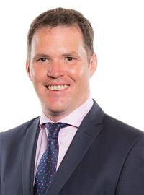
Prosiect Pleidlais Project Vote
Etholiad go iawn
Real election
Notes:
Prosiect Pleidlais / Project Vote – Lee Waters
Etholiad go iawn / Real election – Lee Waters

Slide 49
Trafodaeth | Discussion
- Meddyliwch am 3 pheth rydych ch wedi dysgu trwy wneud yr etholiad paralel
- Pa weithgareddau wnaethoch chi fwynhau mwyaf?
- Meddyliwch am un ffordd mae’r profiad wedi effeithio arnoch chi neu ddatblygu eich barn
- Oedd yna wahaniaeth yn eich ardal chi rhwng y canlyniadau paralel, a’r canlyniadau swyddogol/go iawn? Pam ydych chi’n meddwl?
- Ydych chi’n meddwl bod y pandemig wedi cael effaith ar faint mae pobl yn ei wybod am wleidyddiaeth Cymru?
- Name three things you’ve learned through this Parallel Election
- Which activities did you enjoy the most and why?
- Name one way this experience has changed you or developed opinions
- Was there a difference between the Project Vote results and the real election results? Why do you think that is?
- Do you think that the coronavirus pandemic had an impact on how much people know about Welsh politics?

Slide 50
Camau nesaf | Next steps
Eich aelod o’r Senedd – Mae eich aelod o’r Senedd yna i’ch cynrychioli chi yn y Senedd. Cofiwch mae gennych chi 5 aelod sy’n eich cynrychioli chi – yr un a gafodd ei ethol gan eich etholaeth, a’r 4 cafodd eu hethol gan eich rhanbarth (gweler diwedd y cyflwyniad)
Cofiwch gysylltu gyda nhw os:
- Rydych chi eisiau cyngor neu wybodaeth am rywbeth sydd gan y Senedd pwerau drosto
- Rydych chi eisiau gofyn iddyn nhw beth fydden nhw’n ei wneud i wella eich ardal i bobl ifanc
- Mae gennych chi ddiddordeb mewn mater lleol ac eisiau gwybod mwy
Paid ag ofni cysylltu gyda nhw. Maen nhw’n derbyn cannoedd o ebyst a galwadau ffôn pob blwyddyn ar bob math o fater – eu swydd nhw yw gwrando ar eich pryderon.
Your MS - your MS is there to represent you in the Senedd. Remember you have 5 members of the Senedd representing you – the 1 who was voted in by your constituency, and the 4 who were voted in by your region (see the end of the powerpoint).
Remember to get in touch with them if:
- you want advice or information on something that the Welsh Parliament has control over
- you want to ask them what they will be doing to make your local area better for young people
- there is an issue in your local area that you're interested in
Don't be shy about getting in touch with them. They receive hundreds of emails and phone calls every year on all sorts of issues - it's their job to listen to your concerns.

Slide 51
Camau nesaf | Next steps
Gwneud Gwahaniaeth
Os oes gennych chi ddiddordeb mewn creu newid i faterion sy’n bwysig i chi, yn yr ysgol neu yn eich cymuned leol, ewch i’n hadnodd Gwneud Gwahaniaeth. A plis cysylltwch os oes unrhyw gwestiwn gyda chi amdano fe.
Cofrestru i bleidleisio
Cofiwch gallwch gofrestru i bleidleisio os ydych chi’n 14+ oed.
Ewch at y gwefan yma i wneud hyn.
Byddwch chi wedyn yn gallu pleidleisio mewn etholiadau Senedd, ac etholiadau eich cyngor lleol, pan rydych chi’n troi’n 16.
Making a difference
If you're interested in making a difference to the issues that matter to you, whether it's in school or your local community, take a look at our Make a Difference resource. And please get in touch with us if you have any questions about it.
Registering to vote
Remember you can register to vote if you are aged 14+
Go to this website to do this.
You will then be able to vote in Senedd elections, and your local council elections, when you turn 16.

Slide 52
Sir Drefaldwyn Montgomeryshire

Slide 53
Canlyniadau etholiad paralel | Parallel election Results
Plaid | Party | Ymgeiswyr | Candidates | Pleidleisiau | Votes | %
Democratiaid Rhyddfrydol / Liberal Democrats | Alison Alexander | 1 | 20%
Llafur / Labour | Kait Duerden | 1 | 20%
Gwald | Gwyn Evans | - | -
Ceidwadwyr / Conservatives | Russell George | 2 | 40%
Reform UK | Oliver Lewis | 1 | 20%
Plaid Cymru | Elwyn Vaughan | - | -

Slide 54
Canlyniad Senedd go iawn | Real Senedd result
Plaid | Party | Ymgeiswyr | Candidates | Pleidleisiau | Votes | %
Democratiaid Rhyddfrydol / Liberal Democrats | Alison Alexander | 4,207 | 16.8%
Llafur / Labour | Kait Duerden | 3,576 | 14.3%
Gwald | Gwyn Evans | 157 | 0.6%
Ceidwadwyr / Conservatives | Russell George | 12,013 | 48.1%
Reform UK | Oliver Lewis | 549 | 2.2%
Plaid Cymru | Elwyn Vaughan | 4,485 | 17.9%

Slide 55
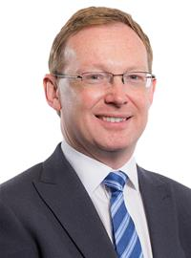
Prosiect Pleidlais Project Vote
Etholiad go iawn
Real election
Notes:
Prosiect Pleidlais / Project Vote – Russell George
Etholiad go iawn / Real election – Russell George

Slide 56
Trafodaeth | Discussion
- Meddyliwch am 3 pheth rydych ch wedi dysgu trwy wneud yr etholiad paralel
- Pa weithgareddau wnaethoch chi fwynhau mwyaf?
- Meddyliwch am un ffordd mae’r profiad wedi effeithio arnoch chi neu ddatblygu eich barn
- Oedd yna wahaniaeth yn eich ardal chi rhwng y canlyniadau paralel, a’r canlyniadau swyddogol/go iawn? Pam ydych chi’n meddwl?
- Ydych chi’n meddwl bod y pandemig wedi cael effaith ar faint mae pobl yn ei wybod am wleidyddiaeth Cymru?
- Name three things you’ve learned through this Parallel Election
- Which activities did you enjoy the most and why?
- Name one way this experience has changed you or developed opinions
- Was there a difference between the Project Vote results and the real election results? Why do you think that is?
- Do you think that the coronavirus pandemic had an impact on how much people know about Welsh politics?

Slide 57
Camau nesaf | Next steps
Eich aelod o’r Senedd – Mae eich aelod o’r Senedd yna i’ch cynrychioli chi yn y Senedd. Cofiwch mae gennych chi 5 aelod sy’n eich cynrychioli chi – yr un a gafodd ei ethol gan eich etholaeth, a’r 4 cafodd eu hethol gan eich rhanbarth (gweler diwedd y cyflwyniad)
Cofiwch gysylltu gyda nhw os:
- Rydych chi eisiau cyngor neu wybodaeth am rywbeth sydd gan y Senedd pwerau drosto
- Rydych chi eisiau gofyn iddyn nhw beth fydden nhw’n ei wneud i wella eich ardal i bobl ifanc
- Mae gennych chi ddiddordeb mewn mater lleol ac eisiau gwybod mwy
Paid ag ofni cysylltu gyda nhw. Maen nhw’n derbyn cannoedd o ebyst a galwadau ffôn pob blwyddyn ar bob math o fater – eu swydd nhw yw gwrando ar eich pryderon.
Your MS - your MS is there to represent you in the Senedd. Remember you have 5 members of the Senedd representing you – the 1 who was voted in by your constituency, and the 4 who were voted in by your region (see the end of the powerpoint).
Remember to get in touch with them if:
- you want advice or information on something that the Welsh Parliament has control over
- you want to ask them what they will be doing to make your local area better for young people
- there is an issue in your local area that you're interested in
Don't be shy about getting in touch with them. They receive hundreds of emails and phone calls every year on all sorts of issues - it's their job to listen to your concerns.

Slide 58
Camau nesaf | Next steps
Gwneud Gwahaniaeth
Os oes gennych chi ddiddordeb mewn creu newid i faterion sy’n bwysig i chi, yn yr ysgol neu yn eich cymuned leol, ewch i’n hadnodd Gwneud Gwahaniaeth. A plis cysylltwch os oes unrhyw gwestiwn gyda chi amdano fe.
Cofrestru i bleidleisio
Cofiwch gallwch gofrestru i bleidleisio os ydych chi’n 14+ oed.
Ewch at y gwefan yma i wneud hyn.
Byddwch chi wedyn yn gallu pleidleisio mewn etholiadau Senedd, ac etholiadau eich cyngor lleol, pan rydych chi’n troi’n 16.
Making a difference
If you're interested in making a difference to the issues that matter to you, whether it's in school or your local community, take a look at our Make a Difference resource. And please get in touch with us if you have any questions about it.
Registering to vote
Remember you can register to vote if you are aged 14+
Go to this website to do this.
You will then be able to vote in Senedd elections, and your local council elections, when you turn 16.

Slide 59
Preseli Sir Benfro Preseli Pembrokeshire

Slide 60
Canlyniadau etholiad paralel | Parallel election Results
Plaid | Party | Ymgeiswyr | Candidates | Pleidleisiau | Votes | %
Ceidwadwyr / Conservatives | Paul Davies | 60 | 22%
Reform UK | William Dennison | 15 | 6%
Llafur / Labour | Jackie Jones | 80 | 30%
Democratiaid Rhyddfrydol / Liberal Democrats | Tina Roberts | 30 | 11%
Plaid Cymru | Cris Tomos | 84 | 31%

Slide 61
Canlyniad Senedd go iawn | Real Senedd result
Plaid | Party | Ymgeiswyr | Candidates | Pleidleisiau | Votes | %
Ceidwadwyr / Conservatives | Paul Davies | 12,295 | 39%
Reform UK | William Dennison | 1,239 | 3.9%
Llafur / Labour | Jackie Jones | 10,895 | 34.6%
Democratiaid Rhyddfrydol / Liberal Democrats | Tina Roberts | 952 | 3%
Plaid Cymru | Cris Tomos | 6,135 | 19.5%

Slide 62
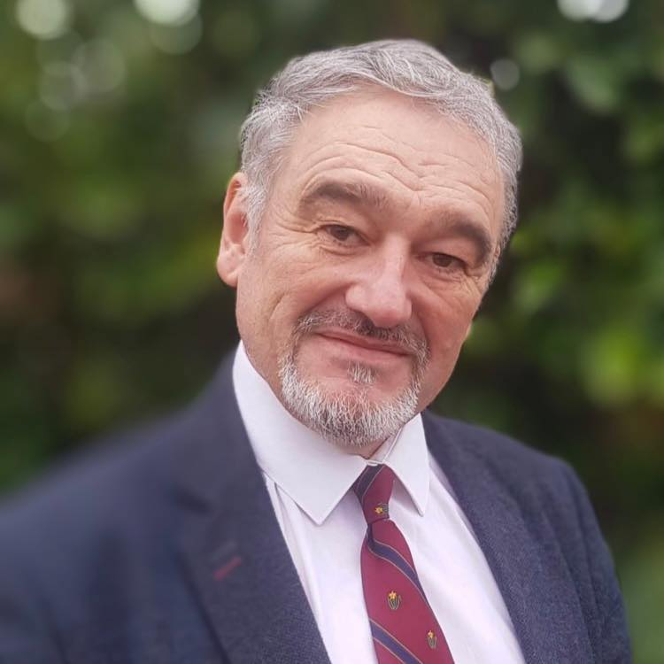
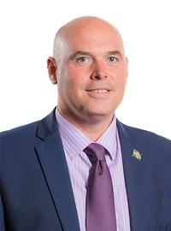
Prosiect Pleidlais Project Vote
Etholiad go iawn
Real election
Notes:
Prosiect Pleidlais / Project Vote – Cris Tomos
Etholiad go iawn / Real election – Paul Davies

Slide 63
Trafodaeth | Discussion
- Meddyliwch am 3 pheth rydych ch wedi dysgu trwy wneud yr etholiad paralel
- Pa weithgareddau wnaethoch chi fwynhau mwyaf?
- Meddyliwch am un ffordd mae’r profiad wedi effeithio arnoch chi neu ddatblygu eich barn
- Oedd yna wahaniaeth yn eich ardal chi rhwng y canlyniadau paralel, a’r canlyniadau swyddogol/go iawn? Pam ydych chi’n meddwl?
- Ydych chi’n meddwl bod y pandemig wedi cael effaith ar faint mae pobl yn ei wybod am wleidyddiaeth Cymru?
- Name three things you’ve learned through this Parallel Election
- Which activities did you enjoy the most and why?
- Name one way this experience has changed you or developed opinions
- Was there a difference between the Project Vote results and the real election results? Why do you think that is?
- Do you think that the coronavirus pandemic had an impact on how much people know about Welsh politics?

Slide 64
Camau nesaf | Next steps
Eich aelod o’r Senedd – Mae eich aelod o’r Senedd yna i’ch cynrychioli chi yn y Senedd. Cofiwch mae gennych chi 5 aelod sy’n eich cynrychioli chi – yr un a gafodd ei ethol gan eich etholaeth, a’r 4 cafodd eu hethol gan eich rhanbarth (gweler diwedd y cyflwyniad)
Cofiwch gysylltu gyda nhw os:
- Rydych chi eisiau cyngor neu wybodaeth am rywbeth sydd gan y Senedd pwerau drosto
- Rydych chi eisiau gofyn iddyn nhw beth fydden nhw’n ei wneud i wella eich ardal i bobl ifanc
- Mae gennych chi ddiddordeb mewn mater lleol ac eisiau gwybod mwy
Paid ag ofni cysylltu gyda nhw. Maen nhw’n derbyn cannoedd o ebyst a galwadau ffôn pob blwyddyn ar bob math o fater – eu swydd nhw yw gwrando ar eich pryderon.
Your MS - your MS is there to represent you in the Senedd. Remember you have 5 members of the Senedd representing you – the 1 who was voted in by your constituency, and the 4 who were voted in by your region (see the end of the powerpoint).
Remember to get in touch with them if:
- you want advice or information on something that the Welsh Parliament has control over
- you want to ask them what they will be doing to make your local area better for young people
- there is an issue in your local area that you're interested in
Don't be shy about getting in touch with them. They receive hundreds of emails and phone calls every year on all sorts of issues - it's their job to listen to your concerns.

Slide 65
Camau nesaf | Next steps
Gwneud Gwahaniaeth
Os oes gennych chi ddiddordeb mewn creu newid i faterion sy’n bwysig i chi, yn yr ysgol neu yn eich cymuned leol, ewch i’n hadnodd Gwneud Gwahaniaeth. A plis cysylltwch os oes unrhyw gwestiwn gyda chi amdano fe.
Cofrestru i bleidleisio
Cofiwch gallwch gofrestru i bleidleisio os ydych chi’n 14+ oed.
Ewch at y gwefan yma i wneud hyn.
Byddwch chi wedyn yn gallu pleidleisio mewn etholiadau Senedd, ac etholiadau eich cyngor lleol, pan rydych chi’n troi’n 16.
Making a difference
If you're interested in making a difference to the issues that matter to you, whether it's in school or your local community, take a look at our Make a Difference resource. And please get in touch with us if you have any questions about it.
Registering to vote
Remember you can register to vote if you are aged 14+
Go to this website to do this.
You will then be able to vote in Senedd elections, and your local council elections, when you turn 16.

Slide 66
Rhanbarth Region

Slide 67
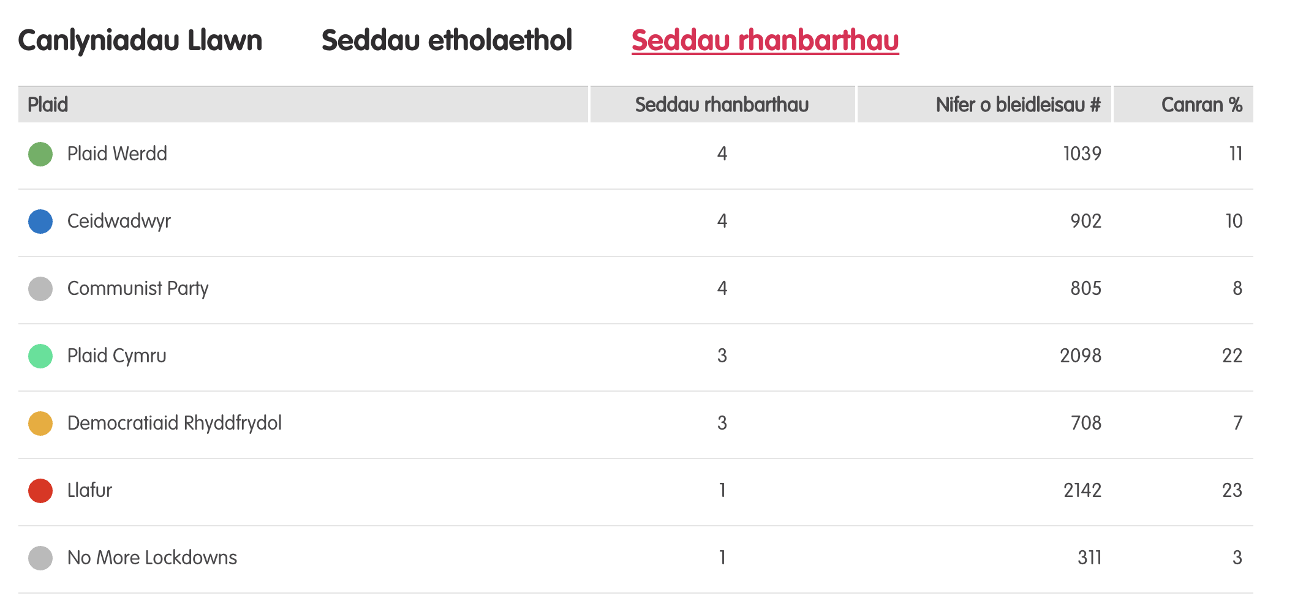
Canlyniadau etholiad paralel
Notes:
Tudalen wê canlyniadau’r Prosiect Pleidlais - https://prosiectpleidlais.cymru/canlyniadau/
Web page for Project Vote results – https://www.projectvote.wales/results/
Tudalen wê canlyniadau go iawn- https://www.bbc.co.uk/cymrufyw/pynciau/cvd627zw9rjt/etholiad-senedd-cymru-2021
Real results web page: https://www.bbc.co.uk/news/topics/cqwn14k92zwt/welsh-parliament-election-2021

Slide 68
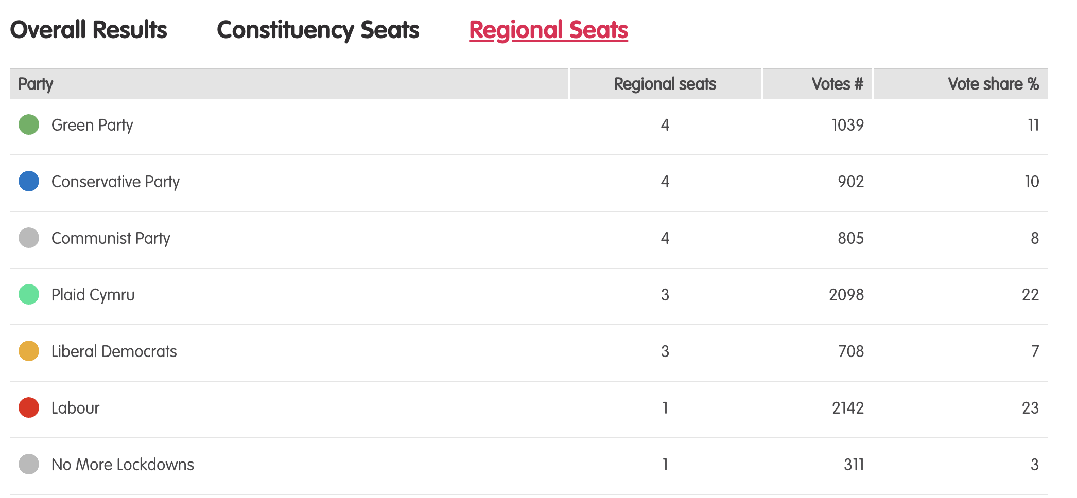
Results – Project vote parallel election
Notes:
Tudalen wê canlyniadau’r Prosiect Pleidlais - https://prosiectpleidlais.cymru/canlyniadau/
Web page for Project Vote results – https://www.projectvote.wales/results/
Tudalen wê canlyniadau go iawn- https://www.bbc.co.uk/cymrufyw/pynciau/cvd627zw9rjt/etholiad-senedd-cymru-2021
Real results web page: https://www.bbc.co.uk/news/topics/cqwn14k92zwt/welsh-parliament-election-2021

Slide 69
Canlyniadau etholiad swyddogol – Official election results
Plaid | Party | Seddau rhanbarthau | Regional seats | Nifer o bleidleisiau | Number of votes | Canran % | Vote share %
Llafur / Labour | 3 | 401,770 | 36.2%
Ceidwadwyr / Conservatives | 8 | 278,560 | 25.1%
Plaid Cymru | 8 | 230,161 | 20.7%
Plaid Werdd / Green Party | 0 | 48,714 | 4.4%
Democratiaid Rhyddfrydol / Liberal Democrats | 1 | 48,217 | 4.3%
Abolish the Welsh Assembly | 0 | 41,399 | 3.7%
Notes:
NB: the number and share of votes are for regional votes only.
We have included the top 6 parties only here

Slide 70
Canolbarth a Gorllewin Cymru Mid and West Wales

Slide 71
Prosiect Pleidlais Project Vote
Etholiad go iawn
Real election
Plaid / Party | Pleidleisiau / Votes | Seddau /Seats
Plaid Werdd / Green Party | 126 | 1
Plaid Cymru | 591 | 2
Democratiaid Rhyddfrydol / Liberal Democrats | 102 | 1
Plaid / Party | Pleidleisiau / Votes | Seddau /Seats
Llafur / Labour | 61,733 | 2
Plaid Cymru | 65,450 | 1
Democratiaid Rhyddfrydol / Liberal Democrats | 16,181 | 1

Slide 72
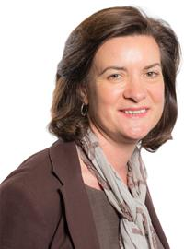
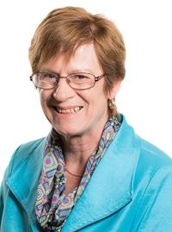
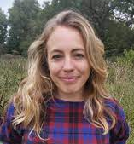
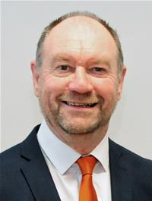
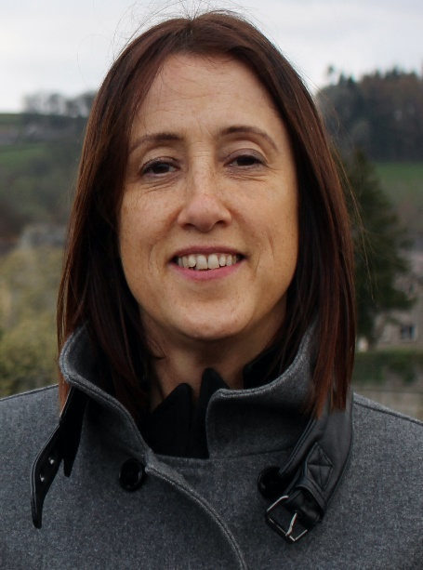
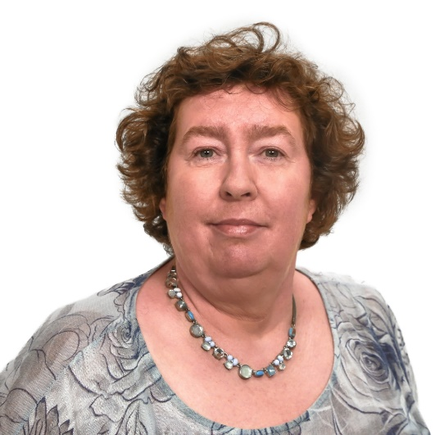
Prosiect Pleidlais Project Vote
Etholiad go iawn
Real election
Notes:
Prosiect Pleidlais / Project Vote (clockwise)
Emily Durrant - Plaid Werdd / Green Party
Cefin Campbell - Plaid Cymru
Helen Mary Jones - Plaid Cymru
Jane Dodds - Democratiaid Rhyddfrydol / Liberal Democrats
Etholiad go iawn / Real election (clockwise)
Eluned Morgan - Llafur / Labour
Joyce Watson - Llafur / Labour
Cefin Campbell - Plaid Cymru
Jane Dodds - Democratiaid Rhyddfrydol / Liberal Democrats

