Slide 2
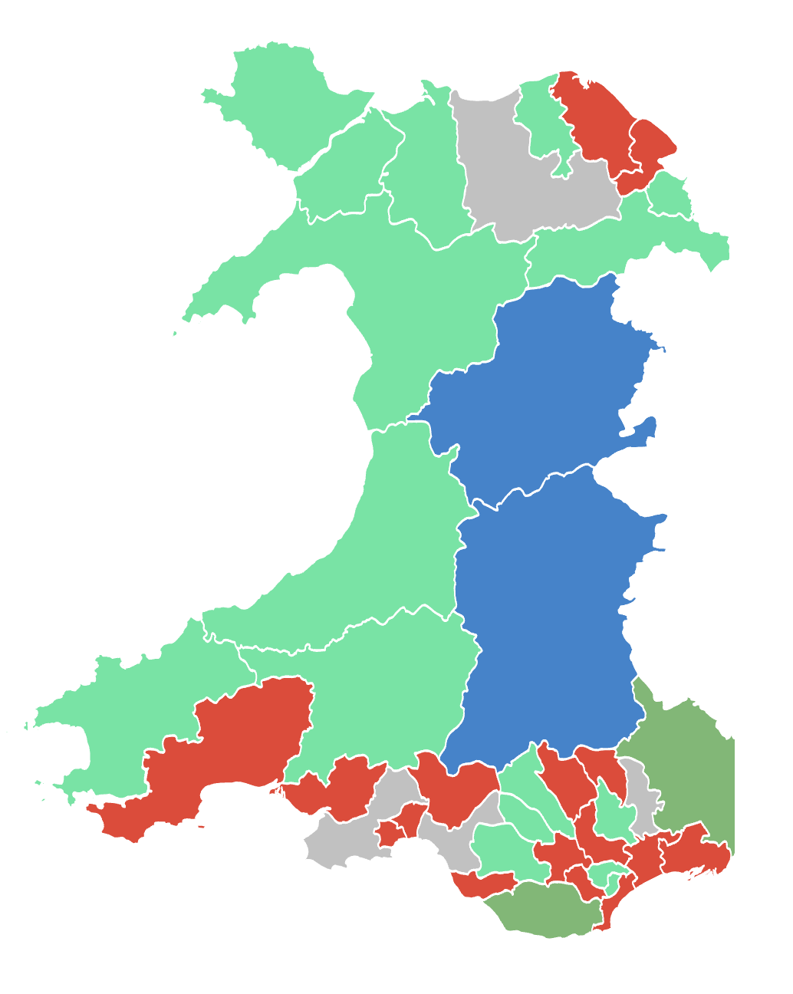
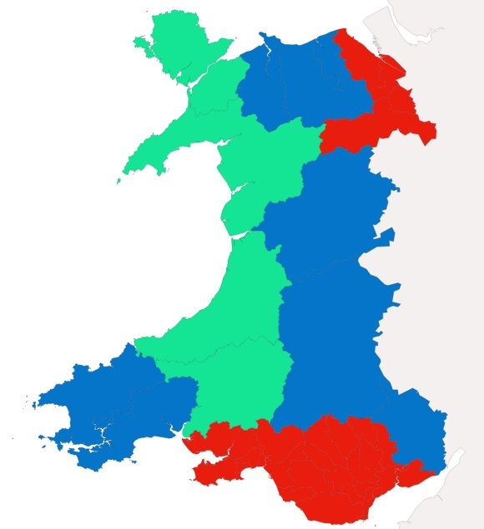
Prosiect Pleidlais | Project Vote
Etholiad go iawn | Real election
Notes:
Lliwiau’r pleidiau / Party colours
Ceidwadwyr / Conservatives – Glas / Blue
Llafur / Labour – Coch / Red
Plaid Cymru – Gwyrdd Golau / Light Green
Plaid Werdd / Green Party – Gwyrdd Tywyll / Dark Green
No results – Llwyd / Grey

Slide 3
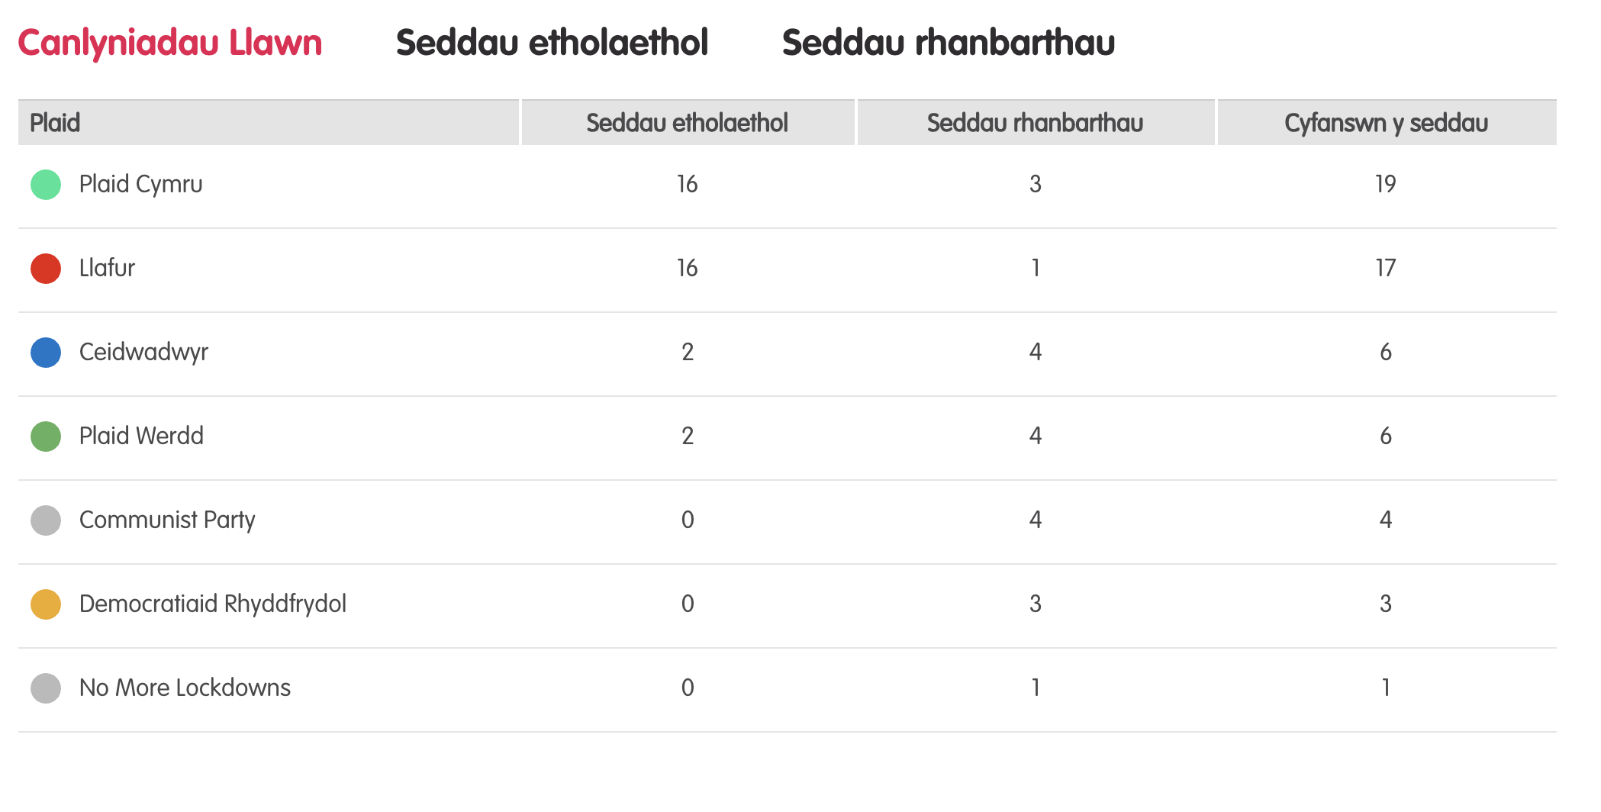
Canlyniadau llawn – Etholiad Paralel
Notes:
Tudalen wê canlyniadau’r Prosiect Pleidlais - https://prosiectpleidlais.cymru/canlyniadau/
Web page for Project Vote results – https://www.projectvote.wales/results/
Tudalen wê canlyniadau go iawn- https://www.bbc.co.uk/cymrufyw/pynciau/cvd627zw9rjt/etholiad-senedd-cymru-2021
Real results web page: https://www.bbc.co.uk/news/topics/cqwn14k92zwt/welsh-parliament-election-2021

Slide 4
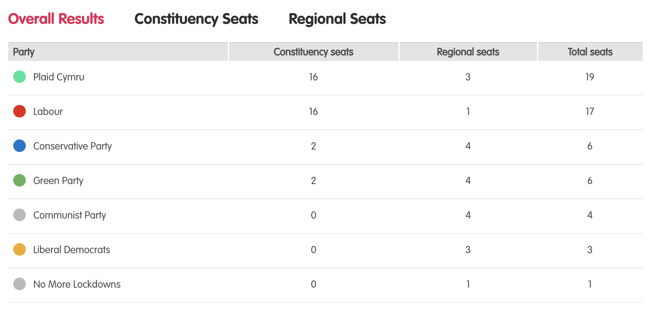
Results – Project vote parallel election
Notes:
Tudalen wê canlyniadau’r Prosiect Pleidlais - https://prosiectpleidlais.cymru/canlyniadau/
Web page for Project Vote results – https://www.projectvote.wales/results/
Tudalen wê canlyniadau go iawn- https://www.bbc.co.uk/cymrufyw/pynciau/cvd627zw9rjt/etholiad-senedd-cymru-2021
Real results web page: https://www.bbc.co.uk/news/topics/cqwn14k92zwt/welsh-parliament-election-2021

Slide 5
Official election Results / Canlyniadau etholiad swyddogol
Plaid | Party | Seddau etholaethol | Constituency seats | Seddau rhanbarthau | Regional seats | Cyfanswn y seddau | Total Seats
Llafur / Labour | 27 | 3 | 30
Ceidwadwyr / Conservatives | 8 | 8 | 16
Plaid Cymru | 5 | 8 | 13
Democratiaid Rhyddfrydol / Liberal Democrats | 0 | 1 | 1

Slide 6
Etholaethau Constituencies

Slide 7
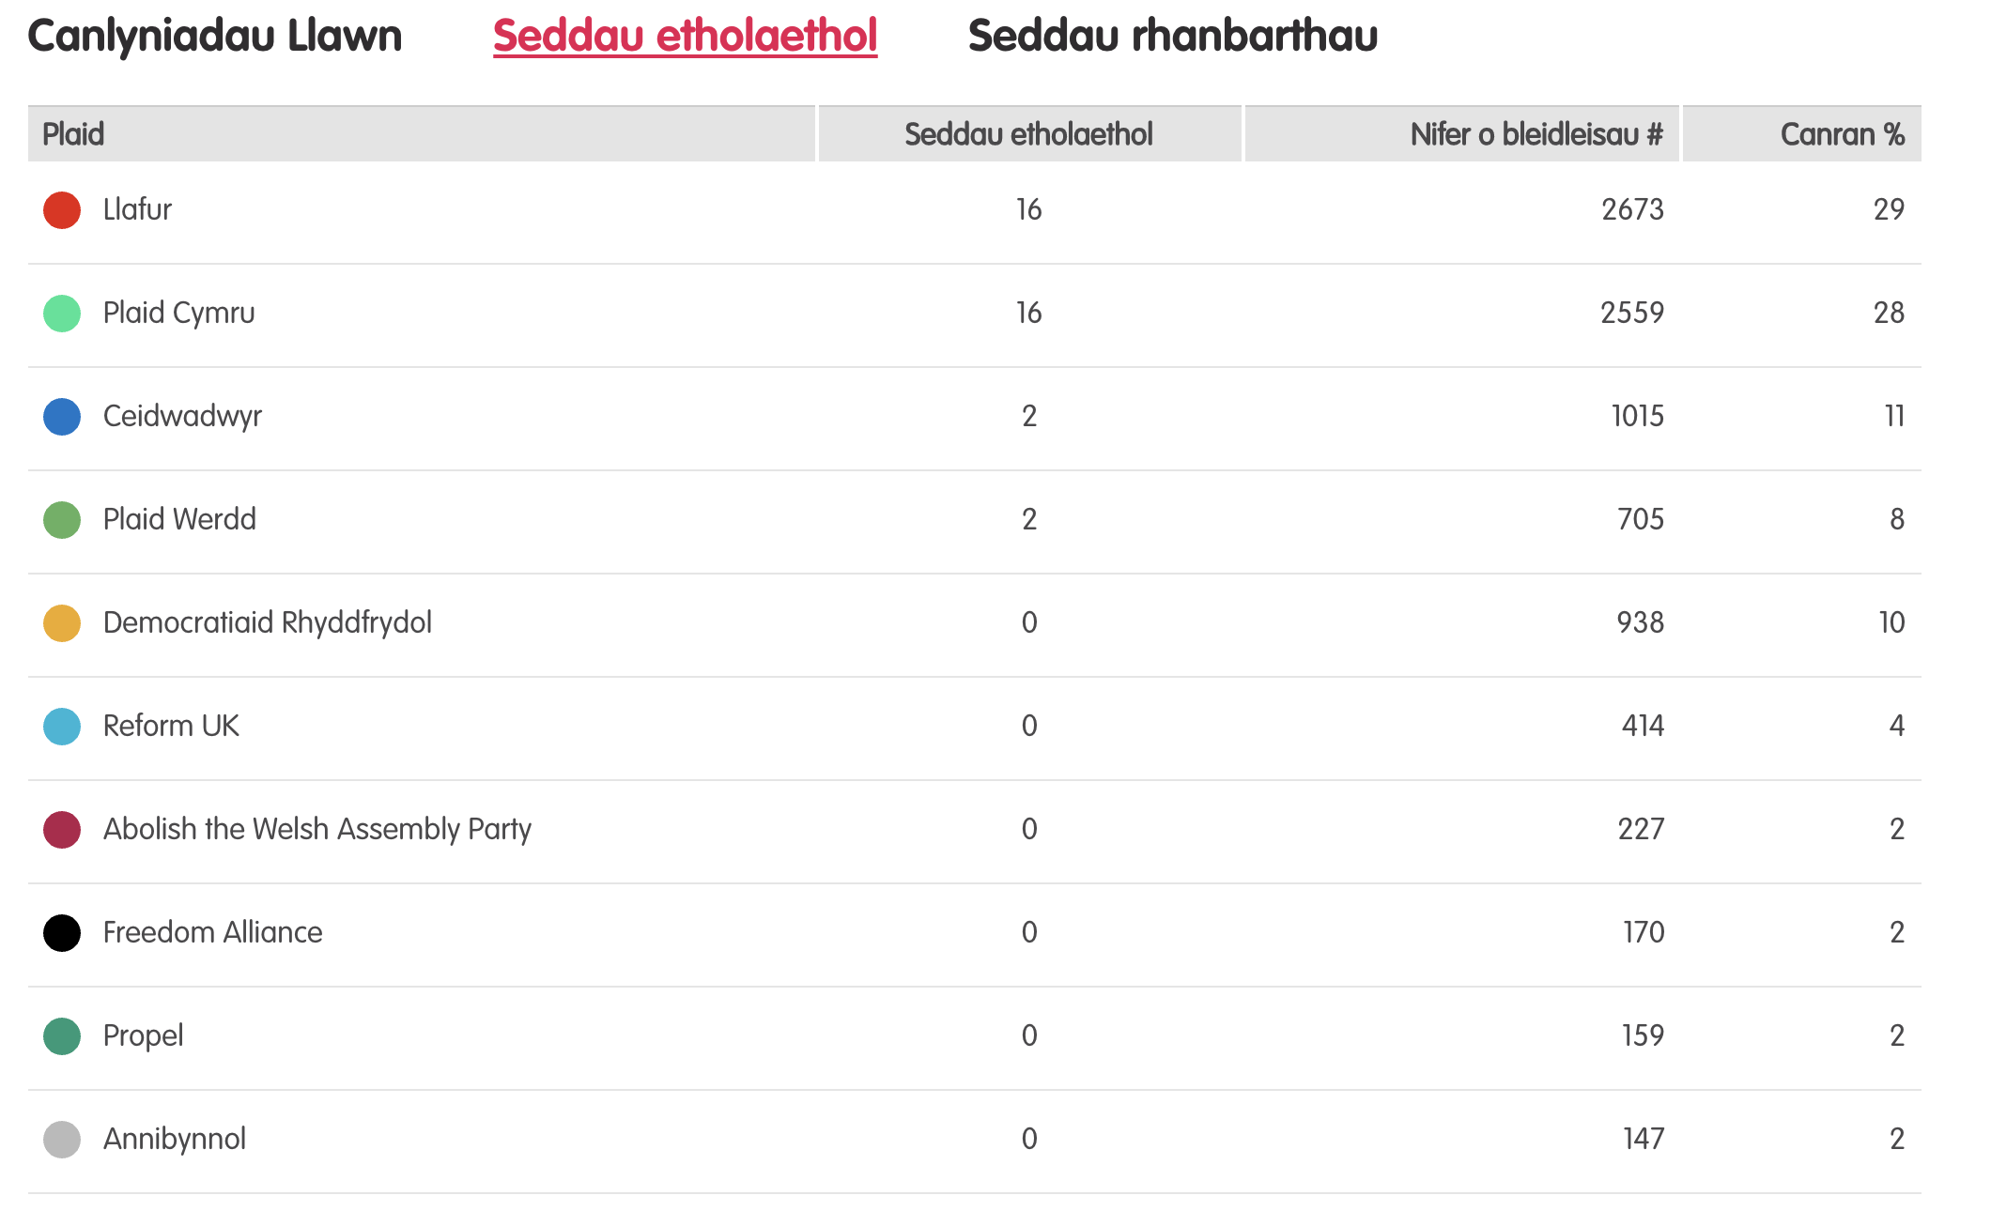
Canlyniadau – Etholiad Paralel
Notes:
Tudalen wê canlyniadau’r Prosiect Pleidlais - https://prosiectpleidlais.cymru/canlyniadau/
Web page for Project Vote results – https://www.projectvote.wales/results/
Tudalen wê canlyniadau go iawn- https://www.bbc.co.uk/cymrufyw/pynciau/cvd627zw9rjt/etholiad-senedd-cymru-2021
Real results web page: https://www.bbc.co.uk/news/topics/cqwn14k92zwt/welsh-parliament-election-2021

Slide 8
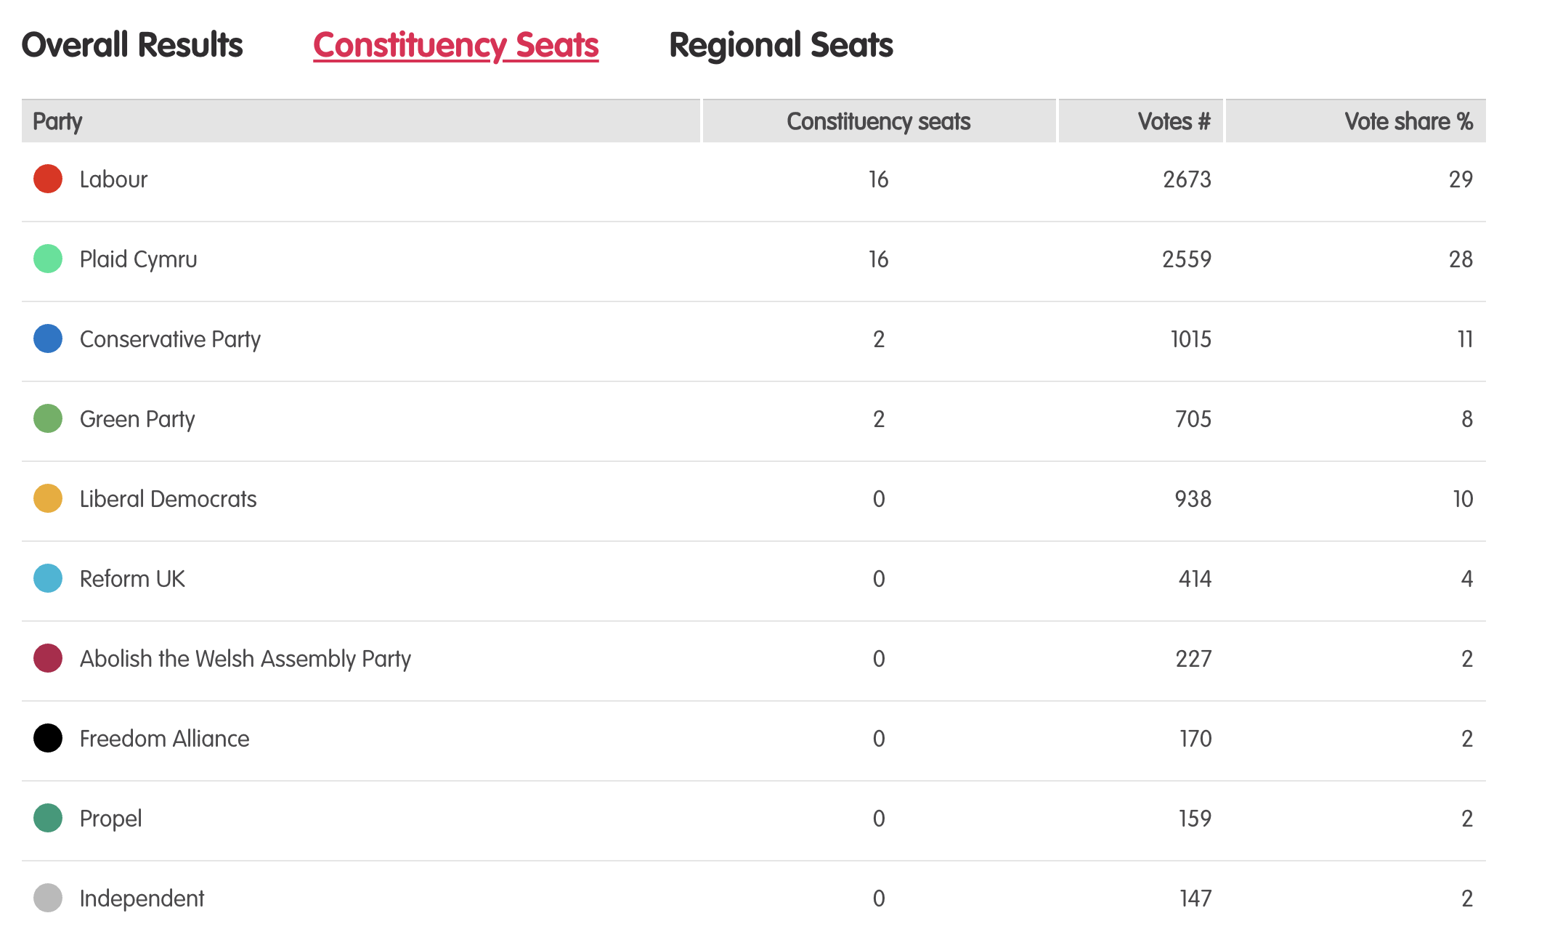
Results – Project vote parallel election
Notes:
Tudalen wê canlyniadau’r Prosiect Pleidlais - https://prosiectpleidlais.cymru/canlyniadau/
Web page for Project Vote results – https://www.projectvote.wales/results/
Tudalen wê canlyniadau go iawn- https://www.bbc.co.uk/cymrufyw/pynciau/cvd627zw9rjt/etholiad-senedd-cymru-2021
Real results web page: https://www.bbc.co.uk/news/topics/cqwn14k92zwt/welsh-parliament-election-2021

Slide 9
Canlyniadau swyddogol – Official results
Plaid | Party | Seddau etholaethol | Constituency seats | Nifer o bleidleisiau | Number of votes | Canran % | Vote share %
Llafur / Labour | 27 | 443,047 | 39.9%
Ceidwadwyr / Conservatives | 8 | 289,802 | 26.1%
Plaid Cymru | 5 | 225,376 | 20.3%
Democratiaid Rhyddfrydol / Liberal Democrats | 0 | 54,202 | 4.9%
Abolish the Welsh Assembly | 0 | 18,149 | 1.6%
Plaid Werdd / Green Party | 0 | 17,817 | 1.6%
Notes:
NB: the number and share of votes are for constituency votes only.
We have included the top 6 parties only here

Slide 10
Aberconwy

Slide 11
Canlyniadau Prosiect Pleidlais | Project Vote Results
Plaid | Party | Ymgeiswyr | Candidates | Pleidleisiau | Votes | %
Reform UK | Rachel Bagshaw | 1 | 2%
Ceidwadwyr / Conservatives | Janet Finch-Saunders | 4 | 7%
Democratiaid Rhyddfrydol / Liberal Democrats | Rhys Jones | 1 | 2%
Llafur / Labour | Dawn McGuinness | 6 | 11%
No More Lockdowns | Sharon Smith | 3 | 6%
Plaid Cymru | Aaron Wynne | 39 | 72%

Slide 12
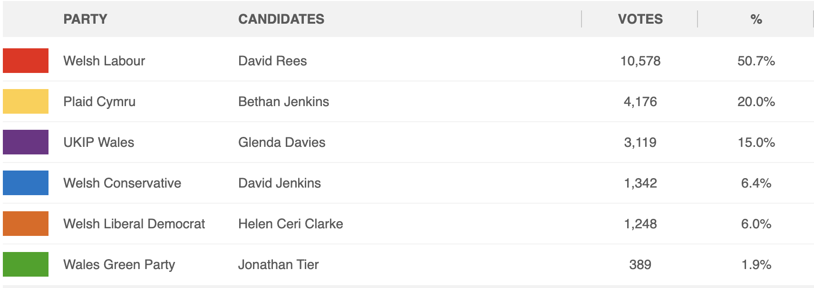
Canlyniad Senedd go iawn | Real Senedd result
Plaid | Party | Ymgeiswyr | Candidates | Pleidleisiau | Votes | %
Reform UK | Rachel Bagshaw | 320 | 1.4%
Ceidwadwyr / Conservatives | Janet Finch-Saunders | 9,815 | 41.7%
Democratiaid Rhyddfrydol / Liberal Democrats | Rhys Jones | 735 | 3.1%
Llafur / Labour | Dawn McGuinness | 5,971 | 25.4%
No More Lockdowns | Sharon Smith | 223 | 0.9%
Plaid Cymru | Aaron Wynne | 6,479 | 27.5%

Slide 13
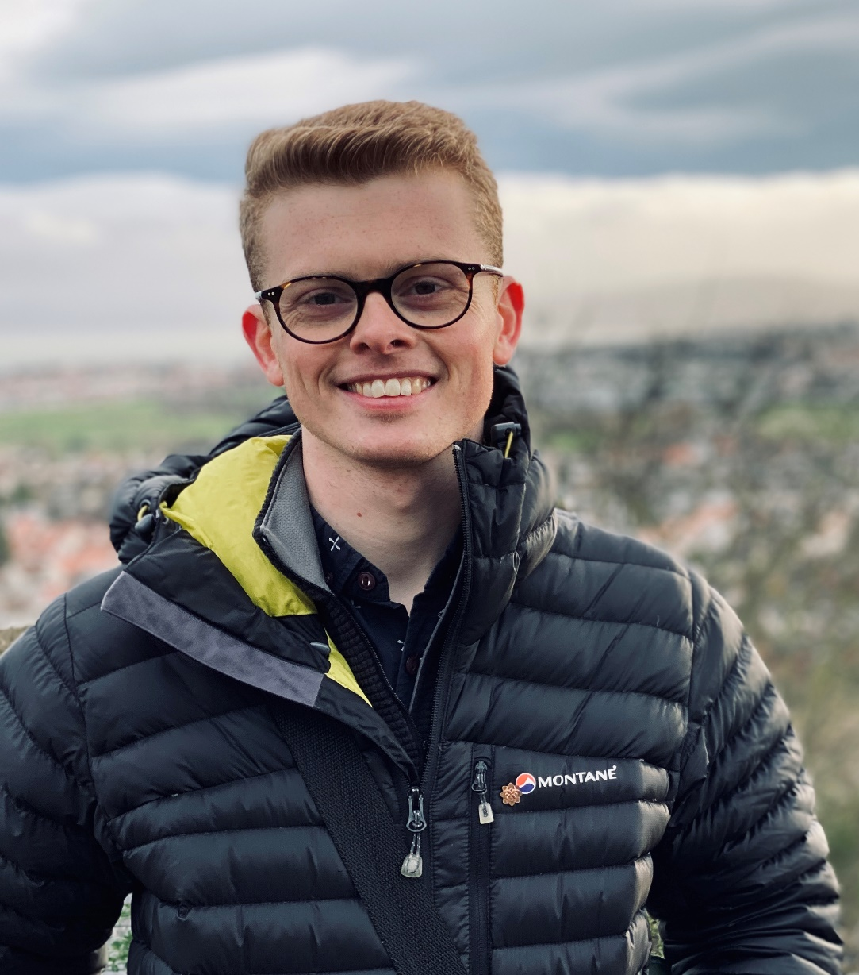
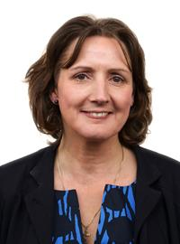
Prosiect Pleidlais Project Vote
Etholiad go iawn
Real election
Notes:
Prosiect Pleidlais / Project Vote – Aaron Wynne
Etholiad go iawn / Real election – Janet Finch-Saunders

Slide 14
Trafodaeth | Discussion
- Meddyliwch am 3 pheth rydych ch wedi dysgu trwy wneud yr etholiad paralel
- Pa weithgareddau wnaethoch chi fwynhau mwyaf?
- Meddyliwch am un ffordd mae’r profiad wedi effeithio arnoch chi neu ddatblygu eich barn
- Oedd yna wahaniaeth yn eich ardal chi rhwng y canlyniadau paralel, a’r canlyniadau swyddogol/go iawn? Pam ydych chi’n meddwl?
- Ydych chi’n meddwl bod y pandemig wedi cael effaith ar faint mae pobl yn ei wybod am wleidyddiaeth Cymru?
- Name three things you’ve learned through this Parallel Election
- Which activities did you enjoy the most and why?
- Name one way this experience has changed you or developed opinions
- Was there a difference between the Project Vote results and the real election results? Why do you think that is?
- Do you think that the coronavirus pandemic had an impact on how much people know about Welsh politics?

Slide 15
Camau nesaf | Next steps
Eich aelod o’r Senedd – Mae eich aelod o’r Senedd yna i’ch cynrychioli chi yn y Senedd. Cofiwch mae gennych chi 5 aelod sy’n eich cynrychioli chi – yr un a gafodd ei ethol gan eich etholaeth, a’r 4 cafodd eu hethol gan eich rhanbarth (gweler diwedd y cyflwyniad)
Cofiwch gysylltu gyda nhw os:
- Rydych chi eisiau cyngor neu wybodaeth am rywbeth sydd gan y Senedd pwerau drosto
- Rydych chi eisiau gofyn iddyn nhw beth fydden nhw’n ei wneud i wella eich ardal i bobl ifanc
- Mae gennych chi ddiddordeb mewn mater lleol ac eisiau gwybod mwy
Paid ag ofni cysylltu gyda nhw. Maen nhw’n derbyn cannoedd o ebyst a galwadau ffôn pob blwyddyn ar bob math o fater – eu swydd nhw yw gwrando ar eich pryderon.
Your MS - your MS is there to represent you in the Senedd. Remember you have 5 members of the Senedd representing you – the 1 who was voted in by your constituency, and the 4 who were voted in by your region (see the end of the powerpoint).
Remember to get in touch with them if:
- you want advice or information on something that the Welsh Parliament has control over
- you want to ask them what they will be doing to make your local area better for young people
- there is an issue in your local area that you're interested in
Don't be shy about getting in touch with them. They receive hundreds of emails and phone calls every year on all sorts of issues - it's their job to listen to your concerns.

Slide 16
Camau nesaf | Next steps
Gwneud Gwahaniaeth
Os oes gennych chi ddiddordeb mewn creu newid i faterion sy’n bwysig i chi, yn yr ysgol neu yn eich cymuned leol, ewch i’n hadnodd Gwneud Gwahaniaeth. A plis cysylltwch os oes unrhyw gwestiwn gyda chi amdano fe.
Cofrestru i bleidleisio
Cofiwch gallwch gofrestru i bleidleisio os ydych chi’n 14+ oed.
Ewch at y gwefan yma i wneud hyn.
Byddwch chi wedyn yn gallu pleidleisio mewn etholiadau Senedd, ac etholiadau eich cyngor lleol, pan rydych chi’n troi’n 16.
Making a difference
If you're interested in making a difference to the issues that matter to you, whether it's in school or your local community, take a look at our Make a Difference resource. And please get in touch with us if you have any questions about it.
Registering to vote
Remember you can register to vote if you are aged 14+
Go to this website to do this.
You will then be able to vote in Senedd elections, and your local council elections, when you turn 16.

Slide 17
Alun a Glannau Dyfrdwy Alyn and Deeside

Slide 18
Canlyniadau Prosiect Pleidlais | Project Vote Results
Plaid | Party | Ymgeiswyr | Candidates | Pleidleisiau | Votes | %
UKIP | Dr Felix Aubel | 8 | 10%
Freedom Alliance | Lien Davies | 7 | 9%
Ceidwadwyr / Conservatives | Abigail Mainon | 8 | 10%
Plaid Cymru | Jack Morris | 8 | 10%
Reform UK | Richard Purviss | 4 | 5%
Llafur / Labour | Jack Sargeant | 34 | 44%
Democratiaid Rhyddfrydol / Liberal Democrats | Chris Twells | 8 | 10%

Slide 19
Canlyniad Senedd go iawn | Real Senedd result
Plaid | Party | Ymgeiswyr | Candidates | Pleidleisiau | Votes | %
UKIP | Dr Felix Aubel | 898 | 3.5%
Freedom Alliance | Lien Davies | 208 | 0.8%
Ceidwadwyr / Conservatives | Abigail Mainon | 8,244 | 31.9%
Plaid Cymru | Jack Morris | 1,886 | 7.3%
Reform UK | Richard Purviss | 401 | 1.6%
Llafur / Labour | Jack Sargeant | 12,622 | 48.8%
Democratiaid Rhyddfrydol / Liberal Democrats | Chris Twells | 1,584 | 6.1%

Slide 20
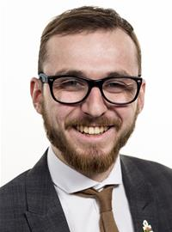
Prosiect Pleidlais Project Vote
Etholiad go iawn
Real election
Notes:
Prosiect Pleidlais / Project Vote – Jack Sargeant
Etholiad go iawn / Real election – Jack Sargeant

Slide 21
Trafodaeth | Discussion
- Meddyliwch am 3 pheth rydych ch wedi dysgu trwy wneud yr etholiad paralel
- Pa weithgareddau wnaethoch chi fwynhau mwyaf?
- Meddyliwch am un ffordd mae’r profiad wedi effeithio arnoch chi neu ddatblygu eich barn
- Oedd yna wahaniaeth yn eich ardal chi rhwng y canlyniadau paralel, a’r canlyniadau swyddogol/go iawn? Pam ydych chi’n meddwl?
- Ydych chi’n meddwl bod y pandemig wedi cael effaith ar faint mae pobl yn ei wybod am wleidyddiaeth Cymru?
- Name three things you’ve learned through this Parallel Election
- Which activities did you enjoy the most and why?
- Name one way this experience has changed you or developed opinions
- Was there a difference between the Project Vote results and the real election results? Why do you think that is?
- Do you think that the coronavirus pandemic had an impact on how much people know about Welsh politics?

Slide 22
Camau nesaf | Next steps
Eich aelod o’r Senedd – Mae eich aelod o’r Senedd yna i’ch cynrychioli chi yn y Senedd. Cofiwch mae gennych chi 5 aelod sy’n eich cynrychioli chi – yr un a gafodd ei ethol gan eich etholaeth, a’r 4 cafodd eu hethol gan eich rhanbarth (gweler diwedd y cyflwyniad)
Cofiwch gysylltu gyda nhw os:
- Rydych chi eisiau cyngor neu wybodaeth am rywbeth sydd gan y Senedd pwerau drosto
- Rydych chi eisiau gofyn iddyn nhw beth fydden nhw’n ei wneud i wella eich ardal i bobl ifanc
- Mae gennych chi ddiddordeb mewn mater lleol ac eisiau gwybod mwy
Paid ag ofni cysylltu gyda nhw. Maen nhw’n derbyn cannoedd o ebyst a galwadau ffôn pob blwyddyn ar bob math o fater – eu swydd nhw yw gwrando ar eich pryderon.
Your MS - your MS is there to represent you in the Senedd. Remember you have 5 members of the Senedd representing you – the 1 who was voted in by your constituency, and the 4 who were voted in by your region (see the end of the powerpoint).
Remember to get in touch with them if:
- you want advice or information on something that the Welsh Parliament has control over
- you want to ask them what they will be doing to make your local area better for young people
- there is an issue in your local area that you're interested in
Don't be shy about getting in touch with them. They receive hundreds of emails and phone calls every year on all sorts of issues - it's their job to listen to your concerns.

Slide 23
Camau nesaf | Next steps
Gwneud Gwahaniaeth
Os oes gennych chi ddiddordeb mewn creu newid i faterion sy’n bwysig i chi, yn yr ysgol neu yn eich cymuned leol, ewch i’n hadnodd Gwneud Gwahaniaeth. A plis cysylltwch os oes unrhyw gwestiwn gyda chi amdano fe.
Cofrestru i bleidleisio
Cofiwch gallwch gofrestru i bleidleisio os ydych chi’n 14+ oed.
Ewch at y gwefan yma i wneud hyn.
Byddwch chi wedyn yn gallu pleidleisio mewn etholiadau Senedd, ac etholiadau eich cyngor lleol, pan rydych chi’n troi’n 16.
Making a difference
If you're interested in making a difference to the issues that matter to you, whether it's in school or your local community, take a look at our Make a Difference resource. And please get in touch with us if you have any questions about it.
Registering to vote
Remember you can register to vote if you are aged 14+
Go to this website to do this.
You will then be able to vote in Senedd elections, and your local council elections, when you turn 16.

Slide 24
Arfon

Slide 25
Canlyniadau Prosiect Pleidlais | Project Vote Results
Plaid | Party | Ymgeiswyr | Candidates | Pleidleisiau | Votes | %
Annibynnol / Independent | Martin Bristow | 5 | 3%
Democratiaid Rhyddfrydol / Liberal Democrats | Calum Davies | 4 | 2%
Plaid Cymru | Siân Gwenllian | 129 | 71%
Reform UK | Andrew Haigh | 9 | 5%
Llafur / Labour | Iwan Wyn Jones | 28 | 15%
Ceidwadwyr / Conservatives | Tony Thomas | 6 | 3%

Slide 26
Canlyniad Senedd go iawn | Real Senedd result
Plaid | Party | Ymgeiswyr | Candidates | Pleidleisiau | Votes | %
Annibynnol / Independent | Martin Bristow | 82 | 0.4%
Democratiaid Rhyddfrydol / Liberal Democrats | Calum Davies | 642 | 3%
Plaid Cymru | Siân Gwenllian | 13,760 | 63.3%
Reform UK | Andrew Haigh | 350 | 1.6%
Llafur / Labour | Iwan Wyn Jones | 5,108 | 23.5%
Ceidwadwyr / Conservatives | Tony Thomas | 1,806 | 8.3%

Slide 27
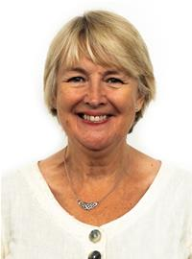
Prosiect Pleidlais Project Vote
Etholiad go iawn
Real election
Notes:
Prosiect Pleidlais / Project Vote – Siân Gwenllian
Etholiad go iawn / Real election – Siân Gwenllian

Slide 28
Trafodaeth | Discussion
- Meddyliwch am 3 pheth rydych ch wedi dysgu trwy wneud yr etholiad paralel
- Pa weithgareddau wnaethoch chi fwynhau mwyaf?
- Meddyliwch am un ffordd mae’r profiad wedi effeithio arnoch chi neu ddatblygu eich barn
- Oedd yna wahaniaeth yn eich ardal chi rhwng y canlyniadau paralel, a’r canlyniadau swyddogol/go iawn? Pam ydych chi’n meddwl?
- Ydych chi’n meddwl bod y pandemig wedi cael effaith ar faint mae pobl yn ei wybod am wleidyddiaeth Cymru?
- Name three things you’ve learned through this Parallel Election
- Which activities did you enjoy the most and why?
- Name one way this experience has changed you or developed opinions
- Was there a difference between the Project Vote results and the real election results? Why do you think that is?
- Do you think that the coronavirus pandemic had an impact on how much people know about Welsh politics?

Slide 29
Camau nesaf | Next steps
Eich aelod o’r Senedd – Mae eich aelod o’r Senedd yna i’ch cynrychioli chi yn y Senedd. Cofiwch mae gennych chi 5 aelod sy’n eich cynrychioli chi – yr un a gafodd ei ethol gan eich etholaeth, a’r 4 cafodd eu hethol gan eich rhanbarth (gweler diwedd y cyflwyniad)
Cofiwch gysylltu gyda nhw os:
- Rydych chi eisiau cyngor neu wybodaeth am rywbeth sydd gan y Senedd pwerau drosto
- Rydych chi eisiau gofyn iddyn nhw beth fydden nhw’n ei wneud i wella eich ardal i bobl ifanc
- Mae gennych chi ddiddordeb mewn mater lleol ac eisiau gwybod mwy
Paid ag ofni cysylltu gyda nhw. Maen nhw’n derbyn cannoedd o ebyst a galwadau ffôn pob blwyddyn ar bob math o fater – eu swydd nhw yw gwrando ar eich pryderon.
Your MS - your MS is there to represent you in the Senedd. Remember you have 5 members of the Senedd representing you – the 1 who was voted in by your constituency, and the 4 who were voted in by your region (see the end of the powerpoint).
Remember to get in touch with them if:
- you want advice or information on something that the Welsh Parliament has control over
- you want to ask them what they will be doing to make your local area better for young people
- there is an issue in your local area that you're interested in
Don't be shy about getting in touch with them. They receive hundreds of emails and phone calls every year on all sorts of issues - it's their job to listen to your concerns.

Slide 30
Camau nesaf | Next steps
Gwneud Gwahaniaeth
Os oes gennych chi ddiddordeb mewn creu newid i faterion sy’n bwysig i chi, yn yr ysgol neu yn eich cymuned leol, ewch i’n hadnodd Gwneud Gwahaniaeth. A plis cysylltwch os oes unrhyw gwestiwn gyda chi amdano fe.
Cofrestru i bleidleisio
Cofiwch gallwch gofrestru i bleidleisio os ydych chi’n 14+ oed.
Ewch at y gwefan yma i wneud hyn.
Byddwch chi wedyn yn gallu pleidleisio mewn etholiadau Senedd, ac etholiadau eich cyngor lleol, pan rydych chi’n troi’n 16.
Making a difference
If you're interested in making a difference to the issues that matter to you, whether it's in school or your local community, take a look at our Make a Difference resource. And please get in touch with us if you have any questions about it.
Registering to vote
Remember you can register to vote if you are aged 14+
Go to this website to do this.
You will then be able to vote in Senedd elections, and your local council elections, when you turn 16.

Slide 31
De Clwyd Clwyd South

Slide 32
Canlyniadau Prosiect Pleidlais | Project Vote Results
Plaid | Party | Ymgeiswyr | Candidates | Pleidleisiau | Votes | %
UKIP | Jeanette Barton | - | -
Democratiaid Rhyddfrydol / Liberal Democrats | Leena Farhat | - | -
Plaid Cymru | Llyr Gruffydd | 5 | 63%
Abolish the Welsh Assembly | Jonathon Harrington | - | -
Ceidwadwyr / Conservatives | Barbara Hughes | - | -
Reform UK | Mandy Jones | - | -
Llafur / Labour | Ken Skates | 3 | 38%

Slide 33
Canlyniad Senedd go iawn | Real Senedd result
Plaid | Party | Ymgeiswyr | Candidates | Pleidleisiau | Votes | %
UKIP | Jeanette Barton | 522 | 2.2%
Democratiaid Rhyddfrydol / Liberal Democrats | Leena Farhat | 730 | 3%
Plaid Cymru | Llyr Gruffydd | 4,094 | 16.9%
Abolish the Welsh Assembly | Jonathon Harrington | 599 | 2.5%
Ceidwadwyr / Conservatives | Barbara Hughes | 7,535 | 31.1%
Reform UK | Mandy Jones | 277 | 1.1%
Llafur / Labour | Ken Skates | 10,448 | 43.2%

Slide 34
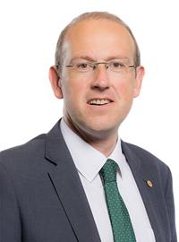
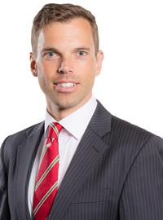
Prosiect Pleidlais Project Vote
Etholiad go iawn
Real election
Notes:
Prosiect Pleidlais / Project Vote – Llyr Gruffydd
Etholiad go iawn / Real election – Ken Skates

Slide 35
Trafodaeth | Discussion
- Meddyliwch am 3 pheth rydych ch wedi dysgu trwy wneud yr etholiad paralel
- Pa weithgareddau wnaethoch chi fwynhau mwyaf?
- Meddyliwch am un ffordd mae’r profiad wedi effeithio arnoch chi neu ddatblygu eich barn
- Oedd yna wahaniaeth yn eich ardal chi rhwng y canlyniadau paralel, a’r canlyniadau swyddogol/go iawn? Pam ydych chi’n meddwl?
- Ydych chi’n meddwl bod y pandemig wedi cael effaith ar faint mae pobl yn ei wybod am wleidyddiaeth Cymru?
- Name three things you’ve learned through this Parallel Election
- Which activities did you enjoy the most and why?
- Name one way this experience has changed you or developed opinions
- Was there a difference between the Project Vote results and the real election results? Why do you think that is?
- Do you think that the coronavirus pandemic had an impact on how much people know about Welsh politics?

Slide 36
Camau nesaf | Next steps
Eich aelod o’r Senedd – Mae eich aelod o’r Senedd yna i’ch cynrychioli chi yn y Senedd. Cofiwch mae gennych chi 5 aelod sy’n eich cynrychioli chi – yr un a gafodd ei ethol gan eich etholaeth, a’r 4 cafodd eu hethol gan eich rhanbarth (gweler diwedd y cyflwyniad)
Cofiwch gysylltu gyda nhw os:
- Rydych chi eisiau cyngor neu wybodaeth am rywbeth sydd gan y Senedd pwerau drosto
- Rydych chi eisiau gofyn iddyn nhw beth fydden nhw’n ei wneud i wella eich ardal i bobl ifanc
- Mae gennych chi ddiddordeb mewn mater lleol ac eisiau gwybod mwy
Paid ag ofni cysylltu gyda nhw. Maen nhw’n derbyn cannoedd o ebyst a galwadau ffôn pob blwyddyn ar bob math o fater – eu swydd nhw yw gwrando ar eich pryderon.
Your MS - your MS is there to represent you in the Senedd. Remember you have 5 members of the Senedd representing you – the 1 who was voted in by your constituency, and the 4 who were voted in by your region (see the end of the powerpoint).
Remember to get in touch with them if:
- you want advice or information on something that the Welsh Parliament has control over
- you want to ask them what they will be doing to make your local area better for young people
- there is an issue in your local area that you're interested in
Don't be shy about getting in touch with them. They receive hundreds of emails and phone calls every year on all sorts of issues - it's their job to listen to your concerns.

Slide 37
Camau nesaf | Next steps
Gwneud Gwahaniaeth
Os oes gennych chi ddiddordeb mewn creu newid i faterion sy’n bwysig i chi, yn yr ysgol neu yn eich cymuned leol, ewch i’n hadnodd Gwneud Gwahaniaeth. A plis cysylltwch os oes unrhyw gwestiwn gyda chi amdano fe.
Cofrestru i bleidleisio
Cofiwch gallwch gofrestru i bleidleisio os ydych chi’n 14+ oed.
Ewch at y gwefan yma i wneud hyn.
Byddwch chi wedyn yn gallu pleidleisio mewn etholiadau Senedd, ac etholiadau eich cyngor lleol, pan rydych chi’n troi’n 16.
Making a difference
If you're interested in making a difference to the issues that matter to you, whether it's in school or your local community, take a look at our Make a Difference resource. And please get in touch with us if you have any questions about it.
Registering to vote
Remember you can register to vote if you are aged 14+
Go to this website to do this.
You will then be able to vote in Senedd elections, and your local council elections, when you turn 16.

Slide 38
Gorllewin Clwyd Clwyd West

Slide 39
Canlyniad Senedd go iawn | Real Senedd result
Plaid | Party | Ymgeiswyr | Candidates | Pleidleisiau | Votes | %
Ceidwadwyr / Conservatives | Darren Millar | 11,839 | 41.7%
Llafur / Labour | Joshua Hurst | 8,154 | 28.7%
Plaid Cymru | Elin Walker Jones | 5,609 | 19.8%
Democratiaid Rhyddfrydol / Liberal Democrats | David Wilkins | 1,158 | 4.1%
UKIP | Jeanie Barton | 520 | 1.8%
Abolish the Welsh Assembly | Euan McGivern | 502 | 1.8%
Reform | Clare Eno | 304 | 1.1%
Gwlad | Rhydian Hughes | 277 | 1.0%

Slide 40
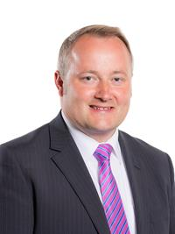
Prosiect Pleidlais Project Vote
Etholiad go iawn
Real election
Notes:
Prosiect Pleidlais / Project Vote – No Result
Etholiad go iawn / Real election – Darren Millar

Slide 41
Delyn

Slide 42
Canlyniadau Prosiect Pleidlais | Project Vote Results
Plaid | Party | Ymgeiswyr | Candidates | Pleidleisiau | Votes | %
Llafur / Labour | Hannah Blythyn | 8 | 50%
UKIP | Mary Davies | - | -
Reform UK | Aiden Down | - | -
Ceidwadwyr / Conservatives | Mark Isherwood | 3 | 19%
Democratiaid Rhyddfrydol / Liberal Democrats | Andrew Parkhurst | 2 | 13%
Plaid Cymru | Paul Rowlinson | 3 | 19%
Gwlad | Anthony Williams | - | -

Slide 43
Canlyniad Senedd go iawn | Real Senedd result
Plaid | Party | Ymgeiswyr | Candidates | Pleidleisiau | Votes | %
Llafur / Labour | Hannah Blythyn | 12,846 | 48.6%
UKIP | Mary Davies | 862 | 3.3%
Reform UK | Aiden Down | 297 | 1.1%
Ceidwadwyr / Conservatives | Mark Isherwood | 9,135 | 34.5%
Democratiaid Rhyddfrydol / Liberal Democrats | Andrew Parkhurst | 1,094 | 4.1%
Plaid Cymru | Paul Rowlinson | 2,097 | 7.9%
Gwlad | Anthony Williams | 112 | 0.4%

Slide 44
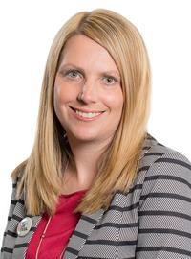
Prosiect Pleidlais Project Vote
Etholiad go iawn
Real election
Notes:
Prosiect Pleidlais / Project Vote – Hannah Blythyn
Etholiad go iawn / Real election – Hannah Blythyn

Slide 45
Trafodaeth | Discussion
- Meddyliwch am 3 pheth rydych ch wedi dysgu trwy wneud yr etholiad paralel
- Pa weithgareddau wnaethoch chi fwynhau mwyaf?
- Meddyliwch am un ffordd mae’r profiad wedi effeithio arnoch chi neu ddatblygu eich barn
- Oedd yna wahaniaeth yn eich ardal chi rhwng y canlyniadau paralel, a’r canlyniadau swyddogol/go iawn? Pam ydych chi’n meddwl?
- Ydych chi’n meddwl bod y pandemig wedi cael effaith ar faint mae pobl yn ei wybod am wleidyddiaeth Cymru?
- Name three things you’ve learned through this Parallel Election
- Which activities did you enjoy the most and why?
- Name one way this experience has changed you or developed opinions
- Was there a difference between the Project Vote results and the real election results? Why do you think that is?
- Do you think that the coronavirus pandemic had an impact on how much people know about Welsh politics?

Slide 46
Camau nesaf | Next steps
Eich aelod o’r Senedd – Mae eich aelod o’r Senedd yna i’ch cynrychioli chi yn y Senedd. Cofiwch mae gennych chi 5 aelod sy’n eich cynrychioli chi – yr un a gafodd ei ethol gan eich etholaeth, a’r 4 cafodd eu hethol gan eich rhanbarth (gweler diwedd y cyflwyniad)
Cofiwch gysylltu gyda nhw os:
- Rydych chi eisiau cyngor neu wybodaeth am rywbeth sydd gan y Senedd pwerau drosto
- Rydych chi eisiau gofyn iddyn nhw beth fydden nhw’n ei wneud i wella eich ardal i bobl ifanc
- Mae gennych chi ddiddordeb mewn mater lleol ac eisiau gwybod mwy
Paid ag ofni cysylltu gyda nhw. Maen nhw’n derbyn cannoedd o ebyst a galwadau ffôn pob blwyddyn ar bob math o fater – eu swydd nhw yw gwrando ar eich pryderon.
Your MS - your MS is there to represent you in the Senedd. Remember you have 5 members of the Senedd representing you – the 1 who was voted in by your constituency, and the 4 who were voted in by your region (see the end of the powerpoint).
Remember to get in touch with them if:
- you want advice or information on something that the Welsh Parliament has control over
- you want to ask them what they will be doing to make your local area better for young people
- there is an issue in your local area that you're interested in
Don't be shy about getting in touch with them. They receive hundreds of emails and phone calls every year on all sorts of issues - it's their job to listen to your concerns.

Slide 47
Camau nesaf | Next steps
Gwneud Gwahaniaeth
Os oes gennych chi ddiddordeb mewn creu newid i faterion sy’n bwysig i chi, yn yr ysgol neu yn eich cymuned leol, ewch i’n hadnodd Gwneud Gwahaniaeth. A plis cysylltwch os oes unrhyw gwestiwn gyda chi amdano fe.
Cofrestru i bleidleisio
Cofiwch gallwch gofrestru i bleidleisio os ydych chi’n 14+ oed.
Ewch at y gwefan yma i wneud hyn.
Byddwch chi wedyn yn gallu pleidleisio mewn etholiadau Senedd, ac etholiadau eich cyngor lleol, pan rydych chi’n troi’n 16.
Making a difference
If you're interested in making a difference to the issues that matter to you, whether it's in school or your local community, take a look at our Make a Difference resource. And please get in touch with us if you have any questions about it.
Registering to vote
Remember you can register to vote if you are aged 14+
Go to this website to do this.
You will then be able to vote in Senedd elections, and your local council elections, when you turn 16.

Slide 48
Dyffryn Clwyd Vale of Clwyd

Slide 49
Canlyniadau Prosiect Pleidlais | Project Vote Results
Plaid | Party | Ymgeiswyr | Candidates | Pleidleisiau | Votes | %
Reform UK | Peter Dain | 14 | 5%
Ceidwadwyr / Conservatives | Gareth Lloyd Davies | 57 | 22%
Llafur / Labour | Jason McLellan | 43 | 17%
Democratiaid Rhyddfrydol / Liberal Democrats | Gavin Scott | 33 | 13%
Plaid Cymru | Glenn Swingler | 101 | 39%
Annibynnol / Independent | David Thomas | 12 | 5%

Slide 50
Canlyniad Senedd go iawn | Real Senedd result
Plaid | Party | Ymgeiswyr | Candidates | Pleidleisiau | Votes | %
Reform UK | Peter Dain | 552 | 2.1%
Ceidwadwyr / Conservatives | Gareth Lloyd Davies | 10,792 | 41.4%
Llafur / Labour | Jason McLellan | 10,426 | 40%
Democratiaid Rhyddfrydol / Liberal Democrats | Gavin Scott | 782 | 3%
Plaid Cymru | Glenn Swingler | 2,972 | 11.4%
Annibynnol / Independent | David Thomas | 529 | 2%

Slide 51
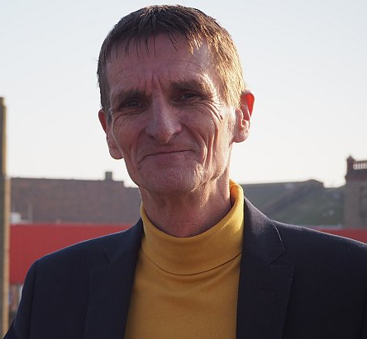
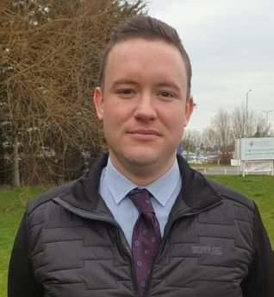
Prosiect Pleidlais Project Vote
Etholiad go iawn
Real election
Notes:
Prosiect Pleidlais / Project Vote – Glenn Swingler
Etholiad go iawn / Real election – Gareth Lloyd Davies

Slide 52
Trafodaeth | Discussion
- Meddyliwch am 3 pheth rydych ch wedi dysgu trwy wneud yr etholiad paralel
- Pa weithgareddau wnaethoch chi fwynhau mwyaf?
- Meddyliwch am un ffordd mae’r profiad wedi effeithio arnoch chi neu ddatblygu eich barn
- Oedd yna wahaniaeth yn eich ardal chi rhwng y canlyniadau paralel, a’r canlyniadau swyddogol/go iawn? Pam ydych chi’n meddwl?
- Ydych chi’n meddwl bod y pandemig wedi cael effaith ar faint mae pobl yn ei wybod am wleidyddiaeth Cymru?
- Name three things you’ve learned through this Parallel Election
- Which activities did you enjoy the most and why?
- Name one way this experience has changed you or developed opinions
- Was there a difference between the Project Vote results and the real election results? Why do you think that is?
- Do you think that the coronavirus pandemic had an impact on how much people know about Welsh politics?

Slide 53
Camau nesaf | Next steps
Eich aelod o’r Senedd – Mae eich aelod o’r Senedd yna i’ch cynrychioli chi yn y Senedd. Cofiwch mae gennych chi 5 aelod sy’n eich cynrychioli chi – yr un a gafodd ei ethol gan eich etholaeth, a’r 4 cafodd eu hethol gan eich rhanbarth (gweler diwedd y cyflwyniad)
Cofiwch gysylltu gyda nhw os:
- Rydych chi eisiau cyngor neu wybodaeth am rywbeth sydd gan y Senedd pwerau drosto
- Rydych chi eisiau gofyn iddyn nhw beth fydden nhw’n ei wneud i wella eich ardal i bobl ifanc
- Mae gennych chi ddiddordeb mewn mater lleol ac eisiau gwybod mwy
Paid ag ofni cysylltu gyda nhw. Maen nhw’n derbyn cannoedd o ebyst a galwadau ffôn pob blwyddyn ar bob math o fater – eu swydd nhw yw gwrando ar eich pryderon.
Your MS - your MS is there to represent you in the Senedd. Remember you have 5 members of the Senedd representing you – the 1 who was voted in by your constituency, and the 4 who were voted in by your region (see the end of the powerpoint).
Remember to get in touch with them if:
- you want advice or information on something that the Welsh Parliament has control over
- you want to ask them what they will be doing to make your local area better for young people
- there is an issue in your local area that you're interested in
Don't be shy about getting in touch with them. They receive hundreds of emails and phone calls every year on all sorts of issues - it's their job to listen to your concerns.

Slide 54
Camau nesaf | Next steps
Gwneud Gwahaniaeth
Os oes gennych chi ddiddordeb mewn creu newid i faterion sy’n bwysig i chi, yn yr ysgol neu yn eich cymuned leol, ewch i’n hadnodd Gwneud Gwahaniaeth. A plis cysylltwch os oes unrhyw gwestiwn gyda chi amdano fe.
Cofrestru i bleidleisio
Cofiwch gallwch gofrestru i bleidleisio os ydych chi’n 14+ oed.
Ewch at y gwefan yma i wneud hyn.
Byddwch chi wedyn yn gallu pleidleisio mewn etholiadau Senedd, ac etholiadau eich cyngor lleol, pan rydych chi’n troi’n 16.
Making a difference
If you're interested in making a difference to the issues that matter to you, whether it's in school or your local community, take a look at our Make a Difference resource. And please get in touch with us if you have any questions about it.
Registering to vote
Remember you can register to vote if you are aged 14+
Go to this website to do this.
You will then be able to vote in Senedd elections, and your local council elections, when you turn 16.

Slide 55
Wrecsam Wrexham

Slide 56
Canlyniadau Prosiect Pleidlais | Project Vote Results
Plaid | Party | Ymgeiswyr | Candidates | Pleidleisiau | Votes | %
Abolish the Welsh Assembly | Paul Ashton | 21 | 5%
Reform UK | Charles Dodman | 27 | 7%
Llafur / Labour | Lesley Griffiths | 133 | 33%
Plaid Cymru | Carrie Harper | 139 | 34%
Ceidwadwyr / Conservatives | Jeremy Kent | 33 | 8%
Gwlad | Aaron Norton | 17 | 4%
UKIP | Sebastian Ross | 8 | 2%
Democratiaid Rhyddfrydol / Liberal Democrats | Tim Sly | 30 | 7%

Slide 57
Canlyniad Senedd go iawn | Real Senedd result
Plaid | Party | Ymgeiswyr | Candidates | Pleidleisiau | Votes | %
Abolish the Welsh Assembly | Paul Ashton | 790 | 3.5%
Reform UK | Charles Dodman | 187 | 0.8%
Llafur / Labour | Lesley Griffiths | 8,452 | 37.4%
Plaid Cymru | Carrie Harper | 4,832 | 21.4%
Ceidwadwyr / Conservatives | Jeremy Kent | 7,102 | 31.4%
Gwlad | Aaron Norton | 110 | 0.5%
UKIP | Sebastian Ross | 378 | 1.7%
Democratiaid Rhyddfrydol / Liberal Democrats | Tim Sly | 755 | 3.3%

Slide 58
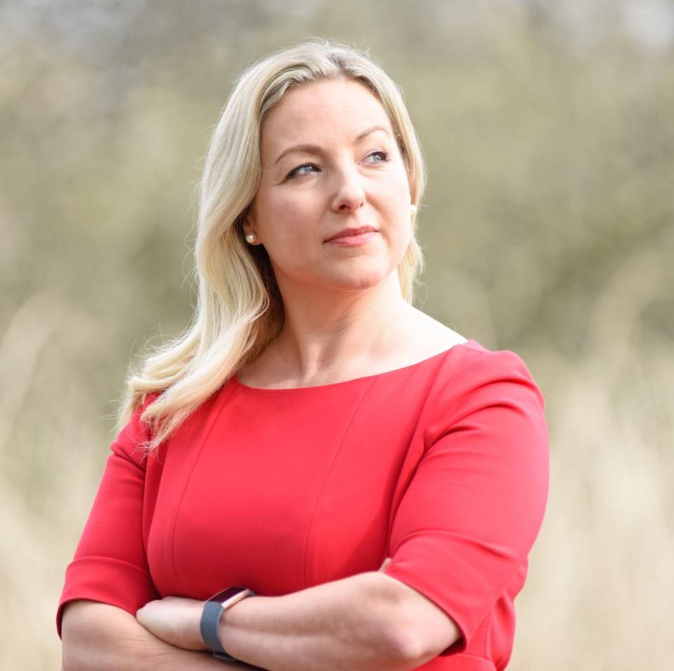
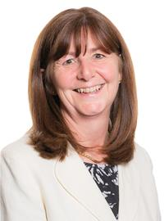
Prosiect Pleidlais Project Vote
Etholiad go iawn
Real election
Notes:
Prosiect Pleidlais / Project Vote – Carrie Harper
Etholiad go iawn / Real election – Lesley Griffiths

Slide 59
Trafodaeth | Discussion
- Meddyliwch am 3 pheth rydych ch wedi dysgu trwy wneud yr etholiad paralel
- Pa weithgareddau wnaethoch chi fwynhau mwyaf?
- Meddyliwch am un ffordd mae’r profiad wedi effeithio arnoch chi neu ddatblygu eich barn
- Oedd yna wahaniaeth yn eich ardal chi rhwng y canlyniadau paralel, a’r canlyniadau swyddogol/go iawn? Pam ydych chi’n meddwl?
- Ydych chi’n meddwl bod y pandemig wedi cael effaith ar faint mae pobl yn ei wybod am wleidyddiaeth Cymru?
- Name three things you’ve learned through this Parallel Election
- Which activities did you enjoy the most and why?
- Name one way this experience has changed you or developed opinions
- Was there a difference between the Project Vote results and the real election results? Why do you think that is?
- Do you think that the coronavirus pandemic had an impact on how much people know about Welsh politics?

Slide 60
Camau nesaf | Next steps
Eich aelod o’r Senedd – Mae eich aelod o’r Senedd yna i’ch cynrychioli chi yn y Senedd. Cofiwch mae gennych chi 5 aelod sy’n eich cynrychioli chi – yr un a gafodd ei ethol gan eich etholaeth, a’r 4 cafodd eu hethol gan eich rhanbarth (gweler diwedd y cyflwyniad)
Cofiwch gysylltu gyda nhw os:
- Rydych chi eisiau cyngor neu wybodaeth am rywbeth sydd gan y Senedd pwerau drosto
- Rydych chi eisiau gofyn iddyn nhw beth fydden nhw’n ei wneud i wella eich ardal i bobl ifanc
- Mae gennych chi ddiddordeb mewn mater lleol ac eisiau gwybod mwy
Paid ag ofni cysylltu gyda nhw. Maen nhw’n derbyn cannoedd o ebyst a galwadau ffôn pob blwyddyn ar bob math o fater – eu swydd nhw yw gwrando ar eich pryderon.
Your MS - your MS is there to represent you in the Senedd. Remember you have 5 members of the Senedd representing you – the 1 who was voted in by your constituency, and the 4 who were voted in by your region (see the end of the powerpoint).
Remember to get in touch with them if:
- you want advice or information on something that the Welsh Parliament has control over
- you want to ask them what they will be doing to make your local area better for young people
- there is an issue in your local area that you're interested in
Don't be shy about getting in touch with them. They receive hundreds of emails and phone calls every year on all sorts of issues - it's their job to listen to your concerns.

Slide 61
Camau nesaf | Next steps
Gwneud Gwahaniaeth
Os oes gennych chi ddiddordeb mewn creu newid i faterion sy’n bwysig i chi, yn yr ysgol neu yn eich cymuned leol, ewch i’n hadnodd Gwneud Gwahaniaeth. A plis cysylltwch os oes unrhyw gwestiwn gyda chi amdano fe.
Cofrestru i bleidleisio
Cofiwch gallwch gofrestru i bleidleisio os ydych chi’n 14+ oed.
Ewch at y gwefan yma i wneud hyn.
Byddwch chi wedyn yn gallu pleidleisio mewn etholiadau Senedd, ac etholiadau eich cyngor lleol, pan rydych chi’n troi’n 16.
Making a difference
If you're interested in making a difference to the issues that matter to you, whether it's in school or your local community, take a look at our Make a Difference resource. And please get in touch with us if you have any questions about it.
Registering to vote
Remember you can register to vote if you are aged 14+
Go to this website to do this.
You will then be able to vote in Senedd elections, and your local council elections, when you turn 16.

Slide 62
Ynys Môn Anglesey

Slide 63
Canlyniadau Prosiect Pleidlais | Project Vote Results
Plaid | Party | Ymgeiswyr | Candidates | Pleidleisiau | Votes | %
Plaid Cymru | Rhun ap Iorwerth | 58 | 72%
Llafur / Labour | Samantha Egelstaff | 13 | 16%
Ceidwadwyr / Conservatives | Lyn Hudson | 7 | 9%
Reform UK | Emmett Jenner | - | -
Democratiaid Rhyddfrydol / Liberal Democrats | Chris Jones | 3 | 4%

Slide 64
Canlyniad Senedd go iawn | Real Senedd result
Plaid | Party | Ymgeiswyr | Candidates | Pleidleisiau | Votes | %
Plaid Cymru | Rhun ap Iorwerth | 15,506 | 55.9%
Llafur / Labour | Samantha Egelstaff | 5,300 | 19.1%
Ceidwadwyr / Conservatives | Lyn Hudson | 5,689 | 20.5%
Reform UK | Emmett Jenner | 692 | 2.5%
Democratiaid Rhyddfrydol / Liberal Democrats | Chris Jones | 547 | 2%

Slide 65
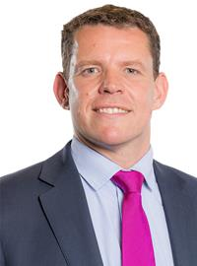
Prosiect Pleidlais Project Vote
Etholiad go iawn
Real election
Notes:
Prosiect Pleidlais / Project Vote – Rhun ap Iorwerth
Etholiad go iawn / Real election – Rhun ap Iorwerth

Slide 66
Trafodaeth | Discussion
- Meddyliwch am 3 pheth rydych ch wedi dysgu trwy wneud yr etholiad paralel
- Pa weithgareddau wnaethoch chi fwynhau mwyaf?
- Meddyliwch am un ffordd mae’r profiad wedi effeithio arnoch chi neu ddatblygu eich barn
- Oedd yna wahaniaeth yn eich ardal chi rhwng y canlyniadau paralel, a’r canlyniadau swyddogol/go iawn? Pam ydych chi’n meddwl?
- Ydych chi’n meddwl bod y pandemig wedi cael effaith ar faint mae pobl yn ei wybod am wleidyddiaeth Cymru?
- Name three things you’ve learned through this Parallel Election
- Which activities did you enjoy the most and why?
- Name one way this experience has changed you or developed opinions
- Was there a difference between the Project Vote results and the real election results? Why do you think that is?
- Do you think that the coronavirus pandemic had an impact on how much people know about Welsh politics?

Slide 67
Camau nesaf | Next steps
Eich aelod o’r Senedd – Mae eich aelod o’r Senedd yna i’ch cynrychioli chi yn y Senedd. Cofiwch mae gennych chi 5 aelod sy’n eich cynrychioli chi – yr un a gafodd ei ethol gan eich etholaeth, a’r 4 cafodd eu hethol gan eich rhanbarth (gweler diwedd y cyflwyniad)
Cofiwch gysylltu gyda nhw os:
- Rydych chi eisiau cyngor neu wybodaeth am rywbeth sydd gan y Senedd pwerau drosto
- Rydych chi eisiau gofyn iddyn nhw beth fydden nhw’n ei wneud i wella eich ardal i bobl ifanc
- Mae gennych chi ddiddordeb mewn mater lleol ac eisiau gwybod mwy
Paid ag ofni cysylltu gyda nhw. Maen nhw’n derbyn cannoedd o ebyst a galwadau ffôn pob blwyddyn ar bob math o fater – eu swydd nhw yw gwrando ar eich pryderon.
Your MS - your MS is there to represent you in the Senedd. Remember you have 5 members of the Senedd representing you – the 1 who was voted in by your constituency, and the 4 who were voted in by your region (see the end of the powerpoint).
Remember to get in touch with them if:
- you want advice or information on something that the Welsh Parliament has control over
- you want to ask them what they will be doing to make your local area better for young people
- there is an issue in your local area that you're interested in
Don't be shy about getting in touch with them. They receive hundreds of emails and phone calls every year on all sorts of issues - it's their job to listen to your concerns.

Slide 68
Camau nesaf | Next steps
Gwneud Gwahaniaeth
Os oes gennych chi ddiddordeb mewn creu newid i faterion sy’n bwysig i chi, yn yr ysgol neu yn eich cymuned leol, ewch i’n hadnodd Gwneud Gwahaniaeth. A plis cysylltwch os oes unrhyw gwestiwn gyda chi amdano fe.
Cofrestru i bleidleisio
Cofiwch gallwch gofrestru i bleidleisio os ydych chi’n 14+ oed.
Ewch at y gwefan yma i wneud hyn.
Byddwch chi wedyn yn gallu pleidleisio mewn etholiadau Senedd, ac etholiadau eich cyngor lleol, pan rydych chi’n troi’n 16.
Making a difference
If you're interested in making a difference to the issues that matter to you, whether it's in school or your local community, take a look at our Make a Difference resource. And please get in touch with us if you have any questions about it.
Registering to vote
Remember you can register to vote if you are aged 14+
Go to this website to do this.
You will then be able to vote in Senedd elections, and your local council elections, when you turn 16.

Slide 69
Rhanbarth Region

Slide 70
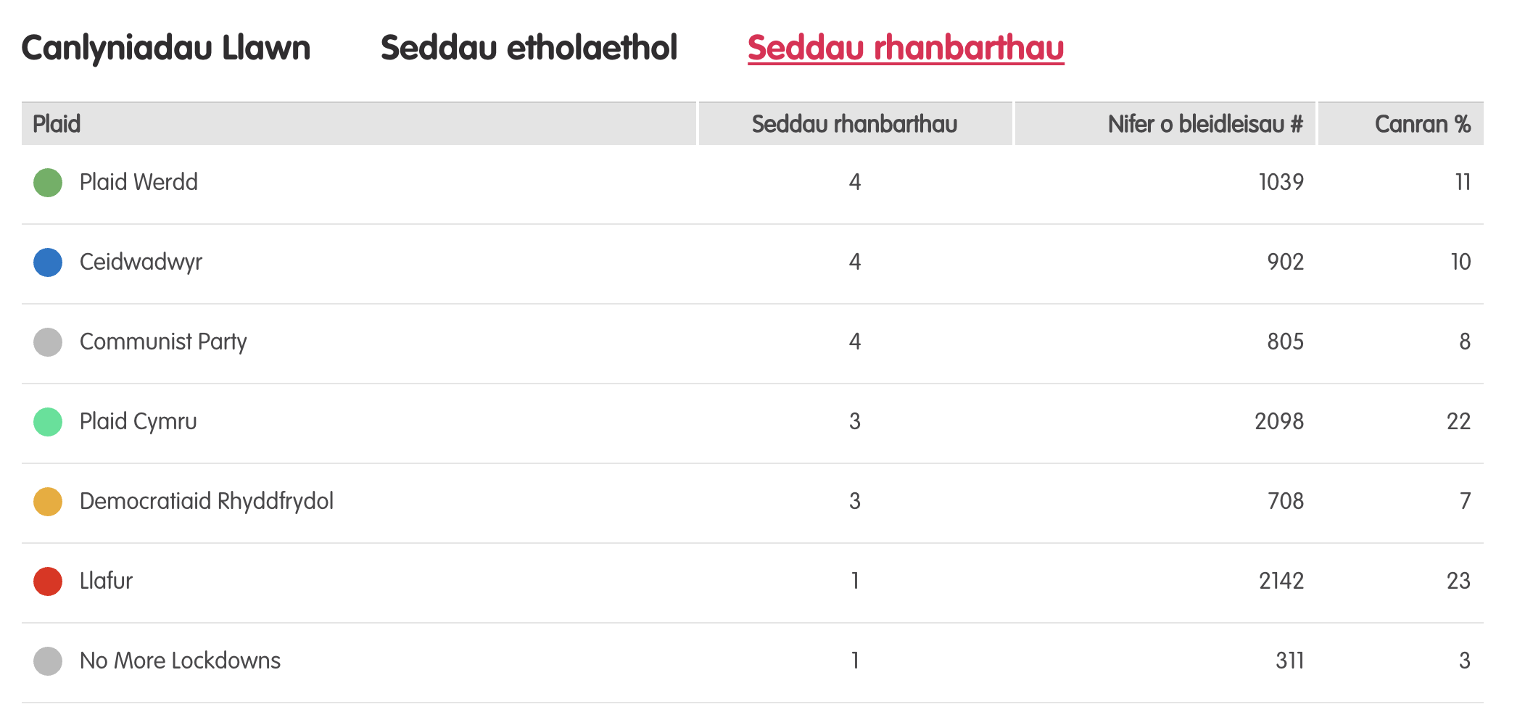
Canlyniadau etholiad paralel
Notes:
Tudalen wê canlyniadau’r Prosiect Pleidlais - https://prosiectpleidlais.cymru/canlyniadau/
Web page for Project Vote results – https://www.projectvote.wales/results/
Tudalen wê canlyniadau go iawn- https://www.bbc.co.uk/cymrufyw/pynciau/cvd627zw9rjt/etholiad-senedd-cymru-2021
Real results web page: https://www.bbc.co.uk/news/topics/cqwn14k92zwt/welsh-parliament-election-2021

Slide 71
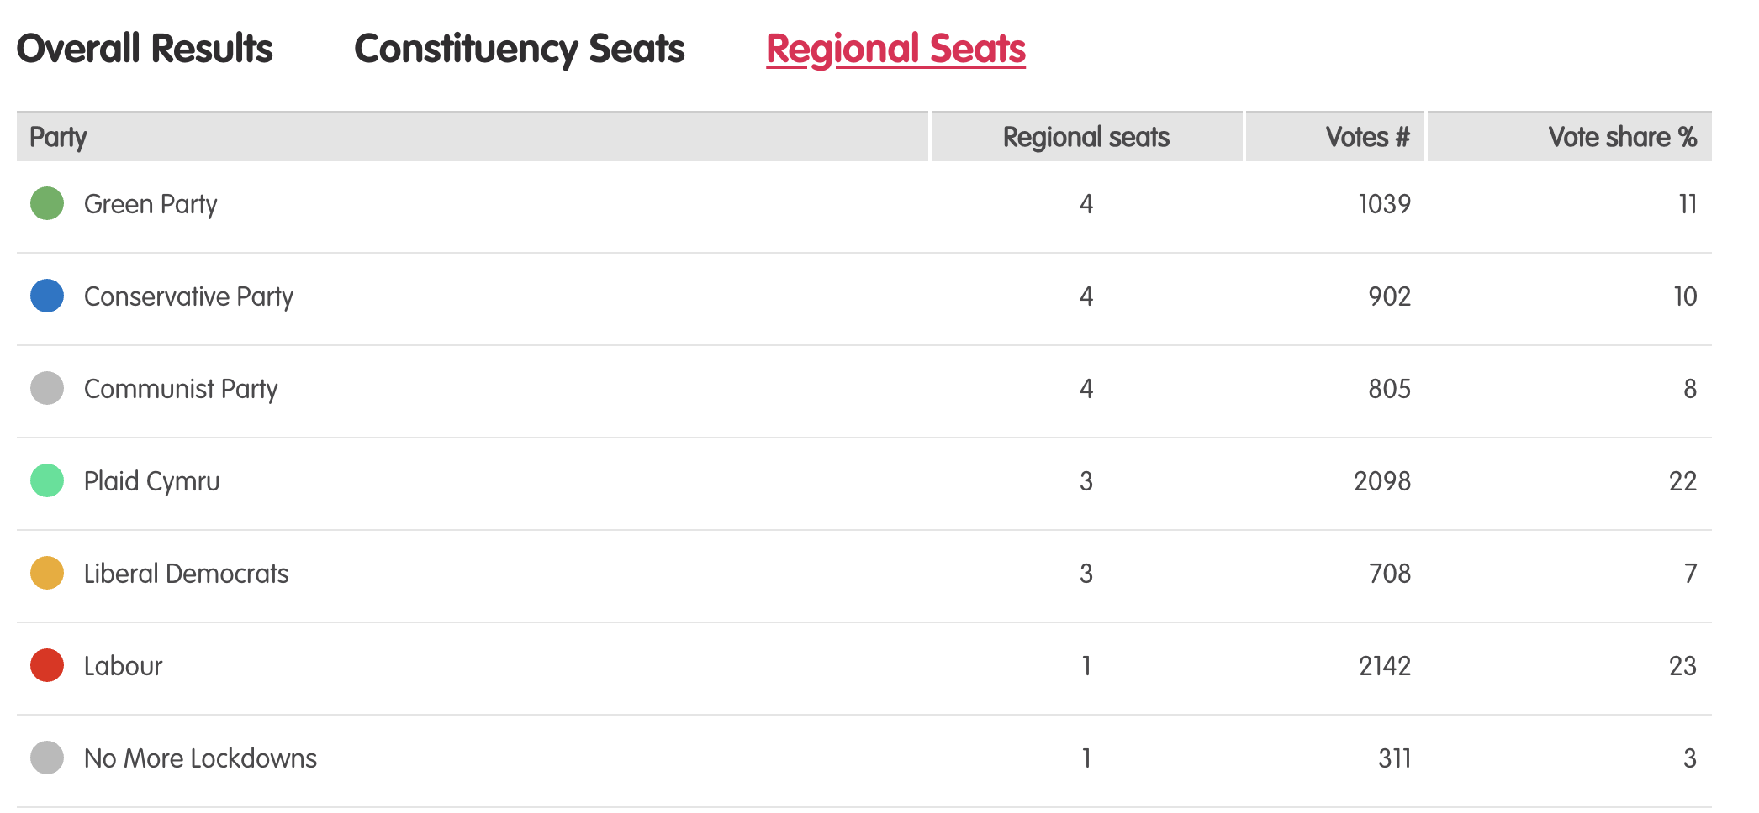
Results – Project vote parallel election
Notes:
Tudalen wê canlyniadau’r Prosiect Pleidlais - https://prosiectpleidlais.cymru/canlyniadau/
Web page for Project Vote results – https://www.projectvote.wales/results/
Tudalen wê canlyniadau go iawn- https://www.bbc.co.uk/cymrufyw/pynciau/cvd627zw9rjt/etholiad-senedd-cymru-2021
Real results web page: https://www.bbc.co.uk/news/topics/cqwn14k92zwt/welsh-parliament-election-2021

Slide 72
Canlyniadau etholiad swyddogol – Official election results
Plaid | Party | Seddau rhanbarthau | Regional seats | Nifer o bleidleisiau | Number of votes | Canran % | Vote share %
Llafur / Labour | 3 | 401,770 | 36.2%
Ceidwadwyr / Conservatives | 8 | 278,560 | 25.1%
Plaid Cymru | 8 | 230,161 | 20.7%
Plaid Werdd / Green Party | 0 | 48,714 | 4.4%
Democratiaid Rhyddfrydol / Liberal Democrats | 1 | 48,217 | 4.3%
Abolish the Welsh Assembly | 0 | 41,399 | 3.7%
Notes:
NB: the number and share of votes are for regional votes only.
We have included the top 6 parties only here

Slide 73
Gogledd Cymru North Wales

Slide 74
Prosiect Pleidlais Project Vote
Etholiad go iawn
Real election
Plaid / Party | Pleidleisiau / Votes | Seddau /Seats
Ceidwadwyr / Conservatives | 89 | 1
Plaid Werdd / Green Party | 74 | 1
Communist Party | 73 | 1
Llafur / Labour | 215 | 1
Plaid / Party | Pleidleisiau / Votes | Seddau /Seats
Ceidwadwyr / Conservatives | 67,544 | 2
Llafur / Labour | 73,120 | 1
Plaid Cymru | 53,950 | 1

Slide 75
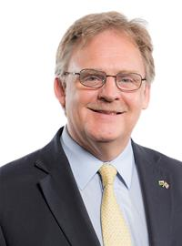
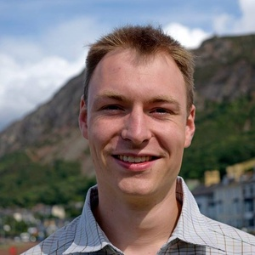
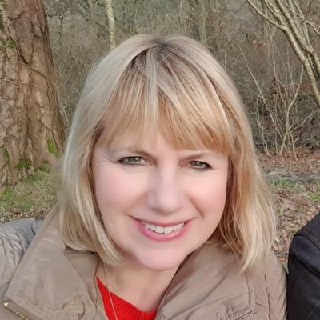
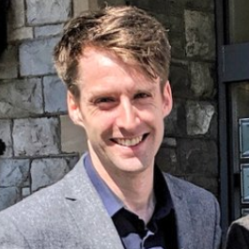
Prosiect Pleidlais Project Vote
Etholiad go iawn
Real election
Notes:
Prosiect Pleidlais / Project Vote (clockwise)
Mark Isherwood - Ceidwadwyr / Conservatives
Carrie Iolo Jones – Plaid Werdd / Green Party
Trevor Jones – Communist Party
Carolyn Thomas - Llafur / Labour
Etholiad go iawn / Real election (clockwise)
Llyr Gruffydd - Plaid Cymru
Mark Isherwood - Ceidwadwyr / Conservatives
Carolyn Thomas - Llafur / Labour
Sam Rowlands - Ceidwadwyr / Conservatives

