Slide 2
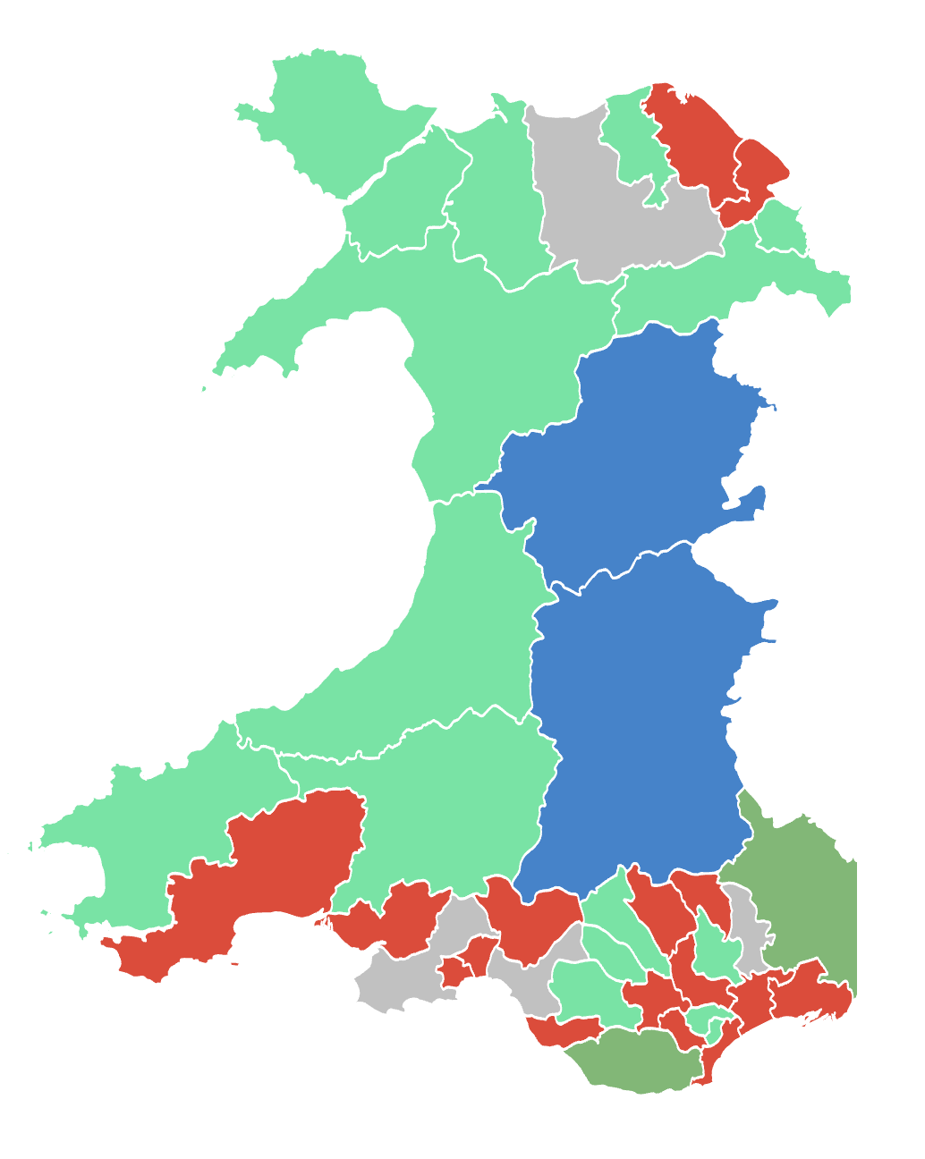
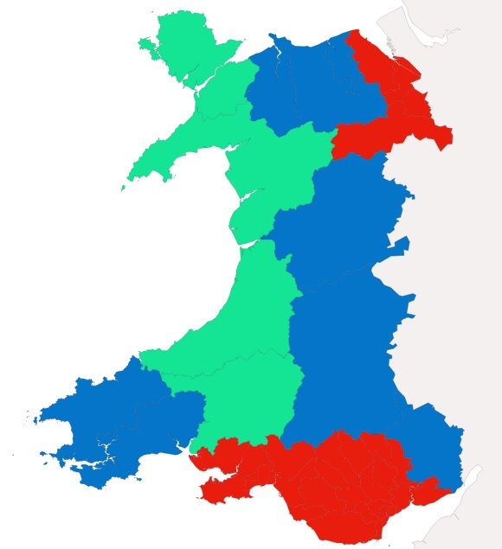
Prosiect Pleidlais | Project Vote
Etholiad go iawn | Real election
Notes:
Lliwiau’r pleidiau / Party colours
Ceidwadwyr / Conservatives – Glas / Blue
Llafur / Labour – Coch / Red
Plaid Cymru – Gwyrdd Golau / Light Green
Plaid Werdd / Green Party – Gwyrdd Tywyll / Dark Green
No results – Llwyd / Grey

Slide 3
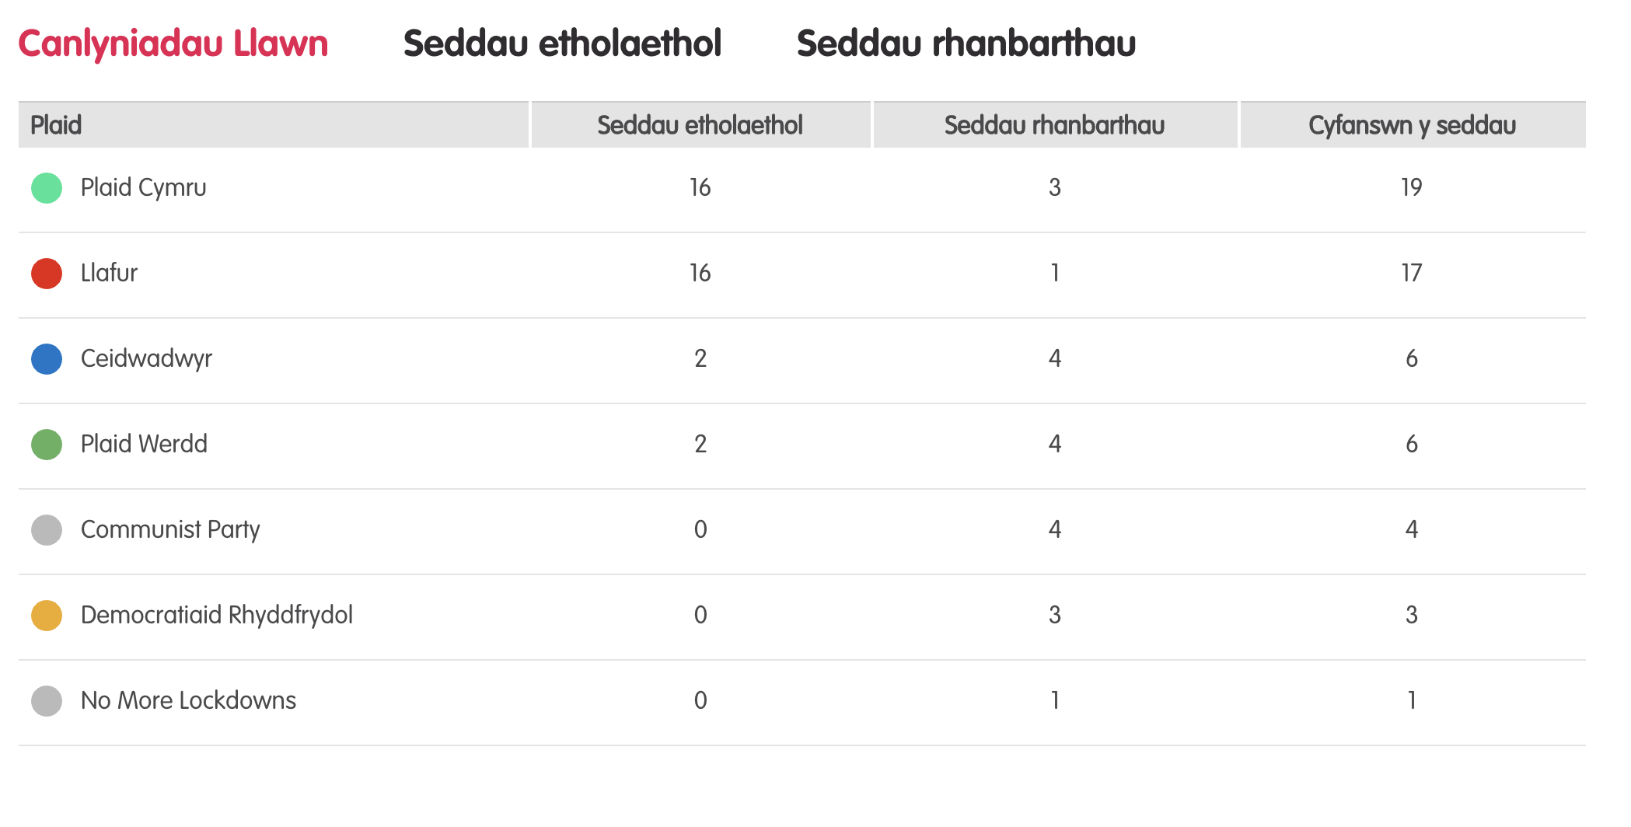
Canlyniadau llawn – Etholiad Paralel
Notes:
Tudalen wê canlyniadau’r Prosiect Pleidlais - https://prosiectpleidlais.cymru/canlyniadau/
Web page for Project Vote results – https://www.projectvote.wales/results/
Tudalen wê canlyniadau go iawn- https://www.bbc.co.uk/cymrufyw/pynciau/cvd627zw9rjt/etholiad-senedd-cymru-2021
Real results web page: https://www.bbc.co.uk/news/topics/cqwn14k92zwt/welsh-parliament-election-2021

Slide 4
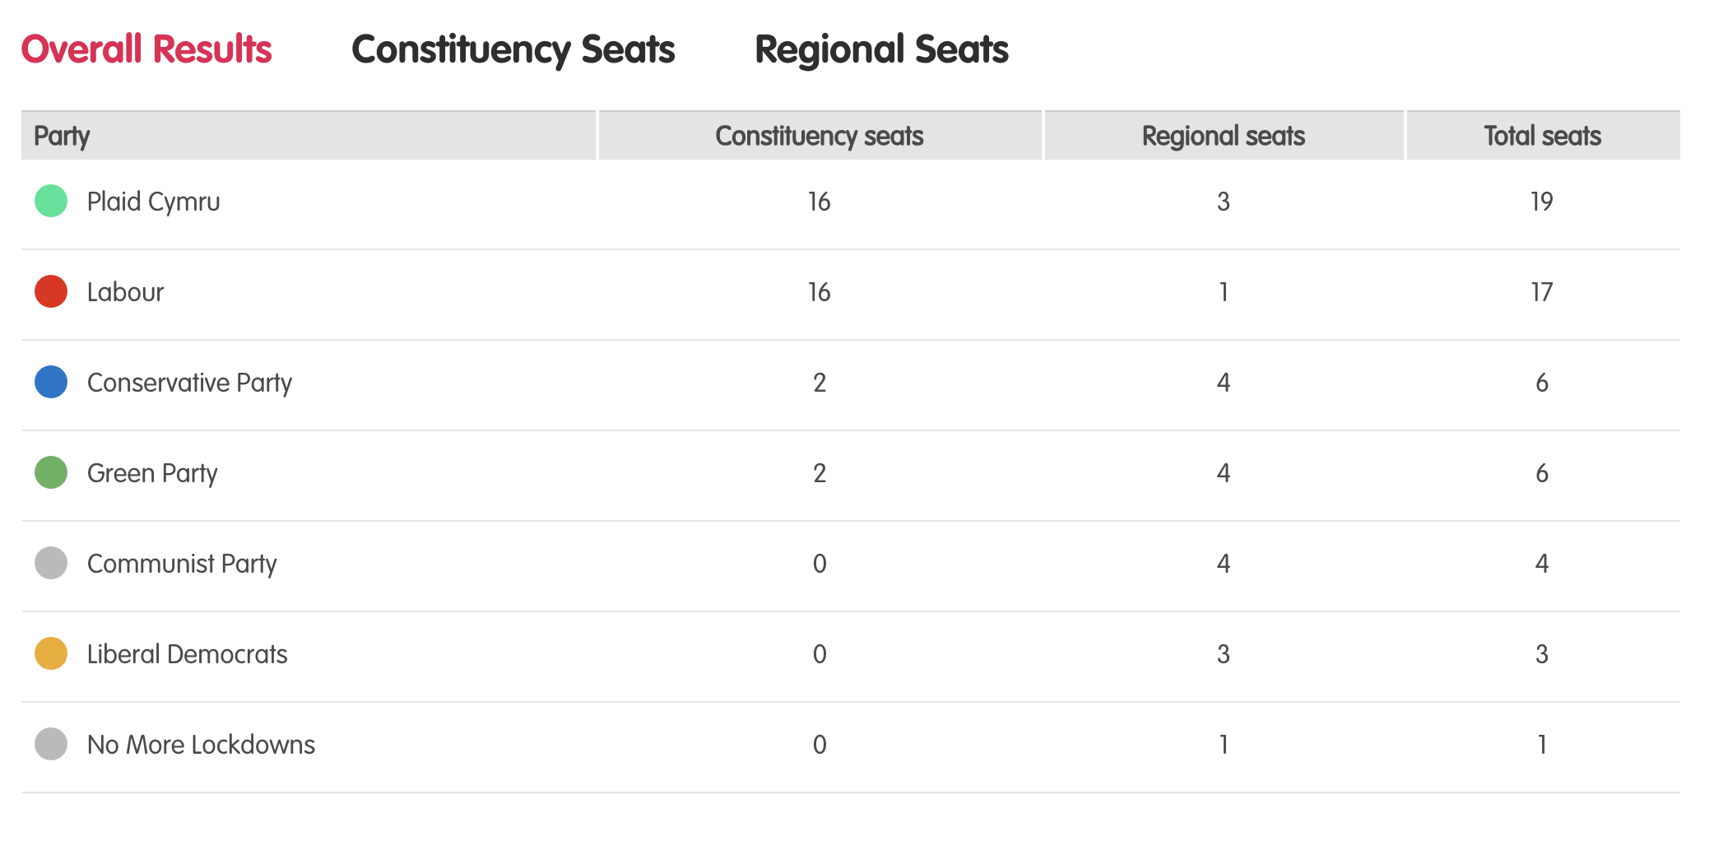
Full Results – Parallel election
Notes:
Tudalen wê canlyniadau’r Prosiect Pleidlais - https://prosiectpleidlais.cymru/canlyniadau/
Web page for Project Vote results – https://www.projectvote.wales/results/
Tudalen wê canlyniadau go iawn- https://www.bbc.co.uk/cymrufyw/pynciau/cvd627zw9rjt/etholiad-senedd-cymru-2021
Real results web page: https://www.bbc.co.uk/news/topics/cqwn14k92zwt/welsh-parliament-election-2021

Slide 5
Official election Results / Canlyniadau etholiad swyddogol
Plaid | Party | Seddau etholaethol | Constituency seats | Seddau rhanbarthau | Regional seats | Cyfanswn y seddau | Total Seats
Llafur / Labour | 27 | 3 | 30
Ceidwadwyr / Conservatives | 8 | 8 | 16
Plaid Cymru | 5 | 8 | 13
Democratiaid Rhyddfrydol / Liberal Democrats | 0 | 1 | 1

Slide 6
Etholaethau Constituencies

Slide 7
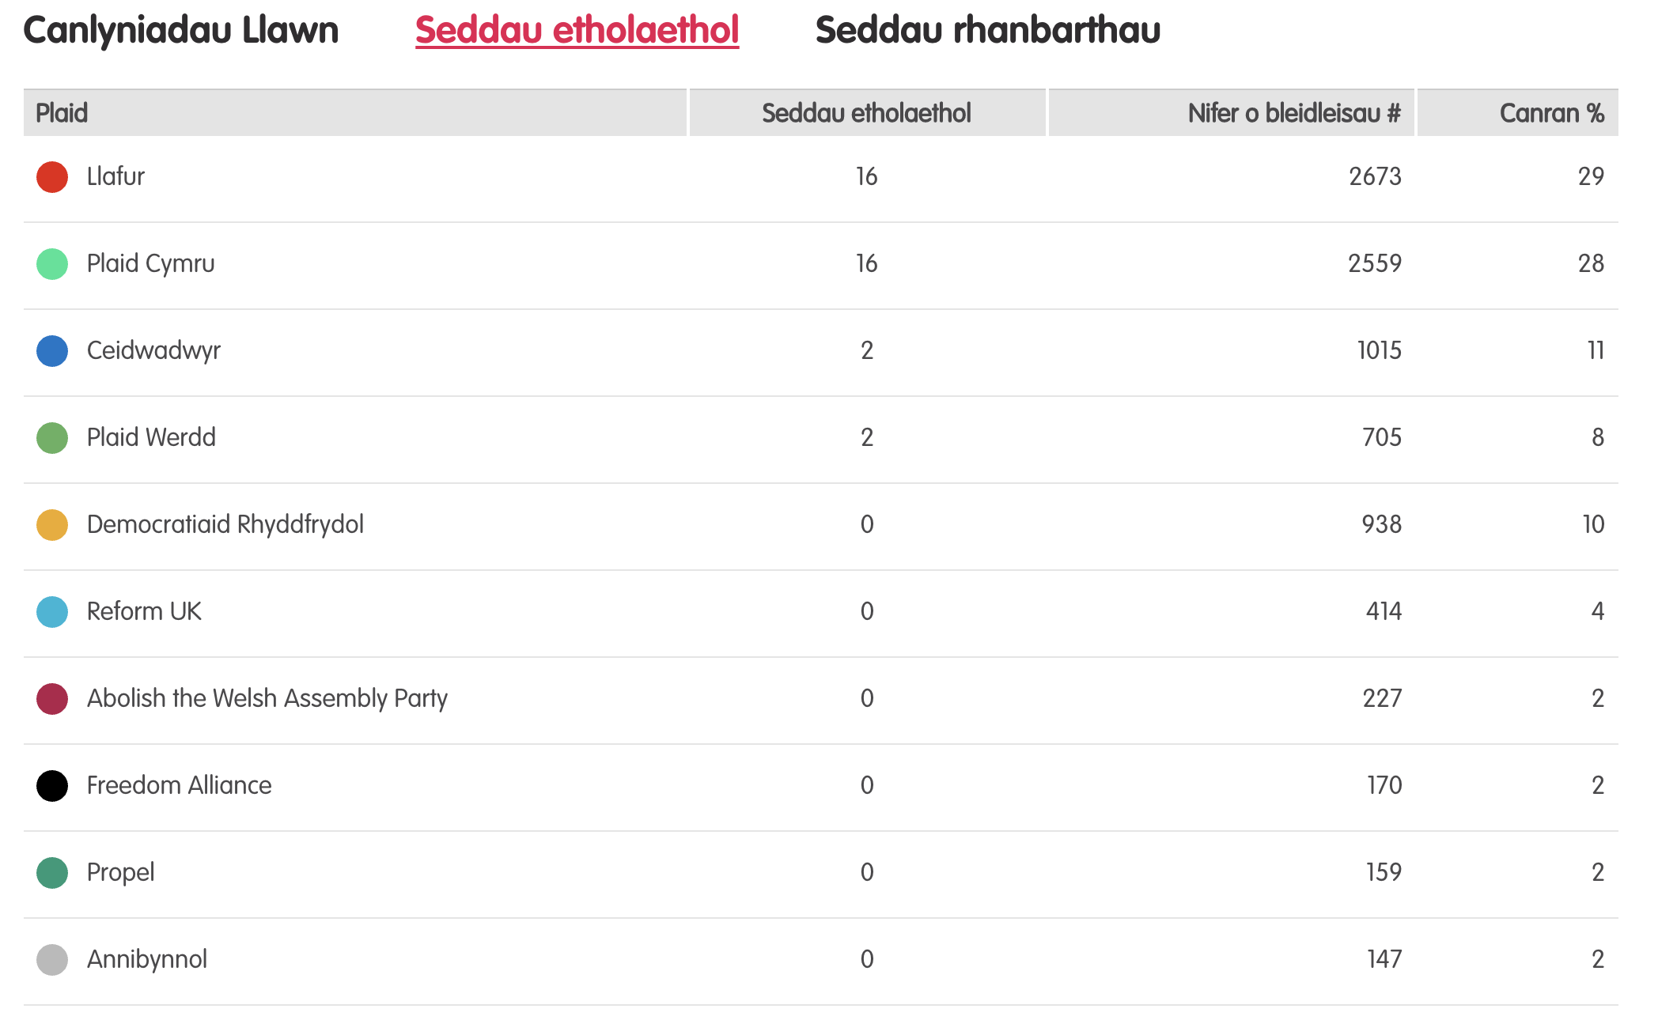
Canlyniadau – Etholiad Paralel
Notes:
Tudalen wê canlyniadau’r Prosiect Pleidlais - https://prosiectpleidlais.cymru/canlyniadau/
Web page for Project Vote results – https://www.projectvote.wales/results/
Tudalen wê canlyniadau go iawn- https://www.bbc.co.uk/cymrufyw/pynciau/cvd627zw9rjt/etholiad-senedd-cymru-2021
Real results web page: https://www.bbc.co.uk/news/topics/cqwn14k92zwt/welsh-parliament-election-2021

Slide 8
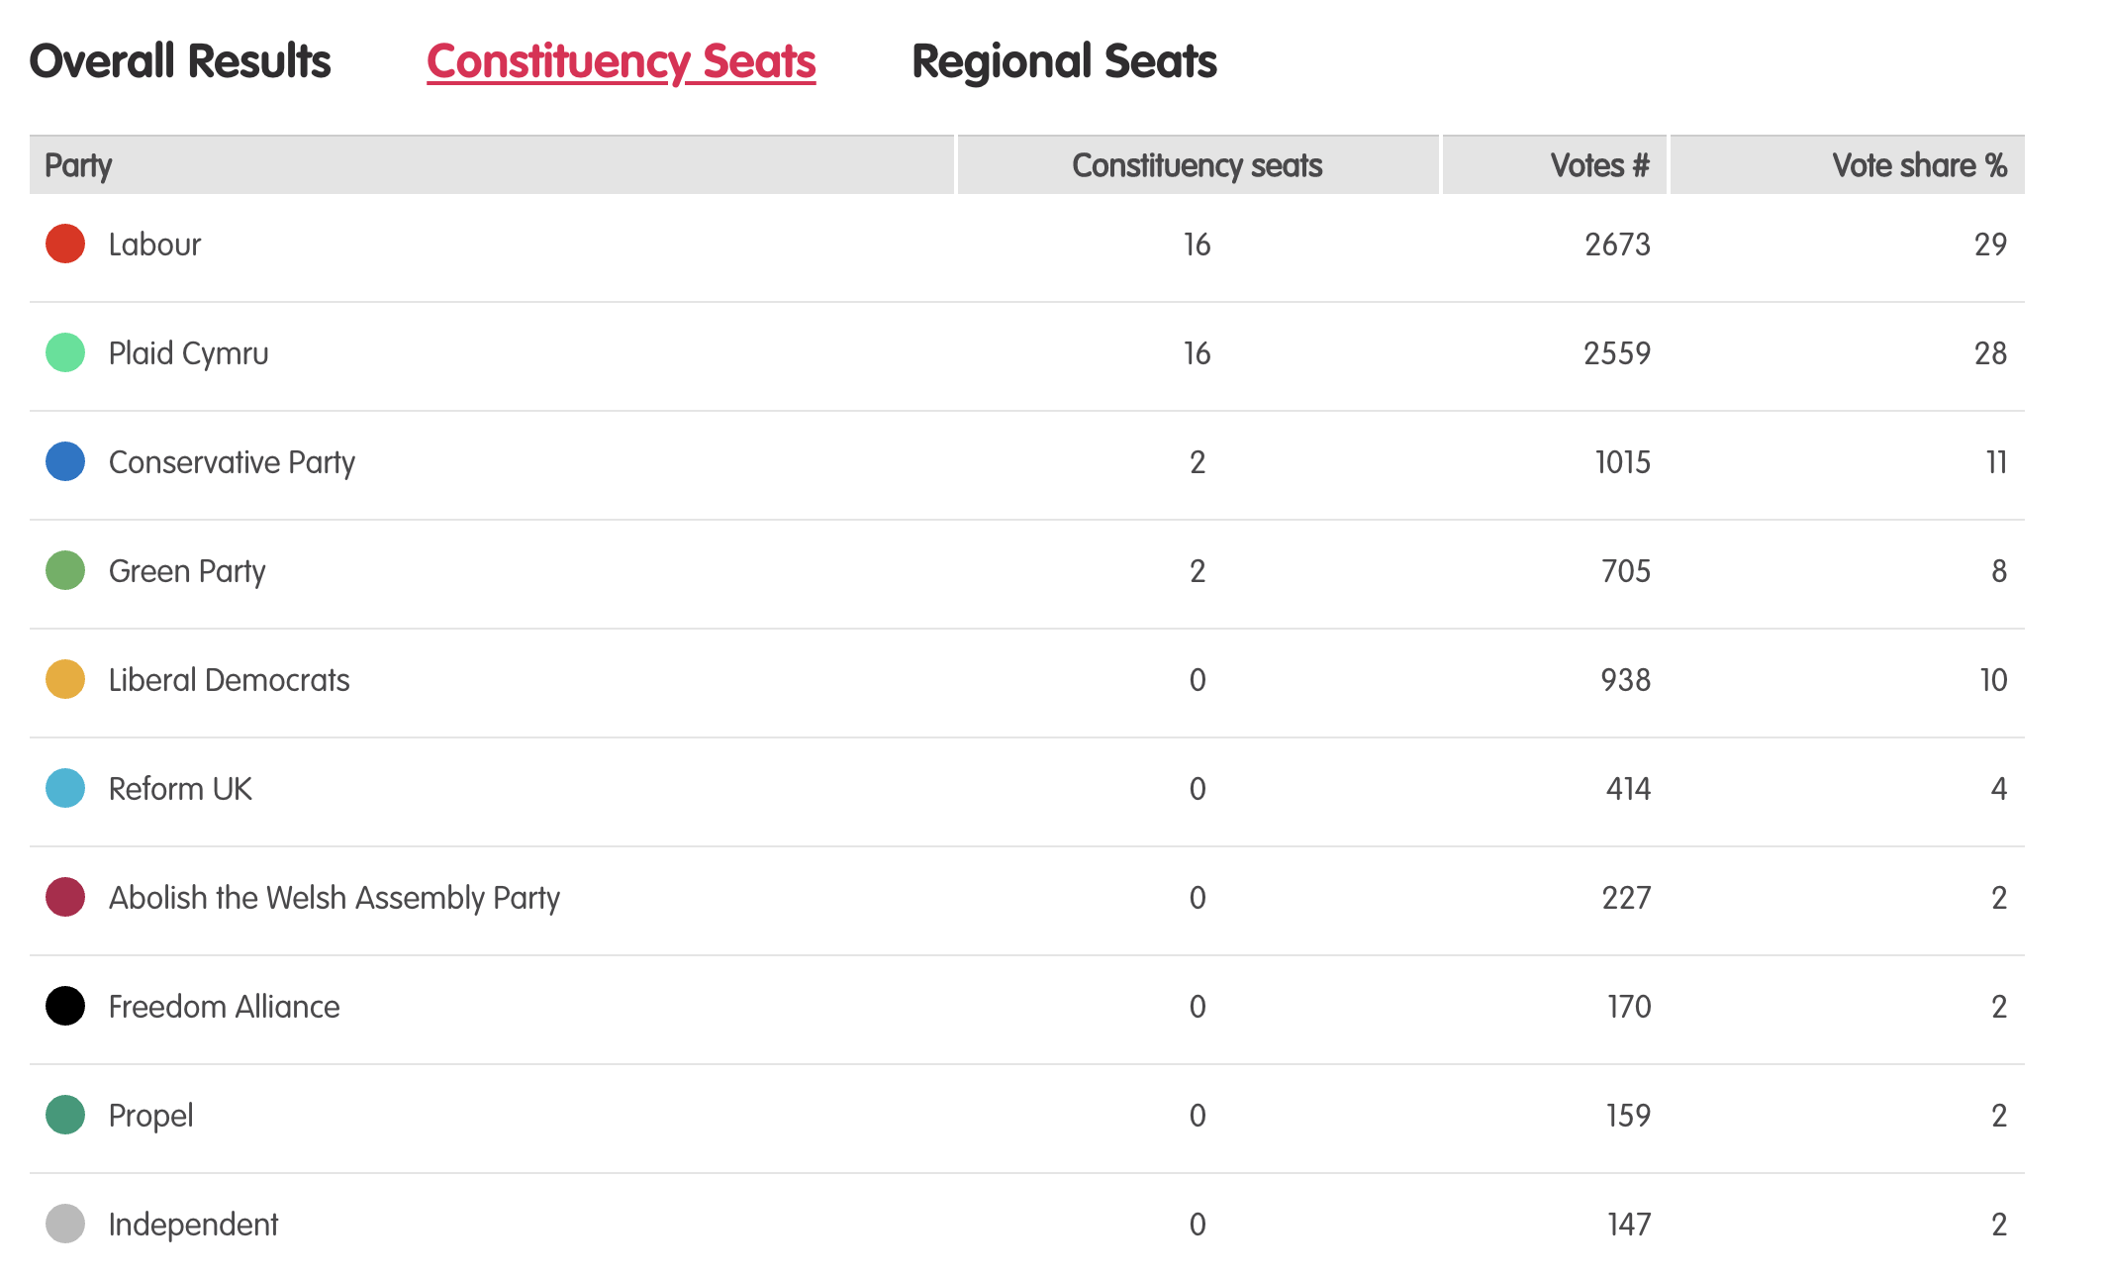
Results – Project vote parallel election
Notes:
Tudalen wê canlyniadau’r Prosiect Pleidlais - https://prosiectpleidlais.cymru/canlyniadau/
Web page for Project Vote results – https://www.projectvote.wales/results/
Tudalen wê canlyniadau go iawn- https://www.bbc.co.uk/cymrufyw/pynciau/cvd627zw9rjt/etholiad-senedd-cymru-2021
Real results web page: https://www.bbc.co.uk/news/topics/cqwn14k92zwt/welsh-parliament-election-2021

Slide 9
Canlyniadau swyddogol – Official results
Plaid | Party | Seddau etholaethol | Constituency seats | Nifer o bleidleisiau | Number of votes | Canran % | Vote share %
Llafur / Labour | 27 | 443,047 | 39.9%
Ceidwadwyr / Conservatives | 8 | 289,802 | 26.1%
Plaid Cymru | 5 | 225,376 | 20.3%
Democratiaid Rhyddfrydol / Liberal Democrats | 0 | 54,202 | 4.9%
Abolish the Welsh Assembly | 0 | 18,149 | 1.6%
Plaid Werdd / Green Party | 0 | 17,817 | 1.6%
Notes:
NB: the number and share of votes are for constituency votes only.
We have included the top 6 parties only here

Slide 10
Canol Caerdydd Cardiff Central

Slide 11
Canlyniadau Prosiect Pleidlais | Project Vote Results (1 / 2)
Plaid | Party | Ymgeiswyr | Candidates | Pleidleisiau | Votes | %
Democratiaid Rhyddfrydol / Liberal Democrats | Rodney Berman | 44 | 14%
Reform UK | Julian Bosley | 7 | 2%
Ceidwadwyr / Conservatives | Calum Davies | 20 | 6%
Plaid Werdd / Green Party | Ceri Davies | 24 | 8%
Freedom Alliance | Thomas Franklin | 7 | 2%
Socialist Party of Great Britain | Brian Johnson | 8 | 3%

Slide 12
Canlyniadau | Results (2 / 2)
Plaid | Party | Ymgeiswyr | Candidates | Pleidleisiau | Votes | %
Abolish the Welsh Assembly | Munawar Mughal | 3 | 1%
Propel | Dilan Nazari | 5 | 2%
Llafur / Labour | Jenny Rathbone | 47 | 15%
Plaid Cymru | William Rees | 147 | 47%
Gwlad | Clem Thomas | 4 | 1%

Slide 13
Canlyniad Senedd go iawn | Real Senedd result (1/2)
Plaid | Party | Ymgeiswyr | Candidates | Pleidleisiau | Votes | %
Democratiaid Rhyddfrydol / Liberal Democrats | Rodney Berman | 5,460 | 19.1%
Reform UK | Julian Bosley | 151 | 0.5%
Ceidwadwyr / Conservatives | Calum Davies | 3,788 | 13.3%
Plaid Werdd / Green Party | Ceri Davies | 1,552 | 5.4%
Freedom Alliance | Thomas Franklin | 156 | 0.5%
Socialist Party of Great Britain | Brian Johnson | 82 | 0.3%

Slide 14
Canlyniad Senedd go iawn | Real Senedd result (2/2)
Plaid | Party | Ymgeiswyr | Candidates | Pleidleisiau | Votes | %
Abolish the Welsh Assembly | Munawar Mughal | 440 | 1.5%
Propel | Dilan Nazari | 268 | 0.9%
Llafur / Labour | Jenny Rathbone | 13,100 | 45.9%
Plaid Cymru | William Rees | 3,470 | 12.2%
Gwlad | Clem Thomas | 65 | 0.2%

Slide 15
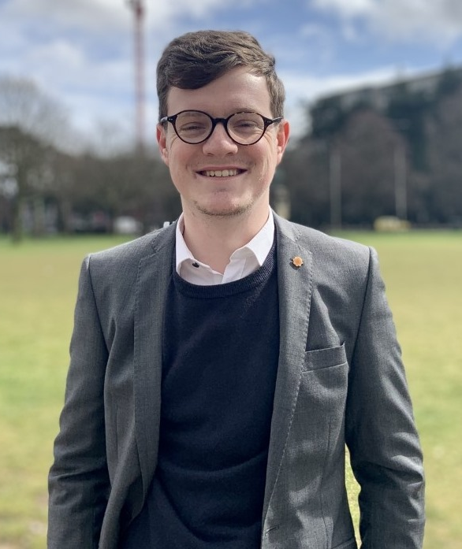
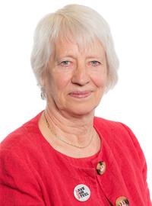
Prosiect Pleidlais Project Vote
Etholiad go iawn
Real election
Notes:
Prosiect Pleidlais / Project Vote - William Rees
Etholiad go iawn / Real election – Jenny Rathbone

Slide 16
Trafodaeth | Discussion
- Meddyliwch am 3 pheth rydych ch wedi dysgu trwy wneud yr etholiad paralel
- Pa weithgareddau wnaethoch chi fwynhau mwyaf?
- Meddyliwch am un ffordd mae’r profiad wedi effeithio arnoch chi neu ddatblygu eich barn
- Oedd yna wahaniaeth yn eich ardal chi rhwng y canlyniadau paralel, a’r canlyniadau swyddogol/go iawn? Pam ydych chi’n meddwl?
- Ydych chi’n meddwl bod y pandemig wedi cael effaith ar faint mae pobl yn ei wybod am wleidyddiaeth Cymru?
- Name three things you’ve learned through this Parallel Election
- Which activities did you enjoy the most and why?
- Name one way this experience has changed you or developed opinions
- Was there a difference between the Project Vote results and the real election results? Why do you think that is?
- Do you think that the coronavirus pandemic had an impact on how much people know about Welsh politics?

Slide 17
Camau nesaf | Next steps
Eich aelod o’r Senedd – Mae eich aelod o’r Senedd yna i’ch cynrychioli chi yn y Senedd. Cofiwch mae gennych chi 5 aelod sy’n eich cynrychioli chi – yr un a gafodd ei ethol gan eich etholaeth, a’r 4 cafodd eu hethol gan eich rhanbarth (gweler diwedd y cyflwyniad)
Cofiwch gysylltu gyda nhw os:
- Rydych chi eisiau cyngor neu wybodaeth am rywbeth sydd gan y Senedd pwerau drosto
- Rydych chi eisiau gofyn iddyn nhw beth fydden nhw’n ei wneud i wella eich ardal i bobl ifanc
- Mae gennych chi ddiddordeb mewn mater lleol ac eisiau gwybod mwy
Paid ag ofni cysylltu gyda nhw. Maen nhw’n derbyn cannoedd o ebyst a galwadau ffôn pob blwyddyn ar bob math o fater – eu swydd nhw yw gwrando ar eich pryderon.
Your MS - your MS is there to represent you in the Senedd. Remember you have 5 members of the Senedd representing you – the 1 who was voted in by your constituency, and the 4 who were voted in by your region (see the end of the powerpoint).
Remember to get in touch with them if:
- you want advice or information on something that the Welsh Parliament has control over
- you want to ask them what they will be doing to make your local area better for young people
- there is an issue in your local area that you're interested in
Don't be shy about getting in touch with them. They receive hundreds of emails and phone calls every year on all sorts of issues - it's their job to listen to your concerns.

Slide 18
Camau nesaf | Next steps
Gwneud Gwahaniaeth
Os oes gennych chi ddiddordeb mewn creu newid i faterion sy’n bwysig i chi, yn yr ysgol neu yn eich cymuned leol, ewch i’n hadnodd Gwneud Gwahaniaeth. A plis cysylltwch os oes unrhyw gwestiwn gyda chi amdano fe.
Cofrestru i bleidleisio
Cofiwch gallwch gofrestru i bleidleisio os ydych chi’n 14+ oed.
Ewch at y gwefan yma i wneud hyn.
Byddwch chi wedyn yn gallu pleidleisio mewn etholiadau Senedd, ac etholiadau eich cyngor lleol, pan rydych chi’n troi’n 16.
Making a difference
If you're interested in making a difference to the issues that matter to you, whether it's in school or your local community, take a look at our Make a Difference resource. And please get in touch with us if you have any questions about it.
Registering to vote
Remember you can register to vote if you are aged 14+
Go to this website to do this.
You will then be able to vote in Senedd elections, and your local council elections, when you turn 16.

Slide 19
Gogledd Caerdydd Cardiff North

Slide 20
Canlyniadau Etholiad Paralel | Parallel election Results
Plaid | Party | Ymgeiswyr | Candidates | Pleidleisiau | Votes | %
Plaid Werdd / Green Party | Debra Cooper | 24 | 8%
Plaid Cymru | Fflur Elin | 140 | 47%
Abolish the Welsh Assembly | Lawrence Gwynn | 5 | 2%
Propel | Akil Kata | 9 | 3%
Freedom Alliance | Virginia Kemp | 5 | 2%
Llafur / Labour | Julie Morgan | 72 | 24%
Reform UK | Haydn Rushworth | 14 | 5%
Democratiaid Rhyddfrydol / Liberal Democrats | Rhys Taylor | 5 | 2%
Ceidwadwyr / Conservatives | Joel Williams | 21 | 7%

Slide 21
Canlyniad Senedd go iawn | Real Senedd result
Plaid | Party | Ymgeiswyr | Candidates | Pleidleisiau | Votes | %
Plaid Werdd / Green Party | Debra Cooper | 1,957 | 4.8%
Plaid Cymru | Fflur Elin | 3,278 | 8.1%
Abolish the Welsh Assembly | Lawrence Gwynn | 990 | 2.4%
Propel | Akil Kata | 336 | 0.8%
Freedom Alliance | Virginia Kemp | 150 | 0.4%
Llafur / Labour | Julie Morgan | 19,348 | 47.6%
Reform UK | Haydn Rushworth | 200 | 0.5%
Democratiaid Rhyddfrydol / Liberal Democrats | Rhys Taylor | 1,641 | 4%
Ceidwadwyr / Conservatives | Joel Williams | 12,755 | 31,4%

Slide 22
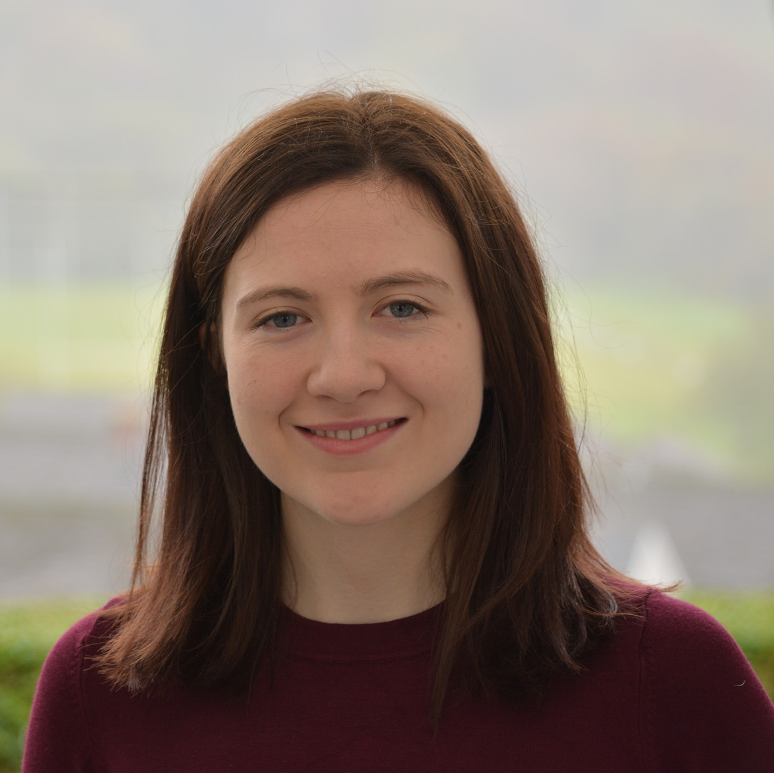
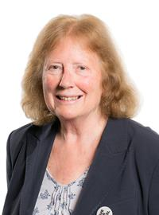
Prosiect Pleidlais Project Vote
Etholiad go iawn
Real election
Notes:
Prosiect Pleidlais / Project Vote – Fflur Elin
Etholiad go iawn / Real election – Julie Morgan

Slide 23
Trafodaeth | Discussion
- Meddyliwch am 3 pheth rydych ch wedi dysgu trwy wneud yr etholiad paralel
- Pa weithgareddau wnaethoch chi fwynhau mwyaf?
- Meddyliwch am un ffordd mae’r profiad wedi effeithio arnoch chi neu ddatblygu eich barn
- Oedd yna wahaniaeth yn eich ardal chi rhwng y canlyniadau paralel, a’r canlyniadau swyddogol/go iawn? Pam ydych chi’n meddwl?
- Ydych chi’n meddwl bod y pandemig wedi cael effaith ar faint mae pobl yn ei wybod am wleidyddiaeth Cymru?
- Name three things you’ve learned through this Parallel Election
- Which activities did you enjoy the most and why?
- Name one way this experience has changed you or developed opinions
- Was there a difference between the Project Vote results and the real election results? Why do you think that is?
- Do you think that the coronavirus pandemic had an impact on how much people know about Welsh politics?

Slide 24
Camau nesaf | Next steps
Eich aelod o’r Senedd – Mae eich aelod o’r Senedd yna i’ch cynrychioli chi yn y Senedd. Cofiwch mae gennych chi 5 aelod sy’n eich cynrychioli chi – yr un a gafodd ei ethol gan eich etholaeth, a’r 4 cafodd eu hethol gan eich rhanbarth (gweler diwedd y cyflwyniad)
Cofiwch gysylltu gyda nhw os:
- Rydych chi eisiau cyngor neu wybodaeth am rywbeth sydd gan y Senedd pwerau drosto
- Rydych chi eisiau gofyn iddyn nhw beth fydden nhw’n ei wneud i wella eich ardal i bobl ifanc
- Mae gennych chi ddiddordeb mewn mater lleol ac eisiau gwybod mwy
Paid ag ofni cysylltu gyda nhw. Maen nhw’n derbyn cannoedd o ebyst a galwadau ffôn pob blwyddyn ar bob math o fater – eu swydd nhw yw gwrando ar eich pryderon.
Your MS - your MS is there to represent you in the Senedd. Remember you have 5 members of the Senedd representing you – the 1 who was voted in by your constituency, and the 4 who were voted in by your region (see the end of the powerpoint).
Remember to get in touch with them if:
- you want advice or information on something that the Welsh Parliament has control over
- you want to ask them what they will be doing to make your local area better for young people
- there is an issue in your local area that you're interested in
Don't be shy about getting in touch with them. They receive hundreds of emails and phone calls every year on all sorts of issues - it's their job to listen to your concerns.

Slide 25
Camau nesaf | Next steps
Gwneud Gwahaniaeth
Os oes gennych chi ddiddordeb mewn creu newid i faterion sy’n bwysig i chi, yn yr ysgol neu yn eich cymuned leol, ewch i’n hadnodd Gwneud Gwahaniaeth. A plis cysylltwch os oes unrhyw gwestiwn gyda chi amdano fe.
Cofrestru i bleidleisio
Cofiwch gallwch gofrestru i bleidleisio os ydych chi’n 14+ oed.
Ewch at y gwrfan yma i wneud hyn.
Byddwch chi wedyn yn gallu pleidleisio mewn etholiadau Senedd, ac etholiadau eich cyngor lleol, pan rydych chi’n troi’n 16.
Making a difference
If you're interested in making a difference to the issues that matter to you, whether it's in school or your local community, take a look at our Make a Difference resource. And please get in touch with us if you have any questions about it.
Registering to vote
Remember you can register to vote if you are aged 14+
Go to this website to do this.
You will then be able to vote in Senedd elections, and your local council elections, when you turn 16.

Slide 26
De Caerdydd a Phenarth Cardiff South and Penarth

Slide 27
Canlyniadau etholiad paralel | Parallel election results (1 / 2)
Plaid | Party | Ymgeiswyr | Candidates | Pleidleisiau | Votes | %
Plaid Cymru | Nasir Adam | 86 | 17%
UKIP | Paul Campbell | 18 | 4%
Propel | Matt Friend | 27 | 5%
Llafur / Labour | Vaughan Gething | 184 | 36%
Freedom Alliance | Alan Golding | 25 | 5%
Gwlad | Angus Hawkins | 13 | 3%

Slide 28
Canlyniadau etholiad paralel | Parallel election results (2 / 2)
Plaid | Party | Ymgeiswyr | Candidates | Pleidleisiau | Votes | %
Abolish the Welsh Assembly | Lisa Peregrine | 17 | 3%
Reform UK | Alan Pick | 11 | 2%
Annibynnol / Independent | David Rolfe | 4 | 1%
Ceidwadwyr / Conservatives | Leighton Rowlands | 31 | 6%
Plaid Werdd / Green Party | Helen Westhead | 47 | 9%
Democratiaid Rhyddfrydol / Liberal Democrats | Alex Wilson | 50 | 10%

Slide 29
Canlyniad Senedd go iawn | Real Senedd result (1/2)
Plaid | Party | Ymgeiswyr | Candidates | Pleidleisiau | Votes | %
Plaid Cymru | Nasir Adam | 4,957 | 13.6%
UKIP | Paul Campbell | 576 | 1.6%
Propel | Matt Friend | 552 | 1.5%
Llafur / Labour | Vaughan Gething | 18,153 | 49.9%
Freedom Alliance | Alan Golding | 273 | 0.8%
Gwlad | Angus Hawkins | 121 | 0.3%

Slide 30
Canlyniad Senedd go iawn | Real Senedd result (2/2)
Plaid | Party | Ymgeiswyr | Candidates | Pleidleisiau | Votes | %
Abolish the Welsh Assembly | Lisa Peregrine | 732 | 2%
Reform UK | Alan Pick | 295 | 0.8%
Annibynnol / Independent | David Rolfe | 135 | 0.4%
Ceidwadwyr / Conservatives | Leighton Rowlands | 7,547 | 20.7%
Plaid Werdd / Green Party | Helen Westhead | 1,643 | 4.5%
Democratiaid Rhyddfrydol / Liberal Democrats | Alex Wilson | 1,402 | 3.9%

Slide 31
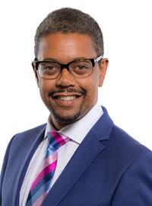
Prosiect Pleidlais Project Vote
Etholiad go iawn
Real election
Notes:
Prosiect Pleidlais / Project Vote – Vaughan Gething
Etholiad go iawn / Real election – Vaughan Gething

Slide 32
Trafodaeth | Discussion
- Meddyliwch am 3 pheth rydych ch wedi dysgu trwy wneud yr etholiad paralel
- Pa weithgareddau wnaethoch chi fwynhau mwyaf?
- Meddyliwch am un ffordd mae’r profiad wedi effeithio arnoch chi neu ddatblygu eich barn
- Oedd yna wahaniaeth yn eich ardal chi rhwng y canlyniadau paralel, a’r canlyniadau swyddogol/go iawn? Pam ydych chi’n meddwl?
- Ydych chi’n meddwl bod y pandemig wedi cael effaith ar faint mae pobl yn ei wybod am wleidyddiaeth Cymru?
- Name three things you’ve learned through this Parallel Election
- Which activities did you enjoy the most and why?
- Name one way this experience has changed you or developed opinions
- Was there a difference between the Project Vote results and the real election results? Why do you think that is?
- Do you think that the coronavirus pandemic had an impact on how much people know about Welsh politics?

Slide 33
Camau nesaf | Next steps
Eich aelod o’r Senedd – Mae eich aelod o’r Senedd yna i’ch cynrychioli chi yn y Senedd. Cofiwch mae gennych chi 5 aelod sy’n eich cynrychioli chi – yr un a gafodd ei ethol gan eich etholaeth, a’r 4 cafodd eu hethol gan eich rhanbarth (gweler diwedd y cyflwyniad)
Cofiwch gysylltu gyda nhw os:
- Rydych chi eisiau cyngor neu wybodaeth am rywbeth sydd gan y Senedd pwerau drosto
- Rydych chi eisiau gofyn iddyn nhw beth fydden nhw’n ei wneud i wella eich ardal i bobl ifanc
- Mae gennych chi ddiddordeb mewn mater lleol ac eisiau gwybod mwy
Paid ag ofni cysylltu gyda nhw. Maen nhw’n derbyn cannoedd o ebyst a galwadau ffôn pob blwyddyn ar bob math o fater – eu swydd nhw yw gwrando ar eich pryderon.
Your MS - your MS is there to represent you in the Senedd. Remember you have 5 members of the Senedd representing you – the 1 who was voted in by your constituency, and the 4 who were voted in by your region (see the end of the powerpoint).
Remember to get in touch with them if:
- you want advice or information on something that the Welsh Parliament has control over
- you want to ask them what they will be doing to make your local area better for young people
- there is an issue in your local area that you're interested in
Don't be shy about getting in touch with them. They receive hundreds of emails and phone calls every year on all sorts of issues - it's their job to listen to your concerns.

Slide 34
Camau nesaf | Next steps
Gwneud Gwahaniaeth
Os oes gennych chi ddiddordeb mewn creu newid i faterion sy’n bwysig i chi, yn yr ysgol neu yn eich cymuned leol, ewch i’n hadnodd Gwneud Gwahaniaeth. A plis cysylltwch os oes unrhyw gwestiwn gyda chi amdano fe.
Cofrestru i bleidleisio
Cofiwch gallwch gofrestru i bleidleisio os ydych chi’n 14+ oed.
Ewch at y gwrfan yma i wneud hyn.
Byddwch chi wedyn yn gallu pleidleisio mewn etholiadau Senedd, ac etholiadau eich cyngor lleol, pan rydych chi’n troi’n 16.
Making a difference
If you're interested in making a difference to the issues that matter to you, whether it's in school or your local community, take a look at our Make a Difference resource. And please get in touch with us if you have any questions about it.
Registering to vote
Remember you can register to vote if you are aged 14+
Go to this website to do this.
You will then be able to vote in Senedd elections, and your local council elections, when you turn 16.

Slide 35
Gorllewin Caerdydd Cardiff West

Slide 36
Canlyniadau Etholiad paralel | Parallel election Results
Plaid | Party | Ymgeiswyr | Candidates | Pleidleisiau | Votes | %
Plaid Cymru | Rhys ab Owen | 184 | 21%
Annibynnol / Independent | Captain Beany | 37 | 4%
Abolish the Welsh Assembly | Lee Canning | 24 | 3%
Llafur / Labour | Mark Drakeford | 298 | 33%
Ceidwadwyr / Conservatives | Sean Driscoll | 72 | 8%
Plaid Werdd/ Green Party | David Griffin | 114 | 13%
Democratiaid Rhyddfrydol / Liberal Democrats | Heath Marshall | 74 | 8%
Propel | Neil McEvoy | 59 | 7%
Reform UK | Nick Mullins | 31 | 3%

Slide 37
Canlyniad Senedd go iawn | Real Senedd result
Plaid | Party | Ymgeiswyr | Candidates | Pleidleisiau | Votes | %
Plaid Cymru | Rhys ab Owen | 5,897 | 16.1%
Annibynnol / Independent | Captain Beany | 95 | 0.3%
Abolish the Welsh Assembly | Lee Canning | 682 | 1.9%
Llafur / Labour | Mark Drakeford | 17,665 | 48.4%
Ceidwadwyr / Conservatives | Sean Driscoll | 6,454 | 17.7%
Plaid Werdd/ Green Party | David Griffin | 1,287 | 3.5%
Democratiaid Rhyddfrydol / Liberal Democrats | Heath Marshall | 803 | 2.2%
Propel | Neil McEvoy | 3,473 | 9.5%
Reform UK | Nick Mullins | 175 | 0.5%

Slide 38
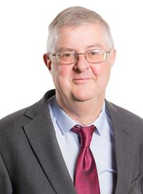
Prosiect Pleidlais Project Vote
Etholiad go iawn
Real election
Notes:
Prosiect Pleidlais / Project Vote – Mark Drakeford
Etholiad go iawn / Real election – Mark Drakeford

Slide 39
Trafodaeth | Discussion
- Meddyliwch am 3 pheth rydych ch wedi dysgu trwy wneud yr etholiad paralel
- Pa weithgareddau wnaethoch chi fwynhau mwyaf?
- Meddyliwch am un ffordd mae’r profiad wedi effeithio arnoch chi neu ddatblygu eich barn
- Oedd yna wahaniaeth yn eich ardal chi rhwng y canlyniadau paralel, a’r canlyniadau swyddogol/go iawn? Pam ydych chi’n meddwl?
- Ydych chi’n meddwl bod y pandemig wedi cael effaith ar faint mae pobl yn ei wybod am wleidyddiaeth Cymru?
- Name three things you’ve learned through this Parallel Election
- Which activities did you enjoy the most and why?
- Name one way this experience has changed you or developed opinions
- Was there a difference between the Project Vote results and the real election results? Why do you think that is?
- Do you think that the coronavirus pandemic had an impact on how much people know about Welsh politics?

Slide 40
Camau nesaf | Next steps
Eich aelod o’r Senedd – Mae eich aelod o’r Senedd yna i’ch cynrychioli chi yn y Senedd. Cofiwch mae gennych chi 5 aelod sy’n eich cynrychioli chi – yr un a gafodd ei ethol gan eich etholaeth, a’r 4 cafodd eu hethol gan eich rhanbarth (gweler diwedd y cyflwyniad)
Cofiwch gysylltu gyda nhw os:
- Rydych chi eisiau cyngor neu wybodaeth am rywbeth sydd gan y Senedd pwerau drosto
- Rydych chi eisiau gofyn iddyn nhw beth fydden nhw’n ei wneud i wella eich ardal i bobl ifanc
- Mae gennych chi ddiddordeb mewn mater lleol ac eisiau gwybod mwy
Paid ag ofni cysylltu gyda nhw. Maen nhw’n derbyn cannoedd o ebyst a galwadau ffôn pob blwyddyn ar bob math o fater – eu swydd nhw yw gwrando ar eich pryderon.
Your MS - your MS is there to represent you in the Senedd. Remember you have 5 members of the Senedd representing you – the 1 who was voted in by your constituency, and the 4 who were voted in by your region (see the end of the powerpoint).
Remember to get in touch with them if:
- you want advice or information on something that the Welsh Parliament has control over
- you want to ask them what they will be doing to make your local area better for young people
- there is an issue in your local area that you're interested in
Don't be shy about getting in touch with them. They receive hundreds of emails and phone calls every year on all sorts of issues - it's their job to listen to your concerns.

Slide 41
Camau nesaf | Next steps
Gwneud Gwahaniaeth
Os oes gennych chi ddiddordeb mewn creu newid i faterion sy’n bwysig i chi, yn yr ysgol neu yn eich cymuned leol, ewch i’n hadnodd Gwneud Gwahaniaeth. A plis cysylltwch os oes unrhyw gwestiwn gyda chi amdano fe.
Cofrestru i bleidleisio
Cofiwch gallwch gofrestru i bleidleisio os ydych chi’n 14+ oed.
Ewch at y gwrfan yma i wneud hyn.
Byddwch chi wedyn yn gallu pleidleisio mewn etholiadau Senedd, ac etholiadau eich cyngor lleol, pan rydych chi’n troi’n 16.
Making a difference
If you're interested in making a difference to the issues that matter to you, whether it's in school or your local community, take a look at our Make a Difference resource. And please get in touch with us if you have any questions about it.
Registering to vote
Remember you can register to vote if you are aged 14+
Go to this website to do this.
You will then be able to vote in Senedd elections, and your local council elections, when you turn 16.

Slide 42
Cwm Cynon Cynon Valley

Slide 43
Canlyniadau | Results
Plaid | Party | Ymgeiswyr | Candidates | Pleidleisiau | Votes | %
Annibynnol / Independent | Gareth Bennet | - | -
Plaid Cymru | Geraint Benney | 11 | 55%
Abolish the Welsh Assembly | Martyn Ford | - | -
Democratiaid Rhyddfrydol / Liberal Democrats | Gerald Francis | - | -
Reform UK | Peter Hopkins | - | -
Llafur / Labour | Vikki Howells | 8 | 40%
Propel | Vicky Jenkins | - | -
Ceidwadwyr / Conservatives | Mia Rees | 1 | 5%

Slide 44
Canlyniad Senedd go iawn | Real Senedd result
Plaid | Party | Ymgeiswyr | Candidates | Pleidleisiau | Votes | %
Annibynnol / Independent | Gareth Bennet | 278 | 1.4%
Plaid Cymru | Geraint Benney | 3,959 | 19.3%
Abolish the Welsh Assembly | Martyn Ford | 648 | 3.2%
Democratiaid Rhyddfrydol / Liberal Democrats | Gerald Francis | 335 | 1.6%
Reform UK | Peter Hopkins | 356 | 1.7%
Llafur / Labour | Vikki Howells | 11,427 | 55.7%
Propel | Vicky Jenkins | 713 | 3.5%
Ceidwadwyr / Conservatives | Mia Rees | 2,795 | 13.6%

Slide 45
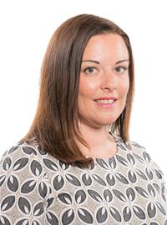
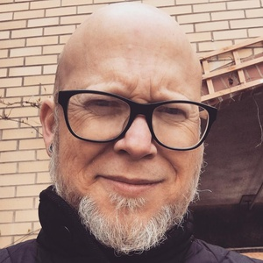
Prosiect Pleidlais Project Vote
Etholiad go iawn
Real election
Notes:
Prosiect Pleidlais / Project Vote – Geraint Benney
Etholiad go iawn / Real election – Vikki Howells

Slide 46
Trafodaeth | Discussion
- Meddyliwch am 3 pheth rydych ch wedi dysgu trwy wneud yr etholiad paralel
- Pa weithgareddau wnaethoch chi fwynhau mwyaf?
- Meddyliwch am un ffordd mae’r profiad wedi effeithio arnoch chi neu ddatblygu eich barn
- Oedd yna wahaniaeth yn eich ardal chi rhwng y canlyniadau paralel, a’r canlyniadau swyddogol/go iawn? Pam ydych chi’n meddwl?
- Ydych chi’n meddwl bod y pandemig wedi cael effaith ar faint mae pobl yn ei wybod am wleidyddiaeth Cymru?
- Name three things you’ve learned through this Parallel Election
- Which activities did you enjoy the most and why?
- Name one way this experience has changed you or developed opinions
- Was there a difference between the Project Vote results and the real election results? Why do you think that is?
- Do you think that the coronavirus pandemic had an impact on how much people know about Welsh politics?

Slide 47
Camau nesaf | Next steps
Eich aelod o’r Senedd – Mae eich aelod o’r Senedd yna i’ch cynrychioli chi yn y Senedd. Cofiwch mae gennych chi 5 aelod sy’n eich cynrychioli chi – yr un a gafodd ei ethol gan eich etholaeth, a’r 4 cafodd eu hethol gan eich rhanbarth (gweler diwedd y cyflwyniad)
Cofiwch gysylltu gyda nhw os:
- Rydych chi eisiau cyngor neu wybodaeth am rywbeth sydd gan y Senedd pwerau drosto
- Rydych chi eisiau gofyn iddyn nhw beth fydden nhw’n ei wneud i wella eich ardal i bobl ifanc
- Mae gennych chi ddiddordeb mewn mater lleol ac eisiau gwybod mwy
Paid ag ofni cysylltu gyda nhw. Maen nhw’n derbyn cannoedd o ebyst a galwadau ffôn pob blwyddyn ar bob math o fater – eu swydd nhw yw gwrando ar eich pryderon.
Your MS - your MS is there to represent you in the Senedd. Remember you have 5 members of the Senedd representing you – the 1 who was voted in by your constituency, and the 4 who were voted in by your region (see the end of the powerpoint).
Remember to get in touch with them if:
- you want advice or information on something that the Welsh Parliament has control over
- you want to ask them what they will be doing to make your local area better for young people
- there is an issue in your local area that you're interested in
Don't be shy about getting in touch with them. They receive hundreds of emails and phone calls every year on all sorts of issues - it's their job to listen to your concerns.

Slide 48
Camau nesaf | Next steps
Gwneud Gwahaniaeth
Os oes gennych chi ddiddordeb mewn creu newid i faterion sy’n bwysig i chi, yn yr ysgol neu yn eich cymuned leol, ewch i’n hadnodd Gwneud Gwahaniaeth. A plis cysylltwch os oes unrhyw gwestiwn gyda chi amdano fe.
Cofrestru i bleidleisio
Cofiwch gallwch gofrestru i bleidleisio os ydych chi’n 14+ oed.
Ewch at y gwrfan yma i wneud hyn.
Byddwch chi wedyn yn gallu pleidleisio mewn etholiadau Senedd, ac etholiadau eich cyngor lleol, pan rydych chi’n troi’n 16.
Making a difference
If you're interested in making a difference to the issues that matter to you, whether it's in school or your local community, take a look at our Make a Difference resource. And please get in touch with us if you have any questions about it.
Registering to vote
Remember you can register to vote if you are aged 14+
Go to this website to do this.
You will then be able to vote in Senedd elections, and your local council elections, when you turn 16.

Slide 49
Pontypridd

Slide 50
Canlyniadau Etholiad Paralel | Parallel election Results
Plaid | Party | Ymgeiswyr | Candidates | Pleidleisiau | Votes | %
Llafur / Labour | Mick Antoniw | 210 | 40%
Plaid Werdd / Green Party | Ken Barker | 77 | 15%
Plaid Cymru | Heledd Fychan | 68 | 13%
Abolish the Welsh Assembly | Mike Hughes | 29 | 6%
Ceidwadwyr / Conservatives | Joel James | 51 | 10%
Reform UK | Jamie Jenkins | 26 | 5%
Annibynnol / Independent | Owen Wayne | 21 | 4%
Democratiaid Rhyddfrydol / Liberal Democrats | Steven Rajam | 42 | 8%

Slide 51
Canlyniad Senedd go iawn | Real Senedd result
Plaid | Party | Ymgeiswyr | Candidates | Pleidleisiau | Votes | %
Llafur / Labour | Mick Antoniw | 11,511 | 41.8%
Plaid Werdd / Green Party | Ken Barker | 655 | 0.4%
Plaid Cymru | Heledd Fychan | 6,183 | 22.4%
Abolish the Welsh Assembly | Mike Hughes | 785 | 2.8%
Ceidwadwyr / Conservatives | Joel James | 5,658 | 5.2%
Reform UK | Jamie Jenkins | 458 | 1.7%
Annibynnol / Independent | Wayne Owen | 1,678 | 6.1%
Democratiaid Rhyddfrydol / Liberal Democrats | Steven Rajam | 628 | 2.3%

Slide 52
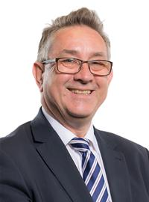
Prosiect Pleidlais Project Vote
Etholiad go iawn
Real election
Notes:
Prosiect Pleidlais / Project Vote – Mick Antoniw
Etholiad go iawn / Real election – Mick Antoniw

Slide 53
Trafodaeth | Discussion
- Meddyliwch am 3 pheth rydych ch wedi dysgu trwy wneud yr etholiad paralel
- Pa weithgareddau wnaethoch chi fwynhau mwyaf?
- Meddyliwch am un ffordd mae’r profiad wedi effeithio arnoch chi neu ddatblygu eich barn
- Oedd yna wahaniaeth yn eich ardal chi rhwng y canlyniadau paralel, a’r canlyniadau swyddogol/go iawn? Pam ydych chi’n meddwl?
- Ydych chi’n meddwl bod y pandemig wedi cael effaith ar faint mae pobl yn ei wybod am wleidyddiaeth Cymru?
- Name three things you’ve learned through this Parallel Election
- Which activities did you enjoy the most and why?
- Name one way this experience has changed you or developed opinions
- Was there a difference between the Project Vote results and the real election results? Why do you think that is?
- Do you think that the coronavirus pandemic had an impact on how much people know about Welsh politics?

Slide 54
Camau nesaf | Next steps
Eich aelod o’r Senedd – Mae eich aelod o’r Senedd yna i’ch cynrychioli chi yn y Senedd. Cofiwch mae gennych chi 5 aelod sy’n eich cynrychioli chi – yr un a gafodd ei ethol gan eich etholaeth, a’r 4 cafodd eu hethol gan eich rhanbarth (gweler diwedd y cyflwyniad)
Cofiwch gysylltu gyda nhw os:
- Rydych chi eisiau cyngor neu wybodaeth am rywbeth sydd gan y Senedd pwerau drosto
- Rydych chi eisiau gofyn iddyn nhw beth fydden nhw’n ei wneud i wella eich ardal i bobl ifanc
- Mae gennych chi ddiddordeb mewn mater lleol ac eisiau gwybod mwy
Paid ag ofni cysylltu gyda nhw. Maen nhw’n derbyn cannoedd o ebyst a galwadau ffôn pob blwyddyn ar bob math o fater – eu swydd nhw yw gwrando ar eich pryderon.
Your MS - your MS is there to represent you in the Senedd. Remember you have 5 members of the Senedd representing you – the 1 who was voted in by your constituency, and the 4 who were voted in by your region (see the end of the powerpoint).
Remember to get in touch with them if:
- you want advice or information on something that the Welsh Parliament has control over
- you want to ask them what they will be doing to make your local area better for young people
- there is an issue in your local area that you're interested in
Don't be shy about getting in touch with them. They receive hundreds of emails and phone calls every year on all sorts of issues - it's their job to listen to your concerns.

Slide 55
Camau nesaf | Next steps
Gwneud Gwahaniaeth
Os oes gennych chi ddiddordeb mewn creu newid i faterion sy’n bwysig i chi, yn yr ysgol neu yn eich cymuned leol, ewch i’n hadnodd Gwneud Gwahaniaeth. A plis cysylltwch os oes unrhyw gwestiwn gyda chi amdano fe.
Cofrestru i bleidleisio
Cofiwch gallwch gofrestru i bleidleisio os ydych chi’n 14+ oed.
Ewch at y gwrfan yma i wneud hyn.
Byddwch chi wedyn yn gallu pleidleisio mewn etholiadau Senedd, ac etholiadau eich cyngor lleol, pan rydych chi’n troi’n 16.
Making a difference
If you're interested in making a difference to the issues that matter to you, whether it's in school or your local community, take a look at our Make a Difference resource. And please get in touch with us if you have any questions about it.
Registering to vote
Remember you can register to vote if you are aged 14+
Go to this website to do this.
You will then be able to vote in Senedd elections, and your local council elections, when you turn 16.

Slide 56
Rhondda

Slide 57
Canlyniadau Etholiad Paralel | Parallel election Results
Plaid | Party | Ymgeiswyr | Candidates | Pleidleisiau | Votes | %
Reform UK | Steve Bayliss | - | -
Democratiaid Rhyddfrydol / Liberal Democrats | Jackie Charlton | 3 | 5%
Propel | Jeff Gregory | 6 | 11%
Abolish the Welsh Assembly | Ian McLean | - | -
Ceidwadwyr / Conservatives | Thomas Parkhill | 2 | 4%
Freedom Alliance | Steven Phillips | - | -
Llafur / Labour | Elizabeth ‘Buffy’ Williams | 19 | 35%
Plaid Cymru | Leanne Wood | 25 | 45%

Slide 58
Canlyniad Senedd go iawn | Real Senedd result
Plaid | Party | Ymgeiswyr | Candidates | Pleidleisiau | Votes | %
Reform UK | Steve Bayliss | 355 | 1.5%
Democratiaid Rhyddfrydol / Liberal Democrats | Jackie Charlton | 200 | 0.9%
Propel | Jeff Gregory | 525 | 2.2%
Abolish the Welsh Assembly | Ian McLean | 430 | 1.8%
Ceidwadwyr / Conservatives | Thomas Parkhill | 1,490 | 6.4%
Freedom Alliance | Steven Phillips | 291 | 1.2%
Llafur / Labour | Elizabeth ‘Buffy’ Williams | 12,832 | 54.7%
Plaid Cymru | Leanne Wood | 7,335 | 31.3%

Slide 59
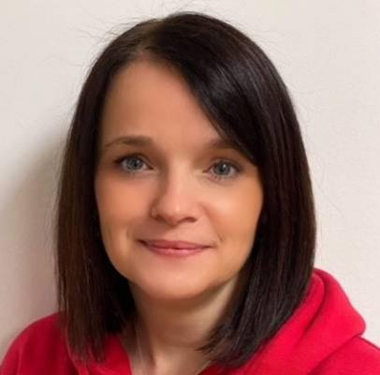
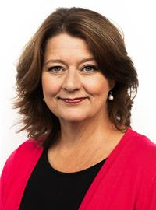
Prosiect Pleidlais Project Vote
Etholiad go iawn
Real election
Notes:
Prosiect Pleidlais / Project Vote – Leanne Wood
Etholiad go iawn / Real election – Elizabeth ‘Buffy’ Williams

Slide 60
Trafodaeth | Discussion
- Meddyliwch am 3 pheth rydych ch wedi dysgu trwy wneud yr etholiad paralel
- Pa weithgareddau wnaethoch chi fwynhau mwyaf?
- Meddyliwch am un ffordd mae’r profiad wedi effeithio arnoch chi neu ddatblygu eich barn
- Oedd yna wahaniaeth yn eich ardal chi rhwng y canlyniadau paralel, a’r canlyniadau swyddogol/go iawn? Pam ydych chi’n meddwl?
- Ydych chi’n meddwl bod y pandemig wedi cael effaith ar faint mae pobl yn ei wybod am wleidyddiaeth Cymru?
- Name three things you’ve learned through this Parallel Election
- Which activities did you enjoy the most and why?
- Name one way this experience has changed you or developed opinions
- Was there a difference between the Project Vote results and the real election results? Why do you think that is?
- Do you think that the coronavirus pandemic had an impact on how much people know about Welsh politics?

Slide 61
Camau nesaf | Next steps
Eich aelod o’r Senedd – Mae eich aelod o’r Senedd yna i’ch cynrychioli chi yn y Senedd. Cofiwch mae gennych chi 5 aelod sy’n eich cynrychioli chi – yr un a gafodd ei ethol gan eich etholaeth, a’r 4 cafodd eu hethol gan eich rhanbarth (gweler diwedd y cyflwyniad)
Cofiwch gysylltu gyda nhw os:
- Rydych chi eisiau cyngor neu wybodaeth am rywbeth sydd gan y Senedd pwerau drosto
- Rydych chi eisiau gofyn iddyn nhw beth fydden nhw’n ei wneud i wella eich ardal i bobl ifanc
- Mae gennych chi ddiddordeb mewn mater lleol ac eisiau gwybod mwy
Paid ag ofni cysylltu gyda nhw. Maen nhw’n derbyn cannoedd o ebyst a galwadau ffôn pob blwyddyn ar bob math o fater – eu swydd nhw yw gwrando ar eich pryderon.
Your MS - your MS is there to represent you in the Senedd. Remember you have 5 members of the Senedd representing you – the 1 who was voted in by your constituency, and the 4 who were voted in by your region (see the end of the powerpoint).
Remember to get in touch with them if:
- you want advice or information on something that the Welsh Parliament has control over
- you want to ask them what they will be doing to make your local area better for young people
- there is an issue in your local area that you're interested in
Don't be shy about getting in touch with them. They receive hundreds of emails and phone calls every year on all sorts of issues - it's their job to listen to your concerns.

Slide 62
Camau nesaf | Next steps
Gwneud Gwahaniaeth
Os oes gennych chi ddiddordeb mewn creu newid i faterion sy’n bwysig i chi, yn yr ysgol neu yn eich cymuned leol, ewch i’n hadnodd Gwneud Gwahaniaeth. A plis cysylltwch os oes unrhyw gwestiwn gyda chi amdano fe.
Cofrestru i bleidleisio
Cofiwch gallwch gofrestru i bleidleisio os ydych chi’n 14+ oed.
Ewch at y gwrfan yma i wneud hyn.
Byddwch chi wedyn yn gallu pleidleisio mewn etholiadau Senedd, ac etholiadau eich cyngor lleol, pan rydych chi’n troi’n 16.
Making a difference
If you're interested in making a difference to the issues that matter to you, whether it's in school or your local community, take a look at our Make a Difference resource. And please get in touch with us if you have any questions about it.
Registering to vote
Remember you can register to vote if you are aged 14+
Go to this website to do this.
You will then be able to vote in Senedd elections, and your local council elections, when you turn 16.

Slide 63
Bro Morgannwg Vale of Glamorgan

Slide 64
Canlyniadau Etholiad Paralel | Parallel election Results (1/2)
Plaid | Party | Ymgeiswyr | Candidates | Pleidleisiau | Votes | %
Propel | Janet Brocklehurst | 20 | 9%
Annibynnol / Independent | Alan Coulthard | 2 | 1%
Abolish the Welsh Assembly | Stuart Field | 4 | 2%
Plaid Cymru | Richard Grigg | 10 | 5%
Reform UK | Mike Hancock | 27 | 13%

Slide 65
Canlyniadau Etholiad Paralel | Parallel election Results (2/2)
Plaid | Party | Ymgeiswyr | Candidates | Pleidleisiau | Votes | %
Llafur / Labour | Jane Hutt | 38 | 18%
Gwlad | Karl James Langford | 8 | 4%
Freedom Alliance | Neil Shah | 6 | 3%
Plaid Werdd / Green Party | Anthony Slaughter | 48 | 23%
Ceidwadwyr / Conservatives | Matt Smith | 28 | 13%
Democratiaid Rhyddfrydol / Liberal Democrats | Sally Stephenson | 20 | 9%

Slide 66
Canlyniad Senedd go iawn | Real Senedd result (1/2)
Plaid | Party | Ymgeiswyr | Candidates | Pleidleisiau | Votes | %
Propel | Janet Brocklehurst | 426 | 1%
Annibynnol / Independent | Alan Coulthard | 237 | 0.6%
Abolish the Welsh Assembly | Stuart Field | 1,394 | 3.3%
Plaid Cymru | Richard Grigg | 3,699 | 8.6%
Reform UK | Mike Hancock | 416 | 1%

Slide 67
Canlyniad Senedd go iawn | Real Senedd result (2/2)
Plaid | Party | Ymgeiswyr | Candidates | Pleidleisiau | Votes | %
Llafur / Labour | Jane Hutt | 18,667 | 43.5%
Gwlad | Karl James Langford | 174 | 0.4%
Freedom Alliance | Neil Shah | 226 | 0.5%
Plaid Werdd / Green Party | Anthony Slaughter | 1,262 | 2.9%
Ceidwadwyr / Conservatives | Matt Smith | 15,397 | 35.9%
Democratiaid Rhyddfrydol / Liberal Democrats | Sally Stephenson | 994 | 2.3%

Slide 68
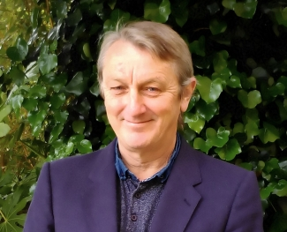
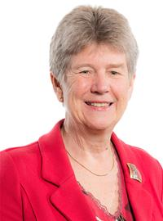
Prosiect Pleidlais Project Vote
Etholiad go iawn
Real election
Notes:
Prosiect Pleidlais / Project Vote – Anthony Slaughter
Etholiad go iawn / Real election – Jane Hutt

Slide 69
Trafodaeth | Discussion
- Meddyliwch am 3 pheth rydych ch wedi dysgu trwy wneud yr etholiad paralel
- Pa weithgareddau wnaethoch chi fwynhau mwyaf?
- Meddyliwch am un ffordd mae’r profiad wedi effeithio arnoch chi neu ddatblygu eich barn
- Oedd yna wahaniaeth yn eich ardal chi rhwng y canlyniadau paralel, a’r canlyniadau swyddogol/go iawn? Pam ydych chi’n meddwl?
- Ydych chi’n meddwl bod y pandemig wedi cael effaith ar faint mae pobl yn ei wybod am wleidyddiaeth Cymru?
- Name three things you’ve learned through this Parallel Election
- Which activities did you enjoy the most and why?
- Name one way this experience has changed you or developed opinions
- Was there a difference between the Project Vote results and the real election results? Why do you think that is?
- Do you think that the coronavirus pandemic had an impact on how much people know about Welsh politics?

Slide 70
Camau nesaf | Next steps
Eich aelod o’r Senedd – Mae eich aelod o’r Senedd yna i’ch cynrychioli chi yn y Senedd. Cofiwch mae gennych chi 5 aelod sy’n eich cynrychioli chi – yr un a gafodd ei ethol gan eich etholaeth, a’r 4 cafodd eu hethol gan eich rhanbarth (gweler diwedd y cyflwyniad)
Cofiwch gysylltu gyda nhw os:
- Rydych chi eisiau cyngor neu wybodaeth am rywbeth sydd gan y Senedd pwerau drosto
- Rydych chi eisiau gofyn iddyn nhw beth fydden nhw’n ei wneud i wella eich ardal i bobl ifanc
- Mae gennych chi ddiddordeb mewn mater lleol ac eisiau gwybod mwy
Paid ag ofni cysylltu gyda nhw. Maen nhw’n derbyn cannoedd o ebyst a galwadau ffôn pob blwyddyn ar bob math o fater – eu swydd nhw yw gwrando ar eich pryderon.
Your MS - your MS is there to represent you in the Senedd. Remember you have 5 members of the Senedd representing you – the 1 who was voted in by your constituency, and the 4 who were voted in by your region (see the end of the powerpoint).
Remember to get in touch with them if:
- you want advice or information on something that the Welsh Parliament has control over
- you want to ask them what they will be doing to make your local area better for young people
- there is an issue in your local area that you're interested in
Don't be shy about getting in touch with them. They receive hundreds of emails and phone calls every year on all sorts of issues - it's their job to listen to your concerns.

Slide 71
Camau nesaf | Next steps
Gwneud Gwahaniaeth
Os oes gennych chi ddiddordeb mewn creu newid i faterion sy’n bwysig i chi, yn yr ysgol neu yn eich cymuned leol, ewch i’n hadnodd Gwneud Gwahaniaeth. A plis cysylltwch os oes unrhyw gwestiwn gyda chi amdano fe.
Cofrestru i bleidleisio
Cofiwch gallwch gofrestru i bleidleisio os ydych chi’n 14+ oed.
Ewch at y gwrfan yma i wneud hyn.
Byddwch chi wedyn yn gallu pleidleisio mewn etholiadau Senedd, ac etholiadau eich cyngor lleol, pan rydych chi’n troi’n 16.
Making a difference
If you're interested in making a difference to the issues that matter to you, whether it's in school or your local community, take a look at our Make a Difference resource. And please get in touch with us if you have any questions about it.
Registering to vote
Remember you can register to vote if you are aged 14+
Go to this website to do this.
You will then be able to vote in Senedd elections, and your local council elections, when you turn 16.

Slide 72
Rhanbarth Region

Slide 73
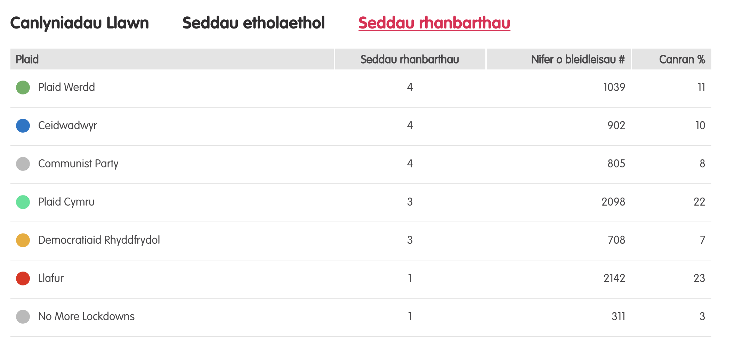
Canlyniadau – etholiad paralel
Notes:
Tudalen wê canlyniadau’r Prosiect Pleidlais - https://prosiectpleidlais.cymru/canlyniadau/
Web page for Project Vote results – https://www.projectvote.wales/results/
Tudalen wê canlyniadau go iawn- https://www.bbc.co.uk/cymrufyw/pynciau/cvd627zw9rjt/etholiad-senedd-cymru-2021
Real results web page: https://www.bbc.co.uk/news/topics/cqwn14k92zwt/welsh-parliament-election-2021

Slide 74
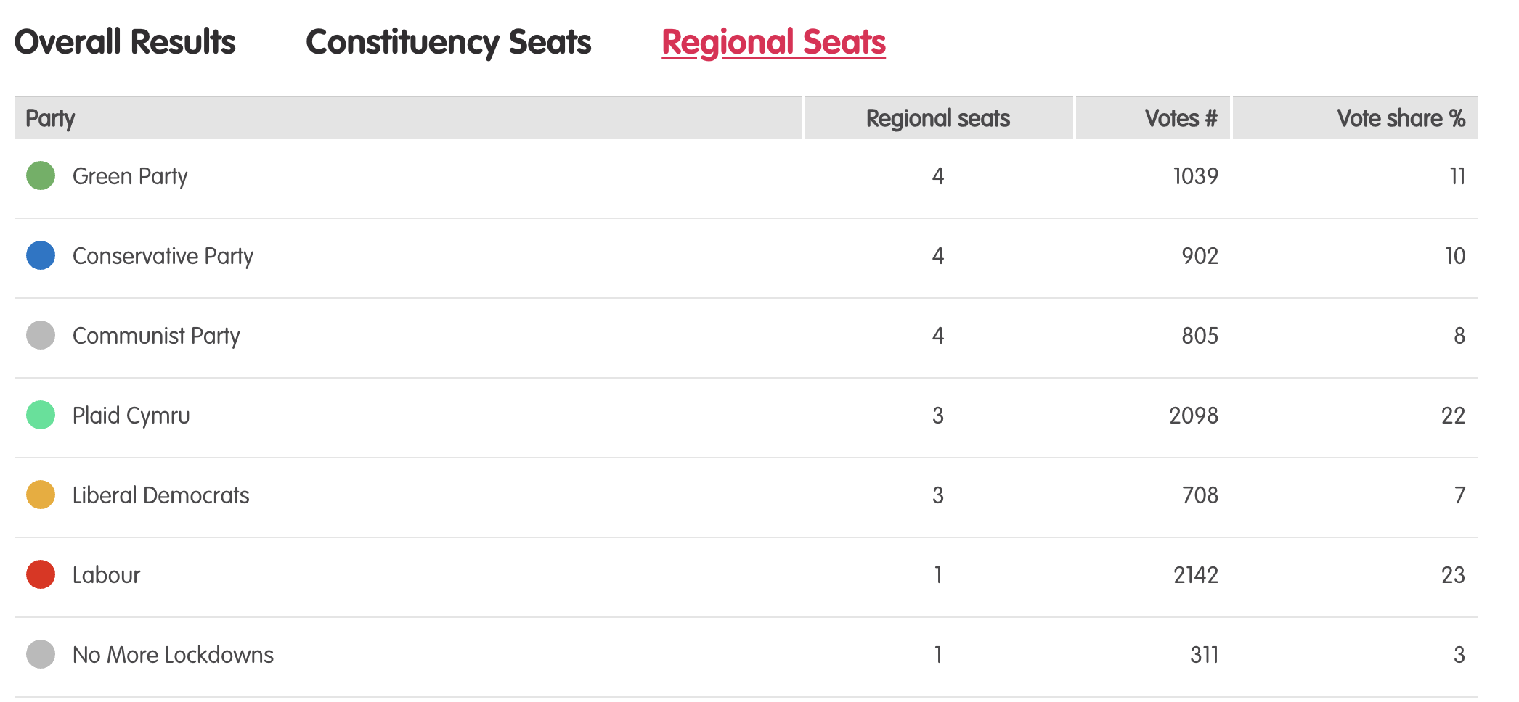
Results – Project vote parallel election
Notes:
Tudalen wê canlyniadau’r Prosiect Pleidlais - https://prosiectpleidlais.cymru/canlyniadau/
Web page for Project Vote results – https://www.projectvote.wales/results/
Tudalen wê canlyniadau go iawn- https://www.bbc.co.uk/cymrufyw/pynciau/cvd627zw9rjt/etholiad-senedd-cymru-2021
Real results web page: https://www.bbc.co.uk/news/topics/cqwn14k92zwt/welsh-parliament-election-2021

Slide 75
Canlynidau swyddogol – Official results
Plaid | Party | Seddau rhanbarthau | Regional seats | Nifer o bleidleisiau | Number of votes | Canran % | Vote share %
Llafur / Labour | 3 | 401,770 | 36.2%
Ceidwadwyr / Conservatives | 8 | 278,560 | 25.1%
Plaid Cymru | 8 | 230,161 | 20.7%
Plaid Werdd / Green Party | 0 | 48,714 | 4.4%
Democratiaid Rhyddfrydol / Liberal Democrats | 1 | 48,217 | 4.3%
Abolish the Welsh Assembly | 0 | 41,399 | 3.7%
Notes:
NB: the number and share of votes are for regional votes only.
We have included the top 6 parties only here

Slide 76
Canol De Cymru South Wales Central

Slide 77
Prosiect Pleidlais Project Vote
Etholiad go iawn
Real election
Plaid / Party | Pleidleisiau / Votes | Seddau /Seats
Communist | 273 | 1
Ceidwadwyr / Conservatives | 209 | 1
Democratiaid Rhyddfrydol / Liberal Democrats | 195 | 1
No More Lockdowns | 185 | 1
Plaid / Party | Pleidleisiau / Votes | Seddau /Seats
Ceidwadwyr / Conservatives | 56,622 | 2
Plaid Cymru | 46,478 | 2

Slide 78
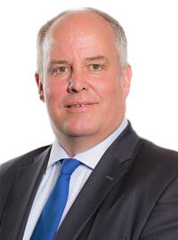
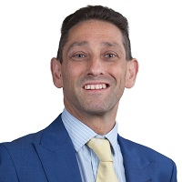
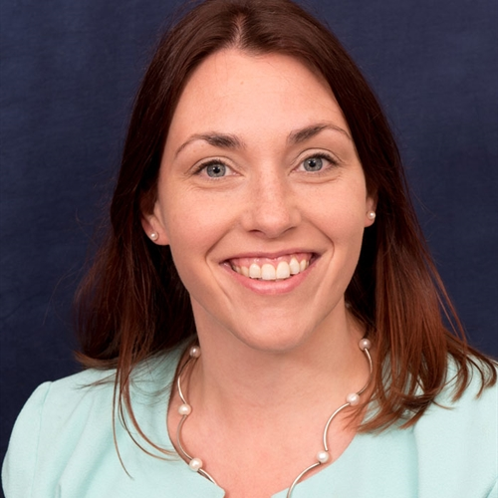
Prosiect Pleidlais Project Vote
Etholiad go iawn
Real election
Notes:
Prosiect Pleidlais / Project Vote (clockwise)
Anita Wright – Communist Party
Andrew RT Davies - Ceidwadwyr / Conservatives
Rodney Berman - Democratiaid Rhyddfrydol / Liberal Democrats
Justin Lilley - No More Lockdowns
Etholiad go iawn / Real election (clockwise)
Andrew RT Davies - Ceidwadwyr / Conservatives
Rhys ab Owen - Plaid Cymru
Joel James - Ceidwadwyr / Conservatives
Heledd Fychan - Plaid Cymru

