Slide 2
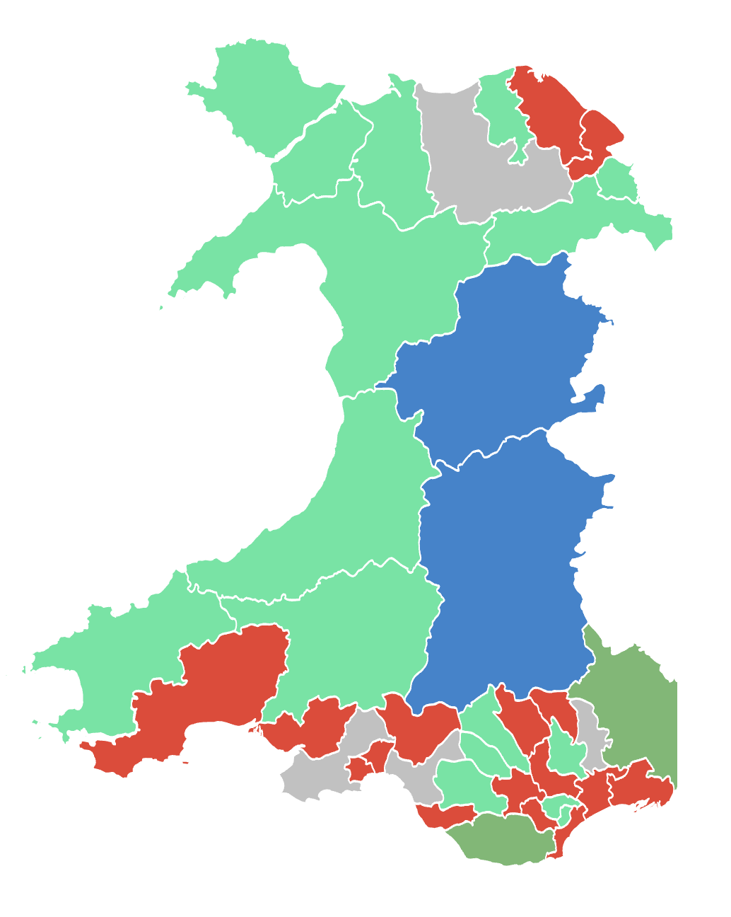
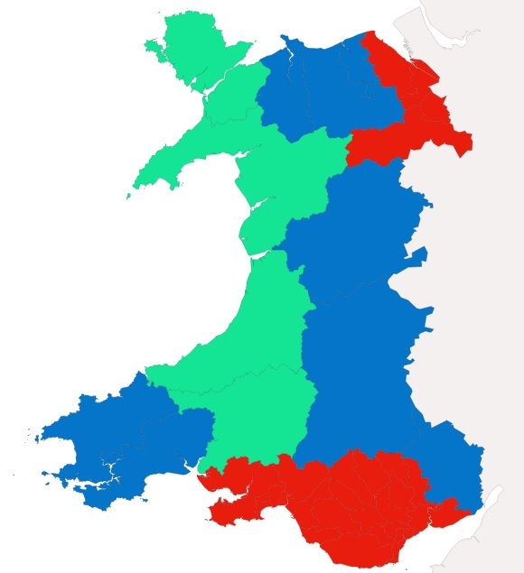
Prosiect Pleidlais | Project Vote
Etholiad go iawn | Real election
Notes:
Lliwiau’r pleidiau / Party colours
Ceidwadwyr / Conservatives – Glas / Blue
Llafur / Labour – Red / Coch
Plaid Cymru – Light Green
Plaid Werdd / Green Party – Dark Green
No results – Llwyd / Grey
Etc

Slide 3
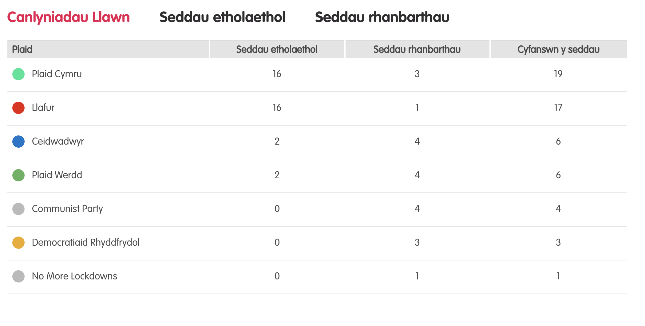
Canlyniadau llawn – Etholiad Paralel
Notes:
Tudalen wê canlyniadau’r Prosiect Pleidlais - https://prosiectpleidlais.cymru/canlyniadau/
Web page for Project Vote results – https://www.projectvote.wales/results/
Tudalen wê canlyniadau go iawn- https://www.bbc.co.uk/cymrufyw/pynciau/cvd627zw9rjt/etholiad-senedd-cymru-2021
Real results web page: https://www.bbc.co.uk/news/topics/cqwn14k92zwt/welsh-parliament-election-2021

Slide 4
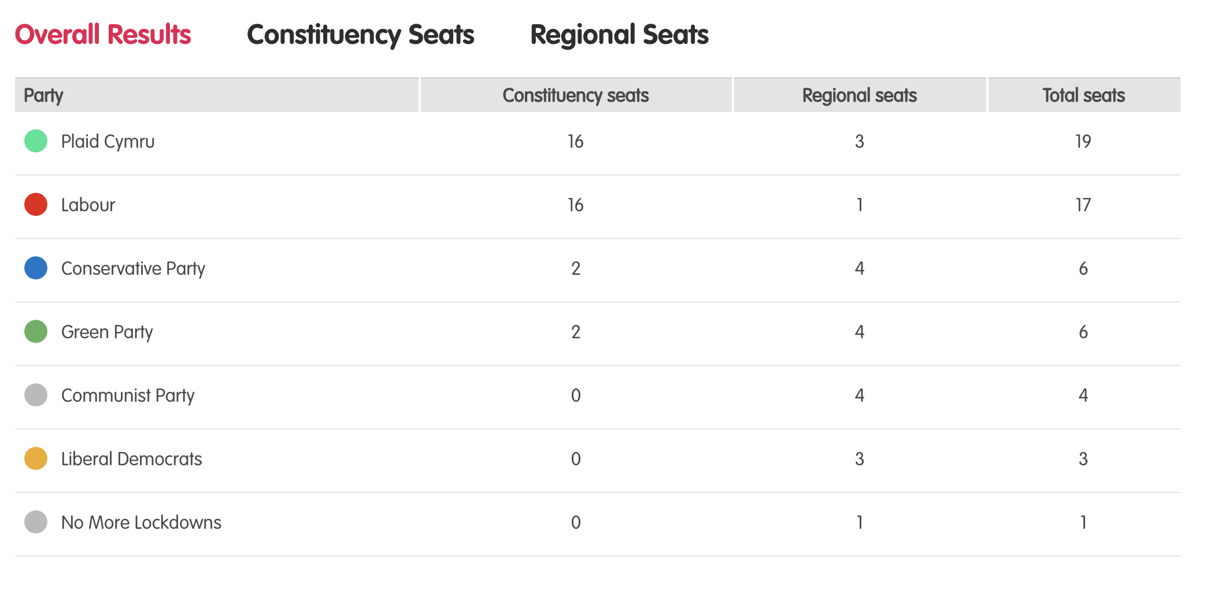
Results – Project vote parallel election
Notes:
Tudalen wê canlyniadau’r Prosiect Pleidlais - https://prosiectpleidlais.cymru/canlyniadau/
Web page for Project Vote results – https://www.projectvote.wales/results/
Tudalen wê canlyniadau go iawn- https://www.bbc.co.uk/cymrufyw/pynciau/cvd627zw9rjt/etholiad-senedd-cymru-2021
Real results web page: https://www.bbc.co.uk/news/topics/cqwn14k92zwt/welsh-parliament-election-2021

Slide 5
Official election Results / Canlyniadau etholiad swyddogol
Plaid | Party | Seddau etholaethol | Constituency seats | Seddau rhanbarthau | Regional seats | Cyfanswn y seddau | Total Seats
Llafur / Labour | 27 | 3 | 30
Ceidwadwyr / Conservatives | 8 | 8 | 16
Plaid Cymru | 5 | 8 | 13
Democratiaid Rhyddfrydol / Liberal Democrats | 0 | 1 | 1

Slide 6
Etholaethau Constituencies

Slide 7
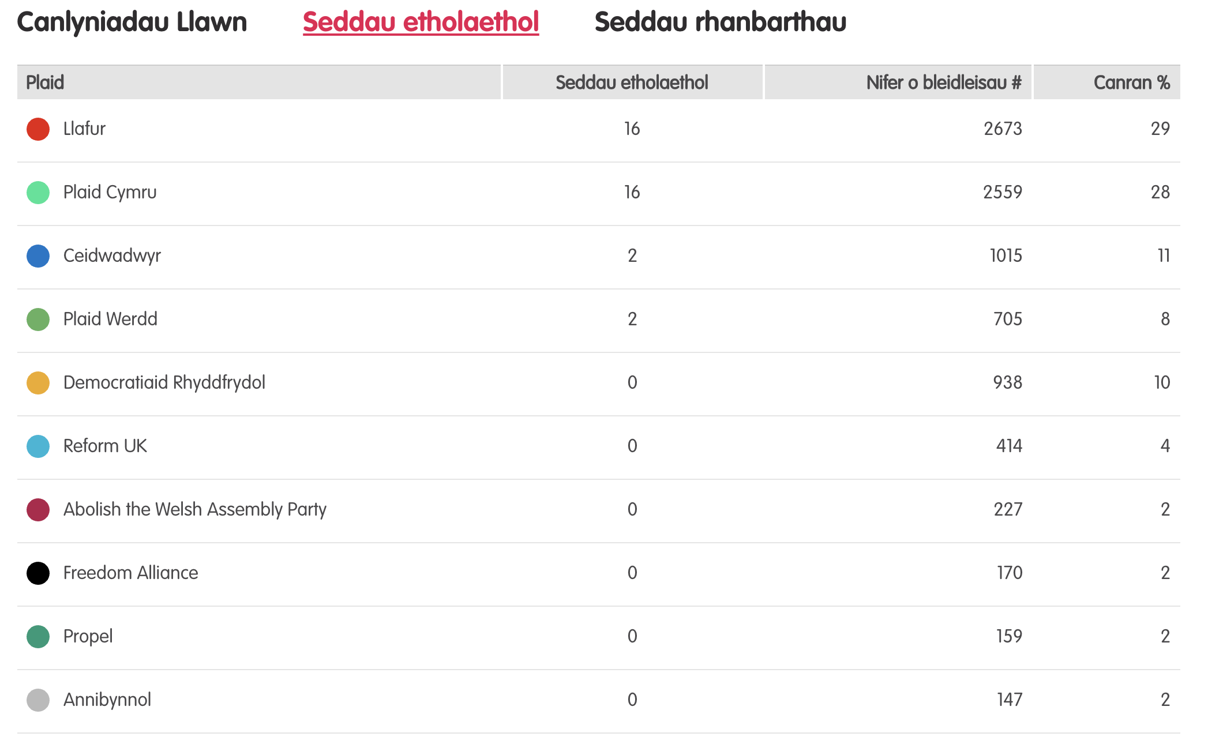
Canlyniadau – Etholiad Paralel
Notes:
Tudalen wê canlyniadau’r Prosiect Pleidlais - https://prosiectpleidlais.cymru/canlyniadau/
Web page for Project Vote results – https://www.projectvote.wales/results/
Tudalen wê canlyniadau go iawn- https://www.bbc.co.uk/cymrufyw/pynciau/cvd627zw9rjt/etholiad-senedd-cymru-2021
Real results web page: https://www.bbc.co.uk/news/topics/cqwn14k92zwt/welsh-parliament-election-2021

Slide 8
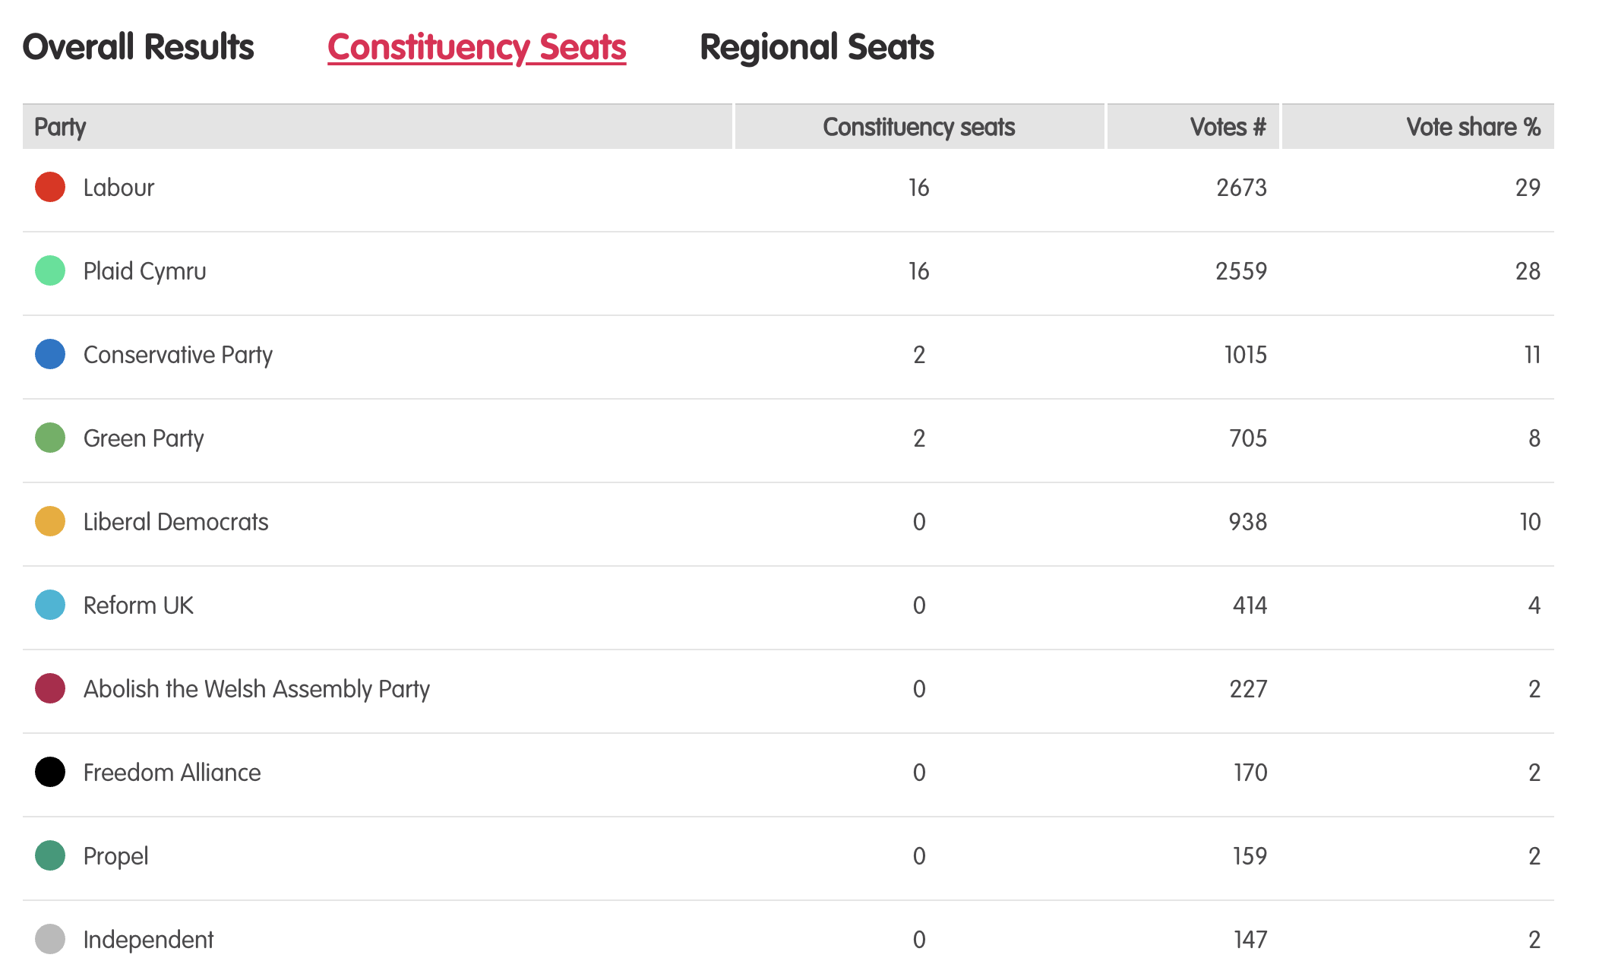
Results – Project vote parallel election
Notes:
Tudalen wê canlyniadau’r Prosiect Pleidlais - https://prosiectpleidlais.cymru/canlyniadau/
Web page for Project Vote results – https://www.projectvote.wales/results/
Tudalen wê canlyniadau go iawn- https://www.bbc.co.uk/cymrufyw/pynciau/cvd627zw9rjt/etholiad-senedd-cymru-2021
Real results web page: https://www.bbc.co.uk/news/topics/cqwn14k92zwt/welsh-parliament-election-2021

Slide 9
Canlyniadau swyddogol – Official results
Plaid | Party | Seddau etholaethol | Constituency seats | Nifer o bleidleisiau | Number of votes | Canran % | Vote share %
Llafur / Labour | 27 | 443,047 | 39.9%
Ceidwadwyr / Conservatives | 8 | 289,802 | 26.1%
Plaid Cymru | 5 | 225,376 | 20.3%
Democratiaid Rhyddfrydol / Liberal Democrats | 0 | 54,202 | 4.9%
Abolish the Welsh Assembly | 0 | 18,149 | 1.6%
Plaid Werdd / Green Party | 0 | 17,817 | 1.6%
Notes:
NB: the number and share of votes are for constituency votes only.
We have included the top 6 parties only here

Slide 10
Blaenau Gwent

Slide 11
Canlyniadau Prosiect Pleidlais | Project Vote Results
Plaid | Party | Ymgeiswyr | Candidates | Pleidleisiau | Votes | %
Reform UK | Robert Beavis | 2 | 3%
Llafur / Labour | Alun Davies | 15 | 26%
Ceidwadwyr / Conservatives | Edwards Dawson | 3 | 5%
Plaid Cymru | Peredur Griffiths | 14 | 24%
Gwlad | Calen Jones | 4 | 7%
Annibynnol / Independent | Mandy Moore | 1 | 2%
Plaid Werdd / Green Party | Stephen Priestnall | 9 | 16%
Abolish the Welsh Assembly | Richard Taylor | 4 | 7%
Democratiaid Rhyddfrydol / Liberal Democrats | Paula Yates | 6 | 10%

Slide 12
Canlyniad Senedd go iawn | Real Senedd result
Plaid | Party | Ymgeiswyr | Candidates | Pleidleisiau | Votes | %
Reform UK | Robert Beavis | 319 | 1.5%
Llafur / Labour | Alun Davies | 10,226 | 49.1%
Ceidwadwyr / Conservatives | Edwards Dawson | 3,611 | 12.5%
Plaid Cymru | Peredur Griffiths | 3,588 | 17.2%
Annibynnol / Independent | Mandy Moore | 2,376 | 11.4%
Abolish the Welsh Assembly | Richard Taylor | 1,364 | 6.6%
Democratiaid Rhyddfrydol / Liberal Democrats | Paula Yates | 333 | 1.6%

Slide 13
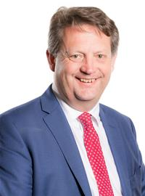
Prosiect Pleidlais Project Vote
Etholiad go iawn
Real election
Notes:
Prosiect Pleidlais / Project Vote – Alun Davies
Etholiad go iawn / Real election – Alun Davies

Slide 14
Trafodaeth | Discussion
- Meddyliwch am 3 pheth rydych ch wedi dysgu trwy wneud yr etholiad paralel
- Pa weithgareddau wnaethoch chi fwynhau mwyaf?
- Meddyliwch am un ffordd mae’r profiad wedi effeithio arnoch chi neu ddatblygu eich barn
- Oedd yna wahaniaeth yn eich ardal chi rhwng y canlyniadau paralel, a’r canlyniadau swyddogol/go iawn? Pam ydych chi’n meddwl?
- Ydych chi’n meddwl bod y pandemig wedi cael effaith ar faint mae pobl yn ei wybod am wleidyddiaeth Cymru?
- Name three things you’ve learned through this Parallel Election
- Which activities did you enjoy the most and why?
- Name one way this experience has changed you or developed opinions
- Was there a difference between the Project Vote results and the real election results? Why do you think that is?
- Do you think that the coronavirus pandemic had an impact on how much people know about Welsh politics?

Slide 15
Camau nesaf | Next steps
Eich aelod o’r Senedd – Mae eich aelod o’r Senedd yna i’ch cynrychioli chi yn y Senedd. Cofiwch mae gennych chi 5 aelod sy’n eich cynrychioli chi – yr un a gafodd ei ethol gan eich etholaeth, a’r 4 cafodd eu hethol gan eich rhanbarth (gweler diwedd y cyflwyniad)
Cofiwch gysylltu gyda nhw os:
- Rydych chi eisiau cyngor neu wybodaeth am rywbeth sydd gan y Senedd pwerau drosto
- Rydych chi eisiau gofyn iddyn nhw beth fydden nhw’n ei wneud i wella eich ardal i bobl ifanc
- Mae gennych chi ddiddordeb mewn mater lleol ac eisiau gwybod mwy
Paid ag ofni cysylltu gyda nhw. Maen nhw’n derbyn cannoedd o ebyst a galwadau ffôn pob blwyddyn ar bob math o fater – eu swydd nhw yw gwrando ar eich pryderon.
Your MS - your MS is there to represent you in the Senedd. Remember you have 5 members of the Senedd representing you – the 1 who was voted in by your constituency, and the 4 who were voted in by your region (see the end of the powerpoint).
Remember to get in touch with them if:
- you want advice or information on something that the Welsh Parliament has control over
- you want to ask them what they will be doing to make your local area better for young people
- there is an issue in your local area that you're interested in
Don't be shy about getting in touch with them. They receive hundreds of emails and phone calls every year on all sorts of issues - it's their job to listen to your concerns.

Slide 16
Camau nesaf | Next steps
Gwneud Gwahaniaeth
Os oes gennych chi ddiddordeb mewn creu newid i faterion sy’n bwysig i chi, yn yr ysgol neu yn eich cymuned leol, ewch i’n hadnodd Gwneud Gwahaniaeth. A plis cysylltwch os oes unrhyw gwestiwn gyda chi amdano fe.
Cofrestru i bleidleisio
Cofiwch gallwch gofrestru i bleidleisio os ydych chi’n 14+ oed.
Ewch at y gwefan yma i wneud hyn.
Byddwch chi wedyn yn gallu pleidleisio mewn etholiadau Senedd, ac etholiadau eich cyngor lleol, pan rydych chi’n troi’n 16.
Making a difference
If you're interested in making a difference to the issues that matter to you, whether it's in school or your local community, take a look at our Make a Difference resource. And please get in touch with us if you have any questions about it.
Registering to vote
Remember you can register to vote if you are aged 14+
Go to this website to do this.
You will then be able to vote in Senedd elections, and your local council elections, when you turn 16.

Slide 17
Caerffili Caerphilly

Slide 18
Canlyniadau Prosiect Pleidlais | Project Vote Results
Plaid | Party | Ymgeiswyr | Candidates | Pleidleisiau | Votes | %
Democratiaid Rhyddfrydol / Liberal Democrats | Stephen Aicheler | 23 | 16%
Llafur / Labour | Hefin David | 52 | 37%
Plaid Cymru | Delyth Jewell | 46 | 33%
Abolish the Welsh Assembly | Stephen Jones | 5 | 4%
Ceidwadwyr / Conservatives | Steven Mayfield | 9 | 6%
Reform UK | Tim Price | 6 | 4%

Slide 19
Canlyniad Senedd go iawn | Real Senedd result
Plaid | Party | Ymgeiswyr | Candidates | Pleidleisiau | Votes | %
Democratiaid Rhyddfrydol / Liberal Democrats | Stephen Aicheler | 787 | 2.7%
Llafur / Labour | Hefin David | 13,289 | 46%
Plaid Cymru | Delyth Jewell | 8,211 | 28.4%
Abolish the Welsh Assembly | Stephen Jones | 1,119 | 3.9%
Ceidwadwyr / Conservatives | Steven Mayfield | 5,013 | 17.3%
Reform UK | Tim Price | 495 | 1.7%

Slide 20
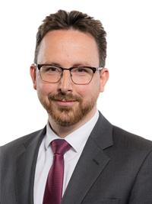
Prosiect Pleidlais Project Vote
Etholiad go iawn
Real election
Notes:
Prosiect Pleidlais / Project Vote – Hefin David
Etholiad go iawn / Real election – Hefin David

Slide 21
Trafodaeth | Discussion
- Meddyliwch am 3 pheth rydych ch wedi dysgu trwy wneud yr etholiad paralel
- Pa weithgareddau wnaethoch chi fwynhau mwyaf?
- Meddyliwch am un ffordd mae’r profiad wedi effeithio arnoch chi neu ddatblygu eich barn
- Oedd yna wahaniaeth yn eich ardal chi rhwng y canlyniadau paralel, a’r canlyniadau swyddogol/go iawn? Pam ydych chi’n meddwl?
- Ydych chi’n meddwl bod y pandemig wedi cael effaith ar faint mae pobl yn ei wybod am wleidyddiaeth Cymru?
- Name three things you’ve learned through this Parallel Election
- Which activities did you enjoy the most and why?
- Name one way this experience has changed you or developed opinions
- Was there a difference between the Project Vote results and the real election results? Why do you think that is?
- Do you think that the coronavirus pandemic had an impact on how much people know about Welsh politics?

Slide 22
Camau nesaf | Next steps
Eich aelod o’r Senedd – Mae eich aelod o’r Senedd yna i’ch cynrychioli chi yn y Senedd. Cofiwch mae gennych chi 5 aelod sy’n eich cynrychioli chi – yr un a gafodd ei ethol gan eich etholaeth, a’r 4 cafodd eu hethol gan eich rhanbarth (gweler diwedd y cyflwyniad)
Cofiwch gysylltu gyda nhw os:
- Rydych chi eisiau cyngor neu wybodaeth am rywbeth sydd gan y Senedd pwerau drosto
- Rydych chi eisiau gofyn iddyn nhw beth fydden nhw’n ei wneud i wella eich ardal i bobl ifanc
- Mae gennych chi ddiddordeb mewn mater lleol ac eisiau gwybod mwy
Paid ag ofni cysylltu gyda nhw. Maen nhw’n derbyn cannoedd o ebyst a galwadau ffôn pob blwyddyn ar bob math o fater – eu swydd nhw yw gwrando ar eich pryderon.
Your MS - your MS is there to represent you in the Senedd. Remember you have 5 members of the Senedd representing you – the 1 who was voted in by your constituency, and the 4 who were voted in by your region (see the end of the powerpoint).
Remember to get in touch with them if:
- you want advice or information on something that the Welsh Parliament has control over
- you want to ask them what they will be doing to make your local area better for young people
- there is an issue in your local area that you're interested in
Don't be shy about getting in touch with them. They receive hundreds of emails and phone calls every year on all sorts of issues - it's their job to listen to your concerns.

Slide 23
Camau nesaf | Next steps
Gwneud Gwahaniaeth
Os oes gennych chi ddiddordeb mewn creu newid i faterion sy’n bwysig i chi, yn yr ysgol neu yn eich cymuned leol, ewch i’n hadnodd Gwneud Gwahaniaeth. A plis cysylltwch os oes unrhyw gwestiwn gyda chi amdano fe.
Cofrestru i bleidleisio
Cofiwch gallwch gofrestru i bleidleisio os ydych chi’n 14+ oed.
Ewch at y gwefan yma i wneud hyn.
Byddwch chi wedyn yn gallu pleidleisio mewn etholiadau Senedd, ac etholiadau eich cyngor lleol, pan rydych chi’n troi’n 16.
Making a difference
If you're interested in making a difference to the issues that matter to you, whether it's in school or your local community, take a look at our Make a Difference resource. And please get in touch with us if you have any questions about it.
Registering to vote
Remember you can register to vote if you are aged 14+
Go to this website to do this.
You will then be able to vote in Senedd elections, and your local council elections, when you turn 16.

Slide 24
Islwyn

Slide 25
Canlyniadau Prosiect Pleidlais | Project Vote Results
Plaid | Party | Ymgeiswyr | Candidates | Pleidleisiau | Votes | %
Ceidwadwyr / Conservatives | Gavin Chambers | 6 | 12%
Annibynnol / Independent | Kevin Etheridge | 5 | 10%
Abolish the Welsh Assembly | Michael Ford | 3 | 6%
UKIP | Neil Hamilton | 2 | 4%
Plaid Cymru | Rhys Mills | 14 | 28%
Llafur / Labour | Rhiannon Passmore | 12 | 24%
Democratiaid Rhyddfrydol / Liberal Democrats | Oliver Townsend | 5 | 10%
Reform UK | James Wells | 3 | 6%

Slide 26
Canlyniad Senedd go iawn | Real Senedd result
Plaid | Party | Ymgeiswyr | Candidates | Pleidleisiau | Votes | %
Ceidwadwyr / Conservatives | Gavin Chambers | 3,894 | 15.9%
Annibynnol / Independent | Kevin Etheridge | 4,723 | 19.3%
Abolish the Welsh Assembly | Michael Ford | 568 | 2.3%
UKIP | Neil Hamilton | 507 | 2.1%
Plaid Cymru | Rhys Mills | 3,930 | 16.1%
Llafur / Labour | Rhianon Passmore | 9,962 | 40.7%
Democratiaid Rhyddfrydol / Liberal Democrats | Oliver Townsend | 476 | 1.9%
Reform UK | James Wells | 421 | 1.7%

Slide 27
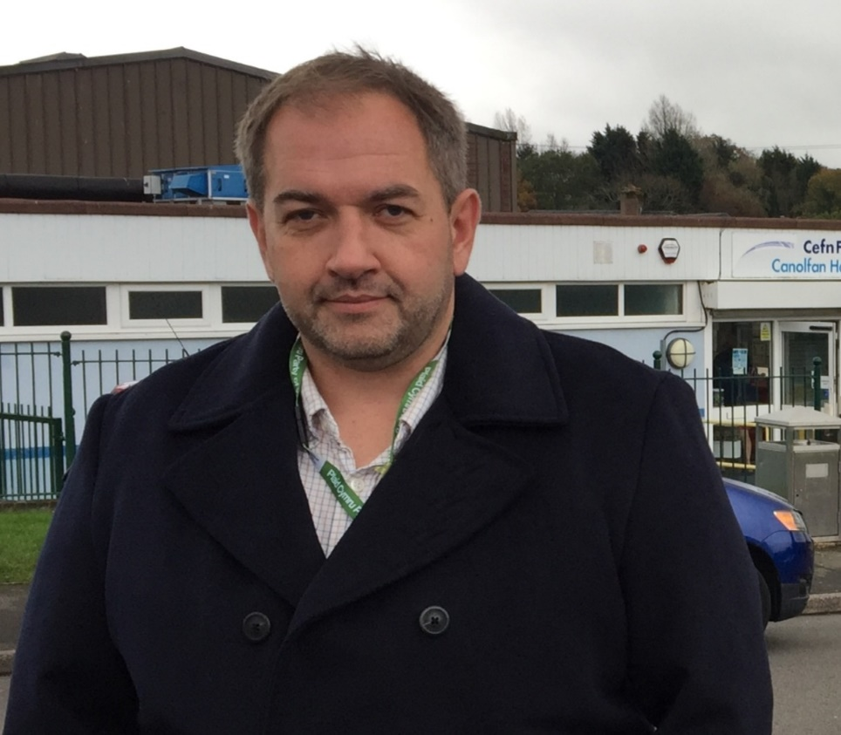
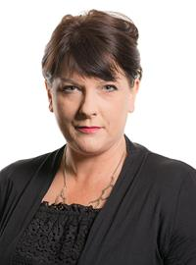
Prosiect Pleidlais Project Vote
Etholiad go iawn
Real election
Notes:
Prosiect Pleidlais / Project Vote – Rhys Mills
Etholiad go iawn / Real election – Rhianon Passmore

Slide 28
Trafodaeth | Discussion
- Meddyliwch am 3 pheth rydych ch wedi dysgu trwy wneud yr etholiad paralel
- Pa weithgareddau wnaethoch chi fwynhau mwyaf?
- Meddyliwch am un ffordd mae’r profiad wedi effeithio arnoch chi neu ddatblygu eich barn
- Oedd yna wahaniaeth yn eich ardal chi rhwng y canlyniadau paralel, a’r canlyniadau swyddogol/go iawn? Pam ydych chi’n meddwl?
- Ydych chi’n meddwl bod y pandemig wedi cael effaith ar faint mae pobl yn ei wybod am wleidyddiaeth Cymru?
- Name three things you’ve learned through this Parallel Election
- Which activities did you enjoy the most and why?
- Name one way this experience has changed you or developed opinions
- Was there a difference between the Project Vote results and the real election results? Why do you think that is?
- Do you think that the coronavirus pandemic had an impact on how much people know about Welsh politics?

Slide 29
Camau nesaf | Next steps
Eich aelod o’r Senedd – Mae eich aelod o’r Senedd yna i’ch cynrychioli chi yn y Senedd. Cofiwch mae gennych chi 5 aelod sy’n eich cynrychioli chi – yr un a gafodd ei ethol gan eich etholaeth, a’r 4 cafodd eu hethol gan eich rhanbarth (gweler diwedd y cyflwyniad)
Cofiwch gysylltu gyda nhw os:
- Rydych chi eisiau cyngor neu wybodaeth am rywbeth sydd gan y Senedd pwerau drosto
- Rydych chi eisiau gofyn iddyn nhw beth fydden nhw’n ei wneud i wella eich ardal i bobl ifanc
- Mae gennych chi ddiddordeb mewn mater lleol ac eisiau gwybod mwy
Paid ag ofni cysylltu gyda nhw. Maen nhw’n derbyn cannoedd o ebyst a galwadau ffôn pob blwyddyn ar bob math o fater – eu swydd nhw yw gwrando ar eich pryderon.
Your MS - your MS is there to represent you in the Senedd. Remember you have 5 members of the Senedd representing you – the 1 who was voted in by your constituency, and the 4 who were voted in by your region (see the end of the powerpoint).
Remember to get in touch with them if:
- you want advice or information on something that the Welsh Parliament has control over
- you want to ask them what they will be doing to make your local area better for young people
- there is an issue in your local area that you're interested in
Don't be shy about getting in touch with them. They receive hundreds of emails and phone calls every year on all sorts of issues - it's their job to listen to your concerns.

Slide 30
Camau nesaf | Next steps
Gwneud Gwahaniaeth
Os oes gennych chi ddiddordeb mewn creu newid i faterion sy’n bwysig i chi, yn yr ysgol neu yn eich cymuned leol, ewch i’n hadnodd Gwneud Gwahaniaeth. A plis cysylltwch os oes unrhyw gwestiwn gyda chi amdano fe.
Cofrestru i bleidleisio
Cofiwch gallwch gofrestru i bleidleisio os ydych chi’n 14+ oed.
Ewch at y gwefan yma i wneud hyn.
Byddwch chi wedyn yn gallu pleidleisio mewn etholiadau Senedd, ac etholiadau eich cyngor lleol, pan rydych chi’n troi’n 16.
Making a difference
If you're interested in making a difference to the issues that matter to you, whether it's in school or your local community, take a look at our Make a Difference resource. And please get in touch with us if you have any questions about it.
Registering to vote
Remember you can register to vote if you are aged 14+
Go to this website to do this.
You will then be able to vote in Senedd elections, and your local council elections, when you turn 16.

Slide 31
Merthyr Tudful a Rhymni Merthyr Tydfil and Rhymney

Slide 32
Canlyniadau Prosiect Pleidlais | Project Vote Results
Plaid | Party | Ymgeiswyr | Candidates | Pleidleisiau | Votes | %
Democratiaid Rhyddfrydol / Liberal Democrats | Jez Becker | 26 | 7%
Llafur / Labour | Dawn Bowden | 146 | 42%
Ceidwadwyr / Conservatives | Donna Gavin | 43 | 12%
Plaid Cymru | Ian Gwynne | 100 | 29%
Abolish the Welsh Assembly | Hugh Moelwyn Hughes | 18 | 5%
Reform UK | Colin Jones | 10 | 3%
UKIP | George Pykov | 6 | 2%

Slide 33
Canlyniad Senedd go iawn | Real Senedd result
Plaid | Party | Ymgeiswyr | Candidates | Pleidleisiau | Votes | %
Democratiaid Rhyddfrydol / Liberal Democrats | Jez Becker | 420 | 2%
Llafur / Labour | Dawn Bowden | 13,009 | 61.5%
Ceidwadwyr / Conservatives | Donna Gavin | 2,665 | 12.6%
Plaid Cymru | Ian Gwynne | 3,698 | 17.5%
Abolish the Welsh Assembly | Hugh Moelwyn Hughes | 656 | 3.1%
Reform UK | Colin Jones | 324 | 1.5%
UKIP | George Pykov | 382 | 1.8%

Slide 34
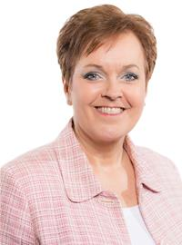
Prosiect Pleidlais Project Vote
Etholiad go iawn
Real election
Notes:
Prosiect Pleidlais / Project Vote – Dawn Bowden
Etholiad go iawn / Real election – Dawn Bowden

Slide 35
Trafodaeth | Discussion
- Meddyliwch am 3 pheth rydych ch wedi dysgu trwy wneud yr etholiad paralel
- Pa weithgareddau wnaethoch chi fwynhau mwyaf?
- Meddyliwch am un ffordd mae’r profiad wedi effeithio arnoch chi neu ddatblygu eich barn
- Oedd yna wahaniaeth yn eich ardal chi rhwng y canlyniadau paralel, a’r canlyniadau swyddogol/go iawn? Pam ydych chi’n meddwl?
- Ydych chi’n meddwl bod y pandemig wedi cael effaith ar faint mae pobl yn ei wybod am wleidyddiaeth Cymru?
- Name three things you’ve learned through this Parallel Election
- Which activities did you enjoy the most and why?
- Name one way this experience has changed you or developed opinions
- Was there a difference between the Project Vote results and the real election results? Why do you think that is?
- Do you think that the coronavirus pandemic had an impact on how much people know about Welsh politics?

Slide 36
Camau nesaf | Next steps
Eich aelod o’r Senedd – Mae eich aelod o’r Senedd yna i’ch cynrychioli chi yn y Senedd. Cofiwch mae gennych chi 5 aelod sy’n eich cynrychioli chi – yr un a gafodd ei ethol gan eich etholaeth, a’r 4 cafodd eu hethol gan eich rhanbarth (gweler diwedd y cyflwyniad)
Cofiwch gysylltu gyda nhw os:
- Rydych chi eisiau cyngor neu wybodaeth am rywbeth sydd gan y Senedd pwerau drosto
- Rydych chi eisiau gofyn iddyn nhw beth fydden nhw’n ei wneud i wella eich ardal i bobl ifanc
- Mae gennych chi ddiddordeb mewn mater lleol ac eisiau gwybod mwy
Paid ag ofni cysylltu gyda nhw. Maen nhw’n derbyn cannoedd o ebyst a galwadau ffôn pob blwyddyn ar bob math o fater – eu swydd nhw yw gwrando ar eich pryderon.
Your MS - your MS is there to represent you in the Senedd. Remember you have 5 members of the Senedd representing you – the 1 who was voted in by your constituency, and the 4 who were voted in by your region (see the end of the powerpoint).
Remember to get in touch with them if:
- you want advice or information on something that the Welsh Parliament has control over
- you want to ask them what they will be doing to make your local area better for young people
- there is an issue in your local area that you're interested in
Don't be shy about getting in touch with them. They receive hundreds of emails and phone calls every year on all sorts of issues - it's their job to listen to your concerns.

Slide 37
Camau nesaf | Next steps
Gwneud Gwahaniaeth
Os oes gennych chi ddiddordeb mewn creu newid i faterion sy’n bwysig i chi, yn yr ysgol neu yn eich cymuned leol, ewch i’n hadnodd Gwneud Gwahaniaeth. A plis cysylltwch os oes unrhyw gwestiwn gyda chi amdano fe.
Cofrestru i bleidleisio
Cofiwch gallwch gofrestru i bleidleisio os ydych chi’n 14+ oed.
Ewch at y gwefan yma i wneud hyn.
Byddwch chi wedyn yn gallu pleidleisio mewn etholiadau Senedd, ac etholiadau eich cyngor lleol, pan rydych chi’n troi’n 16.
Making a difference
If you're interested in making a difference to the issues that matter to you, whether it's in school or your local community, take a look at our Make a Difference resource. And please get in touch with us if you have any questions about it.
Registering to vote
Remember you can register to vote if you are aged 14+
Go to this website to do this.
You will then be able to vote in Senedd elections, and your local council elections, when you turn 16.

Slide 38
Mynwy Monmouth

Slide 39
Canlyniadau Prosiect Pleidlais | Project Vote Results
Plaid | Party | Ymgeiswyr | Candidates | Pleidleisiau | Votes | %
Reform UK | Susan Boucher | 16 | 4%
Plaid Werdd / Green Party | Ian Chandler | 115 | 27%
Ceidwadwyr / Conservatives | Peter Fox | 59 | 14%
Freedom Alliance | Elspeth Hill | 8 | 2%
Plaid Cymru | Hugh Kocan | 19 | 5%
Llafur / Labour | Catrin Maby | 87 | 21%
Annibynnol / Independent | Nick Ramsey | 5 | 1%
Abolish the Welsh Assembly | Mark Reckless | 20 | 5%
Democratiaid Rhyddfrydol / Liberal Democrats | Jo Watkins | 89 | 21%
Gwlad | Laurence Williams | 3 | 1%

Slide 40
Canlyniad Senedd go iawn | Real Senedd result
Plaid | Party | Ymgeiswyr | Candidates | Pleidleisiau | Votes | %
Reform UK | Susan Boucher | 349 | 1%
Plaid Werdd / Green Party | Ian Chandler | 2,000 | 5.6%
Ceidwadwyr / Conservatives | Peter Fox | 15,332 | 42.7%
Freedom Alliance | Elspeth Hill | 181 | 0.5%
Plaid Cymru | Hugh Kocan | 2,085 | 5.8%
Llafur / Labour | Catrin Maby | 11,487 | 32%
Annibynnol / Independent | Nick Ramsey | 1,293 | 3.6%
Abolish the Welsh Assembly | Mark Reckless | 1,174 | 3.3%
Democratiaid Rhyddfrydol / Liberal Democrats | Jo Watkins | 1,892 | 5.3%
Gwlad | Laurence Williams | 90 | 0.3%

Slide 41
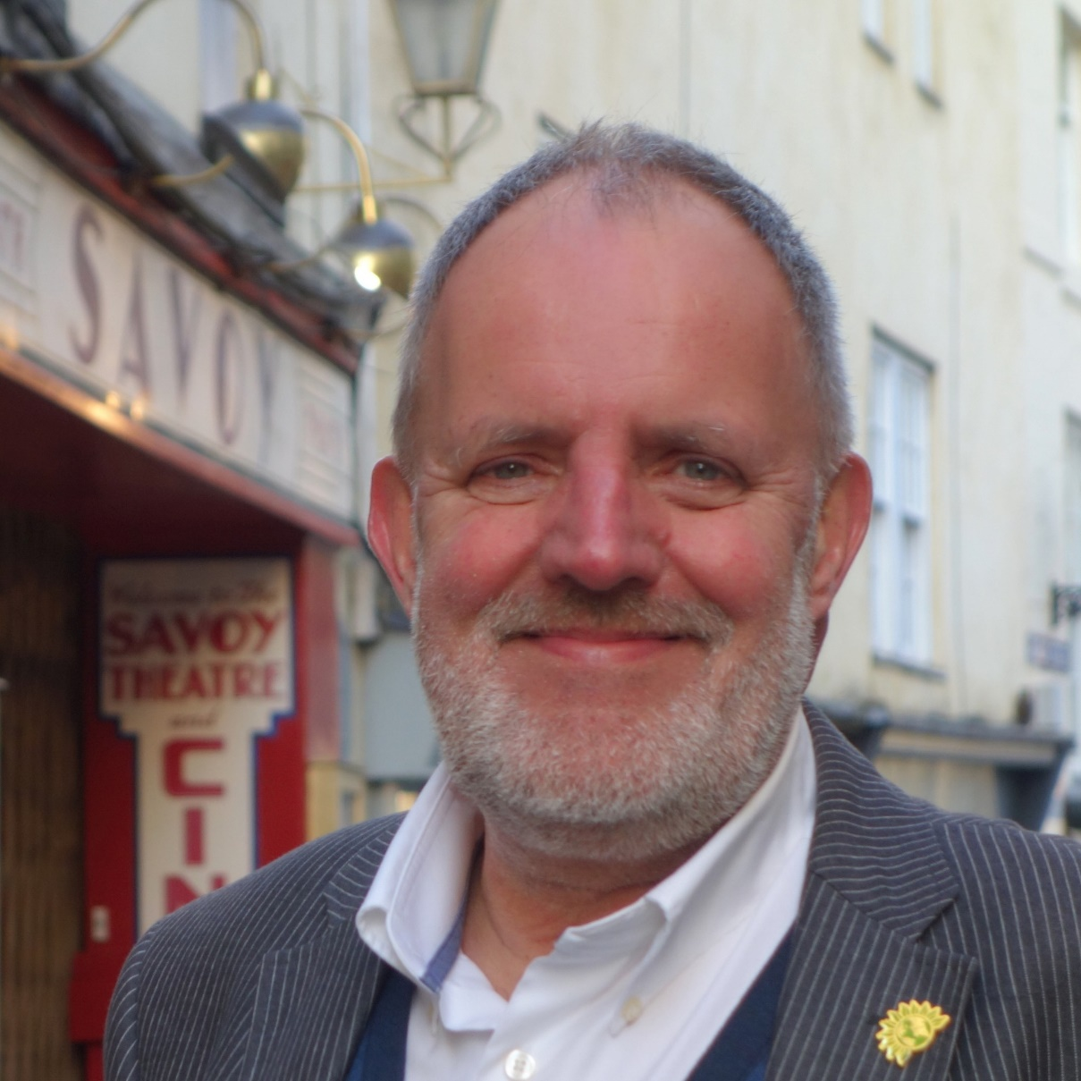
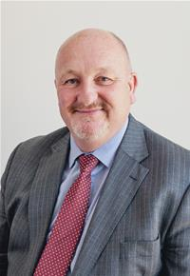
Prosiect Pleidlais Project Vote
Etholiad go iawn
Real election
Notes:
Prosiect Pleidlais / Project Vote – Ian Chandler
Etholiad go iawn / Real election – Peter Fox

Slide 42
Trafodaeth | Discussion
- Meddyliwch am 3 pheth rydych ch wedi dysgu trwy wneud yr etholiad paralel
- Pa weithgareddau wnaethoch chi fwynhau mwyaf?
- Meddyliwch am un ffordd mae’r profiad wedi effeithio arnoch chi neu ddatblygu eich barn
- Oedd yna wahaniaeth yn eich ardal chi rhwng y canlyniadau paralel, a’r canlyniadau swyddogol/go iawn? Pam ydych chi’n meddwl?
- Ydych chi’n meddwl bod y pandemig wedi cael effaith ar faint mae pobl yn ei wybod am wleidyddiaeth Cymru?
- Name three things you’ve learned through this Parallel Election
- Which activities did you enjoy the most and why?
- Name one way this experience has changed you or developed opinions
- Was there a difference between the Project Vote results and the real election results? Why do you think that is?
- Do you think that the coronavirus pandemic had an impact on how much people know about Welsh politics?

Slide 43
Camau nesaf | Next steps
Eich aelod o’r Senedd – Mae eich aelod o’r Senedd yna i’ch cynrychioli chi yn y Senedd. Cofiwch mae gennych chi 5 aelod sy’n eich cynrychioli chi – yr un a gafodd ei ethol gan eich etholaeth, a’r 4 cafodd eu hethol gan eich rhanbarth (gweler diwedd y cyflwyniad)
Cofiwch gysylltu gyda nhw os:
- Rydych chi eisiau cyngor neu wybodaeth am rywbeth sydd gan y Senedd pwerau drosto
- Rydych chi eisiau gofyn iddyn nhw beth fydden nhw’n ei wneud i wella eich ardal i bobl ifanc
- Mae gennych chi ddiddordeb mewn mater lleol ac eisiau gwybod mwy
Paid ag ofni cysylltu gyda nhw. Maen nhw’n derbyn cannoedd o ebyst a galwadau ffôn pob blwyddyn ar bob math o fater – eu swydd nhw yw gwrando ar eich pryderon.
Your MS - your MS is there to represent you in the Senedd. Remember you have 5 members of the Senedd representing you – the 1 who was voted in by your constituency, and the 4 who were voted in by your region (see the end of the powerpoint).
Remember to get in touch with them if:
- you want advice or information on something that the Welsh Parliament has control over
- you want to ask them what they will be doing to make your local area better for young people
- there is an issue in your local area that you're interested in
Don't be shy about getting in touch with them. They receive hundreds of emails and phone calls every year on all sorts of issues - it's their job to listen to your concerns.

Slide 44
Camau nesaf | Next steps
Gwneud Gwahaniaeth
Os oes gennych chi ddiddordeb mewn creu newid i faterion sy’n bwysig i chi, yn yr ysgol neu yn eich cymuned leol, ewch i’n hadnodd Gwneud Gwahaniaeth. A plis cysylltwch os oes unrhyw gwestiwn gyda chi amdano fe.
Cofrestru i bleidleisio
Cofiwch gallwch gofrestru i bleidleisio os ydych chi’n 14+ oed.
Ewch at y gwefan yma i wneud hyn.
Byddwch chi wedyn yn gallu pleidleisio mewn etholiadau Senedd, ac etholiadau eich cyngor lleol, pan rydych chi’n troi’n 16.
Making a difference
If you're interested in making a difference to the issues that matter to you, whether it's in school or your local community, take a look at our Make a Difference resource. And please get in touch with us if you have any questions about it.
Registering to vote
Remember you can register to vote if you are aged 14+
Go to this website to do this.
You will then be able to vote in Senedd elections, and your local council elections, when you turn 16.

Slide 45
Dwyrain Casnewydd Newport East

Slide 46
Canlyniadau Prosiect Pleidlais | Project Vote Results
Plaid | Party | Ymgeiswyr | Candidates | Pleidleisiau | Votes | %
Freedom Alliance | Sonya Cary | 85 | 14%
Llafur / Labour | John Griffiths | 209 | 34%
Gwlad Democratiaid Rhyddfrydol / Liberal Democrats | Mike Hamilton | 61 | 10%
Ceidwadwyr / Conservatives | Gareth Hughes | 43 | 7%
Plaid Werdd / Green Party | Lauren James | 68 | 11%
Plaid Cymru | Daniel Llewelyn | 40 | 7%
Reform UK | David Rowlands | 30 | 5%
Abolish the Welsh Assembly | Robert Steed | 37 | 6%
UKIP | Benjamin Walker | 40 | 7%

Slide 47
Canlyniad Senedd go iawn | Real Senedd result
Plaid | Party | Ymgeiswyr | Candidates | Pleidleisiau | Votes | %
Freedom Alliance | Sonya Cary | 161 | 0.7%
Llafur / Labour | John Griffiths | 10,899 | 47.1%
Gwlad Democratiaid Rhyddfrydol / Liberal Democrats | Mike Hamilton | 1,574 | 6.8%
Ceidwadwyr / Conservatives | Gareth Hughes | 7,315 | 31.6%
Plaid Cymru | Daniel Llewelyn | 1,844 | 8%
Reform UK | David Rowlands | 328 | 1.4%
Abolish the Welsh Assembly | Robert Steed | 660 | 2.9%
UKIP | Benjamin Walker | 368 | 1.6%

Slide 48
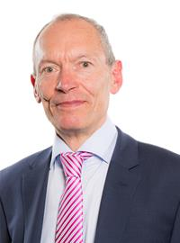
Prosiect Pleidlais Project Vote
Etholiad go iawn
Real election
Notes:
Prosiect Pleidlais / Project Vote – John Griffiths
Etholiad go iawn / Real election – John Griffiths

Slide 49
Trafodaeth | Discussion
- Meddyliwch am 3 pheth rydych ch wedi dysgu trwy wneud yr etholiad paralel
- Pa weithgareddau wnaethoch chi fwynhau mwyaf?
- Meddyliwch am un ffordd mae’r profiad wedi effeithio arnoch chi neu ddatblygu eich barn
- Oedd yna wahaniaeth yn eich ardal chi rhwng y canlyniadau paralel, a’r canlyniadau swyddogol/go iawn? Pam ydych chi’n meddwl?
- Ydych chi’n meddwl bod y pandemig wedi cael effaith ar faint mae pobl yn ei wybod am wleidyddiaeth Cymru?
- Name three things you’ve learned through this Parallel Election
- Which activities did you enjoy the most and why?
- Name one way this experience has changed you or developed opinions
- Was there a difference between the Project Vote results and the real election results? Why do you think that is?
- Do you think that the coronavirus pandemic had an impact on how much people know about Welsh politics?

Slide 50
Camau nesaf | Next steps
Eich aelod o’r Senedd – Mae eich aelod o’r Senedd yna i’ch cynrychioli chi yn y Senedd. Cofiwch mae gennych chi 5 aelod sy’n eich cynrychioli chi – yr un a gafodd ei ethol gan eich etholaeth, a’r 4 cafodd eu hethol gan eich rhanbarth (gweler diwedd y cyflwyniad)
Cofiwch gysylltu gyda nhw os:
- Rydych chi eisiau cyngor neu wybodaeth am rywbeth sydd gan y Senedd pwerau drosto
- Rydych chi eisiau gofyn iddyn nhw beth fydden nhw’n ei wneud i wella eich ardal i bobl ifanc
- Mae gennych chi ddiddordeb mewn mater lleol ac eisiau gwybod mwy
Paid ag ofni cysylltu gyda nhw. Maen nhw’n derbyn cannoedd o ebyst a galwadau ffôn pob blwyddyn ar bob math o fater – eu swydd nhw yw gwrando ar eich pryderon.
Your MS - your MS is there to represent you in the Senedd. Remember you have 5 members of the Senedd representing you – the 1 who was voted in by your constituency, and the 4 who were voted in by your region (see the end of the powerpoint).
Remember to get in touch with them if:
- you want advice or information on something that the Welsh Parliament has control over
- you want to ask them what they will be doing to make your local area better for young people
- there is an issue in your local area that you're interested in
Don't be shy about getting in touch with them. They receive hundreds of emails and phone calls every year on all sorts of issues - it's their job to listen to your concerns.

Slide 51
Camau nesaf | Next steps
Gwneud Gwahaniaeth
Os oes gennych chi ddiddordeb mewn creu newid i faterion sy’n bwysig i chi, yn yr ysgol neu yn eich cymuned leol, ewch i’n hadnodd Gwneud Gwahaniaeth. A plis cysylltwch os oes unrhyw gwestiwn gyda chi amdano fe.
Cofrestru i bleidleisio
Cofiwch gallwch gofrestru i bleidleisio os ydych chi’n 14+ oed.
Ewch at y gwefan yma i wneud hyn.
Byddwch chi wedyn yn gallu pleidleisio mewn etholiadau Senedd, ac etholiadau eich cyngor lleol, pan rydych chi’n troi’n 16.
Making a difference
If you're interested in making a difference to the issues that matter to you, whether it's in school or your local community, take a look at our Make a Difference resource. And please get in touch with us if you have any questions about it.
Registering to vote
Remember you can register to vote if you are aged 14+
Go to this website to do this.
You will then be able to vote in Senedd elections, and your local council elections, when you turn 16.

Slide 52
Gorllewin Casnewydd Newport West

Slide 53
Canlyniadau Prosiect Pleidlais | Project Vote Results
Plaid | Party | Ymgeiswyr | Candidates | Pleidleisiau | Votes | %
Reform UK | Kevin Boucher | 34 | 8%
Llafur / Labour | Jayne Bryant | 131 | 32%
Plaid Cymru | Jonathan Clark | 34 | 8%
Ceidwadwyr / Conservatives | Michael Enea | 63 | 15%
Freedom Alliance | Steve Marsh | 17 | 4%
Democratiaid Rhyddfrydol / Liberal Democrats | John Miller | 63 | 15%
Plaid Werdd / Green Party | Amelia Womack | 69 | 17%

Slide 54
Canlyniad Senedd go iawn | Real Senedd result
Plaid | Party | Ymgeiswyr | Candidates | Pleidleisiau | Votes | %
Reform UK | Kevin Boucher | 486 | 1.6%
Llafur / Labour | Jayne Bryant | 14,259 | 48.2%
Plaid Cymru | Jonathan Clark | 2,076 | 7%
Ceidwadwyr / Conservatives | Michael Enea | 10,353 | 35%
Freedom Alliance | Steve Marsh | 228 | 0.8%
Democratiaid Rhyddfrydol / Liberal Democrats | John Miller | 882 | 3%
Plaid Werdd / Green Party | Amelia Womack | 1,314 | 4.4%

Slide 55
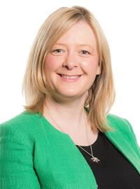
Prosiect Pleidlais Project Vote
Etholiad go iawn
Real election
Notes:
Prosiect Pleidlais / Project Vote – Jayne Bryant
Etholiad go iawn / Real election – Jayne Bryant

Slide 56
Trafodaeth | Discussion
- Meddyliwch am 3 pheth rydych ch wedi dysgu trwy wneud yr etholiad paralel
- Pa weithgareddau wnaethoch chi fwynhau mwyaf?
- Meddyliwch am un ffordd mae’r profiad wedi effeithio arnoch chi neu ddatblygu eich barn
- Oedd yna wahaniaeth yn eich ardal chi rhwng y canlyniadau paralel, a’r canlyniadau swyddogol/go iawn? Pam ydych chi’n meddwl?
- Ydych chi’n meddwl bod y pandemig wedi cael effaith ar faint mae pobl yn ei wybod am wleidyddiaeth Cymru?
- Name three things you’ve learned through this Parallel Election
- Which activities did you enjoy the most and why?
- Name one way this experience has changed you or developed opinions
- Was there a difference between the Project Vote results and the real election results? Why do you think that is?
- Do you think that the coronavirus pandemic had an impact on how much people know about Welsh politics?

Slide 57
Camau nesaf | Next steps
Eich aelod o’r Senedd – Mae eich aelod o’r Senedd yna i’ch cynrychioli chi yn y Senedd. Cofiwch mae gennych chi 5 aelod sy’n eich cynrychioli chi – yr un a gafodd ei ethol gan eich etholaeth, a’r 4 cafodd eu hethol gan eich rhanbarth (gweler diwedd y cyflwyniad)
Cofiwch gysylltu gyda nhw os:
- Rydych chi eisiau cyngor neu wybodaeth am rywbeth sydd gan y Senedd pwerau drosto
- Rydych chi eisiau gofyn iddyn nhw beth fydden nhw’n ei wneud i wella eich ardal i bobl ifanc
- Mae gennych chi ddiddordeb mewn mater lleol ac eisiau gwybod mwy
Paid ag ofni cysylltu gyda nhw. Maen nhw’n derbyn cannoedd o ebyst a galwadau ffôn pob blwyddyn ar bob math o fater – eu swydd nhw yw gwrando ar eich pryderon.
Your MS - your MS is there to represent you in the Senedd. Remember you have 5 members of the Senedd representing you – the 1 who was voted in by your constituency, and the 4 who were voted in by your region (see the end of the powerpoint).
Remember to get in touch with them if:
- you want advice or information on something that the Welsh Parliament has control over
- you want to ask them what they will be doing to make your local area better for young people
- there is an issue in your local area that you're interested in
Don't be shy about getting in touch with them. They receive hundreds of emails and phone calls every year on all sorts of issues - it's their job to listen to your concerns.

Slide 58
Camau nesaf | Next steps
Gwneud Gwahaniaeth
Os oes gennych chi ddiddordeb mewn creu newid i faterion sy’n bwysig i chi, yn yr ysgol neu yn eich cymuned leol, ewch i’n hadnodd Gwneud Gwahaniaeth. A plis cysylltwch os oes unrhyw gwestiwn gyda chi amdano fe.
Cofrestru i bleidleisio
Cofiwch gallwch gofrestru i bleidleisio os ydych chi’n 14+ oed.
Ewch at y gwefan yma i wneud hyn.
Byddwch chi wedyn yn gallu pleidleisio mewn etholiadau Senedd, ac etholiadau eich cyngor lleol, pan rydych chi’n troi’n 16.
Making a difference
If you're interested in making a difference to the issues that matter to you, whether it's in school or your local community, take a look at our Make a Difference resource. And please get in touch with us if you have any questions about it.
Registering to vote
Remember you can register to vote if you are aged 14+
Go to this website to do this.
You will then be able to vote in Senedd elections, and your local council elections, when you turn 16.

Slide 59
Torfaen

Slide 60
Canlyniad Senedd go iawn | Real Senedd result
Plaid | Party | Ymgeiswyr | Candidates | Pleidleisiau | Votes | %
Llafur / Labour | Lynne Neagle | 11,572 | 48.3%
Ceidwadwyr / Conservatives | Gruff Parry | 6,251 | 26.1%
Plaid Cymru | Lyn Ackerman | 2,564 | 10.7%
Democratiaid Rhyddfrydol / Liberal Democrats | Veronica German | 1,180 | 4.9%
UKIP | Thomas Harrison | 895 | 3.7%
Reform | Ian Williams | 730 | 3%
Freedom Alliance | Matthew Ross-Francombe | 522 | 2.2%
Gwlad | Ryan Williams | 239 | 1%

Slide 61
Prosiect Pleidlais Project Vote
Etholiad go iawn
Real election
Notes:
Prosiect Pleidlais / Project Vote – Dim pleidleisiau / No votes
Etholiad go iawn / Real election – Lynne Neagle

Slide 62
Rhanbarth Region

Slide 63
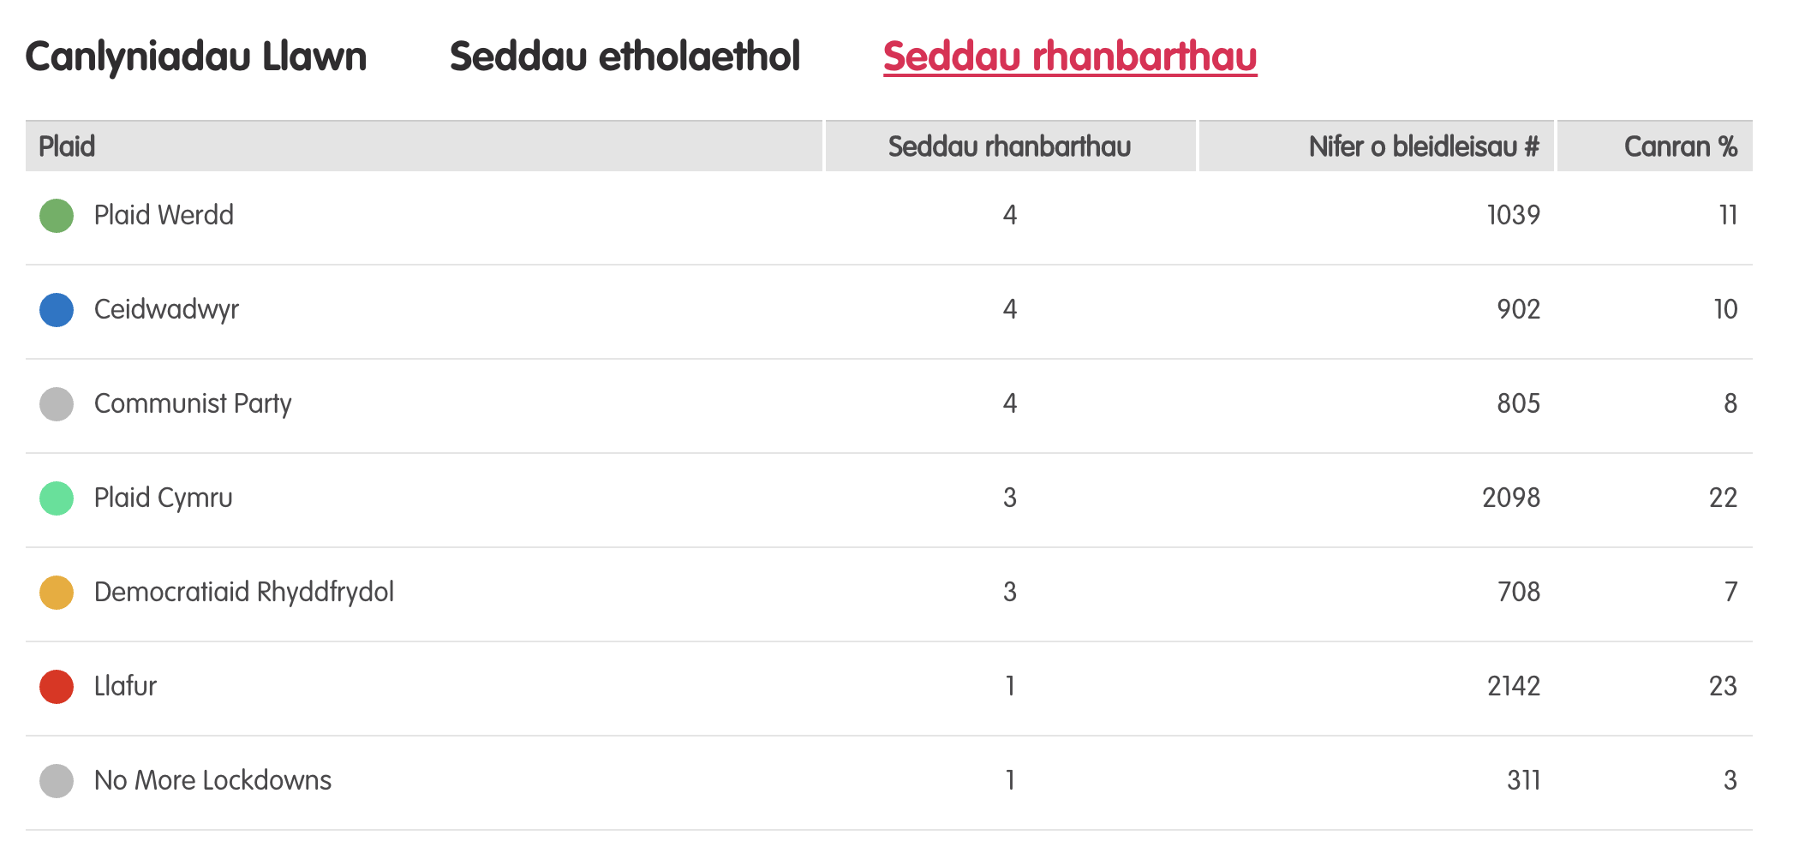
Canlyniadau etholiad paralel
Notes:
Tudalen wê canlyniadau’r Prosiect Pleidlais - https://prosiectpleidlais.cymru/canlyniadau/
Web page for Project Vote results – https://www.projectvote.wales/results/
Tudalen wê canlyniadau go iawn- https://www.bbc.co.uk/cymrufyw/pynciau/cvd627zw9rjt/etholiad-senedd-cymru-2021
Real results web page: https://www.bbc.co.uk/news/topics/cqwn14k92zwt/welsh-parliament-election-2021

Slide 64
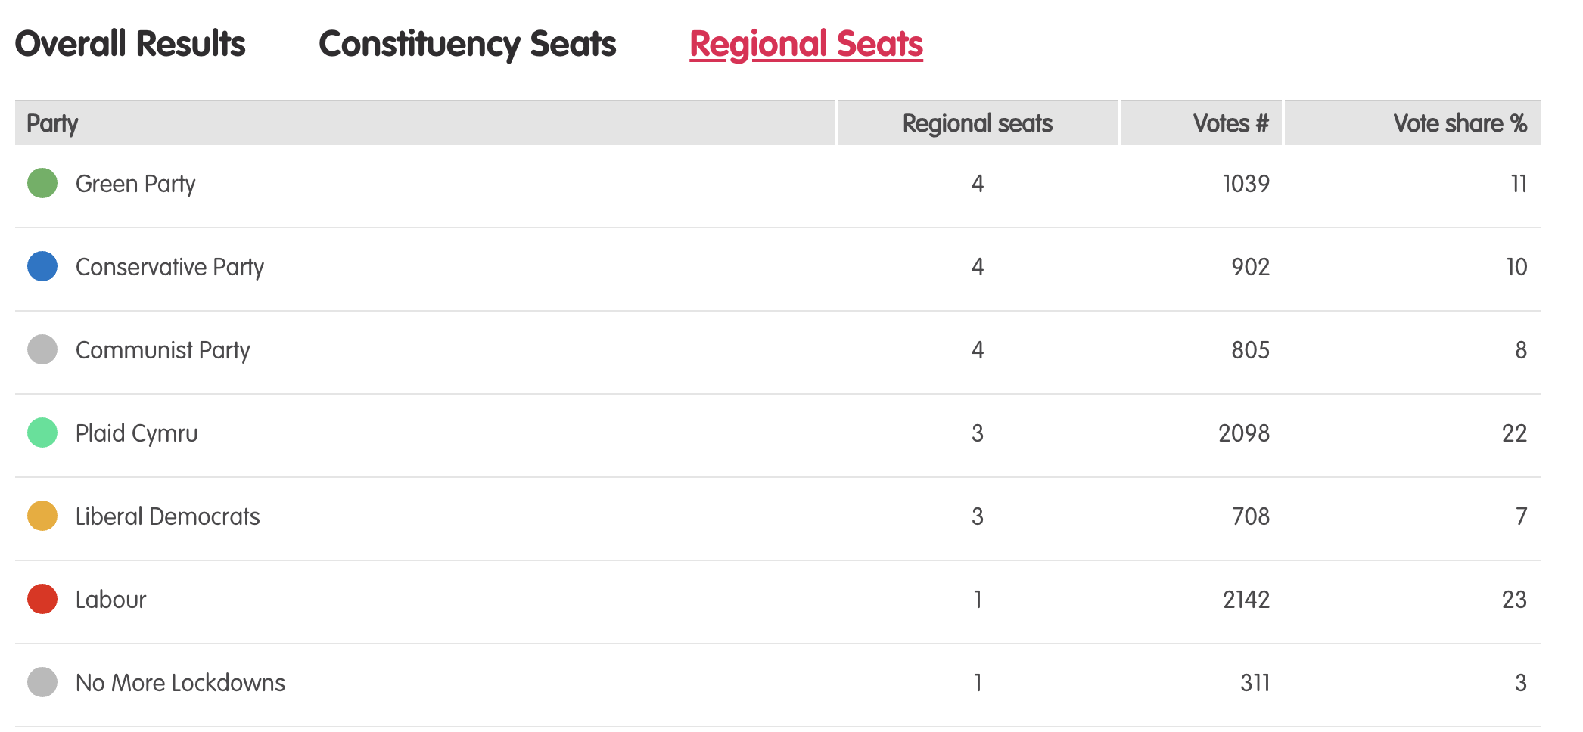
Results – Project vote parallel election
Notes:
Tudalen wê canlyniadau’r Prosiect Pleidlais - https://prosiectpleidlais.cymru/canlyniadau/
Web page for Project Vote results – https://www.projectvote.wales/results/
Tudalen wê canlyniadau go iawn- https://www.bbc.co.uk/cymrufyw/pynciau/cvd627zw9rjt/etholiad-senedd-cymru-2021
Real results web page: https://www.bbc.co.uk/news/topics/cqwn14k92zwt/welsh-parliament-election-2021

Slide 65
Canlyniadau etholiad swyddogol – Official election results
Plaid | Party | Seddau rhanbarthau | Regional seats | Nifer o bleidleisiau | Number of votes | Canran % | Vote share %
Llafur / Labour | 3 | 401,770 | 36.2%
Ceidwadwyr / Conservatives | 8 | 278,560 | 25.1%
Plaid Cymru | 8 | 230,161 | 20.7%
Plaid Werdd / Green Party | 0 | 48,714 | 4.4%
Democratiaid Rhyddfrydol / Liberal Democrats | 1 | 48,217 | 4.3%
Abolish the Welsh Assembly | 0 | 41,399 | 3.7%
Notes:
NB: the number and share of votes are for regional votes only.
We have included the top 6 parties only here

Slide 66
Dwyrain De Cymru South Wales East

Slide 67
Prosiect Pleidlais Project Vote
Etholiad go iawn
Real election
Plaid / Party | Pleidleisiau / Votes | Seddau /Seats
Ceidwadwyr / Conservatives | 233 | 1
Communist | 211 | 1
Democratiaid Rhyddfrydol / Liberal Democrats | 210 | 1
Plaid Werdd / Green Party | 265 | 1
Plaid / Party | Pleidleisiau / Votes | Seddau /Seats
Ceidwadwyr / Conservatives | 52,323 | 2
Plaid Cymru | 30,530 | 2

Slide 68
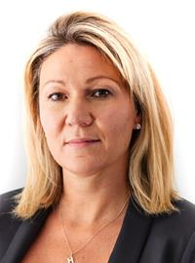
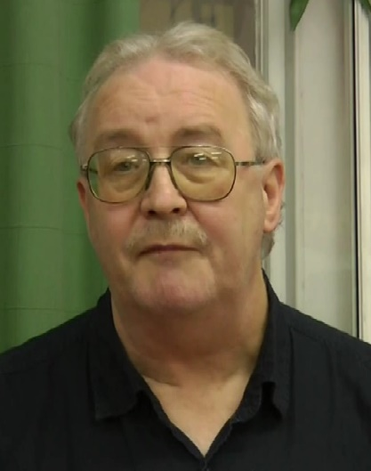
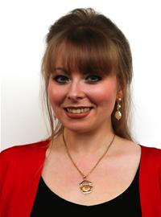
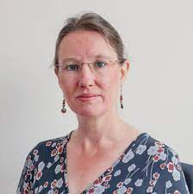
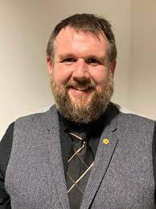
Prosiect Pleidlais Project Vote
Etholiad go iawn
Real election
Notes:
Prosiect Pleidlais / Project Vote (clockwise)
1. Laura Anne Jones - Ceidwadwyr / Conservatives
2. Rob Griffiths - Communist
3. Jo Watkins - Democratiaid Rhyddfrydol / Liberal Democrats
4. Amelia Womack - Plaid Werdd / Green Party
Etholiad go iawn / Real election (clockwise)
Laura Anne Jones - Ceidwadwyr / Conservatives
Delyth Jewell - Plaid Cymru
Natasha Ashgar - Ceidwadwyr / Conservatives
Peredur Owen Griffiths - Plaid Cymru

