Slide 2
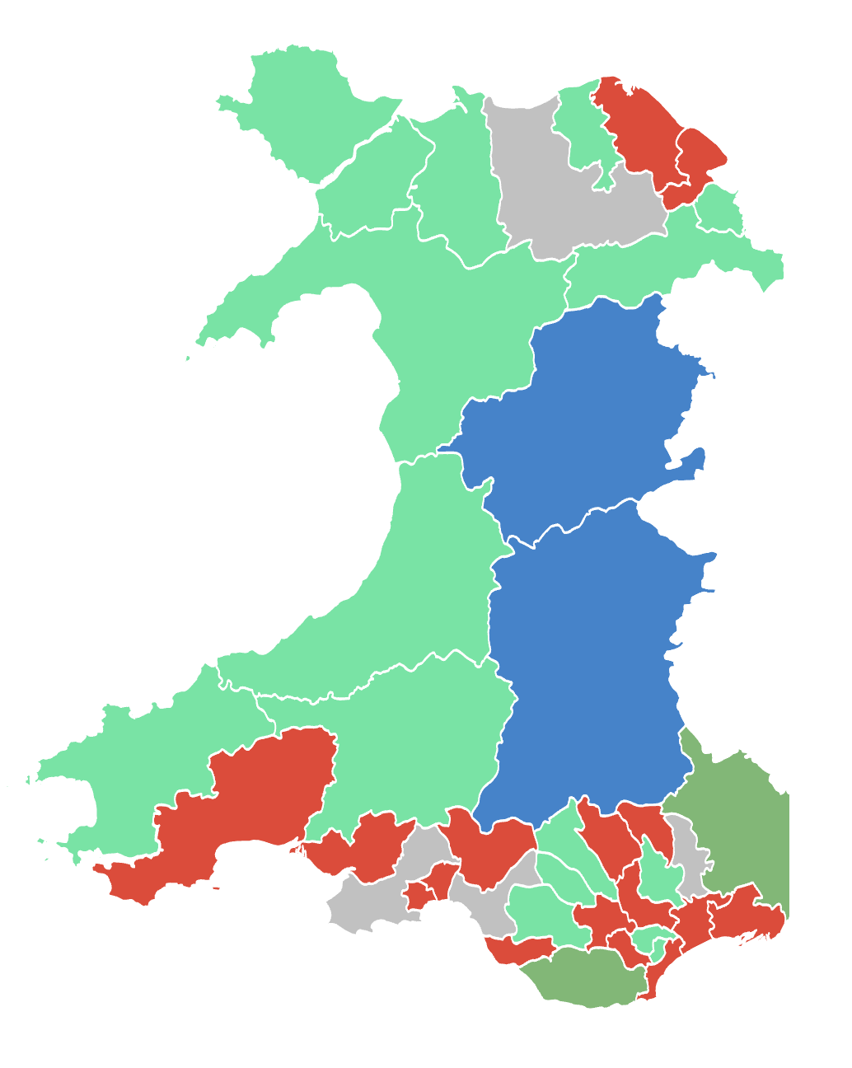
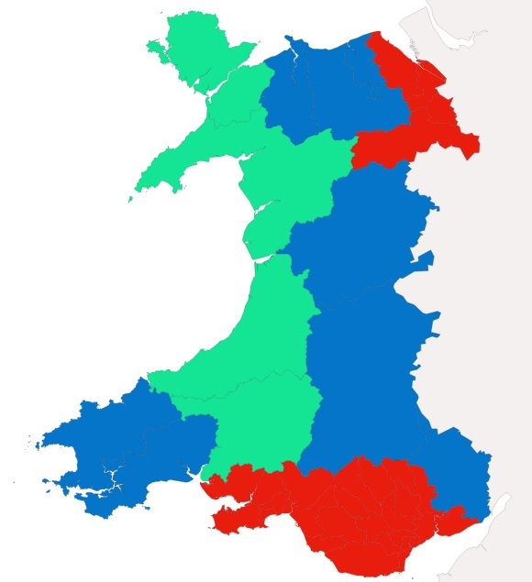
Prosiect Pleidlais | Project Vote
Etholiad go iawn | Real election
Notes:
Lliwiau’r pleidiau / Party colours
Ceidwadwyr / Conservatives – Glas / Blue
Llafur / Labour – Coch / Red
Plaid Cymru – Gwyrdd Golau / Light Green
Plaid Werdd / Green Party – Gwyrdd Tywyll / Dark Green
No results – Llwyd / Grey

Slide 3
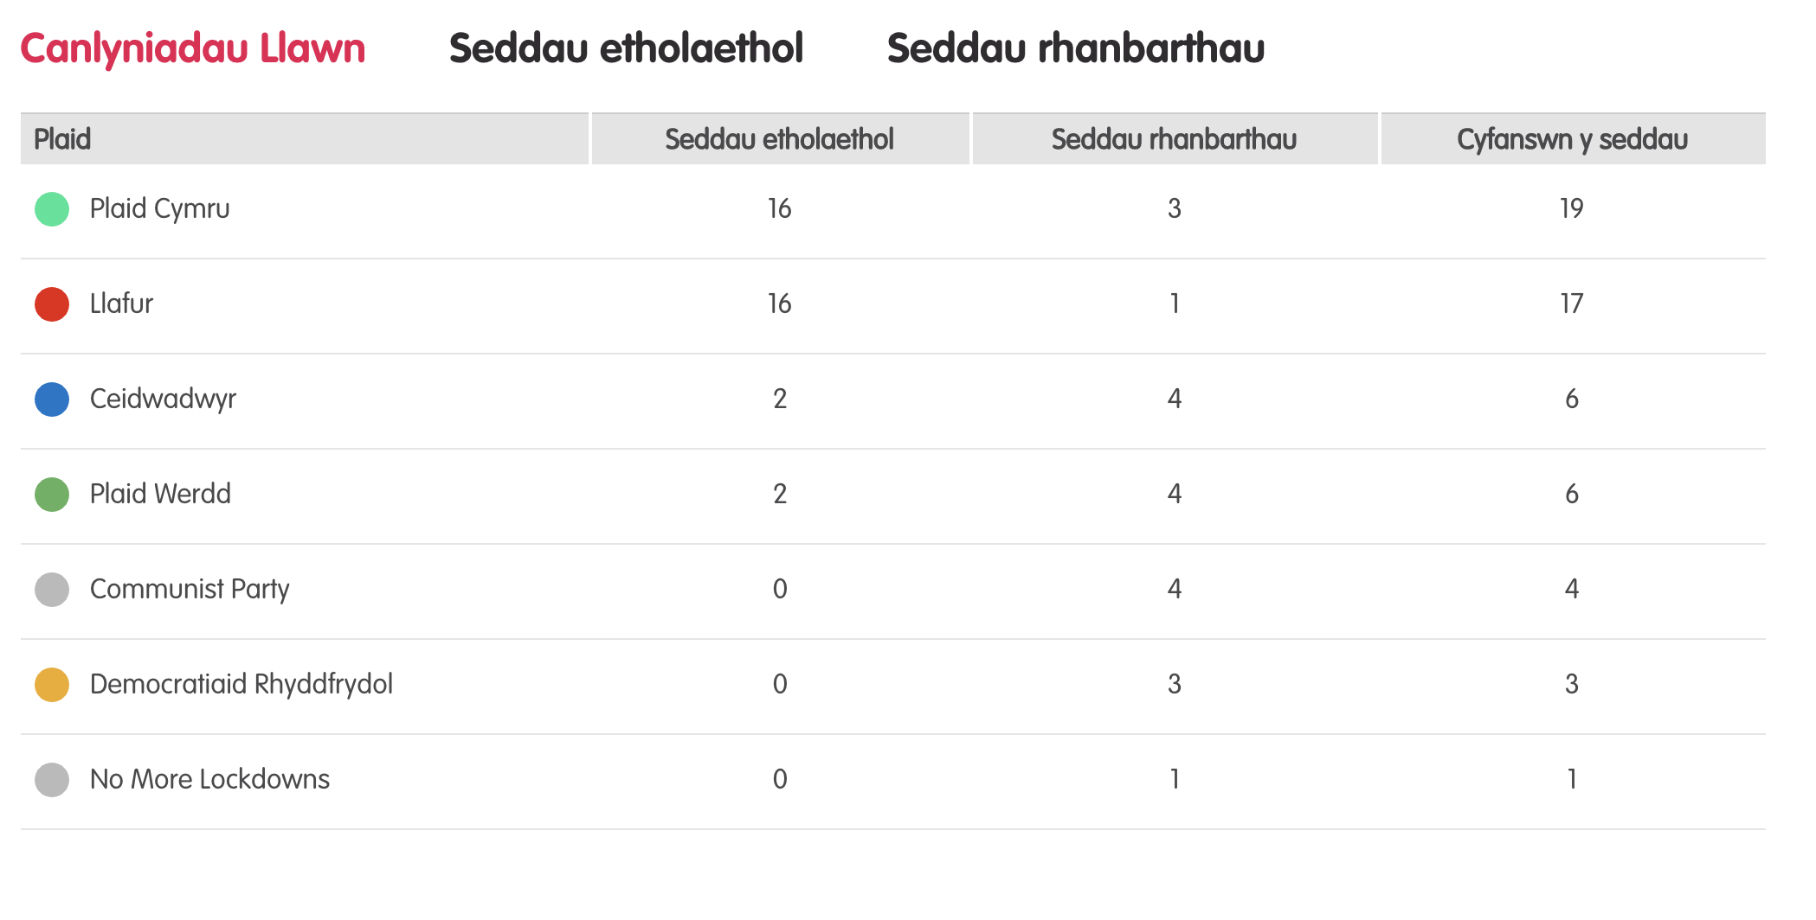
Canlyniadau llawn – Etholiad Paralel
Notes:
Tudalen wê canlyniadau’r Prosiect Pleidlais - https://prosiectpleidlais.cymru/canlyniadau/
Web page for Project Vote results – https://www.projectvote.wales/results/
Tudalen wê canlyniadau go iawn- https://www.bbc.co.uk/cymrufyw/pynciau/cvd627zw9rjt/etholiad-senedd-cymru-2021
Real results web page: https://www.bbc.co.uk/news/topics/cqwn14k92zwt/welsh-parliament-election-2021

Slide 4
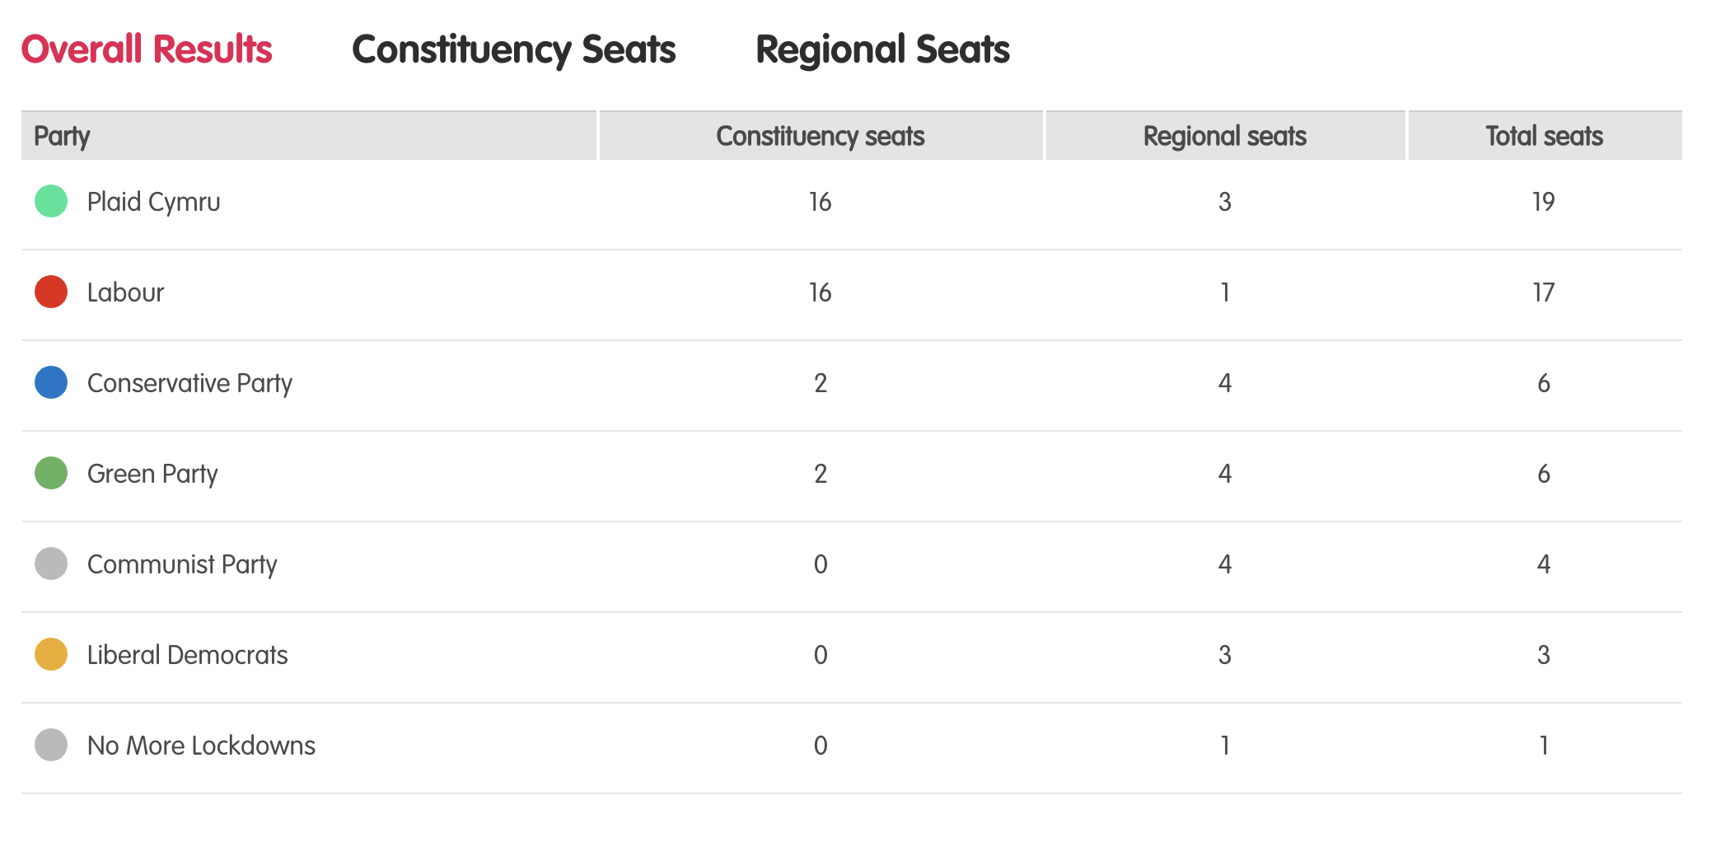
Full Results – Parallel election
Notes:
Tudalen wê canlyniadau’r Prosiect Pleidlais - https://prosiectpleidlais.cymru/canlyniadau/
Web page for Project Vote results – https://www.projectvote.wales/results/
Tudalen wê canlyniadau go iawn- https://www.bbc.co.uk/cymrufyw/pynciau/cvd627zw9rjt/etholiad-senedd-cymru-2021
Real results web page: https://www.bbc.co.uk/news/topics/cqwn14k92zwt/welsh-parliament-election-2021

Slide 5
Official election Results / Canlyniadau etholiad swyddogol
Plaid | Party | Seddau etholaethol | Constituency seats | Seddau rhanbarthau | Regional seats | Cyfanswn y seddau | Total Seats
Llafur / Labour | 27 | 3 | 30
Ceidwadwyr / Conservatives | 8 | 8 | 16
Plaid Cymru | 5 | 8 | 13
Democratiaid Rhyddfrydol / Liberal Democrats | 0 | 1 | 1

Slide 6
Etholaethau Constituencies

Slide 7
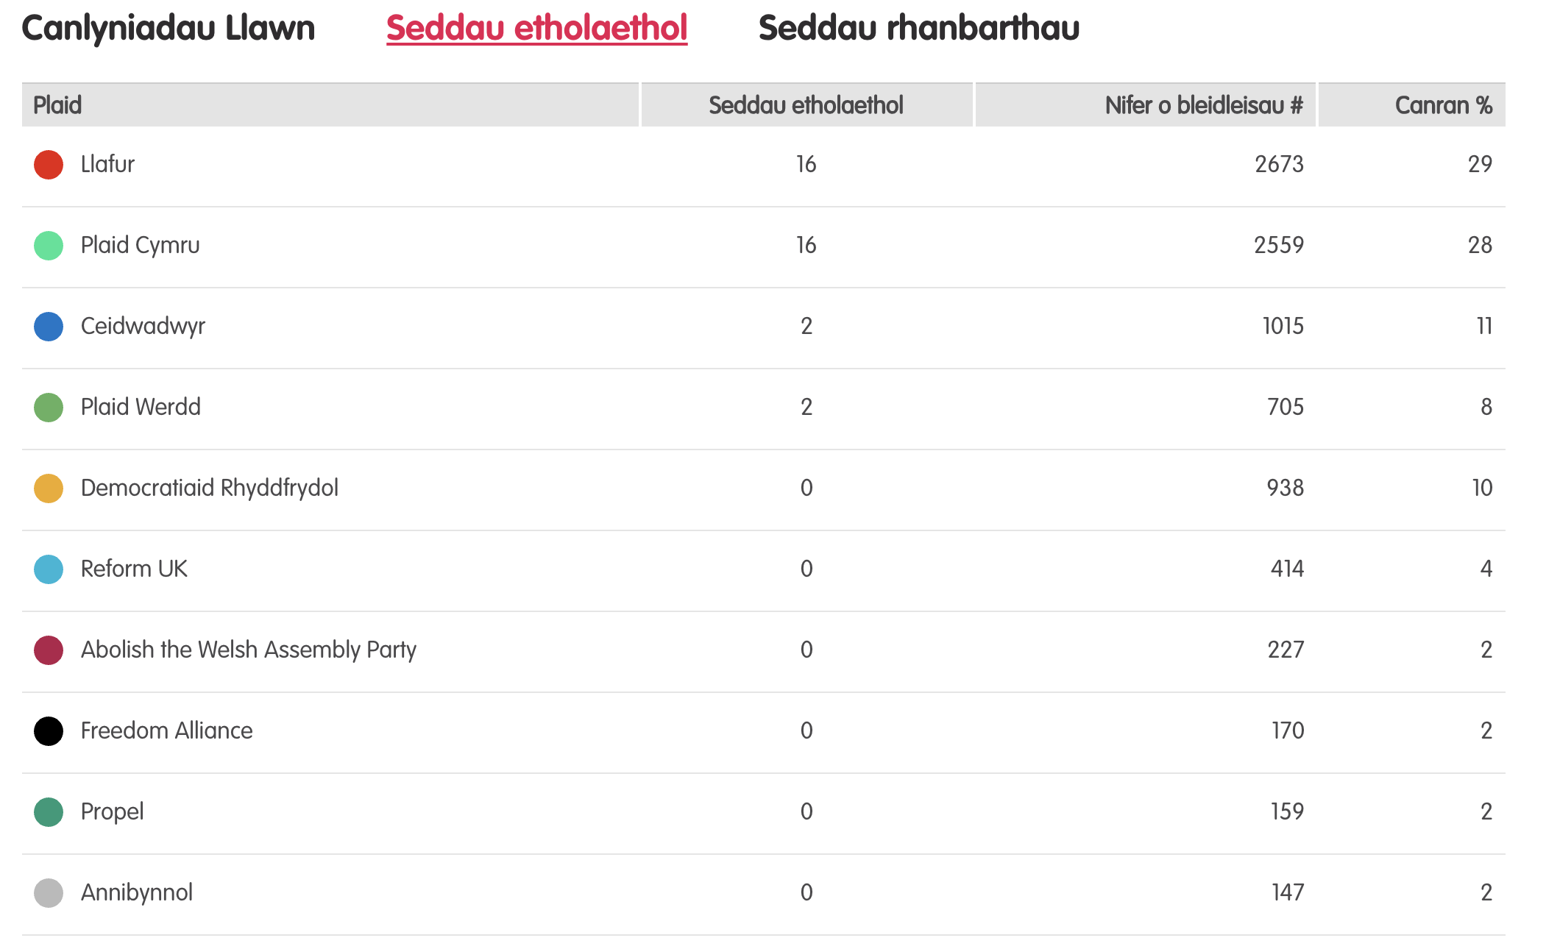
Canlyniadau – Etholiad Paralel
Notes:
Tudalen wê canlyniadau’r Prosiect Pleidlais - https://prosiectpleidlais.cymru/canlyniadau/
Web page for Project Vote results – https://www.projectvote.wales/results/
Tudalen wê canlyniadau go iawn- https://www.bbc.co.uk/cymrufyw/pynciau/cvd627zw9rjt/etholiad-senedd-cymru-2021
Real results web page: https://www.bbc.co.uk/news/topics/cqwn14k92zwt/welsh-parliament-election-2021

Slide 8
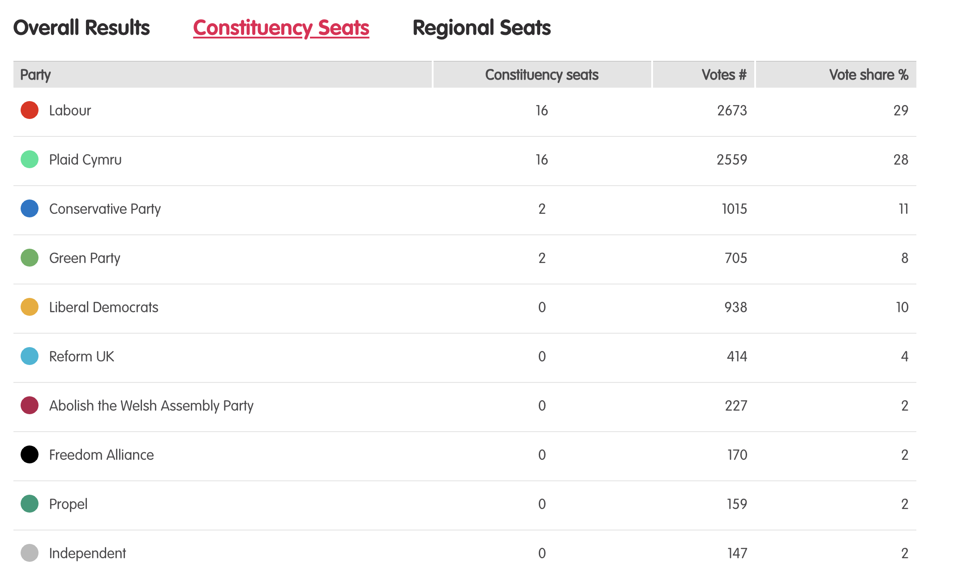
Results – Project vote parallel election
Notes:
Tudalen wê canlyniadau’r Prosiect Pleidlais - https://prosiectpleidlais.cymru/canlyniadau/
Web page for Project Vote results – https://www.projectvote.wales/results/
Tudalen wê canlyniadau go iawn- https://www.bbc.co.uk/cymrufyw/pynciau/cvd627zw9rjt/etholiad-senedd-cymru-2021
Real results web page: https://www.bbc.co.uk/news/topics/cqwn14k92zwt/welsh-parliament-election-2021

Slide 9
Canlyniadau swyddogol – Official results
Plaid | Party | Seddau etholaethol | Constituency seats | Nifer o bleidleisiau | Number of votes | Canran % | Vote share %
Llafur / Labour | 27 | 443,047 | 39.9%
Ceidwadwyr / Conservatives | 8 | 289,802 | 26.1%
Plaid Cymru | 5 | 225,376 | 20.3%
Democratiaid Rhyddfrydol / Liberal Democrats | 0 | 54,202 | 4.9%
Abolish the Welsh Assembly | 0 | 18,149 | 1.6%
Plaid Werdd / Green Party | 0 | 17,817 | 1.6%
Notes:
NB: the number and share of votes are for constituency votes only.
We have included the top 6 parties only here

Slide 10
Aberafan Aberavon

Slide 11
Canlyniad Senedd go iawn | Real Senedd result
Plaid | Party% | Ymgeiswyr | Candidates | Pleidleisiau | Votes | %
Llafur / Labour | David Rees | 10,505 | 47.4%
Plaid Cymru | Victoria Griffiths | 4,760 | 21.5%
Ceidwadwyr / Conservatives | Liz Hill O’Shea | 2,947 | 13.3%
Annibynnol / Independent | Scott Jones | 1,357 | 6.1%
Democratiaid Rhyddfrydol / Liberal Democrats | Helen Clarke | 953 | 4.3%
Abolish the Welsh Assembly | Sarah Allen | 646 | 2.9%
UKIP | Tim Jenkins | 407 | 1.8%
Gwlad | Ceri Golding | 386 | 1.7%
Reform UK | Dennis Walter May | 208 | 0.9%

Slide 12
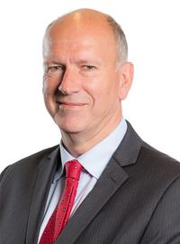
Prosiect Pleidlais Project Vote
Etholiad go iawn
Real election
Notes:
Prosiect Pleidlais / Project Vote – No result
Etholiad go iawn / Real election – David Rees

Slide 13
Pen-y-bont ar Ogwr Bridgend

Slide 14
Canlyniadau Prosiect Pleidlais | Project Vote Results
Plaid | Party | Ymgeiswyr | Candidates | Pleidleisiau | Votes | %
Annibynnol / Independent | Steven Bletsoe | 18 | 3%
Annibynnol / Independent | Caroline Jones | 24 | 4%
Gwlad | Geraint Jones | 24 | 4%
Democratiaid Rhyddfrydol / Liberal Democrats | Harvey Jones | 110 | 18%
Plaid Cymru | Leanne Lewis | 108 | 17%
Llafur / Labour | Sarah Murphy | 192 | 31%
Ceidwadwyr / Conservatives | Rachel Nugent-Finn | 117 | 19%
Reform UK | Christine Roach | 28 | 5%

Slide 15
Canlyniad Senedd go iawn | Real Senedd result
Plaid | Party | Ymgeiswyr | Candidates | Pleidleisiau | Votes | %
Annibynnol / Independent | Steven Bletsoe | 3,046 | 10.3%
Annibynnol / Independent | Caroline Jones | 1,064 | 3.6%
Gwlad | Geraint Jones | 232 | 0.8%
Democratiaid Rhyddfrydol / Liberal Democrats | Harvey Jones | 782 | 2.7%
Plaid Cymru | Leanne Lewis | 3,091 | 10.5%
Llafur / Labour | Sarah Murphy | 12,388 | 42%
Ceidwadwyr / Conservatives | Rachel Nugent-Finn | 8,324 | 28.3%
Reform UK | Christine Roach | 534 | 1.8%

Slide 16
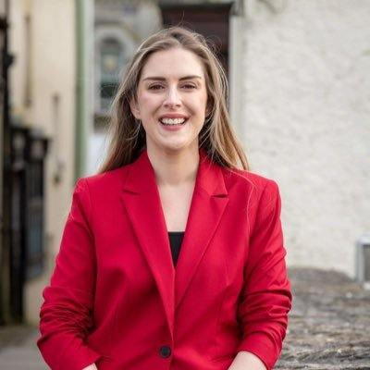
Prosiect Pleidlais Project Vote
Etholiad go iawn
Real election
Notes:
Prosiect Pleidlais / Project Vote – Sarah Murphy
Etholiad go iawn / Real election – Sarah Murphy

Slide 17
Trafodaeth | Discussion
- Meddyliwch am 3 pheth rydych ch wedi dysgu trwy wneud yr etholiad paralel
- Pa weithgareddau wnaethoch chi fwynhau mwyaf?
- Meddyliwch am un ffordd mae’r profiad wedi effeithio arnoch chi neu ddatblygu eich barn
- Oedd yna wahaniaeth yn eich ardal chi rhwng y canlyniadau paralel, a’r canlyniadau swyddogol/go iawn? Pam ydych chi’n meddwl?
- Ydych chi’n meddwl bod y pandemig wedi cael effaith ar faint mae pobl yn ei wybod am wleidyddiaeth Cymru?
- Name three things you’ve learned through this Parallel Election
- Which activities did you enjoy the most and why?
- Name one way this experience has changed you or developed opinions
- Was there a difference between the Project Vote results and the real election results? Why do you think that is?
- Do you think that the coronavirus pandemic had an impact on how much people know about Welsh politics?

Slide 18
Camau nesaf | Next steps
Eich aelod o’r Senedd – Mae eich aelod o’r Senedd yna i’ch cynrychioli chi yn y Senedd. Cofiwch mae gennych chi 5 aelod sy’n eich cynrychioli chi – yr un a gafodd ei ethol gan eich etholaeth, a’r 4 cafodd eu hethol gan eich rhanbarth (gweler diwedd y cyflwyniad)
Cofiwch gysylltu gyda nhw os:
- Rydych chi eisiau cyngor neu wybodaeth am rywbeth sydd gan y Senedd pwerau drosto
- Rydych chi eisiau gofyn iddyn nhw beth fydden nhw’n ei wneud i wella eich ardal i bobl ifanc
- Mae gennych chi ddiddordeb mewn mater lleol ac eisiau gwybod mwy
Paid ag ofni cysylltu gyda nhw. Maen nhw’n derbyn cannoedd o ebyst a galwadau ffôn pob blwyddyn ar bob math o fater – eu swydd nhw yw gwrando ar eich pryderon.
Your MS - your MS is there to represent you in the Senedd. Remember you have 5 members of the Senedd representing you – the 1 who was voted in by your constituency, and the 4 who were voted in by your region (see the end of the powerpoint).
Remember to get in touch with them if:
- you want advice or information on something that the Welsh Parliament has control over
- you want to ask them what they will be doing to make your local area better for young people
- there is an issue in your local area that you're interested in
Don't be shy about getting in touch with them. They receive hundreds of emails and phone calls every year on all sorts of issues - it's their job to listen to your concerns.

Slide 19
Camau nesaf | Next steps
Gwneud Gwahaniaeth
Os oes gennych chi ddiddordeb mewn creu newid i faterion sy’n bwysig i chi, yn yr ysgol neu yn eich cymuned leol, ewch i’n hadnodd Gwneud Gwahaniaeth. A plis cysylltwch os oes unrhyw gwestiwn gyda chi amdano fe.
Cofrestru i bleidleisio
Cofiwch gallwch gofrestru i bleidleisio os ydych chi’n 14+ oed.
Ewch at y gwefan yma i wneud hyn.
Byddwch chi wedyn yn gallu pleidleisio mewn etholiadau Senedd, ac etholiadau eich cyngor lleol, pan rydych chi’n troi’n 16.
Making a difference
If you're interested in making a difference to the issues that matter to you, whether it's in school or your local community, take a look at our Make a Difference resource. And please get in touch with us if you have any questions about it.
Registering to vote
Remember you can register to vote if you are aged 14+
Go to this website to do this.
You will then be able to vote in Senedd elections, and your local council elections, when you turn 16.

Slide 20
Gwyr Gower

Slide 21
Canlyniad Senedd go iawn | Real Senedd result
Plaid | Party | Ymgeiswyr | Candidates | Pleidleisiau | Votes | %
Llafur / Labour | Rebecca Evans | 15,631 | 47.1%
Ceidwadwyr / Conservatives | Myles Langstone | 10,836 | 32.7%
Plaid Cymru | John Davies | 3,946 | 11.9%
Plaid Werdd / Green Party | Anna Pigott | 1,088 | 3.3%
Democratiaid Rhyddfrydol / Liberal Democrats | Michael Sheehan | 869 | 2.6%
Reform UK | Byron John | 547 | 1.6%
Gwlad | David Erasmus | 257 | 0.7%

Slide 22
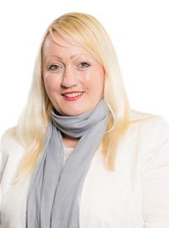
Prosiect Pleidlais Project Vote
Etholiad go iawn
Real election
Notes:
Prosiect Pleidlais / Project Vote – No result
Etholiad go iawn / Real election – Rebecca Evans

Slide 23
Castell-nedd Neath

Slide 24
Canlyniadau Prosiect Pleidlais | Project Vote Results
Plaid | Party | Ymgeiswyr | Candidates | Pleidleisiau | Votes | %
Democratiaid Rhyddfrydol / Liberal Democrats | Iain Clamp | 9 | 4%
Propel | James Henton | 2 | 1%
Annibynnol / Independent | Steve Hunt | 11 | 5%
Plaid Werdd / Green Party | Megan Poppy Lloyd | 23 | 11%
Llafur / Labour | Jeremy Miles | 64 | 31%
Reform UK | Sean Prior | 11 | 5%
Abolish the Welsh Assembly | Simon Rees | 1 | 0%
Ceidwadwyr / Conservatives | Mathew Williams | 37 | 18%
Plaid Cymru | Sioned Williams | 46 | 23%

Slide 25
Canlyniad Senedd go iawn | Real Senedd result
Plaid | Party | Ymgeiswyr | Candidates | Pleidleisiau | Votes | %
Democratiaid Rhyddfrydol / Liberal Democrats | Iain Clamp | 395 | 1.4%
Propel | James Henton | 443 | 1.6%
Annibynnol / Independent | Steve Hunt | 2,418 | 8.8%
Plaid Werdd / Green Party | Megan Poppy Lloyd | 1,038 | 3.8%
Llafur / Labour | Jeremy Miles | 11,666 | 42.3%
Reform UK | Sean Prior | 315 | 1.1%
Abolish the Welsh Assembly | Simon Rees | 751 | 2.7%
Ceidwadwyr / Conservatives | Mathew Williams | 4,107 | 14.9%
Plaid Cymru | Sioned Williams | 6,445 | 23.4%

Slide 26
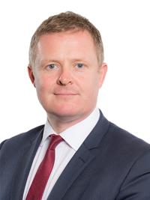
Prosiect Pleidlais Project Vote
Etholiad go iawn
Real election
Notes:
Prosiect Pleidlais / Project Vote – Jeremy Miles
Etholiad go iawn / Real election – Jeremy Miles

Slide 27
Trafodaeth | Discussion
- Meddyliwch am 3 pheth rydych ch wedi dysgu trwy wneud yr etholiad paralel
- Pa weithgareddau wnaethoch chi fwynhau mwyaf?
- Meddyliwch am un ffordd mae’r profiad wedi effeithio arnoch chi neu ddatblygu eich barn
- Oedd yna wahaniaeth yn eich ardal chi rhwng y canlyniadau paralel, a’r canlyniadau swyddogol/go iawn? Pam ydych chi’n meddwl?
- Ydych chi’n meddwl bod y pandemig wedi cael effaith ar faint mae pobl yn ei wybod am wleidyddiaeth Cymru?
- Name three things you’ve learned through this Parallel Election
- Which activities did you enjoy the most and why?
- Name one way this experience has changed you or developed opinions
- Was there a difference between the Project Vote results and the real election results? Why do you think that is?
- Do you think that the coronavirus pandemic had an impact on how much people know about Welsh politics?

Slide 28
Camau nesaf | Next steps
Eich aelod o’r Senedd – Mae eich aelod o’r Senedd yna i’ch cynrychioli chi yn y Senedd. Cofiwch mae gennych chi 5 aelod sy’n eich cynrychioli chi – yr un a gafodd ei ethol gan eich etholaeth, a’r 4 cafodd eu hethol gan eich rhanbarth (gweler diwedd y cyflwyniad)
Cofiwch gysylltu gyda nhw os:
- Rydych chi eisiau cyngor neu wybodaeth am rywbeth sydd gan y Senedd pwerau drosto
- Rydych chi eisiau gofyn iddyn nhw beth fydden nhw’n ei wneud i wella eich ardal i bobl ifanc
- Mae gennych chi ddiddordeb mewn mater lleol ac eisiau gwybod mwy
Paid ag ofni cysylltu gyda nhw. Maen nhw’n derbyn cannoedd o ebyst a galwadau ffôn pob blwyddyn ar bob math o fater – eu swydd nhw yw gwrando ar eich pryderon.
Your MS - your MS is there to represent you in the Senedd. Remember you have 5 members of the Senedd representing you – the 1 who was voted in by your constituency, and the 4 who were voted in by your region (see the end of the powerpoint).
Remember to get in touch with them if:
- you want advice or information on something that the Welsh Parliament has control over
- you want to ask them what they will be doing to make your local area better for young people
- there is an issue in your local area that you're interested in
Don't be shy about getting in touch with them. They receive hundreds of emails and phone calls every year on all sorts of issues - it's their job to listen to your concerns.

Slide 29
Camau nesaf | Next steps
Gwneud Gwahaniaeth
Os oes gennych chi ddiddordeb mewn creu newid i faterion sy’n bwysig i chi, yn yr ysgol neu yn eich cymuned leol, ewch i’n hadnodd Gwneud Gwahaniaeth. A plis cysylltwch os oes unrhyw gwestiwn gyda chi amdano fe.
Cofrestru i bleidleisio
Cofiwch gallwch gofrestru i bleidleisio os ydych chi’n 14+ oed.
Ewch at y gwefan yma i wneud hyn.
Byddwch chi wedyn yn gallu pleidleisio mewn etholiadau Senedd, ac etholiadau eich cyngor lleol, pan rydych chi’n troi’n 16.
Making a difference
If you're interested in making a difference to the issues that matter to you, whether it's in school or your local community, take a look at our Make a Difference resource. And please get in touch with us if you have any questions about it.
Registering to vote
Remember you can register to vote if you are aged 14+
Go to this website to do this.
You will then be able to vote in Senedd elections, and your local council elections, when you turn 16.

Slide 30
Ogwr Ogmore

Slide 31
Canlyniadau Prosiect Pleidlais | Project Vote Results
Plaid | Party | Ymgeiswyr | Candidates | Pleidleisiau | Votes | %
Ceidwadwyr / Conservatives | Nathan Adams | 40 | 10%
Reform UK | Glenda Davies | 7 | 2%
Plaid Cymru | Luke Fletcher | 175 | 42%
Abolish the Welsh Assembly | Robin Hunter-Clarke | 8 | 2%
Llafur / Labour | Huw Irranca-Davies | 142 | 34%
Democratiaid Rhyddfrydol / Liberal Democrats | Cameron Shippam | 23 | 6%
Propel | Tim Thomas | 17 | 4%

Slide 32
Canlyniad Senedd go iawn | Real Senedd result
Plaid | Party | Ymgeiswyr | Candidates | Pleidleisiau | Votes | %
Ceidwadwyr / Conservatives | Nathan Adams | 4,579 | 18.7%
Reform UK | Glenda Davies | 618 | 2.5%
Plaid Cymru | Luke Fletcher | 4,703 | 19.2%
Abolish the Welsh Assembly | Robin Hunter-Clarke | 660 | 2.7%
Llafur / Labour | Huw Irranca-Davies | 12,868 | 52.5%
Democratiaid Rhyddfrydol / Liberal Democrats | Cameron Shippam | 441 | 1.8%
Propel | Tim Thomas | 625 | 2.6%

Slide 33
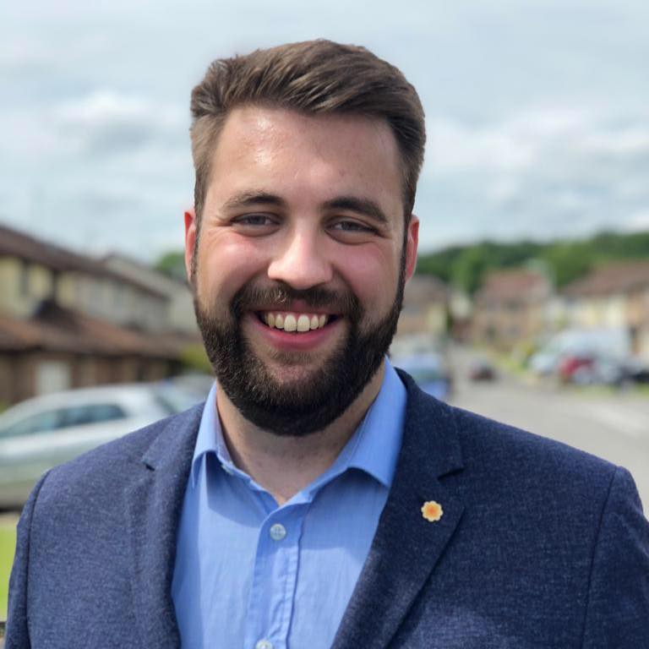
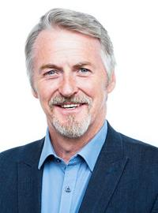
Prosiect Pleidlais Project Vote
Etholiad go iawn
Real election
Notes:
Prosiect Pleidlais / Project Vote – Luke Fletcher
Etholiad go iawn / Real election – Huw Irranca-Davies

Slide 34
Trafodaeth | Discussion
- Meddyliwch am 3 pheth rydych ch wedi dysgu trwy wneud yr etholiad paralel
- Pa weithgareddau wnaethoch chi fwynhau mwyaf?
- Meddyliwch am un ffordd mae’r profiad wedi effeithio arnoch chi neu ddatblygu eich barn
- Oedd yna wahaniaeth yn eich ardal chi rhwng y canlyniadau paralel, a’r canlyniadau swyddogol/go iawn? Pam ydych chi’n meddwl?
- Ydych chi’n meddwl bod y pandemig wedi cael effaith ar faint mae pobl yn ei wybod am wleidyddiaeth Cymru?
- Name three things you’ve learned through this Parallel Election
- Which activities did you enjoy the most and why?
- Name one way this experience has changed you or developed opinions
- Was there a difference between the Project Vote results and the real election results? Why do you think that is?
- Do you think that the coronavirus pandemic had an impact on how much people know about Welsh politics?

Slide 35
Camau nesaf | Next steps
Eich aelod o’r Senedd – Mae eich aelod o’r Senedd yna i’ch cynrychioli chi yn y Senedd. Cofiwch mae gennych chi 5 aelod sy’n eich cynrychioli chi – yr un a gafodd ei ethol gan eich etholaeth, a’r 4 cafodd eu hethol gan eich rhanbarth (gweler diwedd y cyflwyniad)
Cofiwch gysylltu gyda nhw os:
- Rydych chi eisiau cyngor neu wybodaeth am rywbeth sydd gan y Senedd pwerau drosto
- Rydych chi eisiau gofyn iddyn nhw beth fydden nhw’n ei wneud i wella eich ardal i bobl ifanc
- Mae gennych chi ddiddordeb mewn mater lleol ac eisiau gwybod mwy
Paid ag ofni cysylltu gyda nhw. Maen nhw’n derbyn cannoedd o ebyst a galwadau ffôn pob blwyddyn ar bob math o fater – eu swydd nhw yw gwrando ar eich pryderon.
Your MS - your MS is there to represent you in the Senedd. Remember you have 5 members of the Senedd representing you – the 1 who was voted in by your constituency, and the 4 who were voted in by your region (see the end of the powerpoint).
Remember to get in touch with them if:
- you want advice or information on something that the Welsh Parliament has control over
- you want to ask them what they will be doing to make your local area better for young people
- there is an issue in your local area that you're interested in
Don't be shy about getting in touch with them. They receive hundreds of emails and phone calls every year on all sorts of issues - it's their job to listen to your concerns.

Slide 36
Camau nesaf | Next steps
Gwneud Gwahaniaeth
Os oes gennych chi ddiddordeb mewn creu newid i faterion sy’n bwysig i chi, yn yr ysgol neu yn eich cymuned leol, ewch i’n hadnodd Gwneud Gwahaniaeth. A plis cysylltwch os oes unrhyw gwestiwn gyda chi amdano fe.
Cofrestru i bleidleisio
Cofiwch gallwch gofrestru i bleidleisio os ydych chi’n 14+ oed.
Ewch at y gwefan yma i wneud hyn.
Byddwch chi wedyn yn gallu pleidleisio mewn etholiadau Senedd, ac etholiadau eich cyngor lleol, pan rydych chi’n troi’n 16.
Making a difference
If you're interested in making a difference to the issues that matter to you, whether it's in school or your local community, take a look at our Make a Difference resource. And please get in touch with us if you have any questions about it.
Registering to vote
Remember you can register to vote if you are aged 14+
Go to this website to do this.
You will then be able to vote in Senedd elections, and your local council elections, when you turn 16.

Slide 37
Dwyrain Abertawe Swansea East

Slide 38
Canlyniadau Prosiect Pleidlais | Project Vote Results
Plaid | Party | Ymgeiswyr | Candidates | Pleidleisiau | Votes | %
Plaid Cymru | Rhiannon Barrar | 74 | 21%
Reform UK Democratiaid Rhyddfrydol / Liberal Democrats | Sam Bennett | 52 | 15%
Ceidwadwyr / Conservatives | Cameron Brennan | 26 | 7%
Abolish the Welsh Assembly | Cameron Edwards | 12 | 3%
Llafur / Labour | Mike Hedges | 120 | 34%
UKIP | Dan Morgan | 22 | 6%
Reform UK | Darren Rees | 48 | 14%

Slide 39
Canlyniad Senedd go iawn | Real Senedd result
Plaid | Party | Ymgeiswyr | Candidates | Pleidleisiau | Votes | %
Plaid Cymru | Rhiannon Barrar | 3,250 | 15.1%
Reform UK Democratiaid Rhyddfrydol / Liberal Democrats | Sam Bennett | 1,055 | 4.9%
Ceidwadwyr / Conservatives | Cameron Brennan | 2,947 | 13.7%
Abolish the Welsh Assembly | Cameron Edwards | 484 | 2.2%
Llafur / Labour | Mike Hedges | 12,950 | 60.1%
UKIP | Dan Morgan | 567 | 2.6%
Reform UK | Darren Rees | 295 | 1.4%

Slide 40
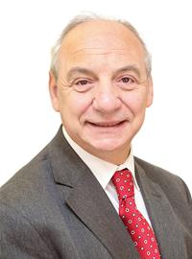
Prosiect Pleidlais Project Vote
Etholiad go iawn
Real election
Notes:
Prosiect Pleidlais / Project Vote – Mike Hedges
Etholiad go iawn / Real election – Mike Hedges

Slide 41
Trafodaeth | Discussion
- Meddyliwch am 3 pheth rydych ch wedi dysgu trwy wneud yr etholiad paralel
- Pa weithgareddau wnaethoch chi fwynhau mwyaf?
- Meddyliwch am un ffordd mae’r profiad wedi effeithio arnoch chi neu ddatblygu eich barn
- Oedd yna wahaniaeth yn eich ardal chi rhwng y canlyniadau paralel, a’r canlyniadau swyddogol/go iawn? Pam ydych chi’n meddwl?
- Ydych chi’n meddwl bod y pandemig wedi cael effaith ar faint mae pobl yn ei wybod am wleidyddiaeth Cymru?
- Name three things you’ve learned through this Parallel Election
- Which activities did you enjoy the most and why?
- Name one way this experience has changed you or developed opinions
- Was there a difference between the Project Vote results and the real election results? Why do you think that is?
- Do you think that the coronavirus pandemic had an impact on how much people know about Welsh politics?

Slide 42
Camau nesaf | Next steps
Eich aelod o’r Senedd – Mae eich aelod o’r Senedd yna i’ch cynrychioli chi yn y Senedd. Cofiwch mae gennych chi 5 aelod sy’n eich cynrychioli chi – yr un a gafodd ei ethol gan eich etholaeth, a’r 4 cafodd eu hethol gan eich rhanbarth (gweler diwedd y cyflwyniad)
Cofiwch gysylltu gyda nhw os:
- Rydych chi eisiau cyngor neu wybodaeth am rywbeth sydd gan y Senedd pwerau drosto
- Rydych chi eisiau gofyn iddyn nhw beth fydden nhw’n ei wneud i wella eich ardal i bobl ifanc
- Mae gennych chi ddiddordeb mewn mater lleol ac eisiau gwybod mwy
Paid ag ofni cysylltu gyda nhw. Maen nhw’n derbyn cannoedd o ebyst a galwadau ffôn pob blwyddyn ar bob math o fater – eu swydd nhw yw gwrando ar eich pryderon.
Your MS - your MS is there to represent you in the Senedd. Remember you have 5 members of the Senedd representing you – the 1 who was voted in by your constituency, and the 4 who were voted in by your region (see the end of the powerpoint).
Remember to get in touch with them if:
- you want advice or information on something that the Welsh Parliament has control over
- you want to ask them what they will be doing to make your local area better for young people
- there is an issue in your local area that you're interested in
Don't be shy about getting in touch with them. They receive hundreds of emails and phone calls every year on all sorts of issues - it's their job to listen to your concerns.

Slide 43
Camau nesaf | Next steps
Gwneud Gwahaniaeth
Os oes gennych chi ddiddordeb mewn creu newid i faterion sy’n bwysig i chi, yn yr ysgol neu yn eich cymuned leol, ewch i’n hadnodd Gwneud Gwahaniaeth. A plis cysylltwch os oes unrhyw gwestiwn gyda chi amdano fe.
Cofrestru i bleidleisio
Cofiwch gallwch gofrestru i bleidleisio os ydych chi’n 14+ oed.
Ewch at y gwefan yma i wneud hyn.
Byddwch chi wedyn yn gallu pleidleisio mewn etholiadau Senedd, ac etholiadau eich cyngor lleol, pan rydych chi’n troi’n 16.
Making a difference
If you're interested in making a difference to the issues that matter to you, whether it's in school or your local community, take a look at our Make a Difference resource. And please get in touch with us if you have any questions about it.
Registering to vote
Remember you can register to vote if you are aged 14+
Go to this website to do this.
You will then be able to vote in Senedd elections, and your local council elections, when you turn 16.

Slide 44
Gorllewin Abertawe Swansea West

Slide 45
Canlyniadau Prosiect Pleidlais | Project Vote Results
Plaid | Party | Ymgeiswyr | Candidates | Pleidleisiau | Votes | %
Propel | Kalon Bouzalakos | 12 | 6%
Ceidwadwyr / Conservatives | Samantha Chohan | 21 | 11%
Abolish the Welsh Assembly | James Cole | 11 | 6%
Plaid Werdd / Green Party | Chris Evans | 38 | 19%
Reform UK | Bernard Holton | 2 | 1%
Democratiaid Rhyddfrydol / Liberal Democrats | Chloe Hutchinson | 14 | 7%
Llafur / Labour | Julie James | 65 | 33%
Plaid Cymru | Dai Lloyd | 24 | 12%
Freedom Alliance | Michelle Valerio | 9 | 5%

Slide 46
Canlyniad Senedd go iawn | Real Senedd result
Plaid | Party | Ymgeiswyr | Candidates | Pleidleisiau | Votes | %
Propel | Kalon Bouzalakos | 189 | 0.8%
Ceidwadwyr / Conservatives | Samantha Chohan | 4,605 | 19.2%
Abolish the Welsh Assembly | James Cole | 866 | 3.6%
Plaid Werdd / Green Party | Chris Evans | 1,109 | 4.6%
Reform UK | Bernard Holton | 250 | 1%
Democratiaid Rhyddfrydol / Liberal Democrats | Chloe Hutchinson | 1,645 | 6.9%
Llafur / Labour | Julie James | 11,126 | 46.4%
Plaid Cymru | Dai Lloyd | 3,910 | 16.3%
Freedom Alliance | Michelle Valerio | 295 | 1.2%

Slide 47
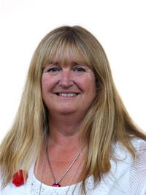
Prosiect Pleidlais Project Vote
Etholiad go iawn
Real election
Notes:
Prosiect Pleidlais / Project Vote – Julie James
Etholiad go iawn / Real election – Julie James

Slide 48
Trafodaeth | Discussion
- Meddyliwch am 3 pheth rydych ch wedi dysgu trwy wneud yr etholiad paralel
- Pa weithgareddau wnaethoch chi fwynhau mwyaf?
- Meddyliwch am un ffordd mae’r profiad wedi effeithio arnoch chi neu ddatblygu eich barn
- Oedd yna wahaniaeth yn eich ardal chi rhwng y canlyniadau paralel, a’r canlyniadau swyddogol/go iawn? Pam ydych chi’n meddwl?
- Ydych chi’n meddwl bod y pandemig wedi cael effaith ar faint mae pobl yn ei wybod am wleidyddiaeth Cymru?
- Name three things you’ve learned through this Parallel Election
- Which activities did you enjoy the most and why?
- Name one way this experience has changed you or developed opinions
- Was there a difference between the Project Vote results and the real election results? Why do you think that is?
- Do you think that the coronavirus pandemic had an impact on how much people know about Welsh politics?

Slide 49
Camau nesaf | Next steps
Eich aelod o’r Senedd – Mae eich aelod o’r Senedd yna i’ch cynrychioli chi yn y Senedd. Cofiwch mae gennych chi 5 aelod sy’n eich cynrychioli chi – yr un a gafodd ei ethol gan eich etholaeth, a’r 4 cafodd eu hethol gan eich rhanbarth (gweler diwedd y cyflwyniad)
Cofiwch gysylltu gyda nhw os:
- Rydych chi eisiau cyngor neu wybodaeth am rywbeth sydd gan y Senedd pwerau drosto
- Rydych chi eisiau gofyn iddyn nhw beth fydden nhw’n ei wneud i wella eich ardal i bobl ifanc
- Mae gennych chi ddiddordeb mewn mater lleol ac eisiau gwybod mwy
Paid ag ofni cysylltu gyda nhw. Maen nhw’n derbyn cannoedd o ebyst a galwadau ffôn pob blwyddyn ar bob math o fater – eu swydd nhw yw gwrando ar eich pryderon.
Your MS - your MS is there to represent you in the Senedd. Remember you have 5 members of the Senedd representing you – the 1 who was voted in by your constituency, and the 4 who were voted in by your region (see the end of the powerpoint).
Remember to get in touch with them if:
- you want advice or information on something that the Welsh Parliament has control over
- you want to ask them what they will be doing to make your local area better for young people
- there is an issue in your local area that you're interested in
Don't be shy about getting in touch with them. They receive hundreds of emails and phone calls every year on all sorts of issues - it's their job to listen to your concerns.

Slide 50
Camau nesaf | Next steps
Gwneud Gwahaniaeth
Os oes gennych chi ddiddordeb mewn creu newid i faterion sy’n bwysig i chi, yn yr ysgol neu yn eich cymuned leol, ewch i’n hadnodd Gwneud Gwahaniaeth. A plis cysylltwch os oes unrhyw gwestiwn gyda chi amdano fe.
Cofrestru i bleidleisio
Cofiwch gallwch gofrestru i bleidleisio os ydych chi’n 14+ oed.
Ewch at y gwefan yma i wneud hyn.
Byddwch chi wedyn yn gallu pleidleisio mewn etholiadau Senedd, ac etholiadau eich cyngor lleol, pan rydych chi’n troi’n 16.
Making a difference
If you're interested in making a difference to the issues that matter to you, whether it's in school or your local community, take a look at our Make a Difference resource. And please get in touch with us if you have any questions about it.
Registering to vote
Remember you can register to vote if you are aged 14+
Go to this website to do this.
You will then be able to vote in Senedd elections, and your local council elections, when you turn 16.

Slide 51
Rhanbarth Region

Slide 52
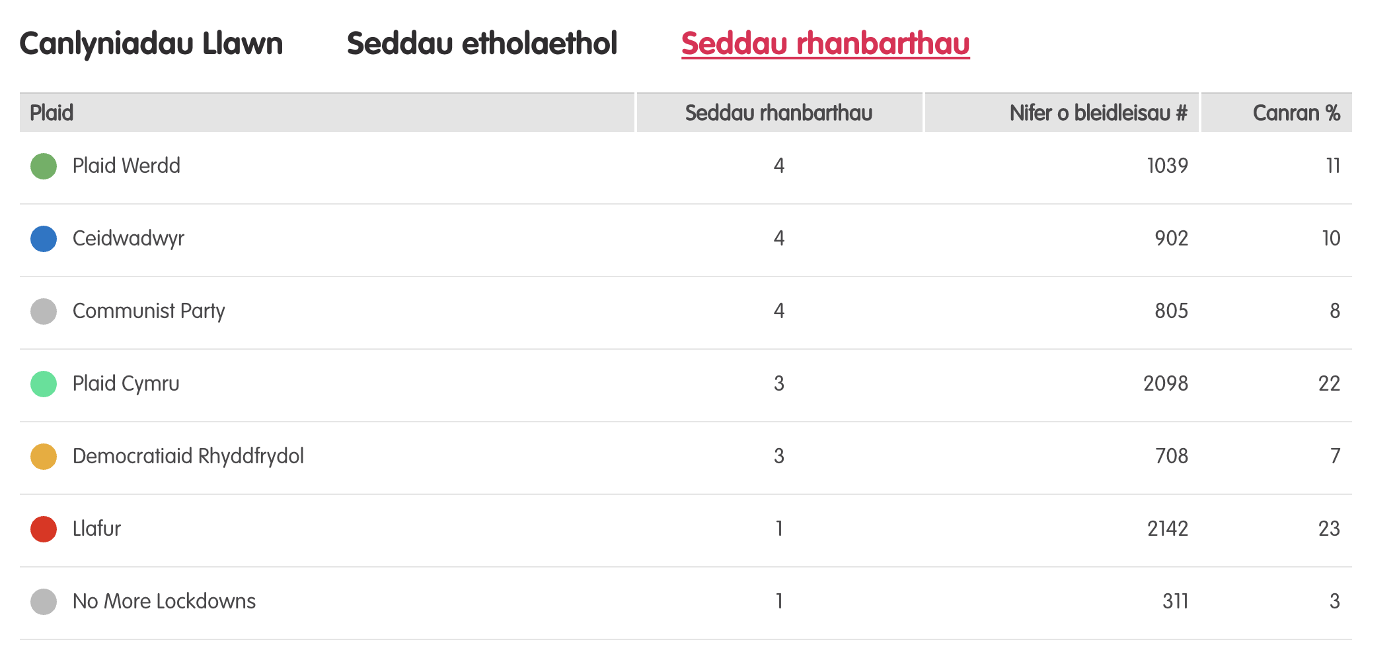
Canlyniadau – etholiad paralel
Notes:
Tudalen wê canlyniadau’r Prosiect Pleidlais - https://prosiectpleidlais.cymru/canlyniadau/
Web page for Project Vote results – https://www.projectvote.wales/results/
Tudalen wê canlyniadau go iawn- https://www.bbc.co.uk/cymrufyw/pynciau/cvd627zw9rjt/etholiad-senedd-cymru-2021
Real results web page: https://www.bbc.co.uk/news/topics/cqwn14k92zwt/welsh-parliament-election-2021

Slide 53
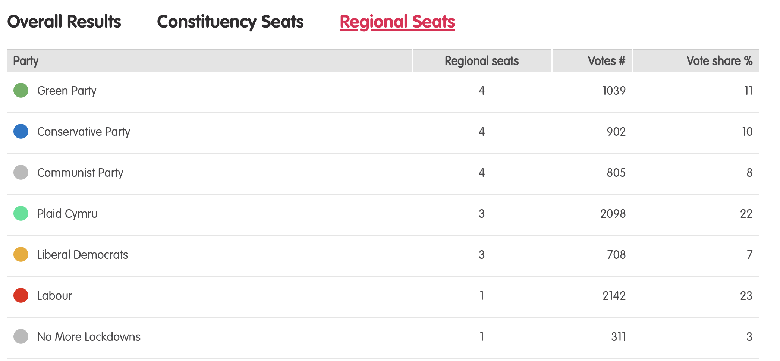
Results – Project vote parallel election
Notes:
Tudalen wê canlyniadau’r Prosiect Pleidlais - https://prosiectpleidlais.cymru/canlyniadau/
Web page for Project Vote results – https://www.projectvote.wales/results/
Tudalen wê canlyniadau go iawn- https://www.bbc.co.uk/cymrufyw/pynciau/cvd627zw9rjt/etholiad-senedd-cymru-2021
Real results web page: https://www.bbc.co.uk/news/topics/cqwn14k92zwt/welsh-parliament-election-2021

Slide 54
Canlyniadau etholiad swyddogol – official election results
Plaid | Party | Seddau rhanbarthau | Regional seats | Nifer o bleidleisiau | Number of votes | Canran % | Vote share %
Llafur / Labour | 3 | 401,770 | 36.2%
Ceidwadwyr / Conservatives | 8 | 278,560 | 25.1%
Plaid Cymru | 8 | 230,161 | 20.7%
Plaid Werdd / Green Party | 0 | 48,714 | 4.4%
Democratiaid Rhyddfrydol / Liberal Democrats | 1 | 48,217 | 4.3%
Abolish the Welsh Assembly | 0 | 41,399 | 3.7%
Notes:
NB: the number and share of votes are for regional votes only.
We have included the top 6 parties only here

Slide 55
Gorllewin De Cymru South Wales West

Slide 56
Prosiect Pleidlais Project Vote
Etholiad go iawn
Real election
Plaid / Party | Pleidleisiau / Votes | Seddau /Seats
Plaid Werdd / Green Party | 257 | 1
Ceidwadwyr / Conservatives | 210 | 1
Communist Party | 167 | 1
Plaid Cymru | 313 | 1
Plaid / Party | Pleidleisiau / Votes | Seddau /Seats
Ceidwadwyr / Conservatives | 38,244 | 2
Plaid Cymru | 33,753 | 2

Slide 57
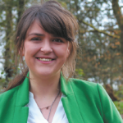
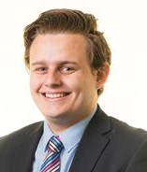
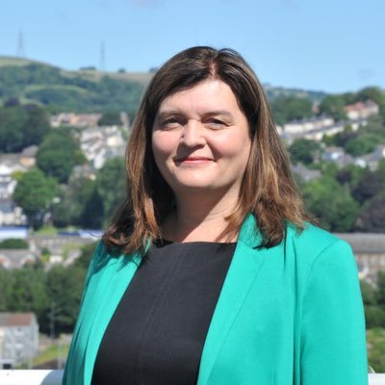
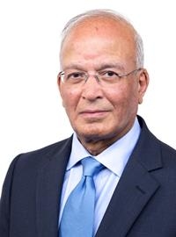
Prosiect Pleidlais Project Vote
Etholiad go iawn
Real election
Notes:
Prosiect Pleidlais / Project Vote (clockwise)
Megan Poppy Lloyd - Plaid Werdd / Green Party
Tom Giffard - Ceidwadwyr / Conservatives
Laura Picand - Communist
Sioned Williams - Plaid Cymru
Etholiad go iawn / Real election (clockwise)
Tom Giffard - Ceidwadwyr / Conservatives
Luke Fletcher - Plaid Cymru
Altaf Hussain- Ceidwadwyr / Conservatives
Sioned Williams- Plaid Cymru

