Slide 1
Project Vote: Local elections 2022
Lesson 1

Slide 2
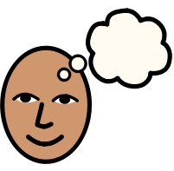
What is a vote?
Can you give any examples?
Notes:
Begin by exploring different types of votes with students. Ask your students: - What is a vote? - Can you think of any examples of things where people use a vote? - What’s the purpose of a vote?
You could prompt students by giving them examples e.g. school council, Strictly Come Dancing, Eurovision.
If nobody has said elections, then make sure to include it after listening to all responses.
Elections are where we choose the people who make decisions which affect all of our lives.
The next slides will show some of the elections that people in Wales take part in.
Adaptation: You could demonstrate how a vote works with students by voting together e.g. hold a vote whether cats or dogs are better, hold a vote to choose a specific activity

Slide 3
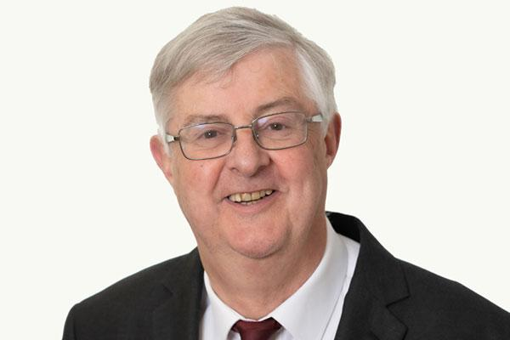
Welsh Parliament/ Senedd election
Last election: 2021
First Minister: Mark Drakeford
Who represents you: MSs
Age you can vote: 16+
Things they control:
Health
Curriculum for schools
Where our energy comes from
Coronavirus regulations in Wales
Notes:
Remind students that there are different elections that happen in Wales. In these elections, we vote for who we want to represent us and make decisions which affect us all.
In the Senedd/Welsh Parliament election, people in Wales choose who will make decisions that affect Wales alone.
You could also show a picture of the Senedd building here.

Slide 4
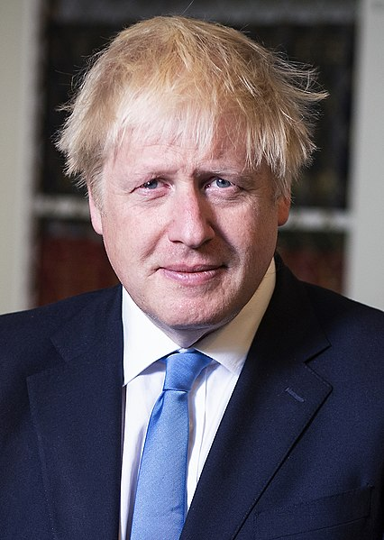
UK Parliament election
Last election: 2019
Prime Minister: Boris Johnson
Who represents you: MPs
Age you can vote: 18+
Things they control:
Immigration
Policing
The internet
Armed forces
Notes:
In the UK election, also called a General Election, people in Wales and all over the UK choose who will make decisions that affect the whole of the UK.
You could show a picture of Westminster here.

Slide 5
Local council elections
Next election: 2022 Leader of the Council: Every council has a different leader
Who represents you: Councillors
Age you can vote: 16+ in Wales
Things they control:
Collecting waste and recycling
Social care
Roads, footpaths and cycle paths
Parks
School transport
Notes:
Teachers/group leaders can add in information and a photo of their council’s previous leader, if they wanted to. You could also display the logo of the local council or the local council building.
In local elections, people choose who will make decisions that affect their local area (e.g. Conwy, Newport). Some places also have town or community councils.
Explain to students that over the next few lessons you will be looking at local council elections.
In May 2022, 16 and 17 year olds will be able to vote in local council elections for the first time.
Adaptation: You could use the information in the summary table to turn this into a card sort activity, then show the Powerpoint slides to the class to check whether they were correct

Slide 6
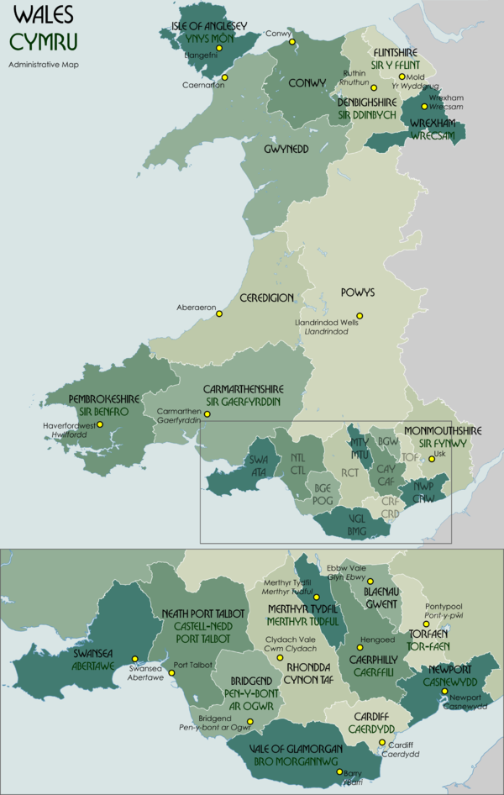
Notes:
Sometimes local councils are referred to as local authorities.
Ask students: - Can you work out which council your school/group is in? - Does the place you live come under the same council?
Explain that in an election, some people vote by post, but most people will go to a particular place (a polling station) in their community on Election Day. There, they will be given a list of people running for the election (a ballot paper). People are given private space to put an X next to the person they want to win the election on the ballot paper and then put their vote in a box to be counted. You choose the people who represent the area you live in at the council by voting to make them your local councillor.
Adaptation: You could show students maps of the local council area, Wales and the whole UK to reinforce the differences and to illustrate the size of the area they cover

Slide 7
Video Link (YouTube)
Notes:
This video tells you a little bit more about what local councils do
https://www.youtube.com/watch?v=_kUf3q-GFQ0
Ask students to feed back some of the things they learned from the video.

Slide 8
Kahoot Quiz:
A quiz about a Chihuahua called Gary.
Who makes the decisions in each question? What does the local council control?
https://play.kahoot.it/v2/?quizId=882ad26b-e4cd-40cc-9d99-e43e2b6d512f
Notes:
Tell students that you’re going to do a quiz which will help them think about who makes different decisions in Wales. They’ll learn more about what their local council does. The quiz will be done via a story about Gary, a Chihuahua.

Slide 9
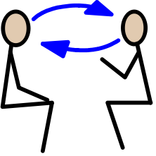
Discussion time
Notes:
Tell students that the council is made up of people called councillors. We vote for the person we want to represent us and the person with the most votes wins. Councillors make decisions which affect everybody in the county. Ask the class or group to imagine that they are the local council for the area and they are all local councillors. Explain that you are going to give them a chance to discuss a topic, as councillors may do in their work. You can propose one of the topics below, or choose your own, as long as it is related to local council’s powers.
Black bins should only be collected once a month to make people recycle more
Street lamps should be turned off at 11pm every day to save the council money
New cycle paths should be built to help young people cycle or walk to school
All school buses should have wi-fi and charging ports
There should be a zebra crossing every 100 metres on every road
All libraries should have cafes in them
Theatre shows should be free for under 16s
You could consider using a ‘talking stick’ or using ‘talking tokens’ (everybody gets 3 tokens and has to hand them back each time they speak) to ensure everybody gets a chance to speak during the discussion.
You may wish to swap this activity with the ‘voting with your feet’ activity in Lesson 3, if you feel that a discussion would not be appropriate for your students during the first lesson.

Slide 10
Project Vote
*
YouTube video link
Notes:
Explain that councillors often have discussions or debates like this. Councillors usually push for the things they think would benefit the people living in the area.
Remind students that over the next few lessons, you will be learning more about local councils, councillors and new candidates standing for election in their area.
Over 3-5 May 2022, students will have the chance to take part in a parallel vote to indicate which candidate they would vote for. Play the video for students.
Remind pupils that when they are 14 they can register to take part in a real election. To take part in a real election, you have to register. They can do this by going to https://www.gov.uk/register-to-vote
Reinforce learning by asking students:
- Can you remember the name of your local council? - Can you name something the local council has control over?
Extension activity: Divide students into groups of 2-4 people. Give each group a set of the domino cards in Appendix 1 (of the lesson plan) and ask them to shuffle and divide the between group members. Tell students that they will need to start by placing the ‘ELECTION’ domino on the table. Then, they need to place the domino with the definition for ‘ELECTION’ next to it. Repeat this until they have placed all their dominoes.

