Slide 1
Project Vote: Local elections 2022
Lesson 2

Slide 2
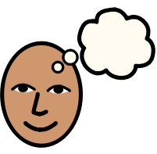
Re-cap from Lesson 1
What can you remember?
Notes:
Remind students that you are learning about a particular type of election. Ask students: - Can you remember which election you are learning about? - Can you remember the name of your local council? - Can you remember how old you have to be to vote in local council elections in Wales? - Can you share anything else that you learned in the last lesson? Explain that in this lesson you are going to be thinking about what a local council does.
You could share an image of the local council area or local council building here.

Slide 3
Video Link (YouTube)
Notes:
Play this short video to introduce the lesson.

Slide 4
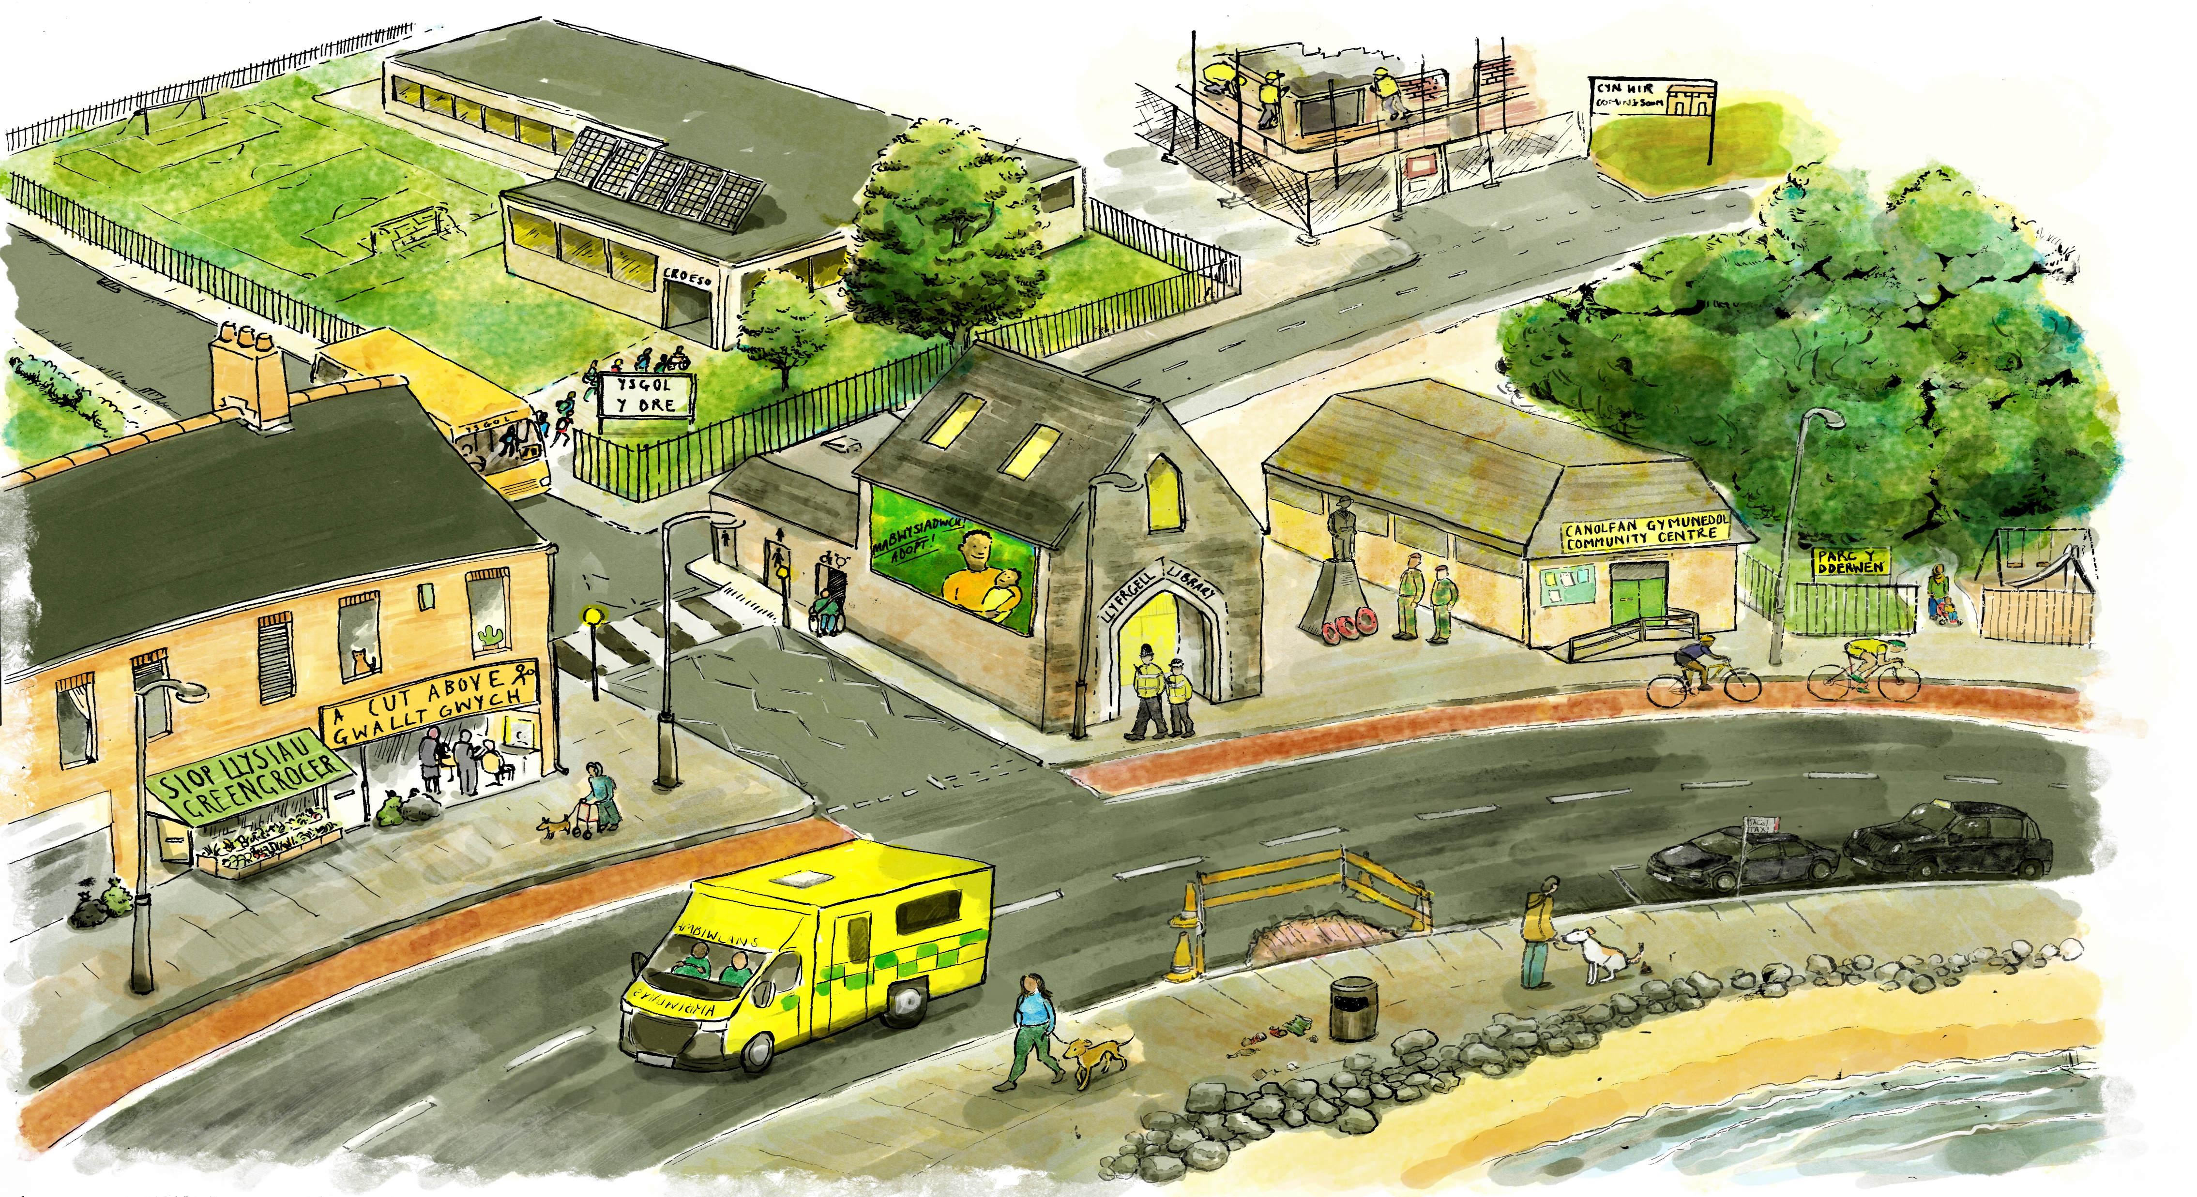
Notes:
Tell students you are going to start thinking about what things your local council has control over.
Councils have to provide certain services to the people who live in the area.
Ask students to get into groups of 4 or 5 and do one of the following activities:
Option 1 Give each group this picture to look at.
Ask students to look at the picture and ask them to circle, mark or put post-its on the things they think councils have control over.
Allow 5 minutes for feedback after whichever activity you choose. Ask students to share which areas they think the council has control over.
Adaptation: You could use the symbols cards in the ALN supporting resource and ask students to match the cards with the corresponding area in the illustration.
Extension activity: In groups, ask students to go out in their community (this could be the area immediately outside the school or could be the area where they live). Ask students to take photos or videos of things they think the council have control over. Share what they found with the rest of class through a PowerPoint or video.

Slide 5
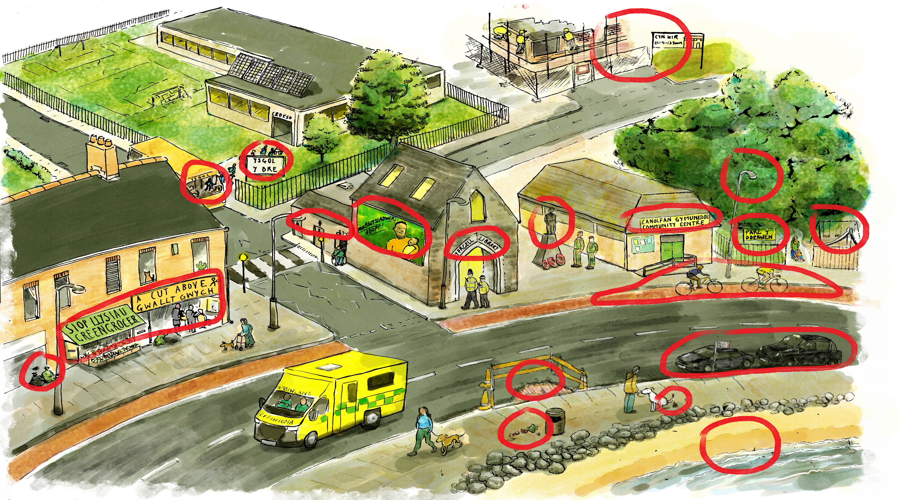
Notes:
Answers are circled above

Slide 6
1. Draw your local area.
2. Circle or mark the places you think the local council has control over.
Notes:
Tell students you are going to start thinking about what things your local council has control over.
Councils have to provide certain services to the people who live in the area. These are set out in the law, so they have to do them.
Ask students to get into groups of 4 or 5 and do one of the following activities:
Option 2
Give each groups a big piece of paper and some pens.
Ask students to draw their local area. This could be your school/your meeting point and the surrounding area or it could be a central point all students are familiar with.
Ask students to mark the places or things in their drawing which they think the local council has control over.
Extension activity: In groups, ask students to go out in their community (this could be the area immediately outside the school or could be the area where they live). Ask students to take photos or videos of things they think the council have control over. Share what they found with the rest of class through a PowerPoint or video.

Slide 7
People living in the local area give money to the local council to provide services. This is called council tax.
The council decide where to spend the money.
Discuss in your groups which three things you would prioritise spending council tax money on
Notes:
Ask students to imagine that they are the local council and they have received £20million in council tax. You could display the illustration in slide 5 to help them.
Give the groups 10 minutes to decide on what things and places they would prioritise spending the money. Are there any things in their local area that the council needs to improve?
The money can only be used on things the council has control over. They can use what they learned in the last activity to help them.
Ask students to feedback and write their answers on the board as they do.
Group together or tally any answers which are the same or similar.
Adaptation: You could use the symbols cards in the ALN supporting resource to give to students them and ask them to rank them using a ‘Diamond 9’ ranking to illustrate their priorities

Slide 8
How relevant are local elections to young people’s lives?
Are all types of elections equally relevant?
Notes:
Ask students to think back and reflect on what they’ve learned today and in Lesson 1. Ask students to consider: - How relevant are local council elections to young people’s lives? - Are all types of elections equally relevant?
You could display the table/PowerPoint showing different types of elections at the front of the class here.

