Slide 1
Project Vote
Remote Learning Pack
Notes:
This PowerPoint will guide you through the Children’s Commissioner for Wales’ Project Vote activities. Before you start the activities you will need to do a few things:
1) Make sure you have the Project Vote booklet open on your device – the booklet is filled with activities and questions for you to complete. If you can’t print it off, don’t worry you can write your answers on a separate piece of paper.
2) If you are taking part in Project Vote and you are home educated (i.e. you are not a part of a school) , make sure you are registered to take part. Go to www.projectvote.wales to do this.

Slide 2
Activity 1: What is a vote?
a. Could you describe what a vote is?
b. Can you give examples of different types of votes?
Notes:
Take a look at Activity one in your booklet.
What is a vote? Take a couple of minutes to think and write your answer to part A and B, don’t worry if you’re not sure.
We will explain what a vote is on the next slide.

Slide 3
Voting is a way that group of people can choose something or someone. Usually everybody in the group will be able to vote for what they want, and the thing with the most votes will win.
Notes:
This is our definition of what a vote is, you might have had something similar
On the next page we have some examples of different types of votes, you might have thought of extra ones.

Slide 4
Different types of vote
School council election
Entertainment shows (Strictly, I’m a Celeb)
Election
Notes:
Here’s a couple of different types of votes.
We are going to think about the last point.
Elections are where we choose the people who make decisions that affect all of our lives.

Slide 5
How do people vote in an election?
Notes:
In an election most people will go to a particular place (a polling station) in their community on Election Day.
There, they will be given a list of people they can vote for in the election.
People are given private space to put an X next to the person they want to win the election.
Then they put their vote in a box to be counted.
In a local election, the people who win become a local councilor.
They make decisions about lots of things that happen in your local area.

Slide 6
Activity 2: Local council elections
Can you find the following information?
Next election date
Name of the people who represent you
Age you can vote
Notes:
In local elections, people choose who will make decisions that affect their local area.
Try and find the answers to the questions on the slide.
Over the next slide, you will find the answers to all of the questions.

Slide 7
Local council elections
Next election: 2022
Leader of the Council: Every council has a different leader
Who represents you: Councillors
Age you can vote: 16+ in Wales
Some of the things they control:
Collecting waste and recycling
Caring for people who need extra help at home, for instance elderly people
Roads, footpaths and cycle paths
Parks
School transport
Notes:
In May 2022, 16 and 17 year olds in Wales will be able to vote in local council elections for the first time.
Once you have learned about the council, you will have a chance to take part in the Project Vote parallel election.

Slide 8
Can you find your council?
Activity 3: Your local council
Notes:
Before we learn any more about councils, lets start by finding your local council. Use activity sheet 3 to help you with this
Find a map of the UK online. You might want to use something like google maps.
Focus on Wales, can you point out where you live without searching for it?
Now put the name of your village/ town or city in the search box. Did you point to the right place on the map?
Next you will need to use an adult or a search engine (like Google) to help you find out which council you are in.
If you learn at school, is your school in the same council as your home?

Slide 9
End of Part 1
Notes:
That’s the end of Part 1 of the Project Vote lessons.
Just a recap:
This year there is an election for local councils in Wales
16 year olds can vote for the first time in this election
At the end of these lessons you will take part in a parallel election

Slide 10
Part 2
Notes:
In Part One, you learned about:
What a vote is
Local council elections
Your local council, and the local council of your school
Some information about what your local council controls
In Part 2 we are going to focus more on your local council and what they do.

Slide 11
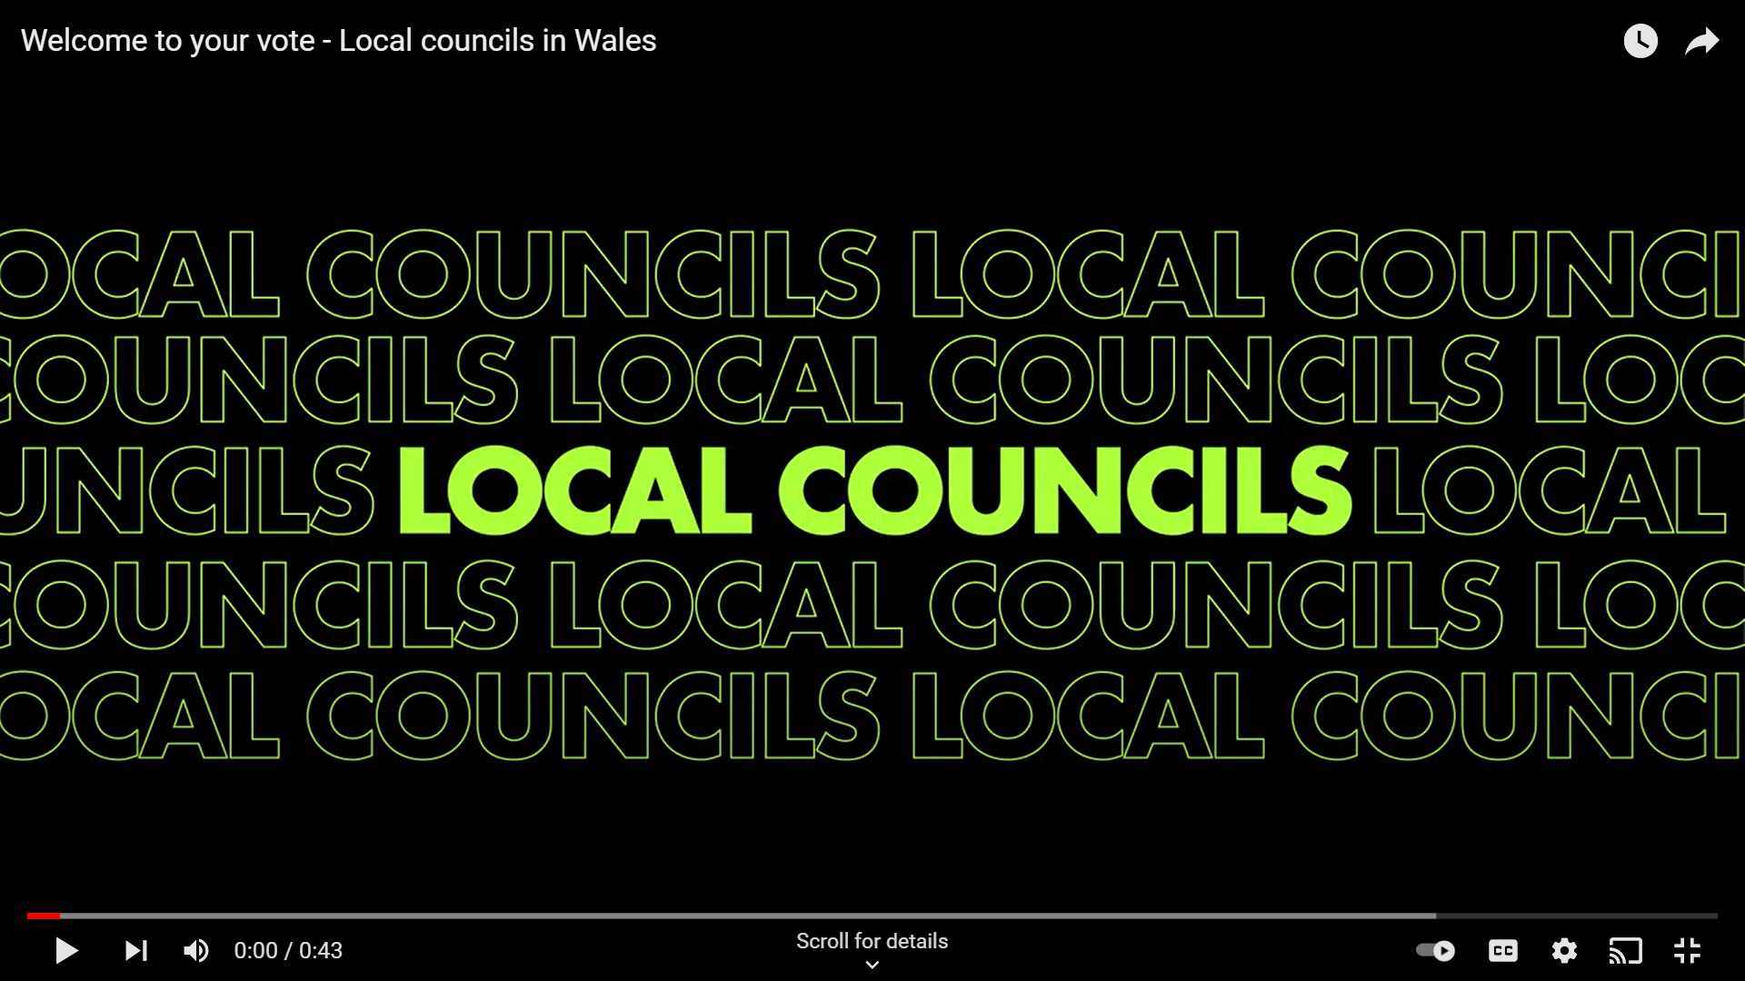
https://www.youtube.com/watch?v=_kUf3q-GFQ0
Notes:
Now you are going to start thinking about what things your local council has control over.
Take a moment to watch this video, it will help you to think about some of the things your local council controls:
https://www.youtube.com/watch?v=_kUf3q-GFQ0
The video link is also included in your booklet.

Slide 12
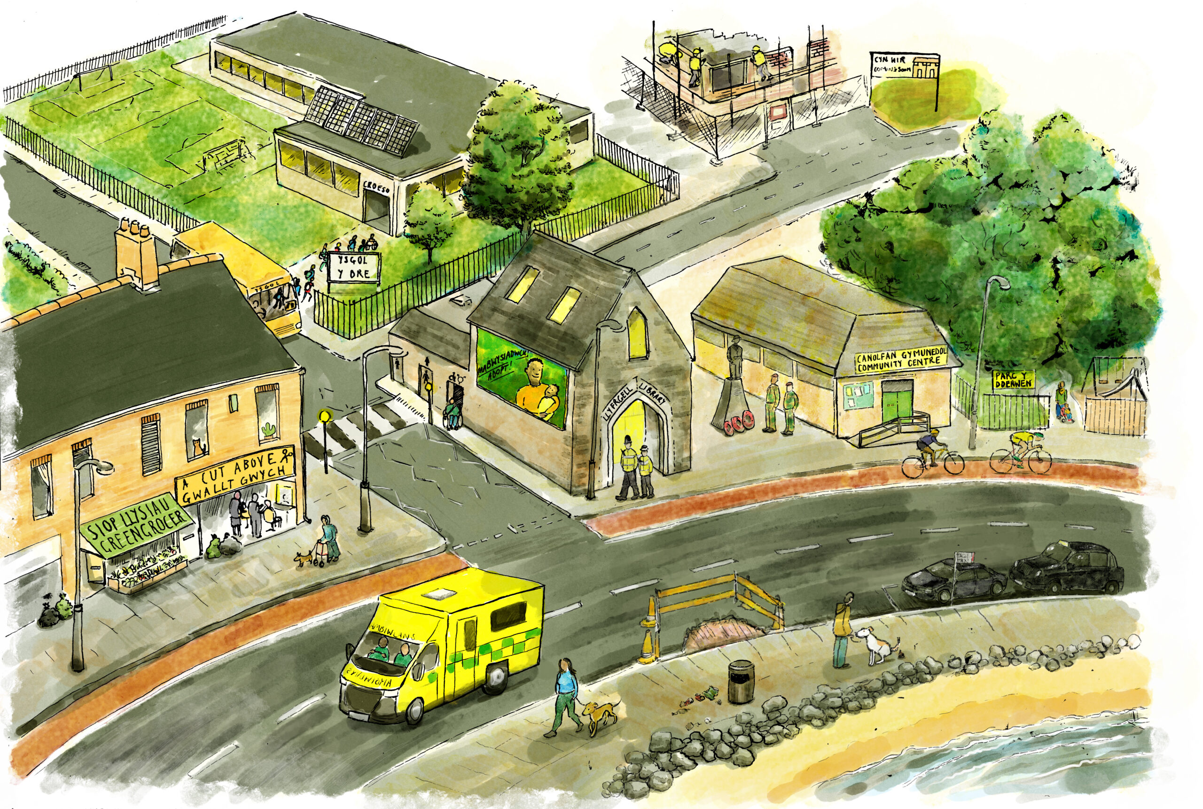
Notes:
Look at the picture above. Take some time to write down the things you think the council has control over.
Once you think you’ve spotted them all go to the next slide for the answers.

Slide 13
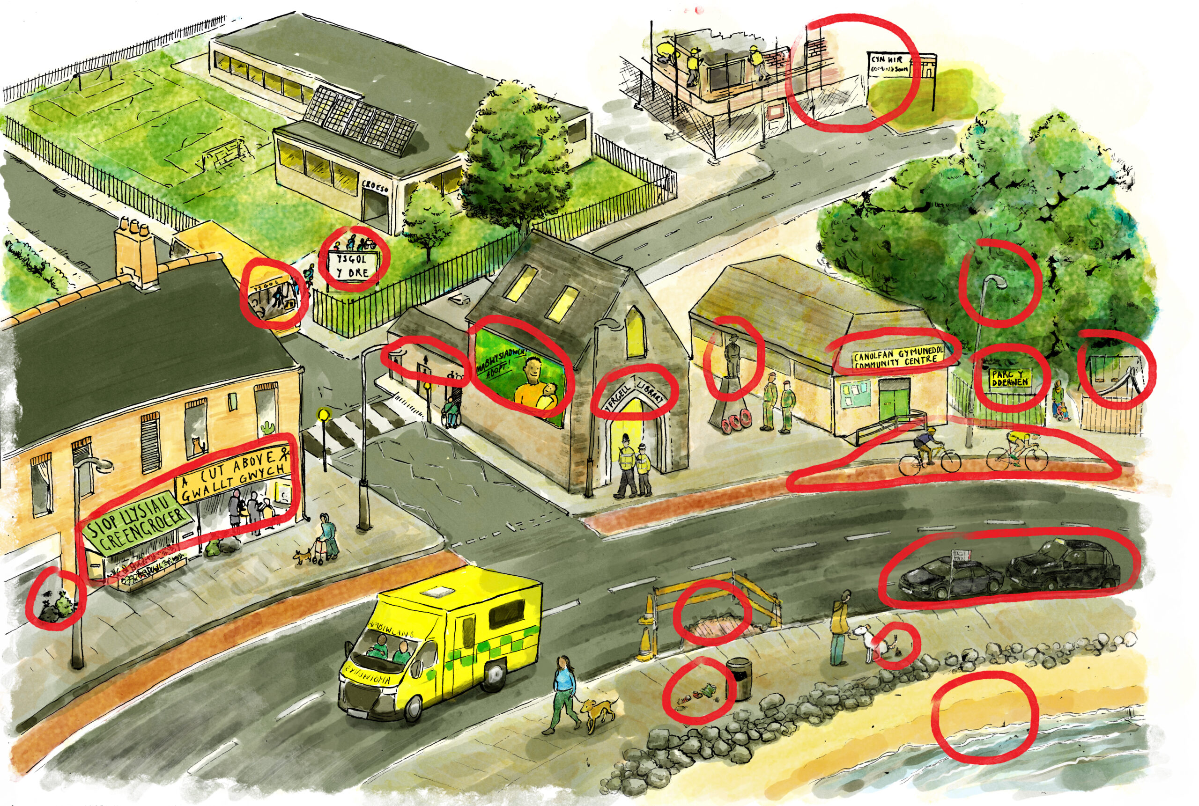
Notes:
From the picture you can see that the council has control over:
Rubbish collection
Street lights
Recycling
School transport
Road Repairs
Library
School – Making sure there are enough schools for local children/ giving schools money to run
Parks
Public toilets
Deciding if and where new houses can be built
Bins for dog poo/fines for people who don’t pick up dog poo
Local shops – making sure that they are doing things within the rules/the law
Statues
Cycle paths
Community Centre
Some beaches (some are run by private companies)
Adoption and fostering
Taxis - Giving taxis a license, and making sure that they are safe and comfortable and that the drivers are suitable.

Slide 14
Activity 5: What would you do?
Take a look at the list in your workbook.
Imagine you are a councilor for your local council. What would be your biggest priority.
Rank them from most to least important and explain why.
Notes:
The council decides how it will spend its money on different things.
In this activity you need to use the list in your work book and explain what you would spend money on in your local area and why?

Slide 15
End of Part 2
Notes:
That’s the end of part two.
In this section you have thought about what the council controls and what you would do if you were a councilor.

Slide 16
Part 3
Notes:
Welcome back to Project Vote, part 3.
In part one and two you learned about:
What a vote is
Different types of voting and elections
Your local council
What your local council controls
In Part 3 we will be thinking more about councilors and their role.
Don’t forget at the end of Project Vote you will be taking part in a pararel online election.

Slide 17
Councillors
What is a councilor?
Councillors are the people who are voted for to represent your local area at the local council.
Some councillors are a part of political parties and others are ‘independents.’
Notes:
What is a councillor?
Councillors are the people who are voted for or elected to represent your local area at the local council.
Some councillors represent a political party and others stand as independents.
A political party is a group of people who work together because they share the same views about the way power should be used in a country or society.
Other councillors stand as ‘independents’. Independent councillors are not a part of any political party.

Slide 18
Activity 6: True or false?
1 | Find out what’s important to local people and share their views in the council
2 | Organise street parties
3 | Work in the Senedd
4 | Take part in council debates and decisions
5 | Invite members of the public to their house for dinner
6 | Be honest, open, and respectful
Notes:
In this activity we’d like you to think about what councillors have to do as part of their role. Mark these statements as true or false in your workbook.
Don’t worry if you are unsure, we will be sharing the answers on the next slide.

Slide 19
Activity 6: True or false?
1 | Find out what’s important to local people and share their views in the council
2 | Organise street parties
3 | Work in the Senedd
4 | Take part in council debates and decisions
5 | Invite members of the public to their house for dinner
6 | Be honest, open, and respectful
Notes:
As you can see on the slide, the true statements are green and false statements are red.
Part of a councillors role includes
Finding out what’s important to local people and share their views in the council
Take part in council debates and decisions
Be honest, open and respectful

Slide 20
Activity 7: A ward
What is a ward?
All councillors represent a specific area within a county called a ward.
What council do you live in?
What ward do you live in?
What wards do other members of your family live in? You’ll need their postcodes.
Do you live in the same ward as your school? You’ll need your school’s postcode.
www.writetothem.com
Notes:
Councillors represent a specific area within, known as a ward. Wards are smaller areas within the county the council has control over.
What council do you live in?
What ward do you line in?
What wards do other members of you family live in?
Do you live in the same ward as your school?
Note these in your workbook or on a piece of paper.
Use the website www.writetothem.com to find out this information.
It will use your postcode to show you your ward name, your council name, and who your councillors are at the moment.
On the next slide we’ve shown you how to use the website
How many questions could you answer correctly? If you were unsure of any answers, make sure you take note of the correct ones.

Slide 21
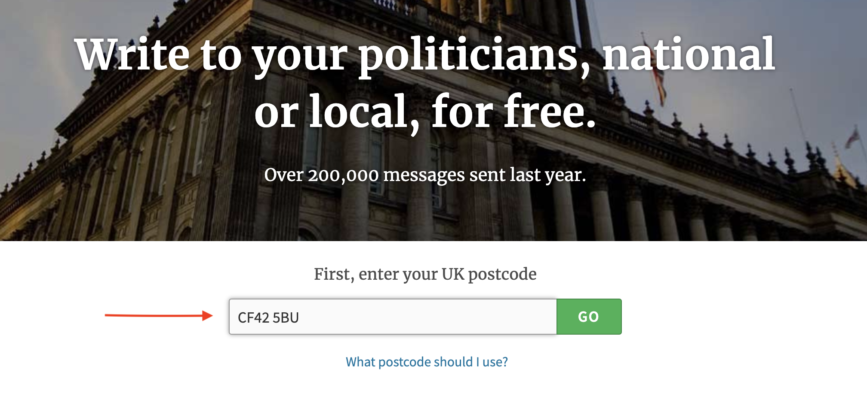

Slide 22
Notes:
We used the postcode, CF42 5BU.
We found out that:
Our ward is Treherbert.
Our Council is Rhondda Cynon Taf Council.
Our current councilors are Geraint Davies, and Will Jones.

Slide 23
Activity 7
What council do you live in?
What ward do you live in?
What wards do other members of your family live in? You’ll need their postcodes.
Do you live in the same ward as your school? You’ll need your school’s postcode.
Notes:
Now it’s your turn to use the website to find the information on the slide.

Slide 24
End of Part 3
If you are 14 or older you can register to vote in a real election here:
https://www.gov.uk/register-to-vote
Notes:
That is the end of Part 3:
In this lesson you have thought about what a councillor is, their role and learnt what county and ward you live and learn in.
In lesson 4 you will have the opportunity to research the candidates standing for election in your area and will be able to take part in a parallel election and vote for the party you think best represent your views.
Don’t forget if you are 14 or older you can register to take part in a real election by going to the government website, the link is on the slide.

